Slide 1

Using CRDS for HST
Not rehashing purpose or design of CRDS
Review current development status
Development schedule for JWST
What needs to be done for HST if adopted
HST effort/schedule/resource issues

Slide 2
Development Status
Three basic stages of development
Bestref service--lookup most appropriate reference files
  Status: basic service implemented.
    Running as web service on ETC test server
Commit functionality--ability to validate and submit reference files, rules and context
  Status: work underway, planned completion: 2013 March
  Will seek input on user interface and features within next month or so
Needed Utilities
  Status: some work started, planned completion: 2013 Dec?

Slide 3
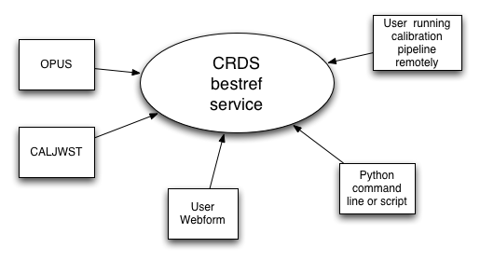
bestref Clients

Slide 4
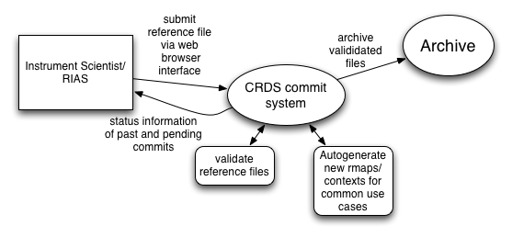
Commit Usage

Slide 5
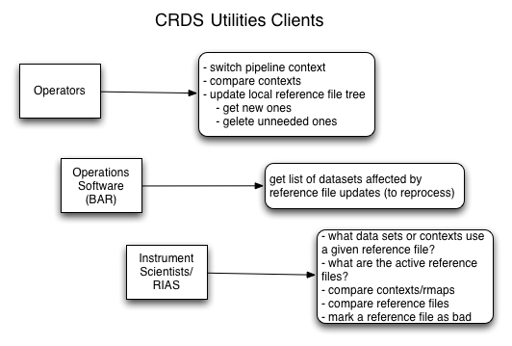

Slide 6
Work needed to support HST
(Beyond that planned for JWST)
Generation of rules and context files from existing system
  Done automatically by software
  Experience doing this for ACS and WFC3 so far
  Most rules can be derived from existing active file lists
    With some customizations to deal with special cases
  One lingering issue regarding ACS bias file rules
    Complex and not yet well specified
Revalidation of existing reference files
  Copying and renaming desired?
    Minor renaming: new prefix but shares old name, or
    Major renaming?
  Some errors discovered in existing files
    E.g., Minor FITS non-conformance
    Should we fix?

Slide 7
Work needed to support HST
(Beyond that planned for JWST)
Inclusion of needed user interface features for HST not requested for JWST
  Hopefully minor, given HST is the general use case for the user interface
Net SSB delta effort expected to be only a few FTE months.
Not including effort to:
  Modify OPUS to use new bestref service
  Modify OPUS to manage reference files differently
  Training of INS staff to use new system
  Preferably done before operational switchover
  INS staff review of correctness of new bestref
    SSB will provide tool to compare old bestref results with new results for consistency
    INS may wish to do independent tests.
  May need to submit new reference files to both systems while reviewing correctness of results
    Since CDBS is always changing
    Can do by continual conversions, or by having INS doing parallel submissions (may be good way to train)

Slide 8
Effort needed outside of SSB
INS
  User Interface for submitting files: Testing and feedback.
  Bestref correctness: Depends on how much independent testing of results is desired by INS
    How much to trust the comparison testing?
  How many to initially train?
    Start small for feedback stage (2-3 at most)
DSB
  Software changes to use new bestref service and reference file updates
    CRDS could manage a reference file tree for OPUS to simply synch to, and provide a utility to only sync to files needed by the specific context (plus coverage for previous contexts to make reversions easier?).
  Testing effort for OPUS to use new bestref service and reference file updates

Slide 9
Open Questions
User interface features needed
Details of interfacing with the current archive
Details of how to handle pysynphot reference files.
Level of validation needed
  Some previous validation could be replaced by regression testing
  Too much validation has its costs also.
Level of INS testing
Which utilities must be ready as opposed to would be nice to have?
  Affects when SSB is ready and priorities for utility development

Slide 10
Utility Tools Needed
What is the set of active reference files for a given context. [DMS-547,548]
  useful for cleaning out unneeded reference files
What are the differences between different:
  contexts
  rmaps (forcing standardized formatting?)
Update a context chain for a set of rmap updates
  I.e., when requested automatically generate and commit pipeline and instrument context files that use those rmaps
  But don’t do automatically for each rmap commit!
Which datasets in the catalog will require recalibration based on an rmap change? [DMS-545]

Slide 11
Tools Needed (cont.)
Mark reference files as bad (i.e., never to be used). [DMS-543]
  Requires that all rmaps that use bad reference files also be flagged as bad [DMS-641]
  Archive/catalog-level action?
List all contexts that use a specified reference file.
  Most efficiently done by creating a database to perform this action.
Interactive web interface for users to get recommended reference files for specified dataset [DMS-540]

Slide 12
New utilities requested
Detection of reversion of context, rmap, or reference file when replacing one context with another
Reference file synch mechanism:
  Remove unneeded files from OPUS directories
  Get new files from CRDS and place in OPUS directories
Obtain selection criteria for a specific reference file in a given context
Make sure new context covers all modes in old context (was part of the plan actually, but not specifically listed)
Make severity of change part of listing which datasets are affected by changes
  (this can be tricky in detail and place surprising burdens on Instrument Scientists since ultimately it means providing consistent severity info for all previous changes—are we sure we want this?)

Slide 13
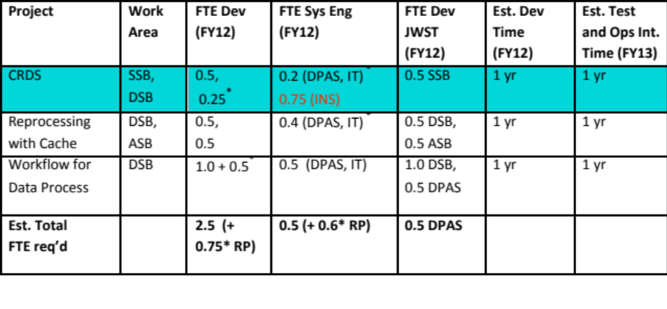
Resources
This is a good time for INS to become involved in user interface issues if we decide to use CRDS for HST

Slide 14
Supplementary Slides
Comments on specific items mentioned in “CDBS Operations Overview” memo follow

Slide 15
INS functional issues
Will do all listed in table 2 except:
verify correct file replacement: File replacement mechanism will be explicit. Selection rules not forced to be taken from reference file headers. We can provide that as one way of generating the initial rules, but they are not binding after the fact. USEAFTER will, in particular, not be part of file meta-data.
Code automatically…: only an optional means of generating rules. Load files not used here.
Automatically extracts parameter values for tables…: likewise
Finds comparison file: will use diff mechanism to match files in two different contexts.
Expands wildcards: wildcard part of rmap machinery. No expansion done.
Certify Load file…: no load file used.
Determine level of change: this has to be relative to a previous rmap or reference file to have any meaning. A complex issue to deal with well in any system.

Slide 16
INS functional issues (cont.)
Will do all listed in table 2 except (cont.):
File verification: N/A?
File integrity: very special case?
Create SQL files: N/A
Checks delivery queue: Reworded: how to avoid conflicting changes to contexts and rmaps? Unique naming prevents any explicit destruction of previous changes. Nevertheless, it is possible to effectively lose previous changes if the same root context or rmap file is used for two different changes by two different people. This can be caught by human review of all submitted changes, but it is also possible to catch the most likely errors by noticing if the version of any reference file, rmap, or context reverts to an older version than present in the context being replaced, and raising a warning on such a check (it may be that such reversions are intended, but in most cases reversions would indicate an error)

Slide 17
INS functional issues (cont.)
Will do all listed in table 2 except (cont.):
Verify validity of database fields: replaced by validation of rmap files
Checks uniqueness of mode/reference file in the database: N/A
Checks that only one file applies to a given mode: Redundancy of selection criteria in rmaps is permitted so long as one is more specific than another. If not, it is not permitted.
Create links for the files for pick-up: something equivalent for OPUS will be provided (details to be worked out).
Free space in operations area: We will plan on providing a utility to synch the files with the context provided.
Install file in operations: Done through utility in previous item.

Slide 18
INS functional issues (cont.)
Will do all listed in table 2 except (cont.):
Makes files active: done explicitly in OPUS by specifying appropriate context to use as part of request to CRDS server.
Verification OPUS pipeline ingest: best done by OPUS?
Verify archive fields: N/A?
Bestref Test: easily done by using different pipeline context specification
CALXXX test: likewise
Best software version: N/A (shouldn’t be part of CRDS; better as a different utility)
Determines best reference files (user interface): will be there, but certainly not as an IRAF command!
Easy access to selection criteria of reference files: Selection criteria are in rmaps, not reference files. We can provide a utility to show where a reference file appears in an rmap (it could appear more than once), and the selection criteria that apply can be determined from that.

Slide 19
“Features worth preserving”
Will do all listed final list.
Comments or issue about specific items:
Ability to check the input parameter values…: Reworded: Ensure rmap modes are legal. Yes, we should do this.
Ability to create a template file…: Reworded: Apply validation constraints to reference files that are separate from reference files or rmaps. Yes, we should do this
Ability to check that changes in a file are correct.: Considered N/A since changes are explicit in rmap files; utilities to compare different versions will be useful though and are planned.
Ability to use the template file to automatically…: N/A?
Ability to check uniqueness of the mode and file available for calibration: up to a point. Redundancy of selection criteria in rmaps is permitted so long as one is more specific than another. If not, it is not permitted.

Slide 20
“Features worth preserving” cont.
Comments or issue about specific items (cont):
A script should be capable of removing obsolete files from the test and operations…: Certainly plan to list active files. There should be a generic script that can retrieve files not present, and delete files not needed. But this should run in the opus environment. Do you prefer that we develop these tools? Simple python scripts suffice?
Ability to update automatically the “[instrument]_ref_data” tables in the archive database.: does this apply in CRDS? Somewhat an open issue depending on how queries are done. We recommend an “on the fly” approach that obviates the need to store recommended reference files in catalogs (particularly since the uniqueness of a reference file recommendation can’t be maintained because of potential software version dependencies)
Ability to keep records about the delivery and when the files made it to other systems: Certainly for the first. No to the second. OPUS should keep the records of when it changes contexts. From that users can determine when updates occurred. CRDS should not keep info on operational states.

Slide 21
“Features worth preserving” cont.
Comments or issue about specific items (cont):
Should keep track of any given reference files warrants recalibration or when it will have a minor impact in the data: We will keep information as submitted by the Instrument Scientist as to the impact that they judge it has compared to a previous reference file. Whether it warrants recalibration is essentially out of scope unless the utility is asked (some utility has to be run, nothing automatic can possibly happen since CRDS does not know what context anyone in particular is using) to reject minor changes in listing datasets affected by new reference files (that is possible).
Should provide easy access to dictionaries with information on the selection parameters for a reference file and the valid values: See answer previously regarding similar request for table 2.
Should be able to handle wildcards in the reference file data…: wildcards are supported. We can take a selection mode from a file to apply to an rmap. But what is in the file can be overridden in rmaps.

