Slide 1

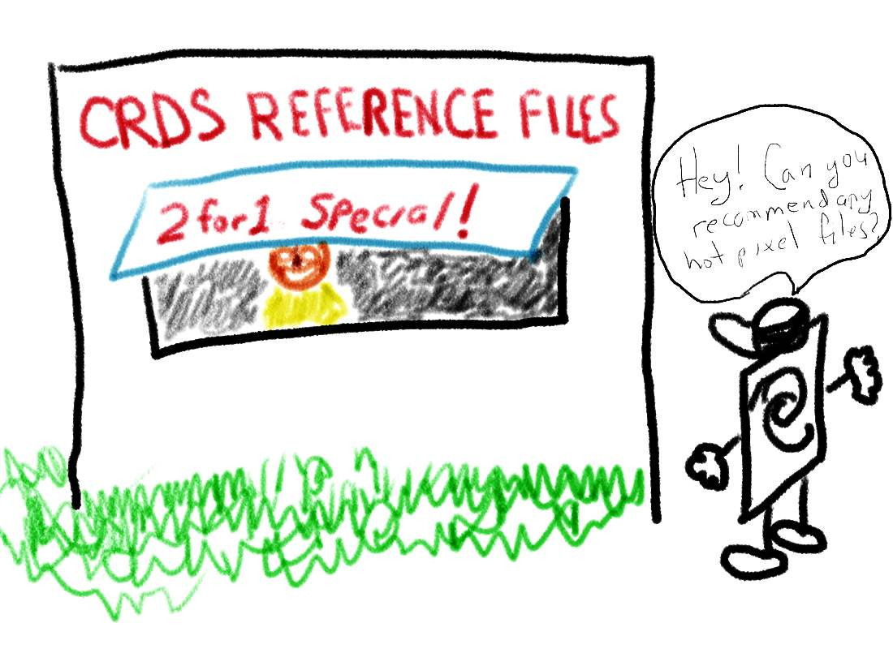

Slide 2
Calibration Reference Data System
What it is
CRDS examples
CRDS capabilities
Needed Tools
Implementation plan

Slide 3
What is CRDS
Different approach to CDBS for JWST
  E.g., no database is used (gasp!)
Could be used for HST as well
  We hope it will be
  Mission Office is interested

Slide 4
Nuts and Bolts First
Focus on examples
Starting with
  The primary purpose of CRDS
  How CRDS would specify the necessary information
  How deliveries for CRDS would work
Many details and issues won’t be covered.

Slide 5
Purpose of CRDS?
Primary:
  Which reference files are to be used for a given dataset.
Secondary:
  Manage new reference files and update rules for which ones to use.
  Provide history of reference files (e.g., when submitted and by whom).
  Understand what is currently being used and effects of changes.

Slide 6
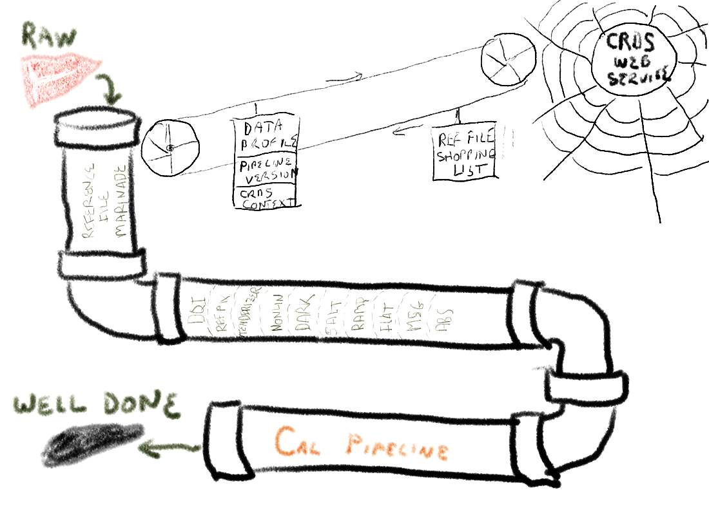

Slide 7
The proposed CRDS approach
Separate reference file deliveries from mapping rules.
  Deliver reference files without any regard for how datasets are mapped to them.
  Deliveries do not trigger use in pipeline or anywhere else.
Entirely different approach for mapping rules.
  Must edit mapping rules in their entirety
  Examples are the best way to explain

Slide 8
About the examples…
None of the syntax is settled
This is just one possible approach
Some details are being left out for simplicity

Slide 9
Simple Example
rmap_header = {
'obseratory':'HST',
'instrument':'ACS',
'reftype':'BIAS',
'parkey': ('detector','gain','amp','xsize','ysize'),
}
rmap_data = {
('WFC','1.0','A',2048,4096):'cref_hst_acs_bias_0001.fits',
('WFC','2.0','A',2048,4096):'cref_hst_acs_bias_0002.fits',
('WFC','4.0','A',2048,4096):'cref_hst_acs_bias_0003.fits',
('WFC','1.0','A',1046,1024):'cref_hst_acs_bias_0004.fits',
('WFC','1.0','A',1046,1024):'cref_hst_acs_bias_0005.fits',
...
('HRC','2.0','D',2048,4096):'cref_hst_acs_bias_0030.fits',
('HRC','4.0','D',2048,4096):'cref_hst_acs_bias_0031.fits',
}

Slide 10
Extended to handle dates
rmap_header = {
'obseratory':'HST',
'instrument':'ACS',
'reftype':'BIAS',
'parkey': ('date','detector','gain','amp','xsize','ysize'),
}
rmap_data = SelectNearestDate({
'2009-5-26': { # pre-SM4
('WFC','1.0','A',2048,4096):'cref_hst_acs_bias_0001.fits',
('WFC','2.0','A',2048,4096):'cref_hst_acs_bias_0002.fits',
...
('HRC','4.0','D',2048,4096):'cref_hst_acs_bias_0031.fits',
},
'2009-5-27': { # post-SM4
('WFC','1.0','A',2048,4096):'cref_hst_acs_bias_0032.fits',
('WFC','2.0','A',2048,4096):'cref_hst_acs_bias_0033.fits',
...
('HRC','4.0','D',2048,4096):'cref_hst_acs_bias_0062.fits',
}
})

Slide 11
Dealing with Software Version Dependencies
rmap_header = {
'obseratory':'HST',
'instrument':'ACS',
'reftype':'MDRIZ',
'parkey': ('mdriz_version','detector'),
}
rmap_data = SelectVersion({
'v<2.0': {
'WFC':'cref_hst_acs_mdriz_010.fits',
'HRC':'cref_hst_acs_mdriz_011.fits',
'SBC':'cref_hst_acs_mdriz_012.fits',
},
'2.0<=v<3.1': {
'WFC':'cref_hst_acs_mdriz_013.fits',
'HRC':'cref_hst_acs_mdriz_014.fits',
'SBC':'cref_hst_acs_mdriz_015.fits',
}
})

Slide 12
One-eyed Jacks
rmap_header = {
'obseratory':'HST',
'instrument':'STIS',
'reftype':'BIAS',
'parkey': ('detector','gain','amp','ccdoffset','binaxis1','binaxis2'),
}
rmap_data = {
('CCD','1','D',3,1,1):'cref_hst_stis_bias_0001.fits',
('CCD','1','D',3,1,2):'cref_hst_stis_bias_0002.fits',
('CCD','1','D',3,2,2):'cref_hst_stis_bias_0003.fits',
('CCD','1','D',3,2,1):'cref_hst_stis_bias_0004.fits',
...
('CCD','4','*',3,'*','*'):'cref_hst_stis_bias_0030.fits',
}

Slide 13
Matching nearest quantity
rmap_header = {
'obseratory':'HST',
'instrument':'ACS',
'reftype':'PFLAT',
'parkey': ('detector','lambda_eff'),
}
rmap_data = {
'WFC': GeometricallyNearest({
3000.:'cref_hst_acs_pflat_0001.fits',
5000.:'cref_hst_acs_pflat_0002.fits',
7500.:'cref_hst_acs_pflat_0003.fits',
9000.:'cref_hst_acs_pflat_0004.fits',
10000.:'cref_hst_acs_pflat_0005.fits',
}),
...
'SBC': GeometricallyNearest({
1200.:'cref_hst_acs_pflat_0033.fits',
1500.:'cref_hst_acs_pflat_0034.fits',
2000.:'cref_hst_acs_pflat_0035.fits',
3000.:'cref_hst_acs_pflat_0036.fits',
5500.:'cref_hst_acs_pflat_0037.fits',
}),
)}

Slide 14
Supporting Pipeline Interpolation
rmap_header = {
'obseratory':'HST',
'instrument':'ACS',
'reftype':'PFLAT',
'parkey': ('detector','lambda_eff'),
}
rmap_data = {
'WFC': Bracket({
3000.:'cref_hst_acs_pflat_0001.fits',
5000.:'cref_hst_acs_pflat_0002.fits',
7500.:'cref_hst_acs_pflat_0003.fits',
9000.:'cref_hst_acs_pflat_0004.fits',
10000.:'cref_hst_acs_pflat_0005.fits',
}),
...
'SBC': Bracket({
1200.:'cref_hst_acs_pflat_0033.fits',
1500.:'cref_hst_acs_pflat_0034.fits',
2000.:'cref_hst_acs_pflat_0035.fits',
3000.:'cref_hst_acs_pflat_0036.fits',
5500.:'cref_hst_acs_pflat_0037.fits',
}),
)}

Slide 15
More on how mapping works
Hierarchical dependency structure
Pipeline context file lists which instrument context files are being used.
Instrument context files list which reference file mapping rules files are being used
The set of mapping rules files (one per reference file type)
No database is used in mapping.

Slide 16
Example Pipeline Context File
pcontext_header = {
'observatory':'HST',
}
pcontext_data = {
’ACS’:’icontext_hst_acs_00023.con’,
’COS’:’icontext_hst_cos_00023.con’,
’STIS’:’icontext_hst_stis_00023.con’,’
’WFC3’:’icontext_hst_wfc3_00023.con’,
’NICMOS’:’icontext_hst_nicmos_00023.con’,
}

Slide 17
Example Instrument Context File
icontext_header = {
'observatory':'HST',
‘instrument’: ‘ACS’,
}
icontext_data = {
’BIAS’: ’rmap_hst_acs_bias_0021.rmap’,
’CRREJ’: ’rmap_hst_acs_crrej_0003.rmap’,
’CCD’: ’rmap_hst_acs_ccd_0002.rmap’,
’IDC’: ’rmap_hst_acs_idc_0005.rmap’,
’LIN’: ’rmap_hst_acs_lin_0002.rmap’,
’DISTXY’:’rmap_hst_acs_distxy_0004.rmap’,
’BPIX’: ’rmap_hst_acs_bpic_0056.rmap’,
’MDRIZ’: ’rmap_hst_acs_mdriz_0001.rmap’,
...
}

Slide 18
How do Deliveries Work?

Slide 19
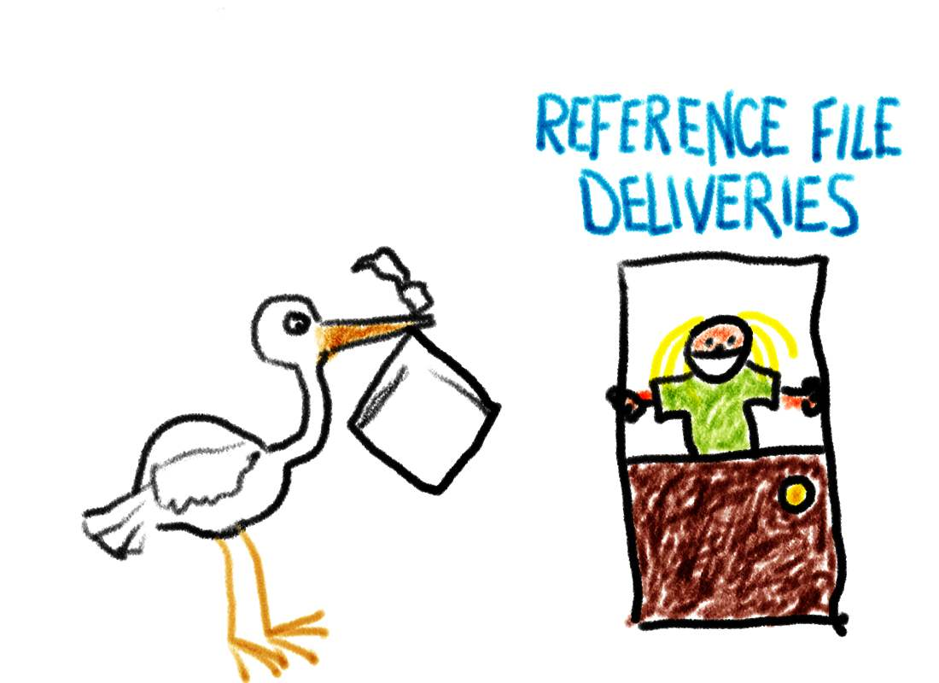

Slide 20
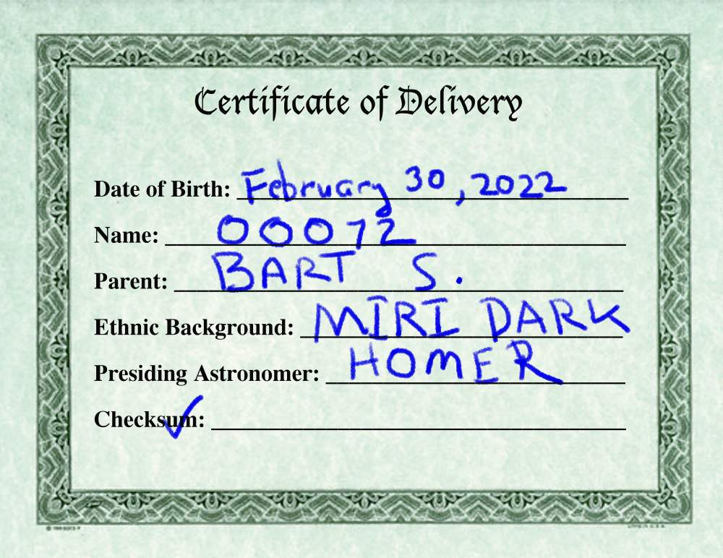

Slide 21
Process for submitting new reference files
Make new reference file(s)
Validate/deliver reference files
Update corresponding reference mapping file
Validated/deliver new mapping file
Update/deliver context files:
  corresponding instrument context file
  pipeline context file
Test new pipeline context file in operations test environment
Update pipeline to use new pipeline context file

Slide 22
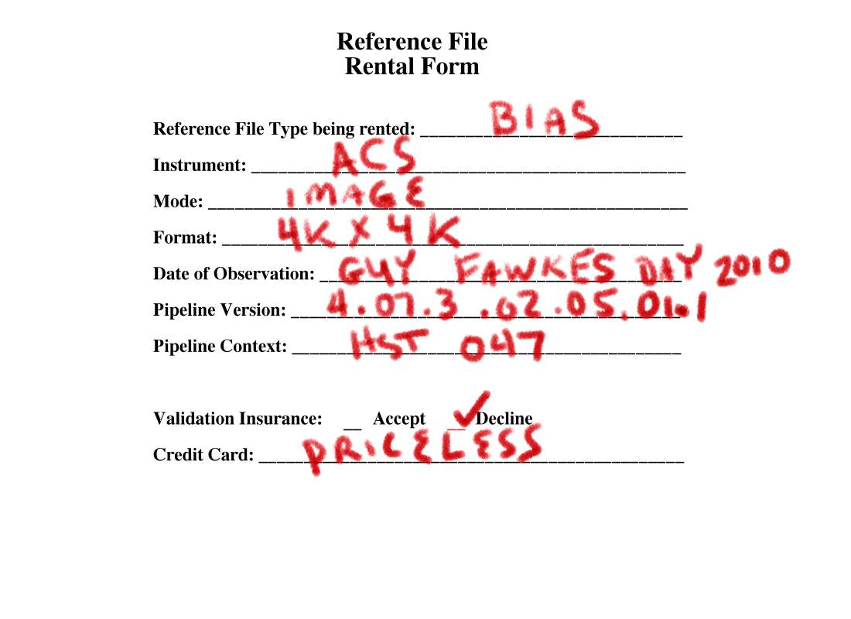

Slide 23
Featured Capabilties
Very flexible for mapping rules
  Easy to add new kinds of mapping
Very explicit and compact
  Requires looking at all rules/reference files together
Easy to support multiple contexts
  And testing new rules in particular
Easy to compare different mapping files
Very simple to implement in software
Portable (no database dependency).
  This code can run anywhere.
    Planes, trains and automobiles…

Slide 24
New Use Cases
Default pipeline access is through web service
  Allows pipelines run remotely to use exactly the same mechanism
  Remote (Astronomer-run) pipelines may use different pipeline versions or contexts
Multiple versions of contexts for operational pipelines can be tested simultaneously
  Sometimes necessary since instrument teams often have asynchronous schedules (use of a common test system is not adequate)
Projects can use rmap engine locally (I.e., not the web service) to:
  Use customized rmaps (e.g., they have their own reference files or different rules they prefer to use)
  To eliminate network dependency

Slide 25
Issues not considered
Determining or answering questions regarding scientific impact of reference file changes
  Long requested
  Practically impossible to do reliably
  OK to display comments regarding impact as supplied by reference file comitter

Slide 26
Commit/Validation
All context/rmap/reference files are archived
One cannot commit an rmap that refers to reference file not yet committed.
One cannot commit a context file that refers to an rmap file not yet committed.
All context/rmap/reference files will have other validations steps performed. E.g.,
  Syntax checking for context and rmap files
  FITS validation for FITS files
  Other TBD requirements for the files (e.g., required file organization, history info, source info, etc.)
    Open ended…

Slide 27
Tools Needed
What is the set of active reference files for a given context
  useful for cleaning out unneeded reference files
What are the differences between different:
  contexts
  rmaps (forcing standardized formatting?)
Update a context chain for a set of rmap updates
  I.e., when requested automatically generate and commit pipeline and instrument context files that use those rmaps
  But don’t do automatically for each rmap commit!
Which datasets in the catalog will require recalibration based on an rmap change?

Slide 28
Tools Needed (cont.)
Mark reference files as bad (i.e., never to be used).
  Requires that all rmaps that use bad reference files also be flagged as bad
  Archive/catalog-level action?
List all contexts that use a specified reference file.
  Most efficiently done by creating a database to perform this action.

Slide 29
Components to be developed
Basic mapping machinery
  I.e., bestref functionality
  Also available through web service
Delivery/Validation machinery, i.e., ensuring:
  Reference files match requirements
  Mapping/context files are valid, e.g.,
    Syntax passes
    All files referenced are in system
Tools and Utilities, e.g.,
  Which rmaps use a given reference file?
  Which data are affected by a change in rmaps?
  Which reference files are active for a given context
  Some of these tools may benefit from a database to perform inverse lookups.

Slide 30
Current Development Plans
Work started on mapping machinery
  That’s the easiest part
  Using HST reference files and selection rules as test cases
  Expect to complete by August
Work on commit/validation tools to start by Fall

Slide 31


