Slide 1
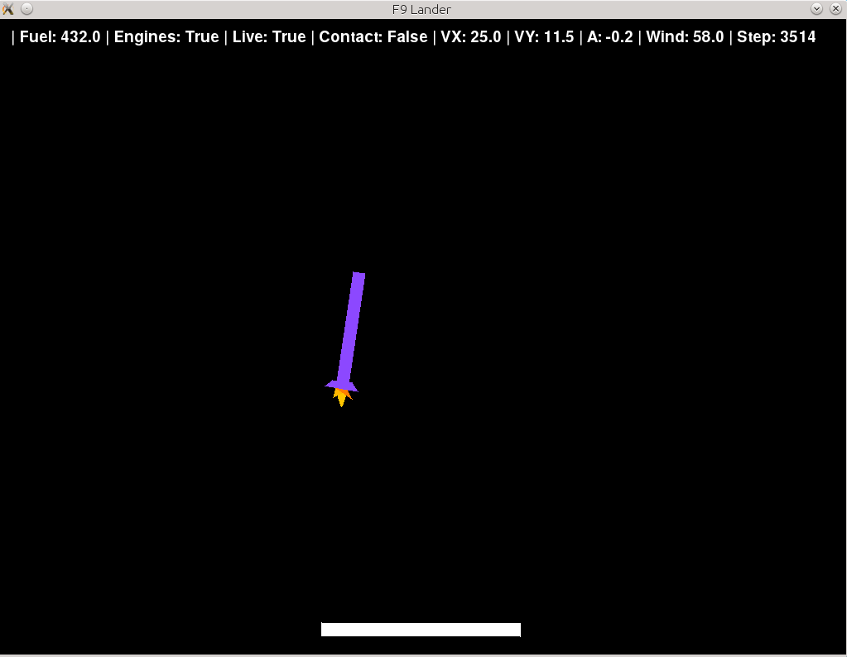
Sensors information (more you can get from object method return)
Rocket (agent)
+
Engines *
Height
Water platform
Width
+

Slide 2
Turn left or right
Engines
A
D
W
A – left engine
W – main engine
D – right engine

