Slide 1
GROUP 3
CTIA
Net Neutrality Group 3
LOBBYIST
Alex Amadeo-Ranch, Lauren Lee, Nicholas Meshcheryakov, Daron Kaloustian, Taly Juarez

Slide 2
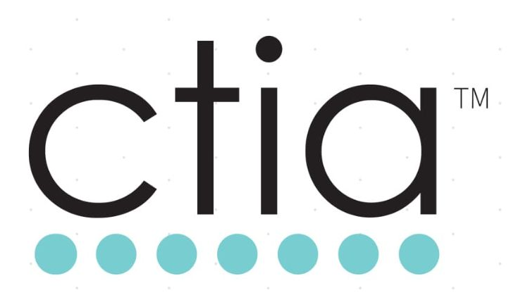
Who are the CTIA?
The CTIA is a trade group that represents the U.S wireless communications industry and cell phone companies
We are interested in protecting and promoting the open internet through net neutrality stances and policies.
We believe the government can make clear rules while allowing wireless investment and innovation to continue.

Slide 3
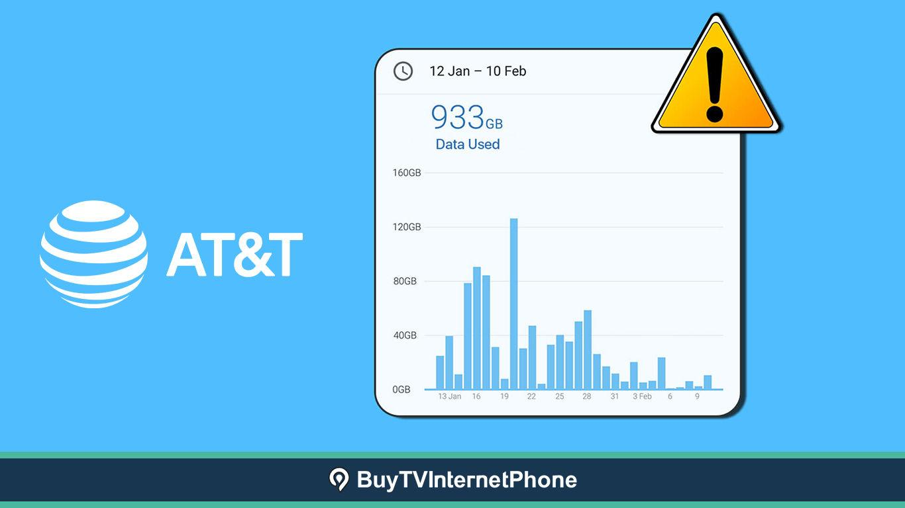
What are Data Caps?
Data caps are monthly limits in consumers’ mobile data plans
After users reach a certain threshold, their packets are given lower priority
In some plans, users are also charged fees for exceeding their agreed-upon limits
In 2015, the FCC created the open Internet order which barred companies from imposing data caps on their users. Should it be brought back?

Slide 4
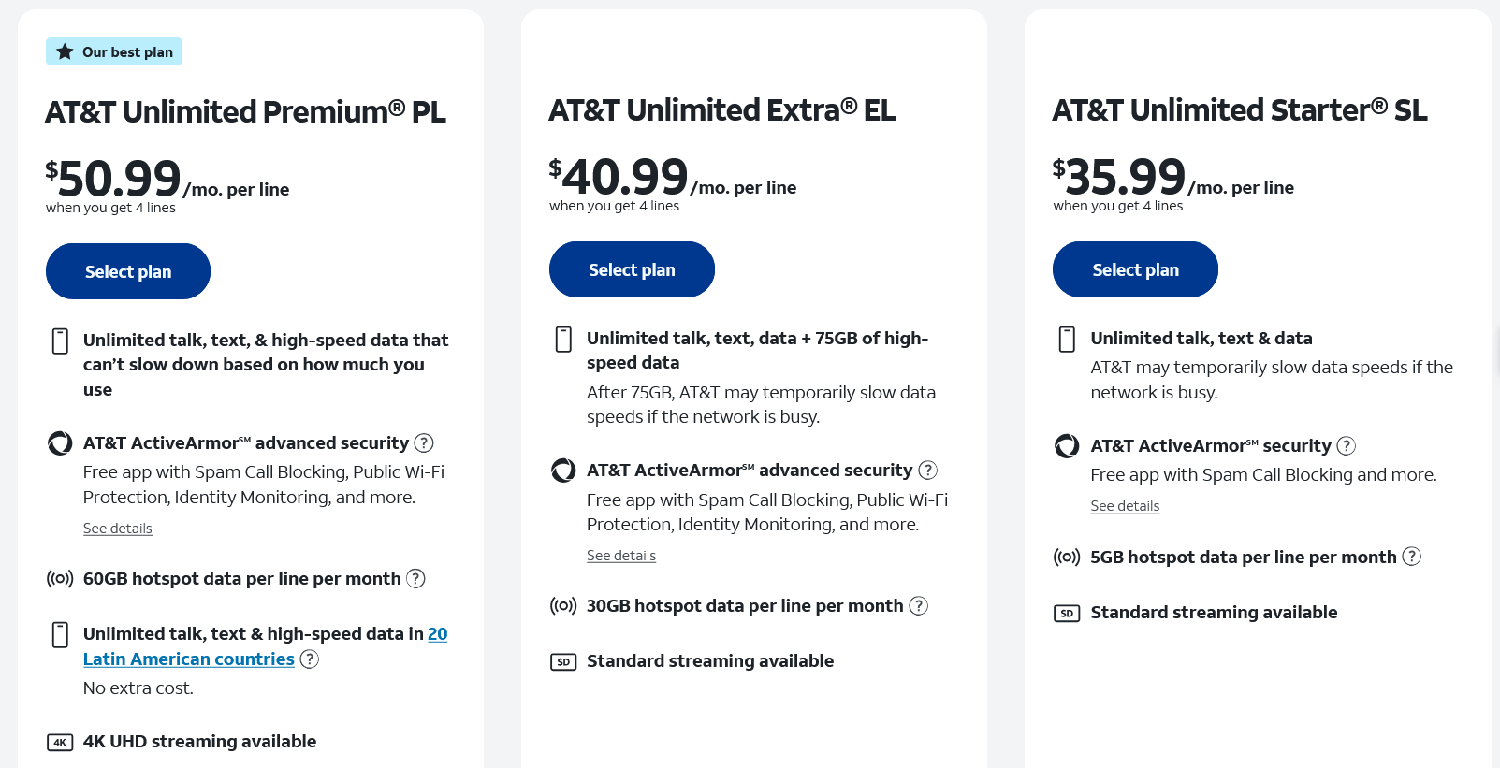

Slide 5

Technical Impact of Data Caps
Data caps allow providers to manage congestion by keeping high data usage users from creating large amount of traffic
Without data caps, there will be unnecessary network congestion, slowing down internet traffic for all users
Mobile data usage rates would skyrocket without caps - If mobile subscribers transferred their current use of fixed broadband to mobile broadband this means that data usage would increase by about thirty times (2016 FCC Report)
Notes:
Talk about we don’t have the infrastructure right now do to this. Despite the fact that ISPs are trying to expand their networks were not close to being able to have the necessary infrastructure.

Slide 6

Economic Impact of Data Caps
Critics of data caps argue that data caps allow companies to price discriminate and charge higher prices in order to make excess profits
However, the market is currently competitive, allowing for different providers to provide multiple plans with different monthly rates and caps
Allowing for data caps keeps prices down - a majority of users don’t have to subsidize the high data usage of a few users
Removing data caps would raise prices, disproportionately harming lower income users

Slide 7
Policy Options
1. Reinstate 2015 FCC rules as is.
2. Create different rules.
3. Do not reinstate the rules for application-specific throttling and heavy user data caps.
ISPs can effectively manage wireless bandwidth as a resource with limitations.
Carriers offer low-cost plans to light users and unlimited plans for heavy users.
Accessible internet creates innovation across the industry.
Creating a more modern framework would be better than reintroducing obsolete policies.

Slide 8
Our Recommendation
We Recommend: No legislation on data caps
Proposed legislation is vague and broad, making it difficult for companies to effectively manage congestion without fear of repercussions
Market is competitive, keeps prices down, gives access to more users
Customers choose their plan and agree to data caps
Eliminating data caps would leave to heavy congestion and higher prices, harming nearly all users in order to benefit a small amount of high usage users
We think that legislation allowing for more transparency for users and preventing content based discrimination is good! But the 2015 FCC rules are too broad and harm both consumers and companies

Slide 9
“Policy Issues in Data Caps and Usage-Based Pricing.” Federal Communications Commission - Open Internet Advisory Committee. August 20, 2013. https://transition.fcc.gov/redirect-transition/bureaus/cgb/oiac/oiac-2013-annual-report.pdf
Wheeler; Cluburn; Rosenworcel, “REPORT AND ORDER ON REMAND, DECLARATORY RULING, AND ORDER.” Federal Communications Commission. 12 Mar. 2015. https://canvas.eee.uci.edu/courses/71942/files/30176043?wrap=1
Morrison, Charles E.; Morrison, Emma H., “THE ECONOMICS OF DATA CAPS AND FREE DATA SERVICES IN MOBILE BROADBAND.” CTIA. 17 Aug. 2016. https://canvas.eee.uci.edu/courses/71942/files/30956860?wrap=1
“FCC Should Track the Application of Fixed Internet Usage-Based Pricing and Help Improve Consumer Education.” United States Government Accountability Office. Nov. 2014. https://canvas.eee.uci.edu/courses/71942/files/30176042?wrap=1
Bibliography

