Slide 1
Introduction to Natural Language Interfaces

Slide 2
Agenda
Definition
Motivation
History

Slide 3
1. Definition
What is a natural language interface?

Slide 4

Activity
Take 3 minutes to collect your thoughts and assumptions about what an NL interface is.
Jot down terms, use cases, key features, characteristics, etc.
After the 3 minutes is up, we’ll share ideas as a group.

Slide 5


Natural language interface
Interaction
With software or hardware

Slide 6

Natural language interface
Interaction
Language
With software or hardware
Sublanguage
Controlled
Restricted
Natural language
Structured, commands

Slide 7
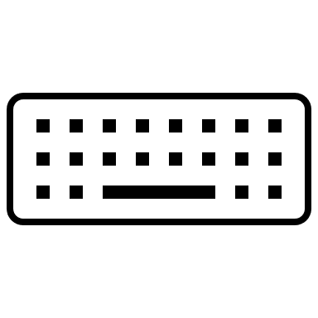




Natural language interface
Interaction
Language
Format
With software or hardware
Sublanguage
Audio
Text
Tab-complete
Menu select
Node assembly
Sign language
Body language
Controlled
Restricted
Natural language
Structured, commands

Slide 8

Natural language interface
Interaction
Language
Format
With software or hardware
Sublanguage
Audio
Text
Tab-complete
Menu select
Node assembly
Sign language
Body language
Controlled
Restricted
Natural language
Structured, commands
Direction
Input only
Output only
Dialog
Single turn
Multi- turn

Slide 9


Natural language interface
Interaction
Language
Format
With software or hardware
Sublanguage
Audio
Text
Tab-complete
Menu select
Node assembly
Sign language
Body language
Controlled
Restricted
Natural language
Structured, commands
Direction
Control
Input only
Output only
User initiated
Agent initiated
Dialog
Share control
Single turn
Multi- turn

Slide 10

Natural language interface
Interaction
Language
Format
With software or hardware
Sublanguage
Audio
Text
Tab-complete
Menu select
Node assembly
Sign language
Body language
Controlled
Restricted
Natural language
Structured, commands
Direction
Control
Timing
Input only
Output only
User initiated
Agent initiated
Synchronous
Dialog
Share control
Asynchronous
Single turn
Multi- turn

Slide 11
Natural language interface
Interaction
Language
Format
With software or hardware
Sublanguage
Audio
Text
Tab-complete
Menu select
Node assembly
Sign language
Body language
Controlled
Restricted
Natural language
Structured, commands
Direction
Control
Timing
Purpose
Input only
Output only
User initiated
Agent initiated
Synchronous
Command
Instruct
Direct
Guide
Explain
Explore
Answer questions
Entertain
Dialog
Share control
Asynchronous
Single turn
Multi- turn

Slide 12
1. Definition
A natural language (NL) interface enables a user to achieve a goal by interacting with systems - using natural language, in a variety of formats. An NL interaction might be initiated by the user or the system; and the interaction can flow like a conversation or be simple input or output, in real time or delayed.

Slide 13
2. Motivation
Why natural language interfaces?

Slide 14
Why Natural language interface?
Voice is easier

Slide 15
Why Natural language interface?
Voice is easier
Hands-free

Slide 16
Why Natural language interface?
Voice is easier
Eyes-free
Hands-free

Slide 17
Why Natural language interface?
Unfamiliar domain
Voice is easier
Eyes-free
Hands-free

Slide 18

Why Natural language interface?
GUI is confusing
Unfamiliar domain
Voice is easier
Eyes-free
Hands-free

Slide 19
Why Natural language interface?
SQL is hard
GUI is confusing
Unfamiliar domain
Voice is easier
Eyes-free
Hands-free

Slide 20
3. History
What do we already know?
How did we get here?

Slide 21
Over the last decade, several computer systems have been developed that support natural-language interaction ...
Advantages of NL interfaces
NL is flexible
Users need less training with NL vs commands or SQL
NL can be faster than using menus or GUIs
NL enables clarifying and follow-up questions
Disadvantages of NL interfaces
Flexibility at the cost of verbosity
Lack of cues about capability
People overestimate capability (eg. expect common sense)

Slide 22
Over the last decade, several computer systems have been developed that support natural-language interaction ...
Advantages of NL interfaces
NL is flexible
Users need less training with NL vs commands or SQL
NL can be faster than using menus or GUIs
NL enables clarifying and follow-up questions
Disadvantages of NL interfaces
Flexibility at the cost of verbosity
Lack of cues about capability
People overestimate capability (eg. expect common sense)
Natural-language interface
Panel discussion, 1982

Slide 23
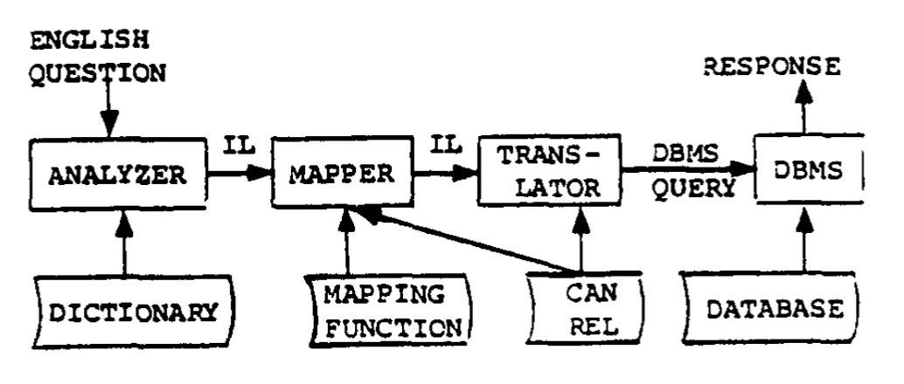
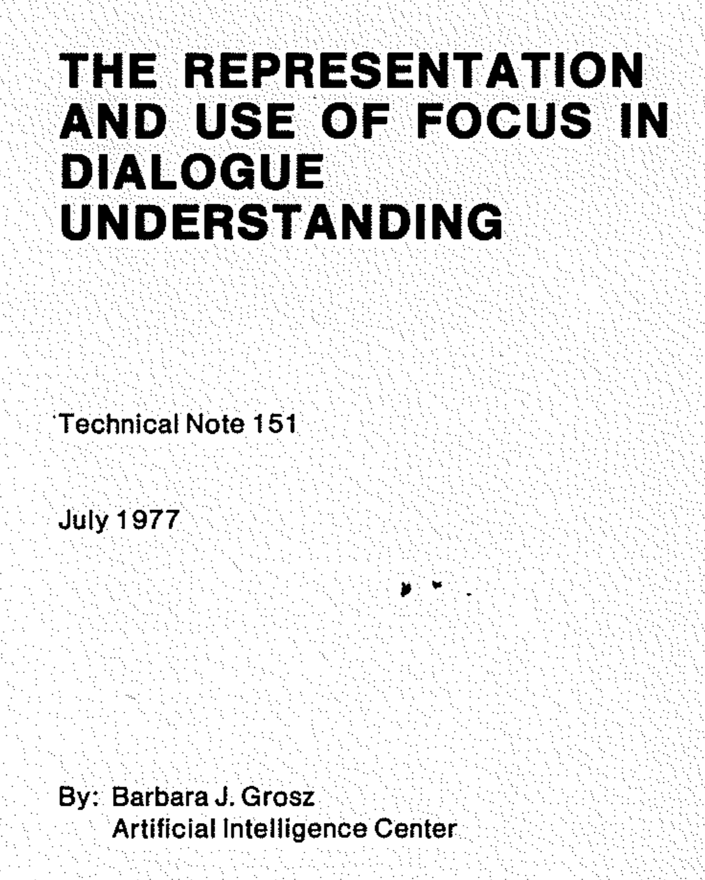
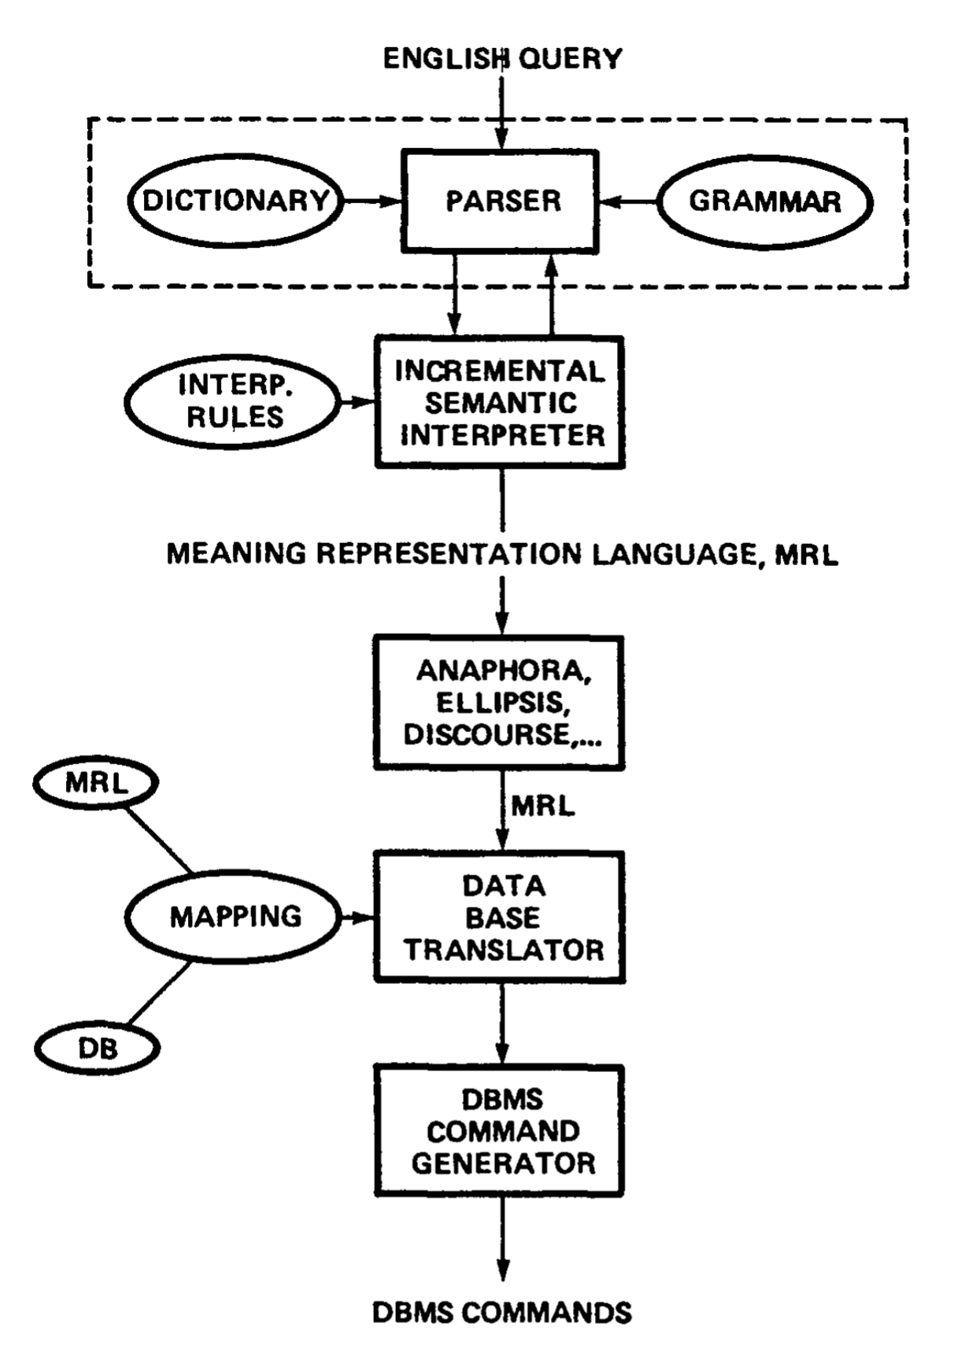
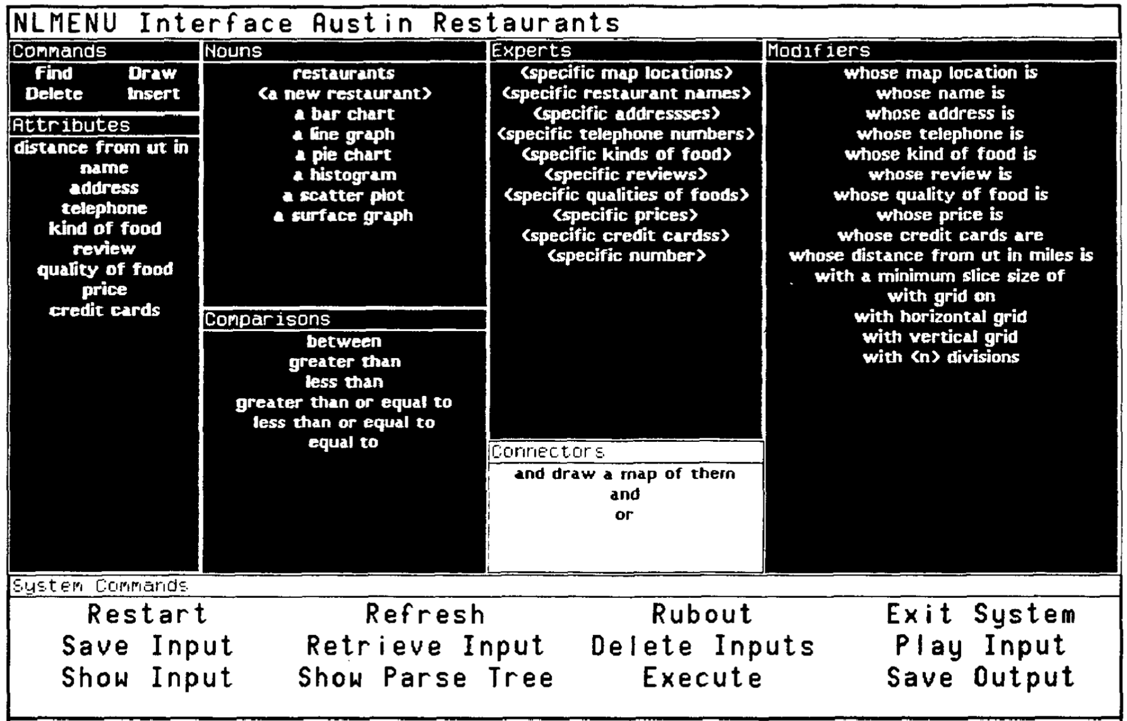
1977 - 1999

Slide 24
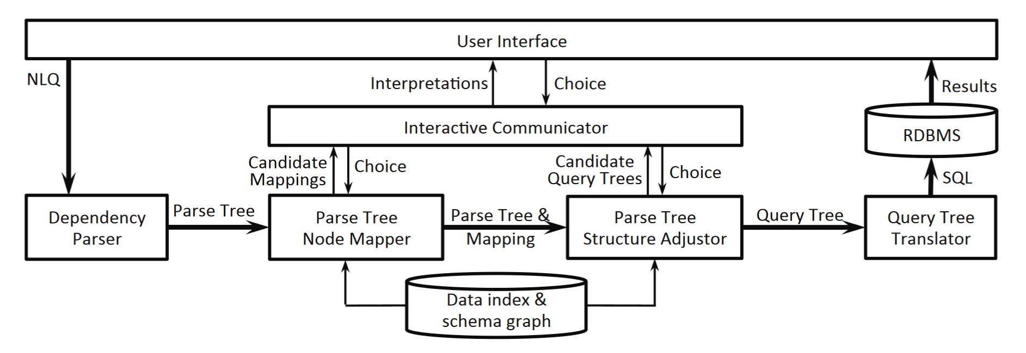
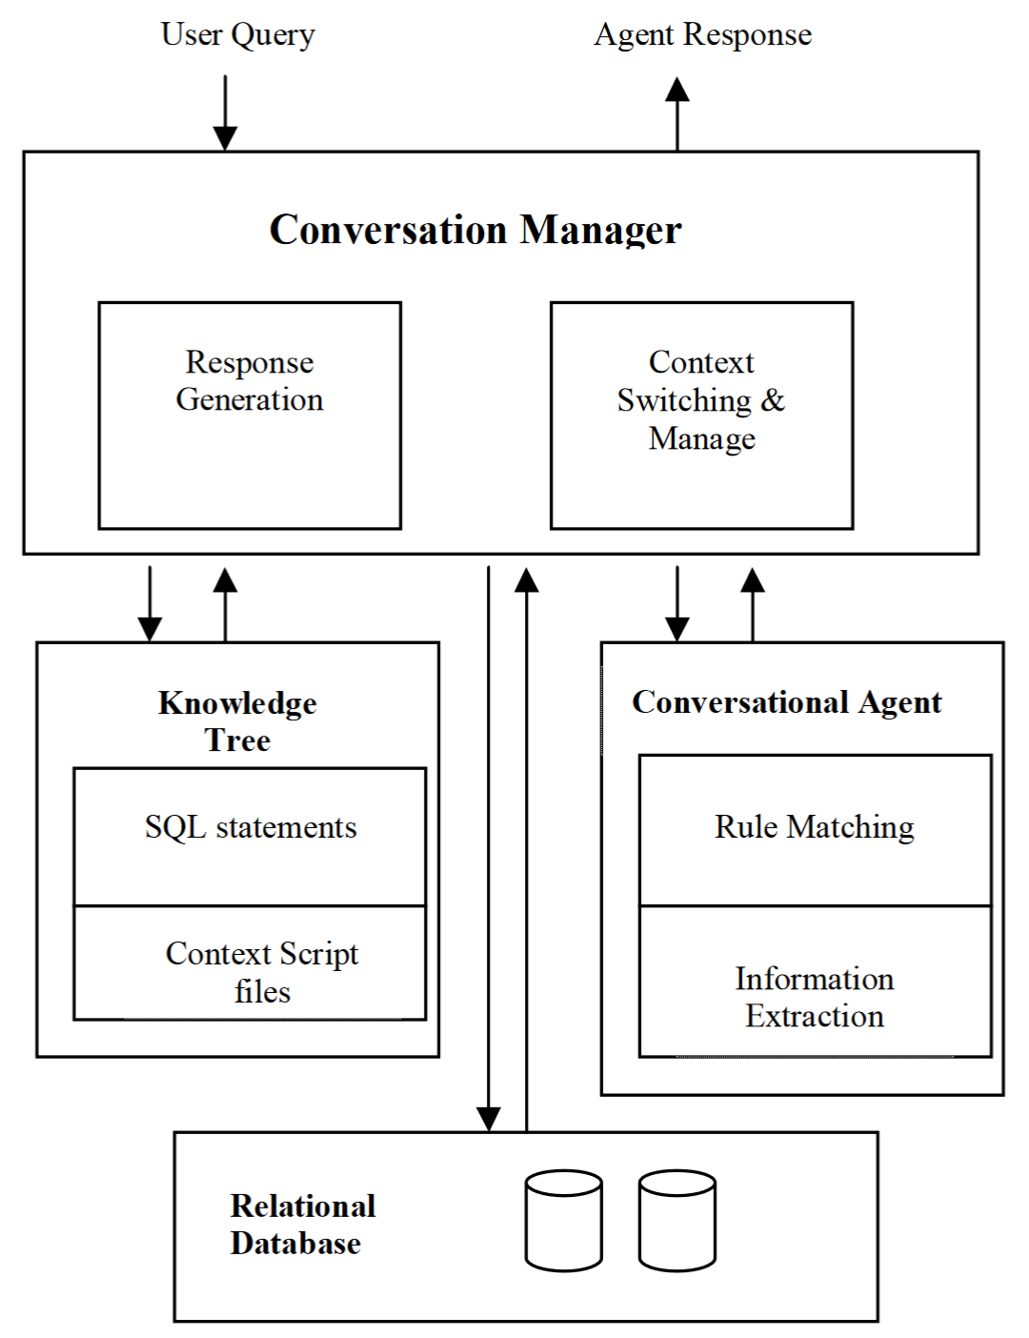
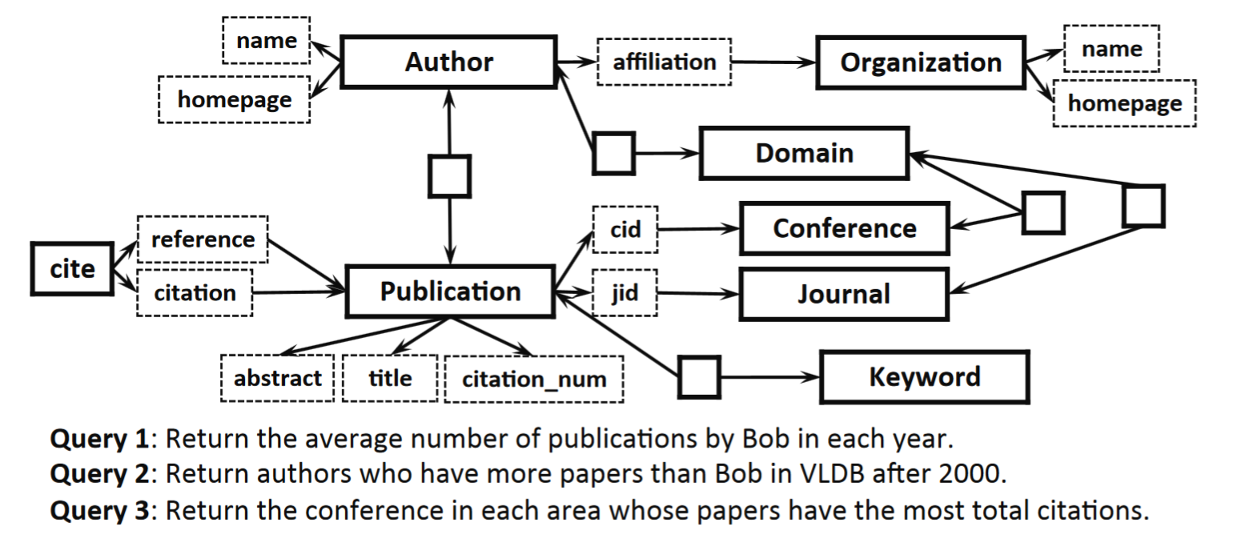
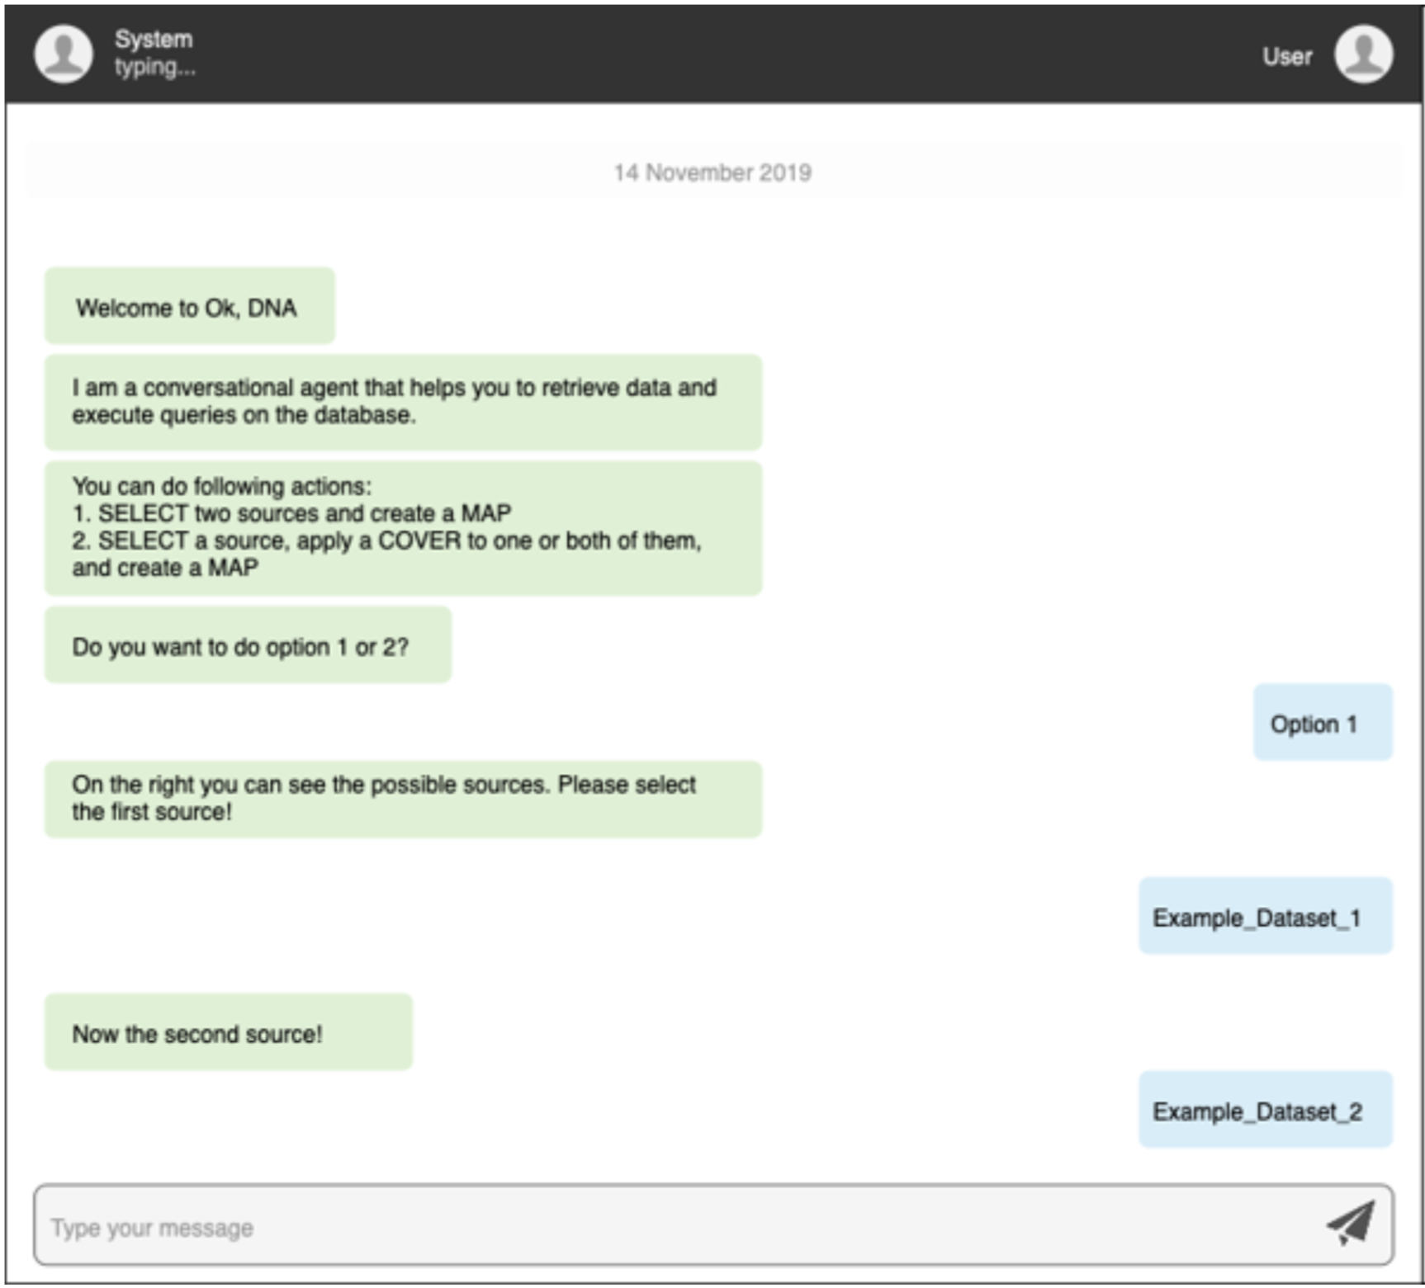
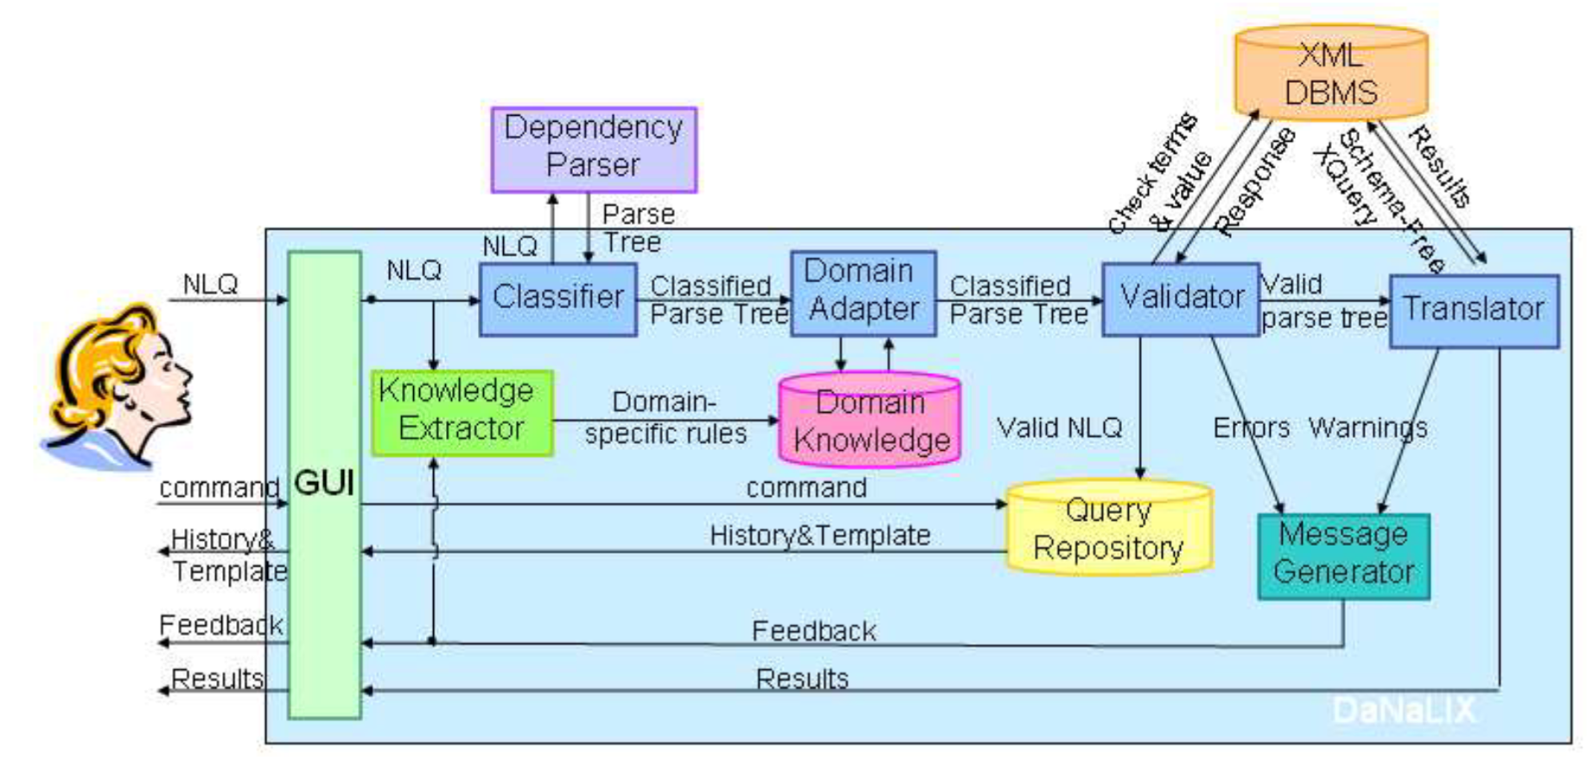
2000 – 2020

Slide 25
Review
Definition
Motivation
History

Slide 26
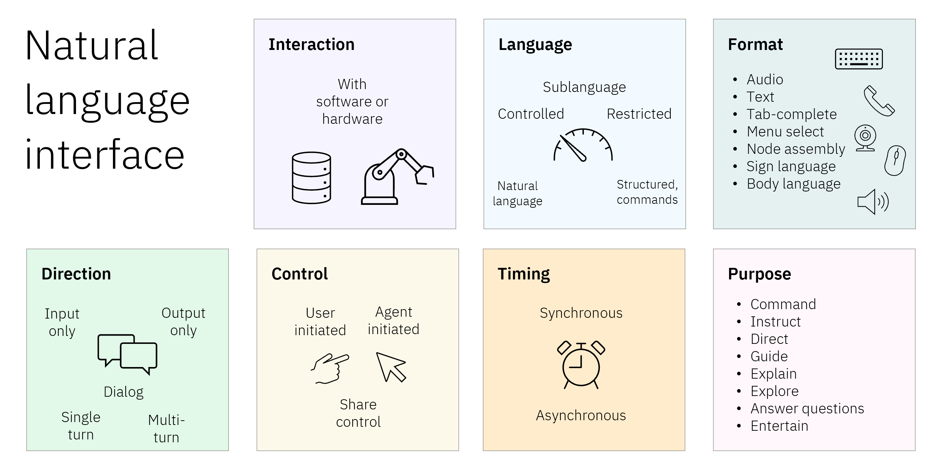
Review
Definition
Motivation
History

Slide 27
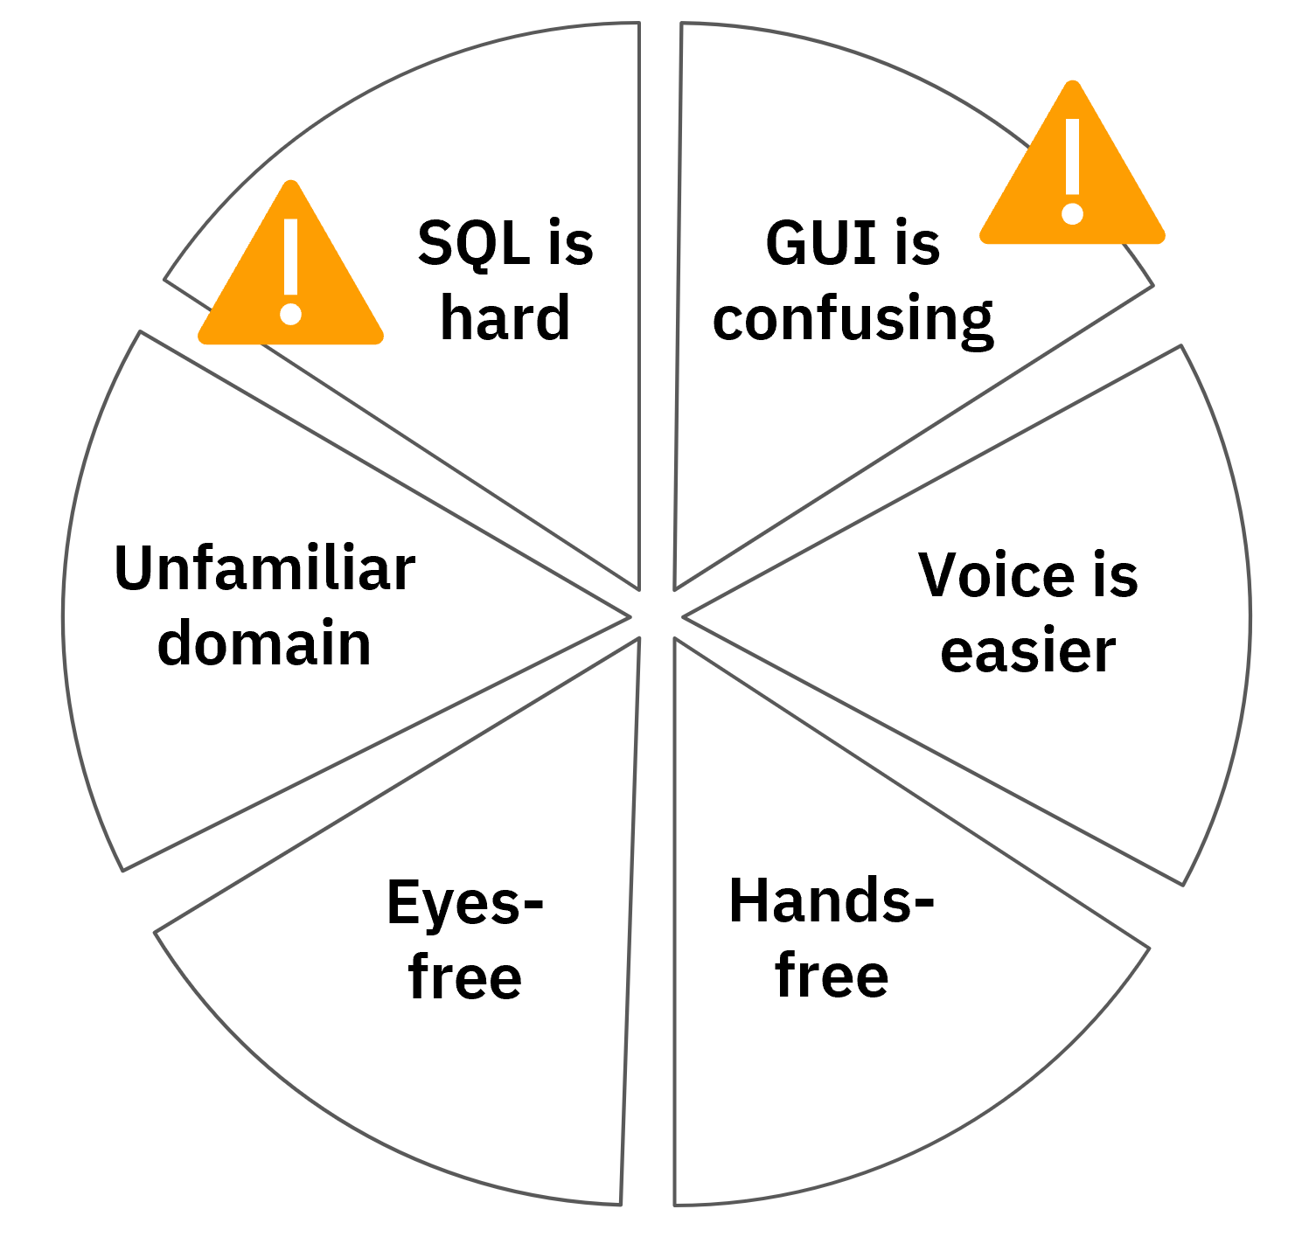
Review
Definition
Motivation
History

Slide 28
Review
Definition
Motivation
History

Slide 29
Review
Definition
Motivation
History

