Slide 1
RAG and agentic projects
need content
professionals
Sarah Packowski
AI ContentOps Architect, IBM

Slide 2
Agenda
RAG and agentic solutions
The role of content professionals
Content strategy
Evaluating, improving results

Slide 3
Agenda
RAG and agentic solutions
The role of content professionals
Content strategy
Evaluating, improving results

Slide 4

Retrieval-augmented generation (RAG)
User input (question)

Slide 5

Retrieval-augmented generation (RAG)
User input (question)
Search for relevant articles

Slide 6

Retrieval-augmented generation (RAG)
User input (question)
Knowledge base (articles)
Search for relevant articles

Slide 7
Retrieval-augmented generation (RAG)
User input (question)
Knowledge base (articles)
Article:
<article-text>
Answer the question based on the article.
Q: <question-text>
A:
Search for relevant articles
Grounded prompt

Slide 8
Retrieval-augmented generation (RAG)
User input (question)
LLM generates output
Knowledge base (articles)
Article:
<article-text>
Answer the question based on the article.
Q: <question-text>
A:
Search for relevant articles
Grounded prompt

Slide 9
Agentic solutions
What is the command to achieve the result in the following request?
API reference: == Lights You can turn enabled lights on or off using the "light" command. Syntax light [ light-ID ] [ on | off ] Example Command to turn the bedroom light off: light bedroom off
Enabled elements: - porch-light - backyard-light - garage-door - dog-door
Request: Turn front lights on
A: light porch-light on
Turn front lights on
User input
Knowledge base (articles, database)
Search for relevant info

Slide 10
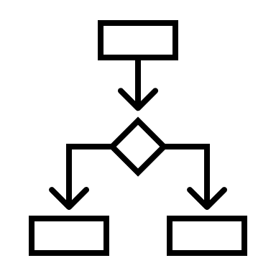
Agentic solutions
Which IoT element is the following request about?
Choices:
light
door
Request: Turn front lights on
A: light
Which light is this about?
Choices:
backyard-light
porch-light
A: porch-light
Should the light be turned on or off?
A: on
Turn front lights on
Search for relevant info
Knowledge base (articles, database)
User input
Application logic

Slide 11
Agenda
RAG and agentic solutions
The role of content professionals
Content strategy
Evaluating, improving results

Slide 12
Content is crucial
What is the command to achieve the result in the following request?
API reference: == Lights You can turn enabled lights on or off using the "light" command. Syntax light [ light-ID ] [ on | off ] Example Command to turn the bedroom light off: light bedroom off
Enabled elements: - porch-light - backyard-light - garage-door - dog-door
Request: Turn front lights on
A: light porch-light on
Where do these articles come from???
Writers!
Article:
<article-text>
Answer the question based on the article.
Q: <question-text>
A:

Slide 13
Agenda
RAG and agentic solutions
The role of content professionals
Content strategy
Evaluating, improving results

Slide 14
Question-driven content development
Collect real user questions
Test whether your topics answer those questions
Test whether RAG solutions can answer those questions using your content as the knowledge base
Write new content and rewrite where needed

Slide 15
Automated topic testing
Collect real user questions
Generate questions for your topics
Compare generated questions with real questions

Slide 16
Optimizing knowledge base content for RAG
Topic-based writing
SEO
Meaningful anchor text
Image descriptions
Intentional table design
Consistency
Concise writing style
Writing for translation
Avoid idioms
Include synonyms
Consider accessibility
Use active voice
Avoid multiple negatives
Lead-in sentence for lists
List parallelism
Simplify complex procedures
Frame optional, condition steps
Place modifiers carefully
Inanimate object possessive
Computerization
Avoid user blame
May vs. might vs. allow
That vs. which
With vs. use vs. together
Nouns vs. names
Avoid and/or

Slide 17
Agenda
RAG and agentic solutions
The role of content professionals
Content strategy
Evaluating, improving results

Slide 18
Content rewriting experiment
Extracted 189 questions from NQ benchmark
Built simple RAG solution
Rewrote articles
Ran the questions again
Compared results
Just rewriting articles improved results to 100% correct

Slide 19
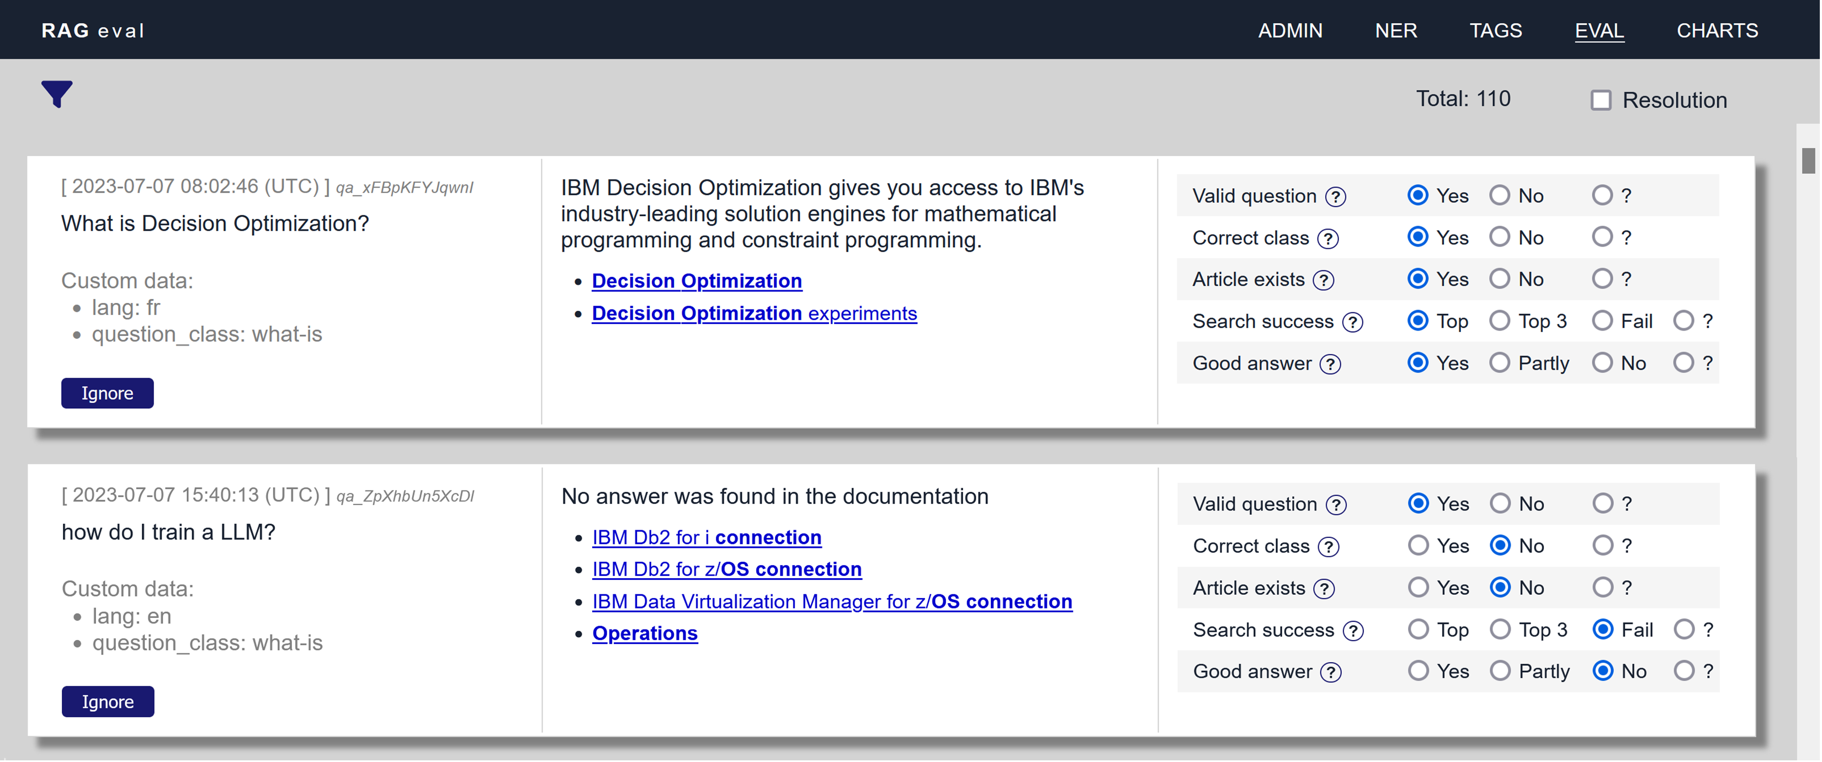
Evaluating RAG results

