Slide 1


Slide 2
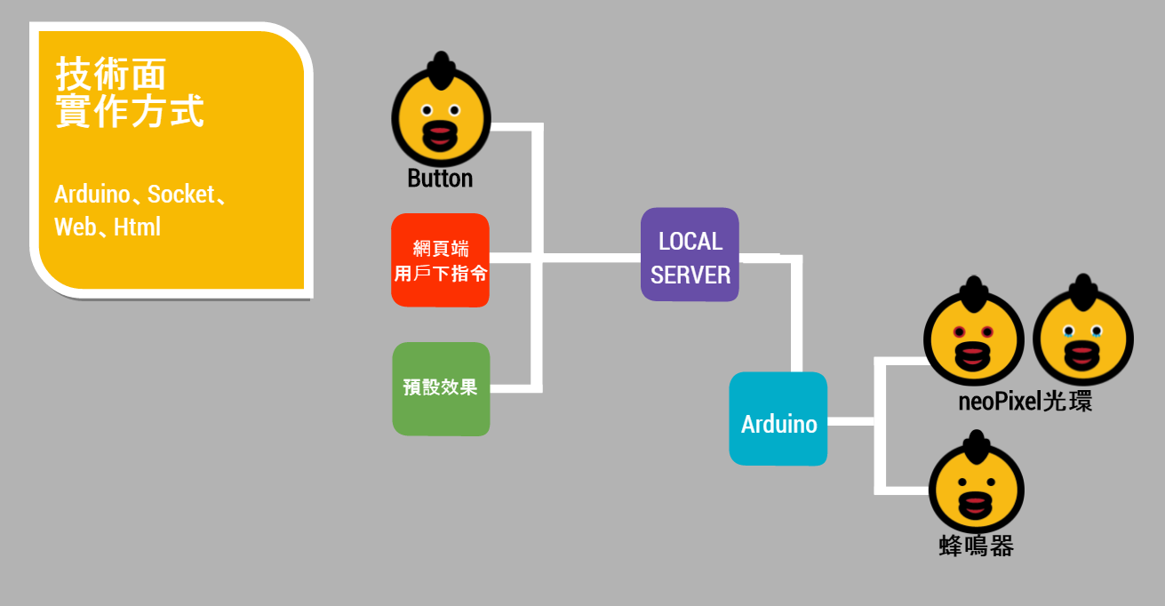

Slide 3


Slide 4
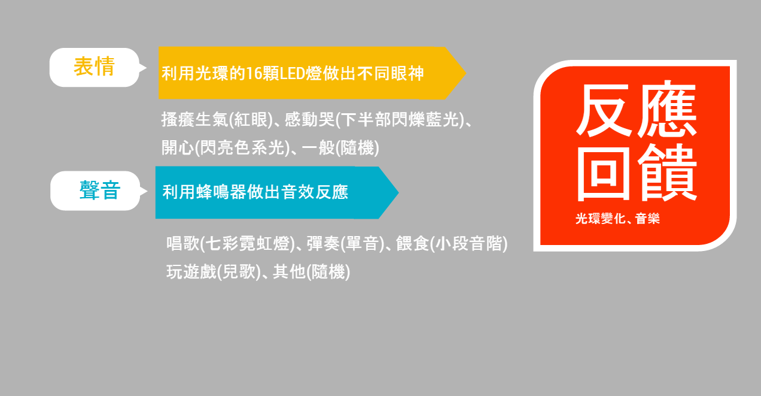

Slide 5

https://goo.gl/b2SuuP

