Slide 1


Capstone Project: Humana-Mays Healthcare Analytics Case Competition 2020
-Names

Slide 2
Overview
Competition Details
Business Problem
Data Overview
Data Exploration
Feature Selection
Modeling Approach
Results
Conclusion
Future Scope & Recommendations
Learning Outcomes

Slide 3
Competition Details
Fourth Annual Competition of Mays Business School partnership with Humana.
Showcase analytical skills and solve real world business problems related to healthcare.
Utilizing Humana Real data.
Having approximately 4.5 millions members and 3.8 PDP members as per July 2020
Total revenue as per 2019 is 64.88 billion.

Slide 4
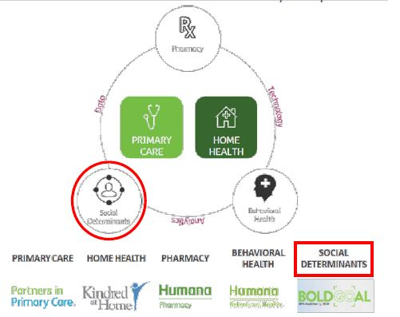
Business Problem
Motivation
Key Component: Social Determinants of Health (SDoH).
“Broader view” of Humana members to better understand
the whole person and to assist them in new ways towards
achieving their best health.

Slide 5
Business Problem
Problem Statement
SDoH are the conditions in the environments in which people live, learn, work, play, worship and age that affect a wide range of health, functioning and quality-of-life outcomes and risks. Transportation is one of these determinants. Using the provided data and potentially supplementing with public data, create a model to predict if which members are likely struggling with Transportation.
Goal
To identify Medicare members most likely experiencing “Transportation Challenges” and purpose viable solutions to overcome this barrier to access care and achieving their best health.

Slide 6
Data Overview
Collected Humana’s MAPD members data.
A year lookback for a member before event collection
Synthetic data
826 features and 69752 observations.
Transportation Challenges – Binary Flag
Data Features include
Medical claims
Pharmacy claims
Lab claims
Demographics
Credit Card
Condition Related
CMS
Other features - Health program status, revenue code, behavioral segmentation

Slide 7
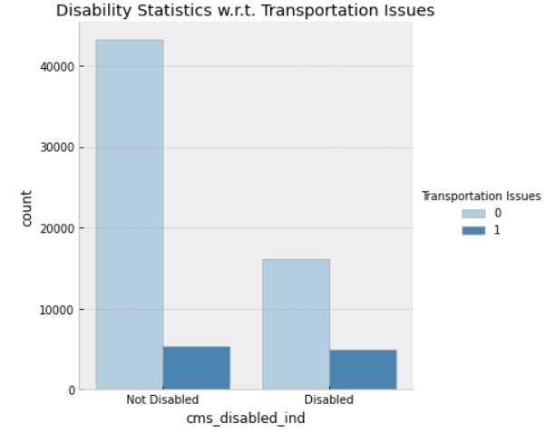
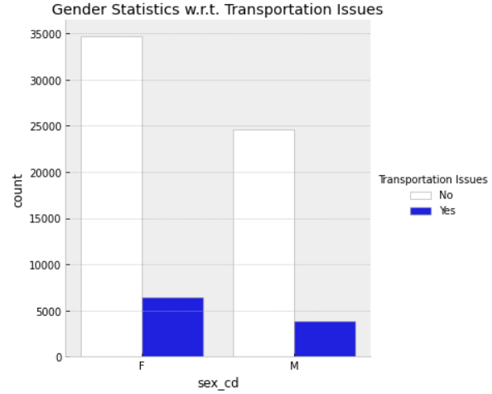
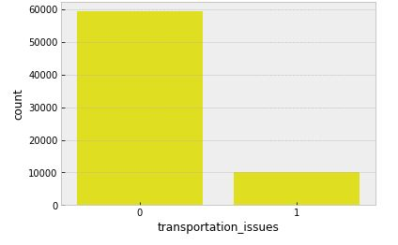
Data Exploration
Tool – Google Colaboratory (Colab)
Programming Language – Python
Duplicate observations
Handling missing data
Dummy variables
Splitting train-80% and test-20%
datasets.

Slide 8
Feature Selection
Variance Threshold – Removes all zero- variance features
SMOTE (Synthetic Minority Oversampling Techniques)

Slide 9
Modeling Approach
Standardize variables
Pipelines for models:
Logistic Regression
Random Forest
Support Vector Machine
XGBoost
Specifying grid searches

Slide 10
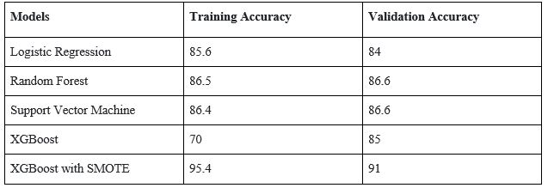
Predictions/ Results

Slide 11
Conclusion
Test data – 17681 observations
Transportation challenges –430 members
60% population are Female.
Age - >55 years
Self-engaged Optimists and Auto-Pilot participators

Slide 12
Future Scope & Recommendations
Online appointments
Virtual care solutions for non-emergency services.
Further breaking them based on absolute necessity for the house-based visit by hospital persona.
To prioritize the members facing transportation issues by finding scores of each member.

Slide 13
Learning Outcomes
Solving real-world business problem.
“High Importance” of Data cleaning, preprocessing before modeling
Exploring
New tool - Google Colab, Python
Understanding features related to healthcare
Using pipelines
Model – XGBoost

Slide 14


Thank You

Slide 15
References
https://machinelearningmastery.com/develop-first-xgboost-model-python-scikit-learn/
https://machinelearningmastery.com/smote-oversampling-for-imbalanced-classification/
https://www.who.int/social_determinants/sdh_definition/en/
https://press.humana.com/news/news-details/2020/Texas-AM-University-Humana
https://machinelearningmastery.com/smote-oversampling-for-imbalanced-classification/
https://xgboost.readthedocs.io/en/latest/
https://machinelearningmastery.com/gentle-introduction-xgboost-applied-machine-learning/
https://scikit-learn.org/stable/modules/generated/sklearn.pipeline.Pipeline.html
https://towardsdatascience.com/a-simple-example-of-pipeline-in-machine-learning-with-scikit-learn-e726ffbb6976
https://machinelearningmastery.com/standardscaler-and-minmaxscaler-transforms-in-python/
https://chrisalbon.com/machine_learning/feature_selection/variance_thresholding_for_feature_selection/

