Slide 1

Predicting Flights Delay
Presented by -
Group 6
Gordan Wall
Srushti Padade
Rithin Gujja
Sharmili Sunil Tandulwadkar

Slide 2
Business Requirement
One of the most common yet unpleasant encounters people fear to have is flight delay. A lot of flights are delayed each year have detrimental effects for passengers, airlines and airports.
Our objective is to predict the flights those are likely to be delayed in future and ultimately save the losses of the passengers as well as airport authority.

Slide 3
Analytic Process
7 million entries of Flights details from Bureau of Transportation Statistics.
SCRUB
Trimming
Imputing missing values
Type conversion
Feature Selection
EXPLORE
Sampling
Balancing
Visualization
MODEL
Partitioning Data
INTERPRET
Performance metrics
OBTAIN
Modeling Strategy
Naïve Bayes Classifier
AUC of 90.26%
Ontime
Delay

Slide 4
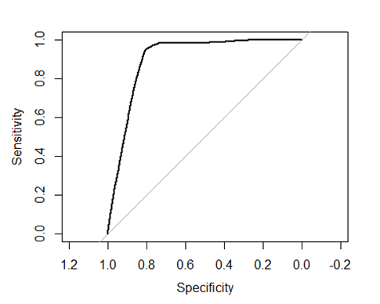
Model Performance Estimation
Naïve Bayes Classification
Accuracy of prediction is 87.25%.
AUC value of 90.26%, which confirms our success in accurately predicting on this flight dataset.

Slide 5

Conclusion
Armed with this ever-improving Naïve Bayes model, the analytics department of this major airline would be able to save money and improve customer experience by accurately predicting flight delay and using that information to decrease flight delay in the future.

Slide 6

Thank You

