Slide 1
Pointers
Chapter 11

Slide 2
Memory Address
Each byte in the memory has a unique address.
Memory
2000
Variable Type Value Address
i int 5 2000
j short int 18 2004
c char '!' 2006
b bool true 2007
f float 2 2008
d double 2 200C
2004
2008
200C
2010

Slide 3
11.1 Pointer Variables (指標)
Pointers are variables whose values are memory addresses. (記憶體位址)
Given that i is an integer variable, p is a pointer variable, we can store i's address in p.
We often express it as "p points to i".
p
i
3

Slide 4
Pointer Variables (指標)
int i = 3;
int * p;
p = i 的位址;
Memory
p
5000
6000
i
6000
3
↑
address

Slide 5
Declaring Pointer Variables
Syntax to declare a pointer
varType * variableName;
Ex: int * p;
double * q;
char * r;
sizeof(a pointer): 4 bytes for 32位元
use * to declare a pointer
pointer to integer
pointer to double
pointer to character

Slide 6
Pointer (指標)
Syntax to define a pointer
varType * variableName;
Ex: int * myPtr;
To tell the compiler: what type of data is stored in the location where this pointer points to.
?? what is this

Slide 7
Pointer (指標)
int * p;
int a = 15;
p = a 的位址;
Memory
p
5000
6000
a
6000
15
↑
address

Slide 8
Pointer (指標)
char * p;
char a = '$';
p = a 的位址;
Memory
p
5000
6000
a
6000
'$'
↑
address

Slide 9
Pointer (指標)
float * p;
float a = 31.58;
p = a 的位址;
Memory
p
5000
6000
a
6000
31.58
↑
address

Slide 10
Pointers to Every Data Type
int * myPtr;
char * myPtr;
float * myPtr;
double * myPtr;
unsigned short int * myPtr;
...
All pointer variables occupies 4 bytes.

Slide 11
Define Many Pointers in a Line
int y, * myPtr1, * myPtr2;
y is an integer variable (int)
myPtr1 and myPtr2 are pointer variables (int *)

Slide 12
11.2 The Address and Indirection Operators
C provides a pair of operators designed specifically for use with pointers.
To find the address of a variable, we use the & (address) operator.
To gain access to the object that a pointer points to, we use the * (indirection) operator.

Slide 13
The Address Operator (&)
int * myPtr;
Declaring a pointer variable doesn’t make it point to an object.
It is crucial to initialize a pointer before using it.
Memory
myPtr
5000
怪值
不知何方

Slide 14
The Address Operator (&)
To get the address of a variable
int * myPtr;
int y = 15;
myPtr = &y;
Memory
myPtr
怪值
5000
6000
不知何方
y
6000
15
y的位址是6000
myPtr的值就會變成y的位址

Slide 15
The Address Operator
It’s also possible to initialize a pointer variable at the time it’s declared:
int i;
int *p = &i;
The declaration of i can even be combined with the declaration of p:
int i, *p = &i;

Slide 16
The Indirection Operator (*)
Also known as dereferencing operator
For accessing data stored in the location where the pointer points to.
"Access" means "read" and "write".

Slide 17
Indirection Operator (*)
int y = 15, z;
int * myPtr;
myPtr = &y;
z = * myPtr;
Memory
myPtr
5000
6000
Read the data in the location where myPtr points to
y
6000
15
z
怪
15
The value of z becomes 15

Slide 18
Indirection Operator (*)
int y = 15, z;
int * myPtr;
myPtr = &y;
* myPtr = 8;
Memory
myPtr
5000
6000
Write the data into the location where myPtr points to
y
15
6000
8
z
怪
The value of y becomes 8

Slide 19
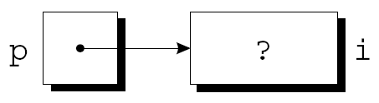
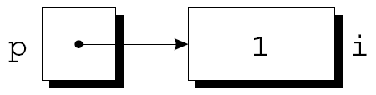
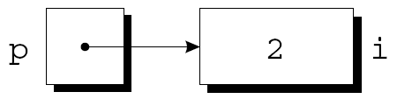
The Indirection Operator
p = &i;
i = 1;
printf("%d\n", i); /* prints 1 */
printf("%d\n", *p); /* prints 1 */
*p = 2;
printf("%d\n", i); /* prints 2 */
printf("%d\n", *p); /* prints 2 */

Slide 20
The Indirection Operator
Applying the indirection operator to an uninitialized pointer variable causes undefined behavior:
int *p;
printf("%d", *p); /*** WRONG ***/
Assigning a value to *p is particularly dangerous:
int *p;
*p = 1; /*** WRONG ***/

Slide 21
The Indirection Operator
Assigning a value to *p is particularly dangerous:
int *p;
*p = 1;
memory
myProgram
p
p
5000
怪怪值
不知何方
1
@@不知改到何方了

Slide 22
Indirection Operator (*)
Do not miss up the roles of * in the following cases:
Defining a pointer variable;
Dereferencing a pointer variable
int *myPtr1, *myPtr2, z;
z = *myPtr1;
Defining myPtr1 and myPtr2 as two pointer variables
Deferencing myPtr1 to access the data
in the location where myPtr1 points to.

Slide 23
Indirection Operator (*)
Memory
int *myptr;
int y;
myptr = &y;
y = 5;
printf("%d\n", *myptr);
*myptr = 7;
printf("%d\n", y);
myptr
myptr
5000
怪怪值
6000
y
y
6000
7
7
5
5
不知何方
5
7

Slide 24
11.3 Pointer Assignment
myptr1
myptr2
int *myptr1;
int *myptr2;
int y;
myptr1 = &y;
myptr2 = myptr1;
y=5;
printf("%d\n", *myptr1);
*myptr2 = 7;
printf("%d\n", y);
Memory
myptr1
5000
怪怪值
6000
myptr2
y
5
7
怪怪值
y
6000
5
6000
7
不知何方
不知何方
5
7

Slide 25
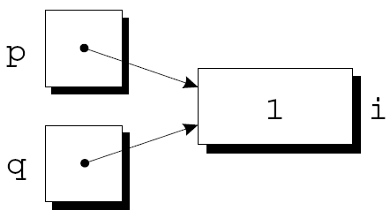
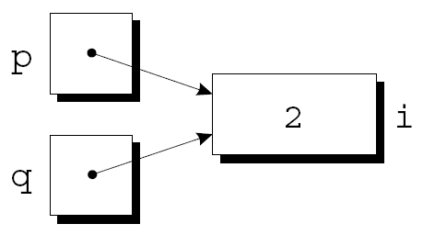
Pointer Assignment
If p and q both point to i, we can change i by assigning a new value to either *p or *q:
*p = 1;
*q = 2;
Any number of pointer variables may point to the same object.

Slide 26
Pointer Assignment
Be careful not to confuse
q = p;
with
*q = *p;
The first statement is a pointer assignment, but the second is not.
The example on the next slide shows the effect of the second statement.

Slide 27
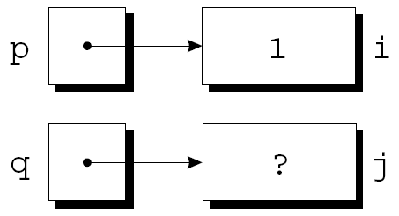
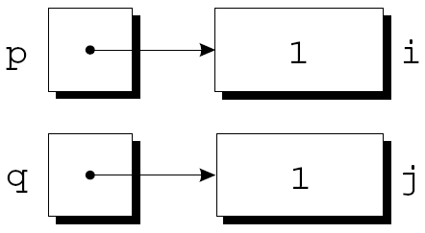
Pointer Assignment
p = &i;
q = &j;
i = 1;
*q = *p;

Slide 28
Consistent Variable Types
int k, m, n;
int * t;
t = &k;
m = 5;
*t = m;
Var type:
k, m, n:
t:
&k:
*t:
t = n; ()
int
Address of int
Address of int
int

Slide 29
When to Use a Pointer?
Call by reference (傳址呼叫)
Manipulate arrays (陣列處理)
Pass functions as function parameters (functions 也可以當參數)
Create and manipulate dynamic data structure (動態產生的 data structure)
linked list, queue, stack, tree, …

Slide 30
11.4 Pointers as Arguments
Pass addresses of variables as parameters.
Now you can modify a variable defined outside a function.
void myfunc(int * x){
...
}
int main(){
int y;
myfunc( &y );
...
}
Get an address as a parameter. Now the parameter is a pointer.
Pass an address as a parameter

Slide 31
Call by Reference (傳址呼叫)
Now you can modify a variable defined outside a function.
void myfunc(int *x){
*x = 7;
}
int main(){
int y = 5;
myfunc( &y );
printf("%d\n",y);
return 0;
}
Memory
x
5000
y
5000
7
5
7

Slide 32
When to Call by Reference?
If you want a function to return "many values"…
Ex:
Input a date (year/month/day) and check if it is a valid date.
Get the integral part and the fractional part of a floating-point number.

Slide 33
Pointers as Arguments
Get the integral part and the fractional part of a floating-point number:
void decompose(double x, long *int_part, double *frac_part)
{
*int_part = (long) x;
*frac_part = x - *int_part;
}

Slide 34
Practice
Swap the values of two integer variables.
swap()
Take two integer variables and return them in sorted order, i.e. the first variable becomes the larger one.
sort2() and sort3()

Slide 35
swap()
void swap( int *a, int *b )
{
int t = *a;
*a = *b;
*b = t;
}
int main(){
int a= 3, b = 5;
swap(&a, &b);
return 0;
}
a
b
t
怪
3
a
b
3
5
5
3

Slide 36
About scanf
int myint;
scanf("%d", &myint);
int main(){
int year;
get_year( &year ); return 0;
}
void get_year(int *y){
printf("請輸入出生年：");
scanf("%d", y );
}
call by reference, int *
int *
int *

Slide 37
About scanf
year
int main(){
int year;
get_year( &year );
return 0;
}
void get_year( int * y ){
printf("請輸入出生年：");
scanf("%d", y );
}
怪
2006
The initial value of y
is the address of year
y
&year

