Slide 1
Functions
Chap 9

Slide 2
Functions (函式)
Modularize a program
Avoid code repetition
Software reusability
Use existing functions as building blocks for new programs
Abstraction - hide internal details (library functions)

Slide 3
ANSI Standard Library (函式庫)
assert.h
ctype.h
errno.h
float.h
limits.h
locale.h
math.h
setjmp.h
signal.h
stdarg.h
stddef.h
stdio.h
stdlib.h
string.h
time.h

Slide 4
Using Libraries
Many developed functions are provided in C libraries. (*.lib files)
Functions of the same topic are grouped together.
Include corresponding header files to get the prototypes of the functions.
#include <stdio.h>
#include <math.h>
#include <string.h>

Slide 5
Library Functions
We have learned many library functions.
In <stdio.h>
int printf(…);
int scanf(…);
In <stdlib.h>
void srand(unsigned int);
int rand(void);
In <time.h>
time() and ctime()

Slide 6
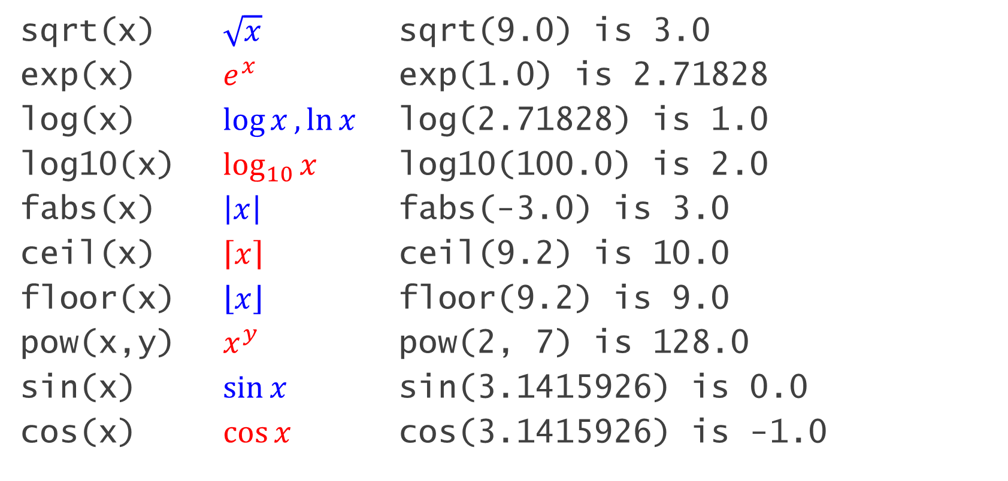
math.h
sqrt(x) $\sqrt{x}$ sqrt(9.0) is 3.0
exp(x) $e^{x}$ exp(1.0) is 2.71828
log(x) $\log{x},\ln{x}$ log(2.71828) is 1.0
log10(x) $\log_{10}{x}$ log10(100.0) is 2.0
fabs(x) $\left|x\right|$ fabs(-3.0) is 3.0
ceil(x) $\left\lceil x\right\rceil$ ceil(9.2) is 10.0
floor(x) $\left\lfloor x\right\rfloor$ floor(9.2) is 9.0
pow(x,y) $x^{y}$ pow(2, 7) is 128.0
sin(x) $\sin{x}$ sin(3.1415926) is 0.0
cos(x) $\cos{x}$ cos(3.1415926) is -1.0

Slide 7
math.h - Examples
Print out log₃343
Print out e⁵, and find the least integer which is larger than e⁵

Slide 8

math.h (Cont.)
$$e^{\sqrt{T+K}}\sin{3x}$$
exp(sqrt(T+K))*sin(3*x)
$$3^{\log{\frac{x}{5y}}}$$
pow(3, log10(x/5/y))

Slide 9
For All C Library Functions
Try:
http://www.cplusplus.com/reference/clibrary/
or
https://www.gnu.org/software/libc/manual/html_node/index.html
https://zh.wikipedia.org/wiki/C標準函式庫
https://web.archive.org/web/20150118141700/http://www.acm.uiuc.edu/webmonkeys/book/c_guide/index.html

Slide 10
Function Example
int max(int a, int b) {
if (a > b) return a;
else return b;
}
int main() {
int a;
scanf("%d", &a);
int n = max(a , 7);
printf("比較大的數是 %d", n);
return 0;
}
// defining a function
// calling a function

Slide 11
Function Definition
Syntax:
return-type function-name(parameters)
{
declaration and statements;
return expression;
}
The format of parameters is:
var-type variable-name[, var-type variable-name]
body

Slide 12
Function Definition
範例
int max(int a, int b) {
if (a>b) return a;
else return b;
}
return-type function-name(parameters)
{
declaration and statements;
return expression;
}
parameters:
var-type variable-name[, var-type variable-name]

Slide 13
Program: Computing Averages
The average.c program reads three numbers and uses the average function to compute their averages, one pair at a time:
Enter three numbers: 3.5 9.6 10.2
Average of 3.5 and 9.6: 6.55
Average of 9.6 and 10.2: 9.9
Average of 3.5 and 10.2: 6.85

Slide 14
average.c
double average(double a, double b) {
return (a + b) / 2;
}
int main() {
double x, y, z;
printf("Enter three numbers: ");
scanf("%lf%lf%lf", &x, &y, &z);
printf("Average of %f and %f: %f\n", x, y, average(x, y));
printf("Average of %f and %f: %f\n", y, z, average(y, z));
printf("Average of %f and %f: %f\n", x, z, average(x, z));
return 0;
}

Slide 15
Examples
Write a power function to calculate x^{n}.
E.g. I want power(5, 3), which should give me 5³ = 125.
Write a factorial function to calculate n!
E.g. I want factorial(5), which should give me 5! = 120.
Write a floor function. (I.e. find the largest integer which is less than or equal to a real number).
E.g. I want floor(5.3645), which should give me 5.

Slide 16
Practice
Print out 1! to 12!
Declare a 7x7 array called myPower[][]. Store the value of x^{y} in myPower[x][y].

Slide 17
Function Call
A function call consists of a function name followed by a list of arguments.
average(x, y)
average(5.1, y+3)
average(x+2, min(c,d) )
Arguments are used to supply information to a function.
The call average(x, y) causes the values of x and y to be copied into the parameters a and b.

Slide 18
Calling (呼叫) Functions
a
b
int max(int a, int b) {
if (a > b) return a;
else return b;
}
int main() {
int x;
scanf("%d", &x);
int n = max(x , 7);
printf("比較大的數是 %d", n);
return 0;
}
5
7
max() return value
7
x
n
@#*$
5
@#*$
7

Slide 19
void Functions
Functions which do not return values
Leaving void functions:
Leave automatically after execution finishes
Use return; to leave in the halfway
Calling void functions:
Simply call by their names with required parameters followed by a semi-colon
No need to get returned values from them

Slide 20
Example
void printWelcome(int times) {
printf("歡迎上站！");
if (times <= 0) {
printf("@@\n");
return;
}
printf(“這是你第 %d 次上站。\n", times);
}
int main() {
printWelcome(10000);
return 0;
}

Slide 21
bool Functions
Functions which returns true or false only.
It is convenient to call a Boolean function to test a condition.
In C programs, use int functions and return 0 or 1 instead.
C++ only

Slide 22
Program: Prime Numbers
The myPrime20.c program prints prime numbers between 1 and 20:
2 3 5 7 11 13 17 19

Slide 23
myPrime20.c
bool is_prime(int n) {
int divisor;
if (n <= 1) return false;
for (divisor = 2; divisor * divisor <= n; divisor++)
if (n % divisor == 0) return false;
return true;
}
int main() {
int n;
for (n= 1; n <= 20; n++)
if (is_prime(n)) printf("%d\t", n);
return 0;
}

Slide 24

Functions Calling Functions
Example: Permutation
int factorial(int a); // return a! 的值
int permute(int n, int k){
return n! / (n-k)! ;
}
int main(){
printf("P(%d, %d) is %d\n", 5, 3, permute(5,3));
return 0;
}
$$P_{k}^{n}=\frac{n!}{(n−k)!}$$
factorial(n)
factorial(n-k)

Slide 25
About Functions
main() is also a function!
But main() is the first function when executing.
So please write our own functions at the same level as main().
Parameters are also variables in the function.
The definition of a function is usually placed above the point where it is called.

Slide 26
9.2 Function Declarations
You can declare a function before calling it or defining it.
A function declaration provides the compiler with a brief glimpse at a function whose full definition will appear later.
Therefore, it does not matter where the definition appear in this program.
It is now called a function prototype.

Slide 27
Function Prototype
A function prototype resembles the first line of a function definition with a semicolon added at the end.
Examples
int max(int a, int b);
double average(double a, double b);
void printWelcome(int times);

Slide 28
Example of a Function Prototype
Ended with a semicolon
int max(int a, int b);
int main() {
int a, b;
scanf("%d%d", &a, &b);
int n = max(a , b);
printf("比較大的數是 %d", n); return 0;
}
int max(int a, int b) {
if (a > b) return a;
else return b;
}
Function prototype,
used to declare the function
Same as the header of a function

Slide 29
Function Prototype
Parameter names can be omitted.
int max(int, int);
Well, better not to do so.

Slide 30
9.3 Arguments
As we know, when calling a function, values of arguments are copied to the parameters of the function.
It is said call-by-value.

Slide 31
Call by Value (傳值呼叫)
Parameters in a function is not the same variables as the arguments outside the function, even if their names are the same.
I.e. modification in a function does not change the value of a variable outside the function.
We will learn how to modify values with calling functions: Call by Reference (傳址呼叫)

Slide 32
Call by Value (傳值呼叫)
int max(int a, int b) {
if (a > b) return a;
else {
a = 9;
return b;
}
}
int main() {
int a, b;
scanf("%d%d", &a, &b);
int n = max(a , b);
printf("比較大的數是 %d\n", n); return 0;
}
a
b
9
5
7
另外配置的記憶體給這邊的 a, b
max回傳值
7
a
b
n
5
7
@#*$
7

Slide 33
Type Conversions about Functions
Two cases for type conversions
Copying values to the parameters
Returning
Type conversions for these two cases follow the conversion rules for assignment.
I.e. if the type of destination is "narrower", the data may be truncated and incorrect.

Slide 34
Functions, Incorrect Examples
int kkk(int a, float b) {
if (a>b) return 10.32;
else return 8;
}
int main() {
int a, b;
scanf("%d%d", &a, &b);
int n = kkk(a, b);
printf("比較大的數是 %d", n); return 0;
}
1
2
2
@@ type inconsistent: return value
@@ type inconsistent: arguments
1

Slide 35
Array Arguments
Use [] to denote an array
In a function:
int max_of(int data[]){
int max = data[0]; ...
}
When calling:
int main(){
int mydata[5] = {4, 3, 8, 3, 1};
int a = max_of(mydata);
printf("Max in data is %d\n", a);
return 0;
}
Name of an array

Slide 36
Array Arguments
To prevent from accessing out of an array:
int max_of(int data[], int size){
int max = data[0], i;
for (i = 0; i < size; i++) ...
}
int main(){
int m[5] = {4, 3, 8, 3, 1};
int a = max_of(m, sizeof(m) / sizeof(m[0]));
printf("Max in data is %d\n", a);
return 0;
}

Slide 37
N-Dimension Arrays as Arguments
Example:
int max_of(int data[][3],int size1,int size2);
int main(){
int data[2][3]={ {3, 4, 8}, {3, 1, 7} };
int a = max_of( data, 2, 3 );
printf("Max in data is %d\n", a);
return 0;
}
Clearly give the sizes of dimensions
other than the 1st dimension

Slide 38
9.4 The return Statement
A non-void function must use the return statement to specify what value it will return.
The return statement has the form
return expression ;
The expression is often just a constant or variable:
return 0;
return status;
More complex expressions are possible:
return n >= 0 ? n : 0;

Slide 39
9.5 Program Termination
A return statement in the main() function will terminate the program.
The value returned by main() is a statue code. In some OS, it can be tested to see if error happens.
return 0 means no error

Slide 40
The exit Function
Terminate the program in any function
Included in stdlib.h
Examples:
exit(0); // normal termination
exit(EXIT_SUCCESS); // normal termination
exit(EXIT_FAILURE); // abnormal termination

Slide 41
Practice
Represent an even number with the sum of two prime numbers.
Random permutation
m-A-n-B game

Slide 42
9.6 Recursion (遞迴)
A function is recursive if it calls itself.
Ex: factorial(k) // to compute k!
factorial(n) = n * factorial(n-1) // n! = n * (n-1)!
factorial(0) = 1
int factorial(int n){
if (n <= 1) return 1;
return n * factorial(n-1);
}

Slide 43
Recursion (Cont.)
Factorial (Cont.)
int factorial(int n){
if (n <= 1) return 1;
return n * factorial(n-1);
}
f(5) = 5 * f(4)
= 5 * 24 = 120
f(4) = 4 * f(3)
= 4 * 6 = 24
f(3) = 3 * f(2)
= 3 * 2 = 6
f(2) = 2 * f(1)
= 2 * 1 = 2
f(1) = 1

Slide 44
Writing Recursion Functions
Find the recursion relations
fibonacci(n) = fibonacci(n-1) + fibonacci(n-2)
Handle special cases (termination condition)
fibonacci(0) = 0
fibonacci(1) = 1

Slide 45
Recursion Functions (Cont.)
Fibonacci: 0, 1, 1, 2, 3, 5, 8, 13, 21, 34, …
a_{n} = a_{n-1} + a_{n-2}
fibonacci(0) = 0
fibonacci(1) = 1
fibonacci(n) = fibonacci(n-1) + fibonacci(n-2)
int fibonacci(int n){
if (n == 0) return 0;
if (n == 1) return 1;
return fibonacci(n-1) + fibonacci(n-2);
}

Slide 46
Examples of Recursion Functions
Factorial: n!
Fibonacci: 0, 1, 1, 2, 3, 5, 8, 13, 21, …
Any recursive series: a_{n} = 2 a_{n-1} + a_{n-2} - 5
Greatest common divider
gcd(a, b) = gcd(b, a%b)
Divide and Conquer algorithm
Hanoi Tower
……

Slide 47
Recursion Functions (Cont.)
Hanoi Tower
To move rings from one pole to another pole
Bigger ring cannot be on top of other smaller rings
A
B
C

Slide 48
Recursion Functions (Cont.)
Hanoi Tower
How to move 5 rings from pole A to pole C?
A
B
C

Slide 49
Recursion Functions (Cont.)
void hanoi(int n, char start, char goal, char other){
if (n == 1){
printf(“從 %c 柱移到 %c 柱\n", start, goal);
}
else {
hanoi(n-1, start, other, goal);
hanoi( 1 , start, goal, other);
hanoi(n-1, other, goal, start);
}
}
int main(){
hanoi(5, 'A', 'C', 'B');
return 0;
}

