Slide 1
Basic Types
Chap 7

Slide 2
C's Basic Types
int 整數 219, -5, 0
float 浮點數 0.3, -6.234, 100.0
double
char 字元 'a', '$', '6'
bool 布林型態 TRUE, FALSE
signed, unsigned: 有無正負數
long, short: 變數範圍大小

Slide 3



Bytes (位元組) in Memory (記憶體)
bit
or
byte (=8 bits)
↑ '!': 0x21=(0010 0001)₂
  cf.
  記憶體: 512 MB (=512 × 2²⁰ bytes)
  硬碟: 120 GB (=120 × 2³⁰ bytes)
  K (kilo): 2¹⁰ , M (mega): 2²⁰
  G (giga): 2³⁰ , T (tera): 2⁴⁰

Slide 4

Bytes in Memory (Cont.)
2 bytes (=16 bits)
2¹⁵
2⁷
2⁰
2⁸
2¹
2²
2³
(00010000 10000011)₂ = 2¹²+2⁷+2¹+2⁰ = 4227
(11111111 11111111)₂ = 2¹⁵+2¹⁴+2¹³+…+2¹+2⁰ = 2¹⁶-1

Slide 5
7.1 Integer Types (整數)
signed: 可有負數 (以 2 的補數存之)
  最左邊 bit 是 1 的都是負數
  最左邊 bit 是 0 的是 0 或正數
unsigned signed: 數都解讀為正數
  不論最左邊 bit 是 1 還是 0
short or long: fewer or more bytes to store integers
  short int ≤ int
  int ≤ long int

Slide 6




Integer Types (整數)
Signed and unsigned integers
  signed short int: 0
  unsigned short int: 0
  signed short int: 2¹⁴+2¹³+…+2¹+2⁰ = 2¹⁵-1 = 32767
  unsigned short int: 2¹⁴+2¹³+…+2¹+2⁰ = 2¹⁵-1
  signed short int: -1
  unsigned short int: 2¹⁵+2¹⁴+…+2¹+2⁰ = 2¹⁶-1 =65535
  signed short int: -32768
  unsigned short int: 32768

Slide 7
Integer Types (整數)
Maximal integers (on a 32-bit machine)
  signed short int: 2¹⁵-1 = 32767
  (01111111 11111111)₂ = 2¹⁴+2¹³+…+2¹+2⁰ = 2¹⁵-1
  unsigned short int: 2¹⁶-1 = 65535
  (11111111 11111111)₂ = 2¹⁵+2¹⁴+2¹³+…+2¹+2⁰ = 2¹⁶-1
  signed long int: 2³¹-1 = 2147483647
  (01111111 11111111 11111111 11111111)₂ = 2³¹-1
  unsigned long int: 2³²-1 = 4294967295 (11111111 11111111 11111111 11111111)₂ = 2³²-1

Slide 8
Integer Types
Typical ranges on a 16-bit machine:
Type Smallest Value Largest Value
short int –32,768 32,767
unsigned short int 0 65,535
int –32,768 32,767
unsigned int 0 65,535
long int –2,147,483,648 2,147,483,647
unsigned long int 0 4,294,967,295
short int long
2 bytes 2 bytes 4 bytes

Slide 9
Integer Types
Typical ranges on a 32-bit machine:
Type Smallest Value Largest Value
short int –32,768 32,767
unsigned short int 0 65,535
int –2,147,483,648 2,147,483,647
unsigned int 0 4,294,967,295
long int –2,147,483,648 2,147,483,647
unsigned long int 0 4,294,967,295
short int long
2 bytes 4 bytes 4 bytes

Slide 10
Integer Types
Typical ranges on a 64-bit machine:
Type Smallest Value Largest Value
short int –32,768 32,767
unsigned short int 0 65,535
int –2,147,483,648 2,147,483,647
unsigned int 0 4,294,967,295
long int –2⁶³ 2⁶³–1
unsigned long int 0 2⁶⁴–1
short int long
2 bytes 4 bytes 8 bytes

Slide 11
Integer Types
The <limits.h> header defines macros that represent the smallest and largest values of each integer type.

Slide 12
Integer Constants
Decimal constants contain digits between 0 and 9, but must not begin with a zero:
15 255 32767
Octal constants contain only digits between 0 and 7, and must begin with a zero:
017 0377 077777
Hexadecimal constants contain digits between 0 and 9 and letters between a and f, and always begin with 0x (case-insensitive):
0xf 0xff 0x7fff 0xFF 0X3a9 0X3DcA

Slide 13
Integer Constants
To force the compiler to treat a constant as a long integer, just follow it with the letter L (or l):
15L 0377L 0x7fffL
To indicate that a constant is unsigned, put the letter U (or u) after it:
15U 0377U 0x7fffU
L and U may be used in combination:
0xffffffffUL

Slide 14
Overflow and Underflow
Overflow: when arithmetic operations are performed on integers, it’s possible that the result will be too large to represent.
  unsigned short int k = 65535;
  // unsigned short int 0 ~ 65535
  k += 1; // overflow!!
Underflow: the result will be too small to represent
  If repeatedly divide a floating point number by 10, it will eventually become 0!

Slide 15
Overflow (溢位)
unsigned short int my_int = 65535;
What about my_int + 1 ?
  1 + 1 = 2 = (10)₂
  加法器 (2 bytes for unsigned short int)
  Overflow!
1
1
1
1
1
1
1
1
1
1
1
1
1
1
1
1
1
0
0
1
0
1
0
=65535
1
= 0
0
1
0
1
0
1
0
1
0
1
0
1
0
1
0
1
0
1
0
1
0
1
0
1
1
+1

Slide 16
Reading and Writing Integers
To read or write an unsigned integer:
unsigned int k;
scanf("%u", &k); /* reads k in base 10 */
printf("%u", k); /* writes k in base 10 */
scanf("%o", &k); /* reads k in base 8 */
printf("%o", k); /* writes k in base 8 */
scanf("%x", &k); /* reads k in base 16 */
printf("%x", k); /* writes k in base 16 */

Slide 17
Reading and Writing Integers
To read or write a short or long integer:
short a; long b;
scanf("%hd", &a); /* reads a short int */
printf("%hd", a); /* writes a short int */
scanf("%ld", &b); /* reads a long int */
printf("%ld", b); /* writes a long int */

Slide 18
Example of Integers
#include <stdio.h>
int main()
{
unsigned int score;
score=3000000000;
printf("原值是：%u\n新值：", score);
scanf("%u", &score);
return 0;
}
原值：3000000000
新值：_

Slide 19
7.2 Floating Types (浮點數)
float is suitable when the amount of precision isn’t critical.
double provides enough precision for most programs.
long double is rarely used.
The precisions of the floating types on modern computers are mostly follow the specifications in IEEE Standard 754 (also known as IEC 60559).

Slide 20
The IEEE Floating-Point
Standard
IEEE Standard 754 was developed by the Institute of Electrical and Electronics Engineers.
It has two primary formats for floating-point numbers: single precision (32 bits) and double precision (64 bits).
Numbers are stored in a form of scientific notation, with each number having a sign, an exponent, and a fraction (mantissa).

Slide 21
Floating Types
float: 4 bytes (aka single precision)
  number = ± (1+mantissa) × 2^{(exponent-127)}
    exponent: 0 ~ 255 (therefore, 2⁻¹²⁷ ~ 2¹²⁸)
    mantissa:
  range: ± 1 × 2⁻¹²⁷ ~ (2-2⁻²³) × 2¹²⁸
  (about ± 1.18 × 10^{–38} ~ 3.40 × 10³⁸)
…
2⁻⁴…
2⁻³
2⁻²
2⁻¹

Slide 22
Floating Types (Cont.)
double: 8 bytes (aka double precision)
  range: ± 1 × 2⁻¹⁰²³ ~ (2-2⁻⁵²) × 2¹⁰²⁴
  (about ± 2.23 × 10^{–308} ~ 1.80 × 10³⁰⁸)
NOTE: numbers stored in float type variables are only approximate values
  Don't use float as for-loop's condition.
  Be careful with arithmetic and comparison.

Slide 23
Floating Constants
Floating constants can be written in a variety of ways.
Valid ways of writing the number 57.0:
57.0 57. 57.0e0 57E0 5.7e1 5.7e+1 .57e2 570.e-1
A floating constant must contain a decimal point and/or an exponent; the exponent indicates the power of 10 by which the number is to be scaled.

Slide 24
Floating Constants
Floating constants are stored as double by default.
To force the compiler to treat a constant as float, just follow it with the letter
F (or f):
1.5f 57.0F

Slide 25
Reading and Writing
Floating-Point Numbers
To read or write a single-precision or a double-precision floating-point number:
float a; double b;
scanf("%f", &a); /* reads float value */
printf("%f", a); /* writes float value */
scanf("%lf", &b); /* reads double value */
printf("%f", b); /* writes double value */

Slide 26
Example of Float
#include <stdio.h>
int main()
{
float fnum;
double dnum;
fnum=0.2f; dnum=324.43;
printf("結果：%f 和 %f\n", fnum, dnum);
scanf("%f%lf", &fnum, &dnum);
return 0;
}
結果：0.200000 和 324.430000
_

Slide 27
7.3 Character Types (字元)
The only remaining basic type is char, the character type.
The values of type char can vary from one computer to another, because different machines may have different underlying character sets.

Slide 28
Character Sets
Today’s most popular character set is ASCII (American Standard Code for Information Interchange), a 7-bit code capable of representing 128 characters.
ASCII is often extended to a 256-character code known as Latin-1 that provides the characters necessary for Western European and many African languages.

Slide 29
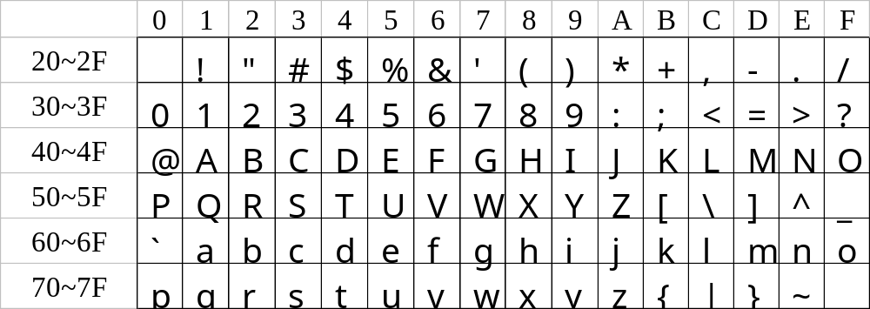
ASCII

Slide 30
Character Types
A variable of type char can be assigned any single character:
char ch;
ch = 'a'; /* lower-case a */
ch = 'A'; /* upper-case A */
ch = '2'; /* two */
ch = ' '; /* space */
Notice that character constants are enclosed in single quotes, not double quotes.

Slide 31



Character Types
char: 1 byte
  each symbol is represented by a number
    'a': 97 = 0x61 = (0110 0001)₂
    '$': 36 = 0x24 = (0010 0100)₂
    '6': 54 = 0x36 = (0011 0110)₂
  special characters
    ' ': 32 = 0x20 = (0010 0000)₂
    '\n': 10 = 0x0a = (0000 1010)₂
    '\t': 9 = 0x09 = (0000 1001)₂

Slide 32
Operations on Characters
When a character appears in a computation, C uses its integer value.
Consider the following examples, which assume the ASCII character set:
char ch; int i;
i = 'a'; /* i is now 97 */
ch = 65; /* ch is now 'A' */
ch = ch + 1; /* ch is now 'B' */
ch++; /* ch is now 'C' */

Slide 33
Operations on Characters
The fact that characters have the same properties as numbers has advantages.
1. Characters can be compared in an if statement:
  if ('a' <= ch && ch <= 'z')
  printf("Yes a lower case letter.\n");
2. It is easy to write a for statement whose control variable steps through all the upper-case letters:
  for (ch = 'A'; ch <= 'Z'; ch++)
  ......

Slide 34
Operations on Characters
Disadvantages of treating characters as numbers:
  Can lead to errors that won’t be caught by the compiler.
  Allows meaningless expressions such as
  'a' * 'b' / 'c' .
  Can hamper portability, since programs may rely on assumptions about the underlying character set.

Slide 35
Character (Cont.)
More examples:
  Obtain rank of an alphabet
    'A': 'A' – 'A' = 65 – 65 = 0
    'C': 'C' – 'A' = 67 – 65 = 2
  Obtain the number of a digit
    '7': '7' – '0' = 55 – 48 = 7
  Change case
    ch = 'd';
    ch = ch – 'a' + 'A';
= 100 – 97 + 65 = 68
= 'D' (change to upper case)

Slide 36
Character Types
Two character types:
  unsigned char: 0 ~ 2⁸-1 ( 0 ~ 255)
  signed char: -2⁷ ~ 2⁷-1 (-128 ~ 127)
Some compilers treat char as a signed type, while others treat it as an unsigned type.

Slide 37
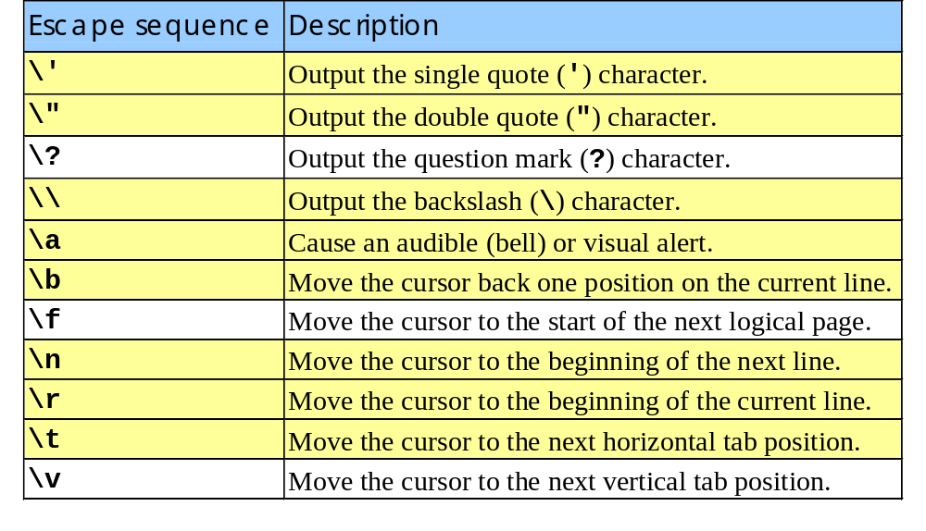
7.3 Escape Sequences

Slide 38
Escape Sequences
An octal escape sequence consists of the \ character followed by an octal number with at most three digits, such as \33 or \033.
A hexadecimal escape sequence consists of \x followed by a hexadecimal number, such as \x1b or \x1B.
The x must be in lower case, but the hex digits can be upper or lower case.

Slide 39
Reading and Writing Characters
#include <stdio.h>
int main()
{
char ch='B'; // assign a value to char
printf("原先是：%c\n", ch);
scanf("%c", &ch);
return 0;
}
原先是：B
_

Slide 40
Using getchar and putchar
putchar() writes a character:
putchar(ch);
Each time getchar() is called, it reads one character, which it returns:
ch = getchar();
getchar() returns an int value rather than a char value, so ch will often have type int.
Like scanf(), getchar() doesn’t skip white-space characters as it reads.

Slide 41
Using getchar and putchar
Consider the scanf loop that we used to skip the rest of an input line:
do {
scanf("%c", &ch);
} while (ch != '\n');
Rewriting this loop using getchar gives us the following:
do {
ch = getchar();
} while (ch != '\n');

Slide 42
Using getchar and putchar
Moving the call of getchar into the controlling expression allows us to condense the loop:
while ((ch = getchar()) != '\n')
;
The ch variable isn’t even needed; we can just compare the return value of getchar with the new-line character:
while (getchar() != '\n')
;

Slide 43
Using getchar and putchar
getchar is useful in loops that skip characters as well as loops that search for characters.
A statement that uses getchar to skip an indefinite number of blank characters:
while ((ch = getchar()) == ' ')
;
When the loop terminates, ch will contain the first nonblank character that getchar encountered.

Slide 44
Using getchar and putchar
Be careful when mixing getchar and scanf.
scanf has a tendency to leave behind characters that it has “peeked” at but not read, including the new-line character:
printf("Enter an integer: ");
scanf("%d", &i);
printf("Enter a command: ");
command = getchar();
scanf will leave behind any characters that weren’t consumed during the reading of i, including (but not limited to) the new-line character.
getchar will fetch the first leftover character.

Slide 45
Program: Determining the
Length of a Message
The length.c program displays the length of a message entered by the user:
Enter a message: Brevity is the soul of wit.
Your message was 27 character(s) long.
The length includes spaces and punctuation, but not the new-line character at the end of the message.
We could use either scanf or getchar to read characters; most C programmers would choose getchar.
length2.c is a shorter program that eliminates the variable used to store the character read by getchar.

Slide 46
length.c
char ch;
int len = 0;
printf("Enter a message: ");
ch = getchar();
while (ch != '\n') {
len++;
ch = getchar();
}
printf("Your message was %d \ character(s) long.\n", len);

Slide 47
length2.c
int len = 0;
printf("Enter a message: ");
while (getchar() != '\n')
len++;
printf("Your message was %d \ character(s) long.\n", len);

Slide 48

Boolean (布林)
bool: 1 byte
  false: 0
  true: any non-zero number
void main()
{
bool a;
a = (3 > 5);
if (a)
printf("3 is greater than 5.\n");
}

Slide 49
7.4 Type Conversion
C allows the basic types to be mixed in expressions.
If variables or constants in an expression do not have the same type, type conversion is performed automatically (implicit conversion).
More cases of implicit conversions are about function calls (see Chap 9).

Slide 50
The Usual Arithmetic Conversion
For arithmetic, relational and equality operators:
If two operands of an operator do not have the same type, the narrower type will be converted into the wider type.
  E.g.
  3 + 5.0
  // 3 will be converted into double
  // before addition

Slide 51
The Usual Arithmetic Conversion
Type conversion diagram
  1. If one of the operand is a floating type
long double
↑
double
↑
float

Slide 52
The Usual Arithmetic Conversion
Type conversion diagram
  2. If neither of the operand is a floating type
unsigned
↑
signed
long int
↑
int
↑
short int, char
(Always converted)

Slide 53
Example of the Usual Arithmetic Conversions
char c;
short int s;
int i;
unsigned int u;
long int l;
unsigned long int ul;
float f;
double d;
long double ld;
i = i + c; /* c is converted to int */
i = i + s; /* s is converted to int */
u = u + i; /* i is converted to unsigned int */
l = l + u; /* u is converted to long int */
ul = ul + l; /* l is converted to unsigned long int */
f = f + ul; /* ul is converted to float */
d = d + f; /* f is converted to double */
ld = ld + d; /* d is converted to long double */

Slide 54
More Example of the Usual Arithmetic Conversions
int i;
unsigned int u;
long int l;
unsigned long int ul;
bool b;
i = -1;
u = 10;
l = 100;
ul = l + u;
/* both l and u are converted to unsigned long int */
b = i < u;
/* i is converted to unsigned long int */
/* the value is no longer -1 */
/* b is false now! */

Slide 55
Conversion During Assignment
The expression on the right side is converted to the type of the variable on the left side.
  E.g.
  double d = 3;
  // 3 will be converted into double
  // before assignment

Slide 56
Conversion During Assignment
Conversion yields no error if the variable's type is as "wide" as the expression:
char c;
int i;
float f;
double d;
i = c; /* c is converted to int */
f = i; /* i is converted to float */
d = f; /* f is converted to double */

Slide 57
Conversion During Assignment
"Narrowing" assignments are problematic:
  char c;
  int i;
  float f;
  i = 842.97; /* i is now 842 */
  i = -842.97; /* i is now -842 */
  c = 10000; /*** WRONG ***/
  i = 1.0e20; /*** WRONG ***/
  f = 1.0e100; /*** WRONG ***/

Slide 58
Type Conversion
Examples
  int total = 378;
  float new_total = total + 120;
  float average = total / 10.0;
  double my_avg = average;
  int k = 'm' - 'b'; // 11
  char ch = 'm' + 3; // 'p'

Slide 59
Casting
Although C’s implicit conversions are convenient, we sometimes need a greater degree of control over type conversion.
For this reason, C provides casts.
A cast expression has the form
( type-name ) expression
type-name specifies the type to which the expression should be converted.

Slide 60
Casting
Using a cast expression to compute the fractional part of a float value:
float f, frac_part;
frac_part = f - (int) f;
Cast expressions enable us to document type conversions that would take place anyway:
i = (int) f;
/* f is converted to int */

Slide 61
Casting
integer to floating type
  int total=378, count=10;
  float average = total/count; //得到錯誤答案
    convert the result to type float after division
  float average = (float)total/count; //正確
    convert total to type float first before division
  float average= (float)(total/count);//錯誤
    convert the result to type float after division
average=37.000000
average=37.800000
average=37.000000

