Slide 1
Input/Ouput
Chap 22

Slide 2

22.1 Streams
Stream means any source of input or any destination for output.
A file pointer is used to access a stream.
  FILE *fp1, *fp2;
Standard streams

Slide 3
Opening a File (22.2)
Syntax:
FILE *filePtr = fopen(fileName, mode);
  filePtr is a variable of a file pointer, a pointer to a FILE-structure object.
  mode: read (讀檔), write (寫檔), append (追加);
  text (文字檔), binary 檔. (See next page)
Ex:
FILE *fptr = fopen("mydata.txt", "r");
if (fptr == NULL){ >< ! and exit; }

Slide 4
Opening a File
mode in fopen():
  "r":
    If the file does not exit, file opening fails;
    Otherwise open it.
  "w":
    If the file exists, current content will be discarded;
    If the directory in the file name does not exist,
    file opening fails;
    Otherwise, create a new file for writing.

Slide 5
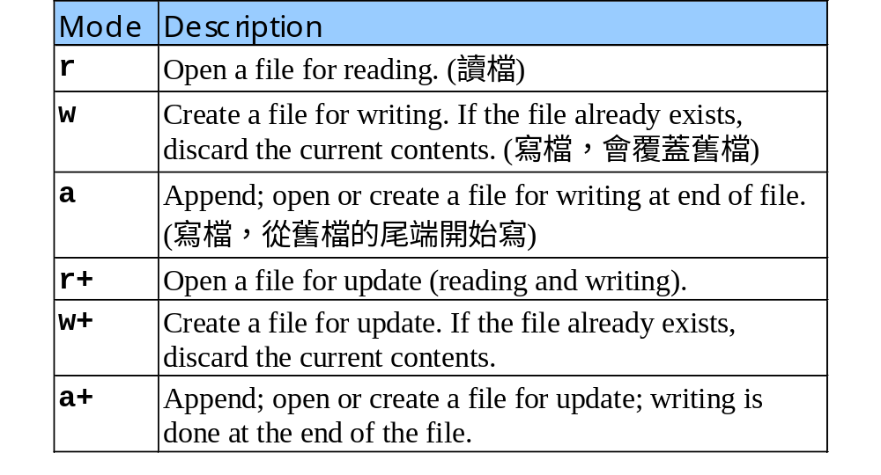
Opening a File
Table of file open modes (開啟模式):

Slide 6
Opening a File
ASCII mode (純文字模式):
  fopen()預設是 ASCII 模式
  讀入 DOS 換行符號 "\r\n" (\x0d0a) 時，會自動改成 '\n'
  寫出 '\n'時也會改為 "\r\n"
  '\0' 會被視為字串結尾
Binary mode:
  在 fopen()中以 "rb", "wb", etc. 開啟檔案
  影片檔、圖片檔、甚至 MSWord檔都應該以 binary 格式存取。

Slide 7
Opening a File
fopen()
  On failure, fopen()returns NULL.
    It is a good habit to check if the return value is NULL whenever you open a file.
    Ex:
    FILE *fptr = fopen("mydata.txt", "r");
    if (fptr == NULL){
    printf("開檔失敗\n");
    exit(0);
    }

Slide 8
Closing a File (22.2)
Syntax:
fclose(FILE * filePtr);
  Ex:
  FILE *fptr = fopen("mydata.txt", "r");
  if (fptr == NULL){ >< ! }
  // handling files here, then...
  fclose(fptr);
  fclose()returns memory allocated for this file pointer
  If you open too many (>= 31 or so) files without closing it, your program will crash.

Slide 9
Checking end-of-file (22.2)
Syntax:
feof(FILE * filePtr);
  Returns true if the end-of-file indicator of the stream for this file pointer is set.

Slide 10
22.3 Formatted I/O
fscanf(FILE *fptr, …scanf-params… )
  Same format and usage as scanf(), but its first parameter is a FILE pointer and the input comes from this file.
fprintf(FILE *fptr, …printf-params…)
  Same format and usage as printf(), but its first parameter is a FILE pointer and the output is stored in this file.

Slide 11
22.4 Character I/O
fgetc(FILE *fptr)
  Read in one chatacter from a file.
  You should check end of file by yourself by using feof().
  fgetc(stdin) equals getchar()
fputc(int ch,FILE *fptr)
  Write a character into a file.
  fputc('a',stdout) equals putchar('a')

Slide 12
22.5 Line I/O
fgets(char *str, int size, FILE *fptr)
  Read in one line from a file.
  If end-of-file is found, returns NULL.
Ex:
char buf[1000];
while (fgets(buf, sizeof(buf), fptr)!= NULL){
// buf 是新讀入的一行文字
}
fputs(const char *str, FILE *fptr)
  Write a line into a file.

Slide 13
22.6 Block I/O
Reading or writing a block of data into a file at one time.
  fread()
  fwrite()
Especially useful for handling binary files

Slide 14
Block I/O
fread(const void *buffer, size_t size, size_t count, FILE *fptr)
  Reading data from a file into a buffer.
  count: number of data; size: size of each datum
  Ex:
  int a[30], k; FILE *fptr; ...
  // 讀一筆整數資料到一個整數變數
  fread(&k, sizeof(int), 1, fptr);
  // 一次讀 30 筆整數資料到一個整數陣列
  fread(a, sizeof(int), 30, fptr);

Slide 15
範例
  int k; FILE *fptr; ...
  fread(&k, sizeof(int), 1, fptr);
  // k 的值就會變成 (00 00 01 02)₂=258
  // 注意x86 機器儲存 bytes 的順序是 low byte 在前面，high byte 在後面
fptr 所開檔案
02 01 00 00 a1 00 00 00
00 00 8C 45 00 77 EF DD
.......................

Slide 16
Block I/O
fwrite(const void *buffer, size_t size, size_t count, FILE *fptr)
  Write data into a file.
  count: number of data; size: size of each datum
  Ex:
  int a[30], k; FILE *fptr; ...
  // 將一個整數變數資料寫到檔案
  fwrite(&k, sizeof(int), 1, fptr);
  // 一次將 30 筆陣列中的整數資料寫到檔案
  fwrite(a, sizeof(int), 30, fptr);

Slide 17
22.7 File Positioning
fseek(FILE *fptr, int offset, seek_const)
  將檔案讀取位置移至指定位置
    seek_const 可設為
    SEEK_SET –移至檔頭算來 offset 的位置
    SEEK_CUR –移至目前位置再往後 offset 的位置
    SEEK_END –移至檔尾算來 offset 的位置
  offset 單位是 bytes，offset<0 表往回的相對位置
rewind( FILE *fptr )
  將檔案讀取位置歸零
int ftell( FILE *fptr )
  傳回目前檔案讀取位置

Slide 18
Ex: 取得檔案大小
FILE *fptr = fopen(yourFile,"rb");
fseek(fptr, 0, SEEK_END);
// 將檔案讀取位置調到檔案結尾處
int fsize = ftell(fptr);
// 這時的檔案讀取位置相當於檔案大小
rewind(fptr);
// 記得將檔案讀取位置設回開始位置
// 以便從頭讀取

Slide 19
Practice – Read File into Memory
FILE *fptr = fopen(yourFile,"rb");
if (fptr == NULL) { ><! exit }
fseek(fptr, 0, SEEK_END);//move to the end
int fsize = ftell(fptr);
rewind(fptr); // move to the beginning
char *docp = (char *)malloc(fsize + 1);
if (docp == NULL) { ><! exit }
fread(docp, fsize, 1, fptr);
docp[fsize] = ‘\0’;
fclose(fptr);

