Slide 1
UFOS The Truth Is Out There
Siddharth Padture

Slide 2
Data Sources
89723 distinct reports of UFOs scraped from the National UFO Reporting Center (http://www.nuforc.org/) dating from 1900-2014
Airport location data acquired from http://openflights.org/

Slide 3
Data Description and Facts
Mean Duration: 2 minutes 46 seconds
Most common descriptors: ‘Lights’, ‘Triangle’, ‘Circle’
Most often sighted at night
Seattle, WA has the highest number of sightings, but California has the highest of any state

Slide 4
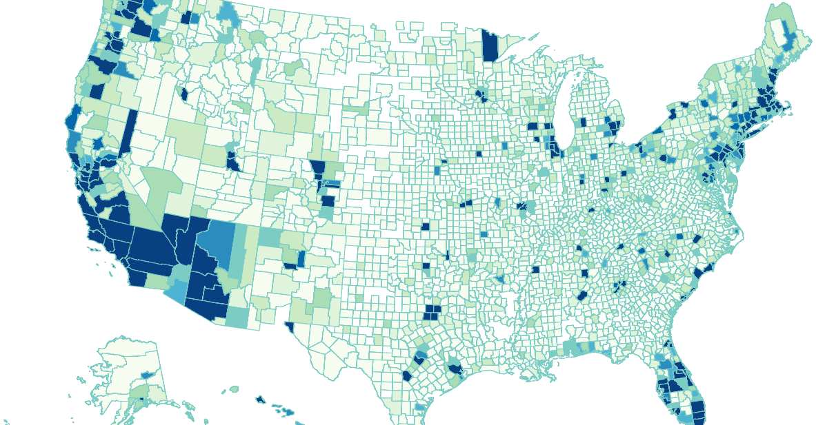
Frequency of Sightings by County

Slide 5
Hypothesis
Frequency of UFO reports will have a negative relationship with the distance to the nearest airport.

Slide 6
Investigation
For each distinct location in the dataset the distance to the nearest airport was computed.
Only locations with a sighting frequency >1 were admitted to the analysis to clarify results.
A linear regression model was trained and fitted to the data to draw a conclusion.

Slide 7
Results and Conclusion
The regression analysis confirms an inverse relationship between frequency of UFO sightings and the distance to the nearest airport.
Coefficent: -14.47
Residual Sum of Squares: 203.46
However, the proportion of variance explained by this regression is quite low at ~0.03
This leads to the conclusion that distance to airport is a minor, though statistically significant, factor in how many UFOs are reported from a given location

Slide 8
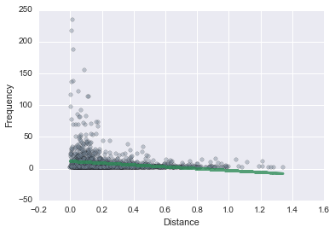
Frequency of Reports by Distance to Nearest Airport with Predicted Fit

Slide 9
Other Data Sources
Location names converted to coordinates with data from OpenStreetMap
FIPS county codes retrieved from FCC Census Block API

