Slide 1
Business Intelligence
Pooja Singh
Prabesh ADhikari

Slide 2
What is BI?
Component of business analytics
Cumulative outcome of organization's data, software, infrastructure, business process and human intuition in the form of reports, dashboards

Slide 3
Business intelligence
Business Analytics
Concerned with how insights are consumed or delivered to support decision making
Uses historical data to understand and make decisions on current business operations
Process of finding insights
Tends to used data to predict future trends and opportunites

Slide 4
Points of consider for choosing BI
Features
Different features depending on industry, specialization and target market
Reviews
Feedback form other customers
Demos
Demo or free trial to evaluate suitability
Cost

Slide 5
BI Vendors
Qlik
Tableau
Sisense
Domo
MS Power BI
Looker
Zoho Analytics
Alteryx

Slide 6
Alteryx
American based computer software company
Products used for data science and analytics
Software designed to make advanced analytics automation accessible
Perform complex tasks such as predictive modelling, geospatial analysis and advance reporting
Primarily focused on advanced analytics

Slide 7
Key Function
Data Blending: combining data from multiple sources
Predictive analysis: using machine learning algorithms
Reporting and visualization: interactive dashboards and reports

Slide 8
How it works
Follows a drag and drop design
Selecting tools for connecting together in a logical flow
Uses Alteryx Designer, a intuitive visual language

Slide 9
Core Features
Data Analytics Automation
Data Presentation Capabilities
Automated Workflows
Predictive modelling
Geospatial Analysis
User Friendly Interface

Slide 10
Benefits
Increased efficiency
Improved data quality
Cost savings

Slide 11
Use Cases
Real-world scenarios
Retail, finance, healthcare, marketing, etc.
Data analysts, Business analysts, Data scientists, etc uses BI

Slide 12
Conclusion
Powerful platform for making sense of data, automating workflows
User friendly, advanced features, and ability to handle large data sets

Slide 13
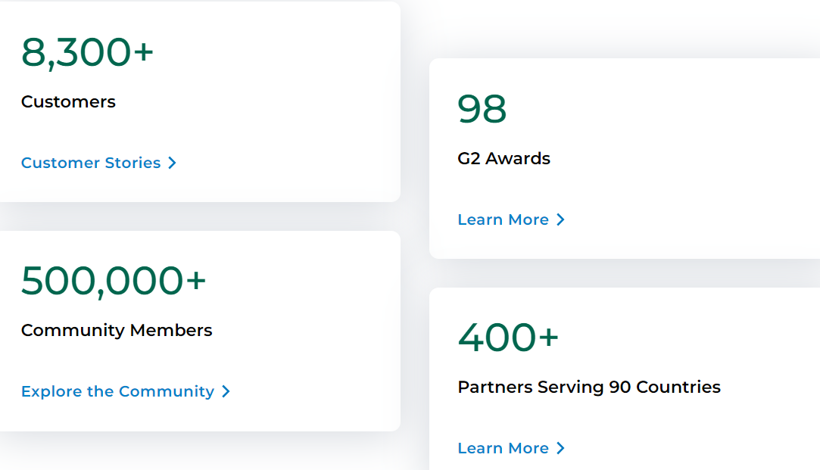

Slide 14
References
https://www.alteryx.com/
https://www.datacamp.com/blog/what-is-alteryx-introductory-guide

