Slide 1

PIVOTING
Prabesh ADHIKARI

Slide 2
Introduction
Strategic move where company switches its focus to respond market changes, customer demands, or unforeseen challenges.
Main idea:
To recognize the initial business model, product, or strategy might not be yielding desired results
Rather than sticking to original plan, performing successful pivot allows to adjust their course while building on their existing strengths.
Encourages flexibility and fosters a culture of innovation, positioning businesses to seize new opportunities and tackle emerging threats proactively.

Slide 3
Process to change company’s direction when current strategy is not producing desired results
Involves strategic change of business model, product, or target market
Creates opportunities for overcoming emerging challenges e.g. market changes, customer demands, unforeseen challenges,
Might be challenging and risky process but also rewarding and necessary
e.g. adapting product, market, or strategy to changing customer need, competitive pressures, new opportunities

Slide 4
Tool allowing users to perform same function as chart, but in simpler way
Four Main Parts
Values
Rows
Columns
Filters
Main idea to recognize initial business, model, product or strategy
Enables to rearrange columns and rows for viewing data in different perspectives

Slide 5
Types
Product Pivot: → Changing features, functionality, target audience of an existing product to better meet market demands
Market Pivot → Takes existing product and starts targeting new customer segment or industry
Technology Pivot → Adapting core technology or expertise to address a different problem or industry
Business Model Pivot → Fundamental change in generating revenue
Geographic Pivot → Expanding or contracting its geographic scope of operations to explore new markets or consolidate existing ones.

Slide 6
How to know if pivoting is needed?
Recognize the signs→ Current idea not getting momentum
Conduct candid evaluation → Make sure team’s skill and interests match new direction
Fear not pivoting → Avoid being attached to a failing idea and be willing to iterate and experiment
Iterate carefully → Avoid hasty decisions based on momentary setbacks
Leverage your teams expertise → Pivoting needs cohesive and agile team. Prioritize communication and collaboration on group

Slide 7
How to Pivot Effectively?
Do as soon as you can
Pick new goals to align with your vision
Don’t scrap that work you’ve already done
Listen to your customers
Develop a pivot plan
Make sure pivot presents opportunities for growth
Communicate the pivot
Monitor and revise

Slide 8
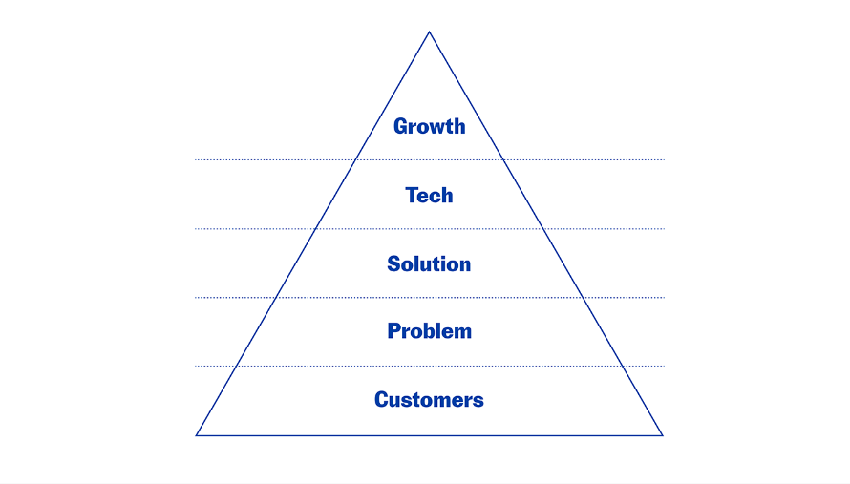
Five Main Pivoting Areas
Source: Selcuk Atli,
CEO AND Co-founder, Bunch

Slide 9
To sum up
Data Transformation – Restructuring of data to wide format
Changing Perspectives – Changing the way of viewing data
Aggregation – Aggregating data in one or more dimension
Enhancing Visualization – Allows users to display data in different ways
Facilitating Analysis – Quickly explore different dimension and identify trends, patterns an outliers
Dynamic Reporting – Allows interactive exploration of data

Slide 10
Examples
Sales Analysis
Financial Reporting
Inventory Management
Social Media Analysis
Market Analysis
Employee Performance

Slide 11
Quick note
Entrepreneurship is hard
Startup is high uncertain
Difficult to clearly identify a universal moment
Changing of strategy at right moment pays you
First aspect must be to look overall customer satisfaction

Slide 12
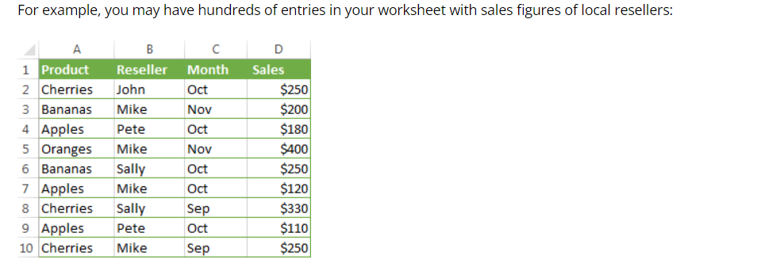
Demo

Slide 13
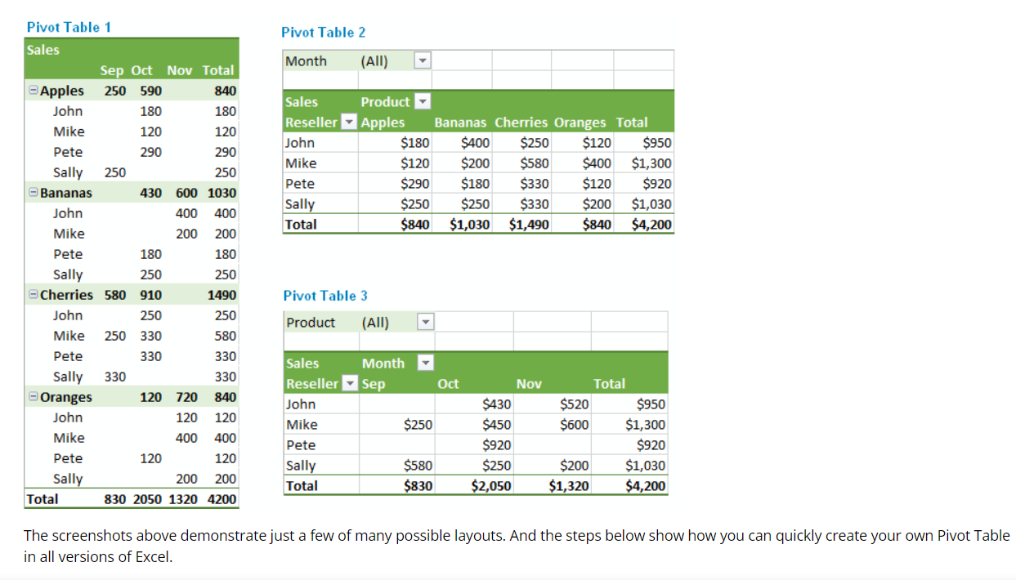

Slide 14


Slide 15
Reference
https://www.rst.software/blog/effective-business-pivoting-101-when-why-and-how#:~:text=The%20idea%20of%20pivoting%20is,building%20on%20their%20existing%20strengths
https://fi.co/insight/what-pivoting-is-when-to-pivot-and-how-to-pivot-effectively#:~:text=In%20business%2C%20pivoting%20is%20a,%2C%20product%2C%20or%20target%20market
https://www.merriam-webster.com/dictionary/pivot#

