Slide 1
Clean and relevant open public data
How difficult can it be?
CORDIS - COmmunity Research & Development Information Service
@the Publications Office of the European Union (OP)
Baya Remaoun - Open Data Fest – 2 June 2017 – Caltanissetta, Italy

Slide 2
What's CORDIS?
  CORDIS is the European Commission's primary public repository and portal for (almost) all EU-funded research projects and results
  Commission (Research & Innovation DG) service operated at the OP (interinstitutional)
  OP more data oriented (metadata registry, controlled vocabularies, thesauri, open data portal etc.)
  Over 114 000 projects from FP1 to Horizon 2020
  During FP4-FP7: web services, applications, other databases, calls
  Horizon 2020: return focus to dissemination of research results

Slide 3

What's on CORDIS?
  Two main pillars:
  Data: open and reusable access to public information on EU-funded projects and results held by the European Commission, e.g. project factsheets, report summaries
    Human resources: 1 business + 1 technical ± 4 external contract
  Editorial: multilingual value-added products to support dissemination and exploitation of EU-funded research results, e.g. "Results in Brief", "Results Packs", research*eu magazines
    Human resources: 4 business ± 20 external contract
  Target audiences:
  Enterprise and industry – new products and technologies
  Researchers – scientific breakthroughs
  Policy makers – guidelines and recommendations

Slide 4

What's not on CORDIS?
  After two decades of web activity…
  Participant Portal: H2020 (FP7) calls, documents, registration, proposal submission, evaluation, experts, grant management…
    Partners: will move to Participant Portal
  Europa and co: web pages for policy, themes, general public
    Digital Transformation ongoing
  Output of research grants : (open access) publications, research data, project websites, grey literature…
    not owned by EC so we can only capture links
  Certain parts of research programmes, e.g. JRC, EIT, some JUs

Slide 5

How is CORDIS managed?
  H2020 Common Support Centre in DG Research & Innovation (RTD): provides guidance and coordination, Partnership Agreement with OP
  CSC represents the "research family":
    DGs: AGRI, CNECT, EAC, ENER, GROW, HOME, MOVE, RTD
    Agencies: EASME, ERCEA, INEA, REA, GSA
    Joint Undertakings: BBI, Clean Sky, ECSEL, FCH, IMI, SESAR, Shift2rail

Slide 6
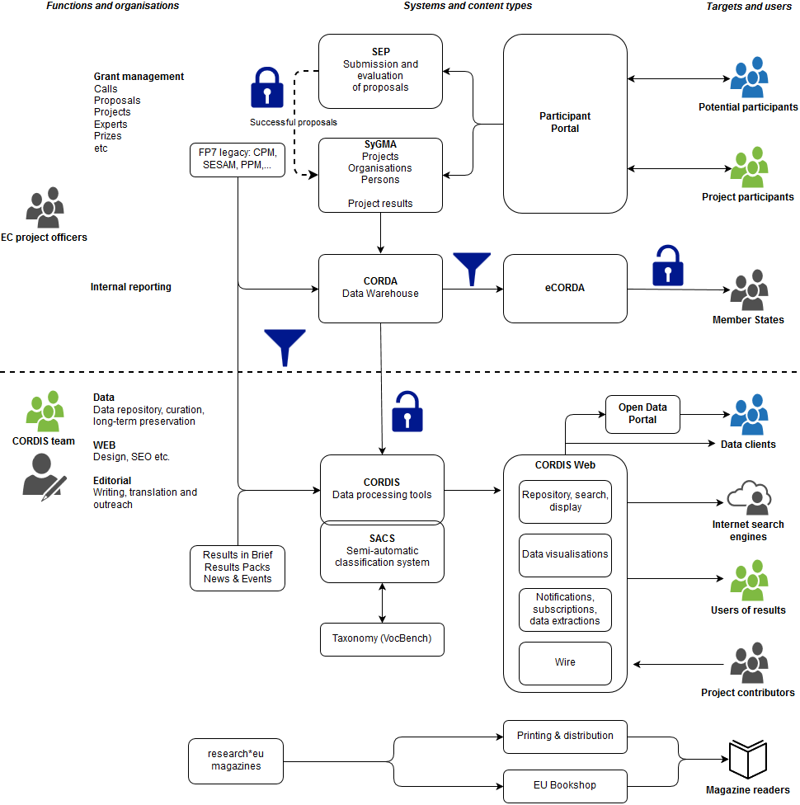
From internal EC systems to users

Slide 7
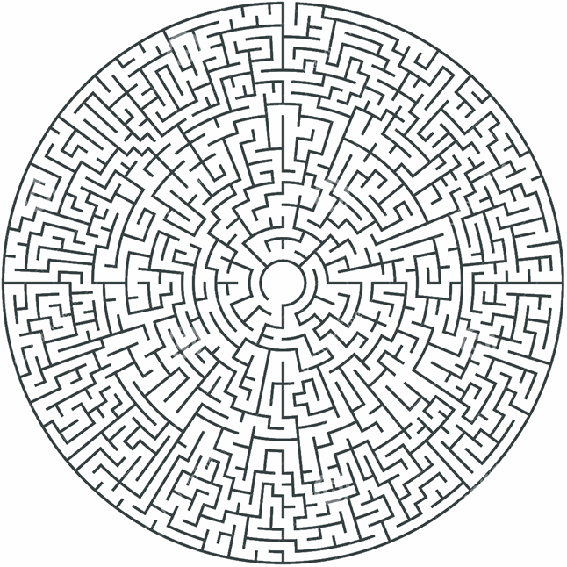
CORDIS evolution
Until 2011/2012
Mostly entry point for project participants
Focus on:
  Calls
  Reference documents
  Policy documents and webpages
  Partners
  Etc.
Multiple applications/databases
➔Data as support only - taken for granted

Slide 8
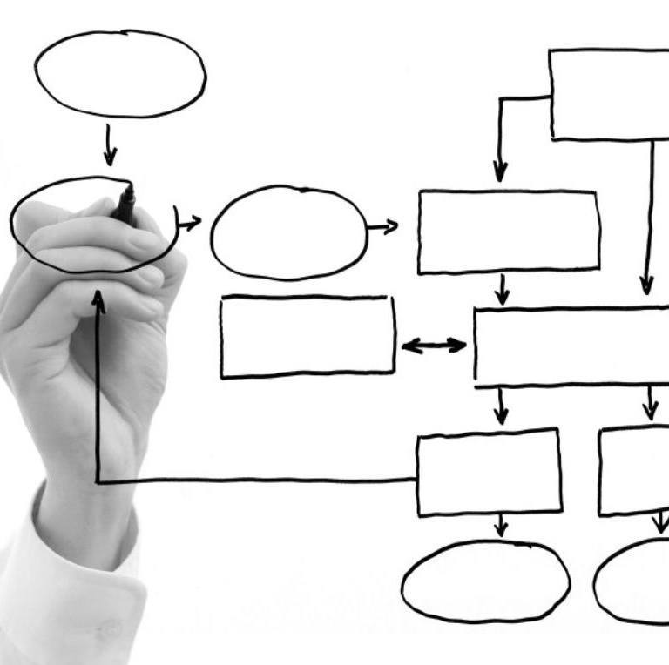
CORDIS evolution
After 2011/2012:
Information/applications on project participation
moved to Participants portal
Thematic and other 20+ years of static pages
were archived (completed in 2017)
Migration of technical platform, data-model
and redevelopment of web applications
Structured content – ongoing work:
➔Understand & document
➔Obtain additional data
➔Re-structure
The EU Open Data Portal was created in 2012 (1st CORDIS dataset: 2013)

Slide 9
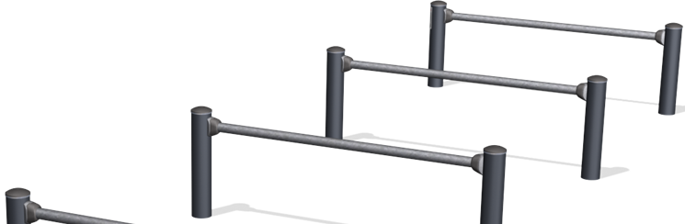
CORDIS constraints
Internally Commission treats each FP separately
  CORDIS needs to harmonise over all FPs
  Source systems not conceived to collect data to be exposed externally
  Data quality issues
  OP outside the "research family"
  ➔Less understanding of business needs and political context

Slide 10
In the meantime at the European Commission…
EC open data policy became important around 2011, but...
  EC data operations and quality were/are still taken for granted
Simplification of the procedures for participation and grant management ➔ H2020
Corporate data, information and knowledge management policy at the European Commission decided in 2016 (C(2016) 6626 final) to:
  Improve information retrieval and delivery
  Work together and share information and knowledge
  Maximise use of data for better policy-making
  Create a culture of knowledge sharing and learning

Slide 11

What's next for CORDIS?
  New call for tender: specific lot for data management
  Better communication with data sources raising awareness
  Thematic taxonomy (text mining, align with EuroVoc) and Linked Open Data
  Better search, greater possibilities for users to extract data

Slide 12

Thank you for your attention!
Any questions…?
cordis@publications.europa.eu
@CORDIS_EU
cordis.europa.eu

