Slide 1
LA MIA APPLICAZIONE E’ LENTA: E ADESSO?
Gianluca Sartori

Slide 2


Un ringraziamento agli sponsor

Slide 3
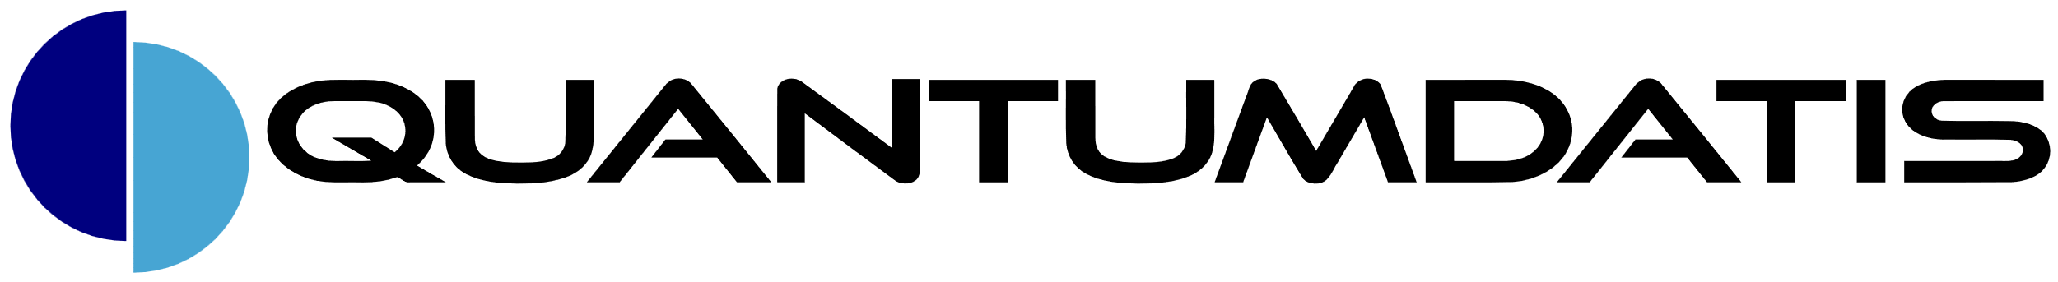



Gianluca Sartori
Founder at Quantumdatis
Data Platform MVP
Works with SQL Server since version 7
DBA @ Scuderia Ferrari
Blog: spaghettidba.com
Twitter: @spaghettidba

Slide 4
Agenda
A performance tuning methodology
How to perform a Health Check
What to collect
How to collect
Tuning Performance

Slide 5
A performance tuning methodology

Slide 6
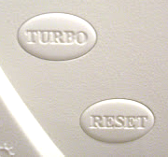
Why a methodology?
SQL Server is a complex product
Many levers to pull
No easy turbo button
It is easy to get overwhelmed
Needs a reproducible methodology
Mere guidelines, you can use your own method

Slide 7
Health Check
Best Practices
Capture Data
Analyze Data
Action Plan
Repeat Regularly
Implement in Production
Test Modifications
In Test Environment
Performance Baseline

Slide 8

Capture Data
Data about the “patient”
Windows
Version
Hardware
CPU
RAM
Disk
SQL Server
Version
Configuration options
Number and size of databases
Files placement

Slide 9

Capture Data
What to capture?
Wait Stats
Performance Counters
Dynamic Management Views
Workload Stats

Slide 10
Capture Data – Wait Statistics
Wait Statistics
DMV → sys.dm_os_wait_stats
Computes wait time spent waiting for resources
Cumulative wait time (since instance startup)
Great point to start assessing the situation
Allows to identify issues based on their symptoms
Shows which areas need attention
Not all wait classes are meaningful or performance related

Slide 11
Capture Data – Wait Statistics
Common Wait Classes
Resource | Class | Example
Locking | LCK_* | LCK_M_S LCK_M_X
Latching | LATCH_* PAGELATCH_* | LATCH_EX PAGELATCH_UP
I/O | PAGEIOLATCH_* *_COMPLETION WRITELOG | PAGEIOLATCH_SH IO_COMPLETION ASYNC_IO_COMPLETION
CPU | THREADPOOL SOS_SCHEDULER_YIELD
Network | ASYNC_NETWORK_IO
Parallelism | CXPACKET

Slide 12
Wait Statistics

Slide 13
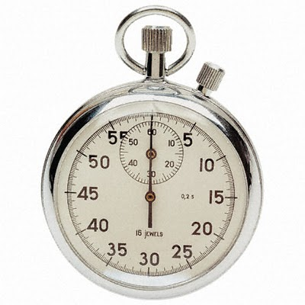
Capture Data – Performance Counters
Performance Counters
Resource specific
CPU
Memory
Disk
SQL Server specific
Batches / sec
Transactions / sec
…
Which performance counters?
586 counters in SQL Server 2019!!!

Slide 14
Performance Counters

Slide 15
Capture Data - DMVs
DMVs
sys.dm_os_... OS information, memory, performance
sys.dm_io_... Disk performance
sys.dm_exec_... Sessions, requests, connections
sys.dm_db… Database info
sys.dm_tran… Transactions, locks
sys.dm_... Audits, broker, CDC, CLR, FileStream,
FTS, HADR, Repl, Resource Governor,
Extended Events
Not all DMVs are about performance

Slide 16
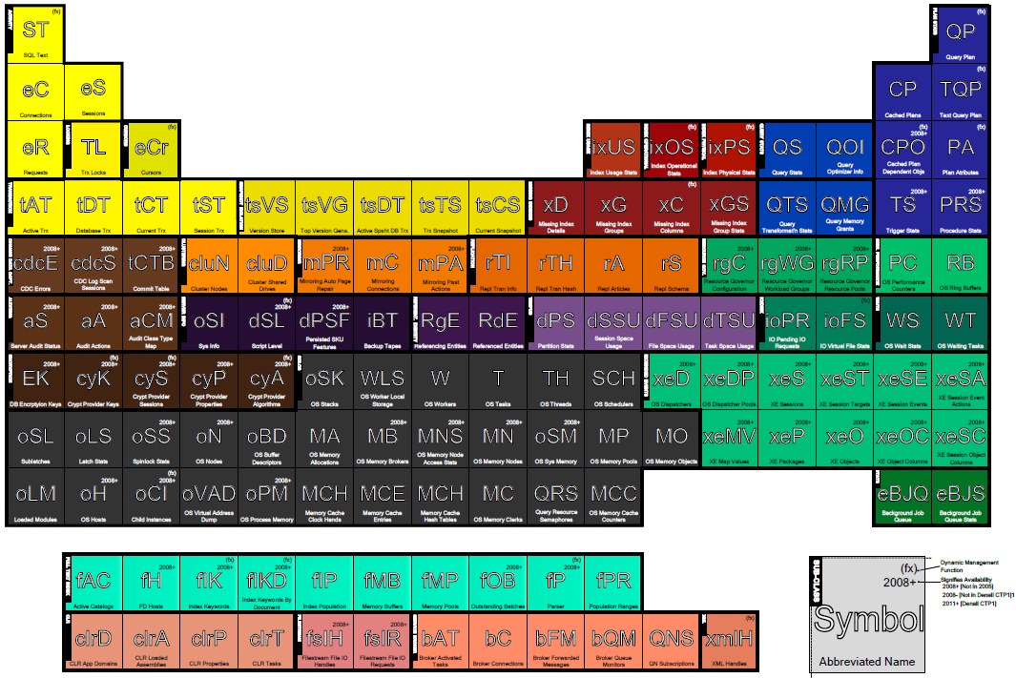
Capture Data - DMVs
Which DMVs?
280 DMVs in SQL Server 2019!!
SELECT name
,type_desc
FROM sys.all_objects
WHERE name LIKE 'dm[_]%'
ORDER BY name

Slide 17
Capture Data - Tools
How do you survive with hundreds of performance counters and DMVs?
Glenn Berry’s Diagnostic Information Queries
https://glennsqlperformance.com/resources/
Brent Ozar’s sp_Blitz
https://github.com/BrentOzarULTD/SQL-Server-First-Responder-Kit

Slide 18
Glenn Berry’s Diagnostic Queries

Slide 19
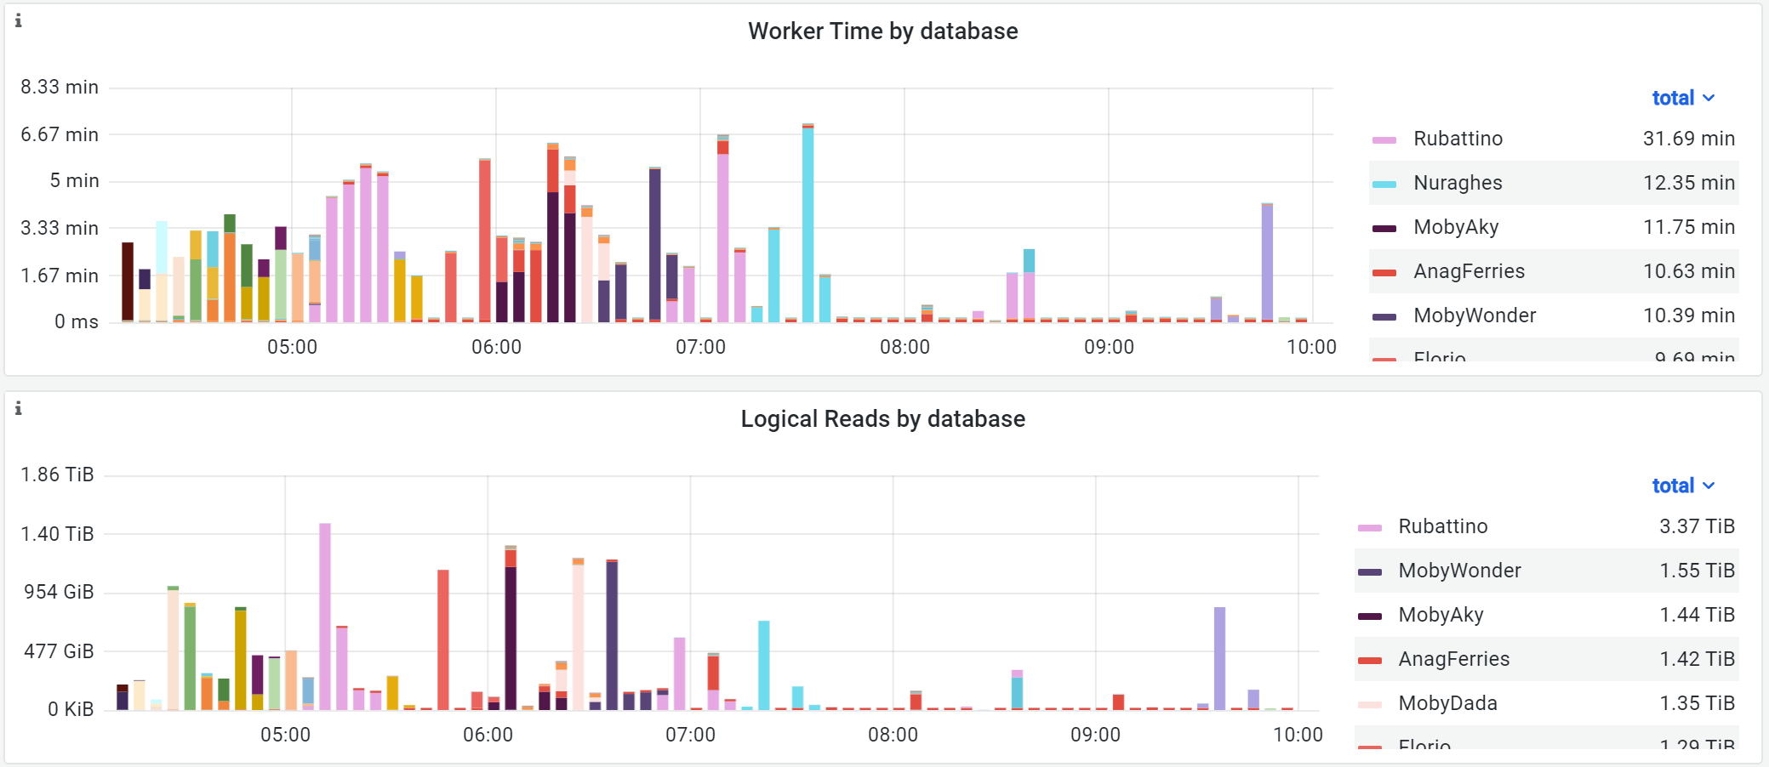
Capture Data – Workload Statistics
Purpose:
Identify resource intensive queries
Aggregate / filter workload by database, application, login…
Tools:
Query Stats
Query Store
SqlTrace
Extended Events

Slide 20
Capture Data – Query Stats
Gives overall description of the server workload
Has been in the product for a very long time (2005 in its current form)
Can be queried with DMVs:
sys.dm_exec_query_stats
sys.dm_exec_...
Lives in the cache
Not persisted
Does not survive server restarts
Not everything is cached (e.g. RECOMPILE)
Cumulative stats since 1° appearance in the cache

Slide 21
Query Stats

Slide 22
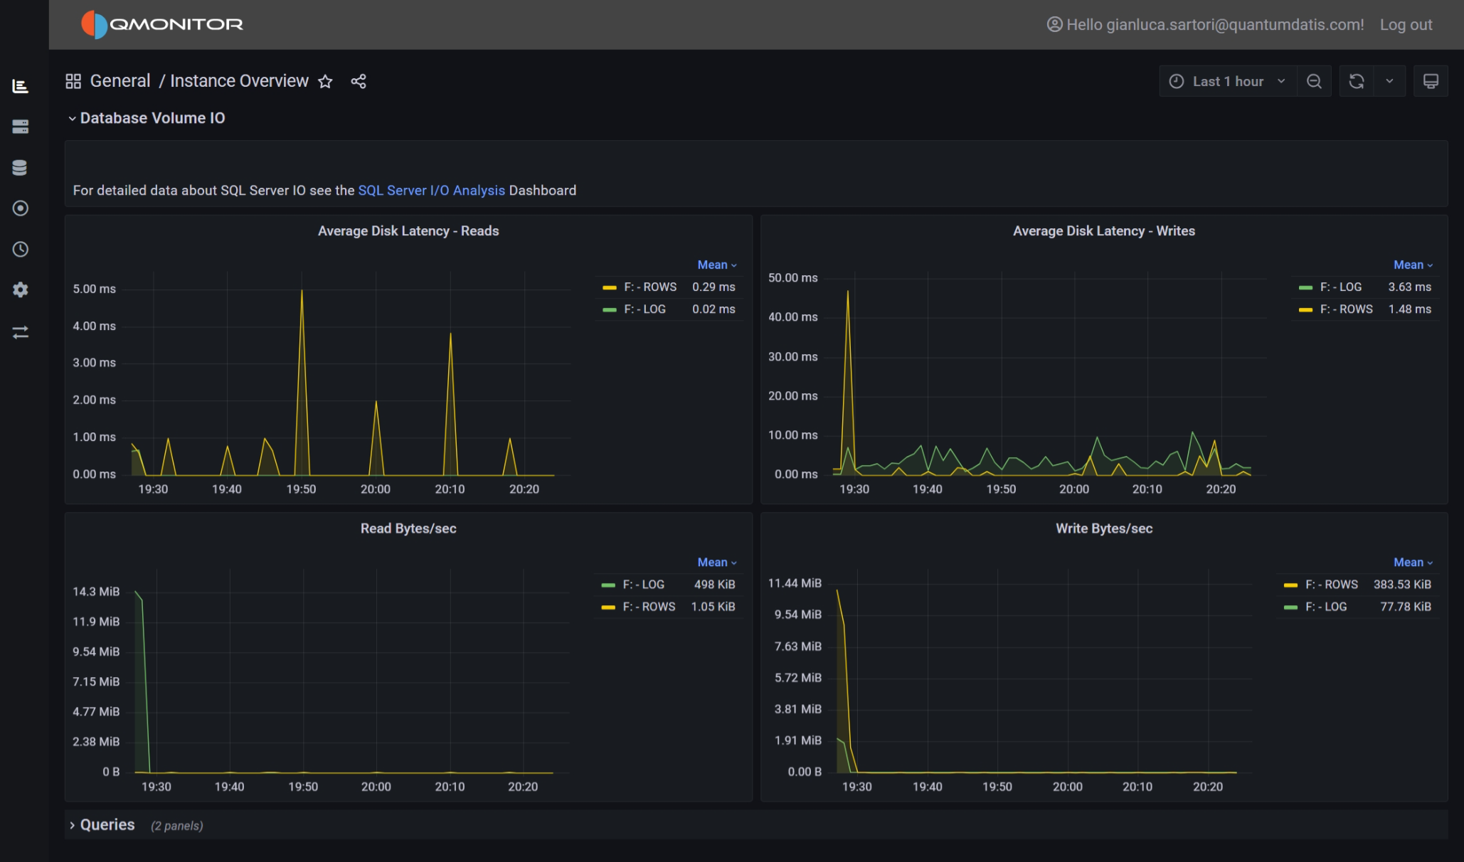
Capture Data - Persistence
Query Stats, Performance Counters, Wait Stats etc… is not persisted
If you want persistence you need a monitoring tool
Example: QMonitor
Cloud based
Lightweight
Web based
Subscription model

Slide 23
Capture Data – Query Store
Gives overall description of the database workload
Since SQL Server 2016
Persisted in the database
Survives server restart
Survives cache flush
Not cumulative, allows time series analysis
Not enabled by default (it is from SQL Server 2022)
Can be disabled
Can’t slice or aggregate by application, login, host…

Slide 24
Query Store

Slide 25
Troubleshooting
SQL Trace / Profiler
Extended Events
Provides events to capture query activity
Provides attributes for fine-grained analysis
Can have noticeable impact on performance
Does not work with Azure SQL Database or Managed Instance
Needs to write data to file / table to analyze
Everything available in SQLTrace and (much) more
Lightweight capture technology
Allows streaming events directly (no need for files)

Slide 26
Troubleshooting - WorkloadTools
Collection of Open Source tools
https://workloadtools.com
Takes care of all aspects of benchmarking
Workload capture
Workload analysis
Workload replay
Works against Azure SQL Database
Can do real-time capture and replay
UNIQUE FEATURES!!!!

Slide 27
WorkloadTools

Slide 28
Tuning Performance

Slide 29
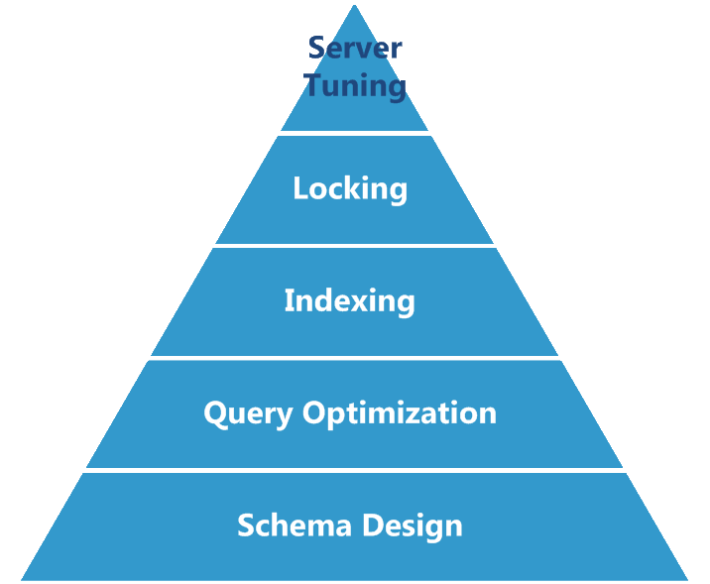
More effective
Easier
GOALS
Reduce Resource Usage
Reduce Waits

Slide 30
Tuning Performance
The performance tuning plan needs a goal
Tuning measures must improve performance
Compared to what?
Performance gains must be measurable
- Compared to what?
Must not introduce regressions
- Compared to what?
BASELINE

Slide 31
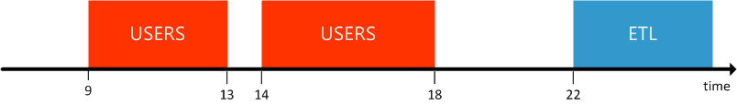
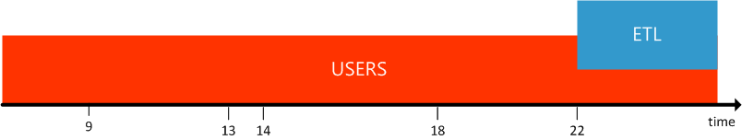
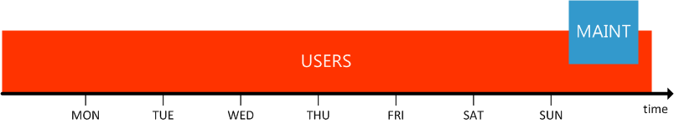
Tuning Performance
Is one baseline enough?

Slide 32
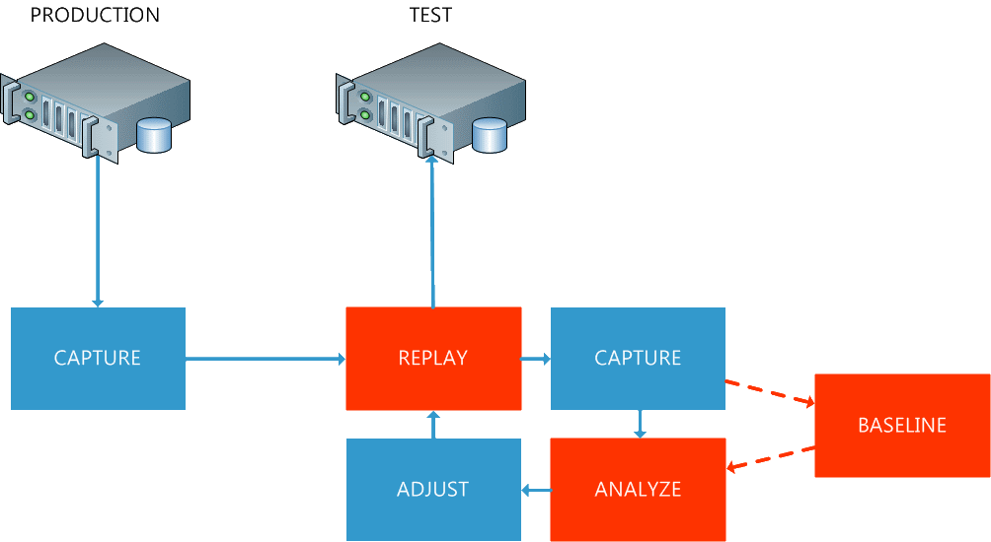
Performance Tuning Cycle

Slide 33
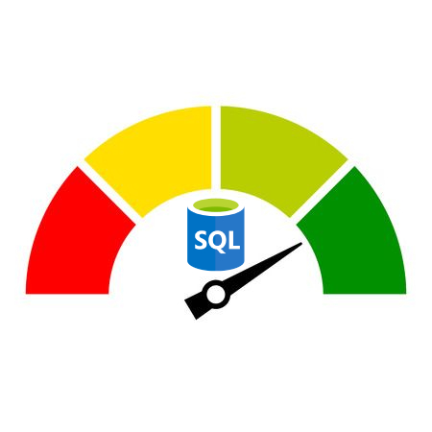
Tuning queries
Goals
Reduce Execution Time
Reduce CPU Time
Reduce Logical Reads
Tools
Estimated Execution Plan
Actual Execution Plan
IO Statistics

Slide 34
Tuning a Query

Slide 35
Resources
WorkloadTools on GitHub
https://github.com/spaghettidba/WorkloadTools
https://github.com/spaghettidba/WorkloadTools/releases
https://github.com/spaghettidba/WorkloadTools/wiki
https://github.com/spaghettidba/WorkloadTools/issues
WorkloadTools blog posts
https://spaghettidba.com/tag/workloadtools/

Slide 36
Resources
Questions? Ask me!
spaghettidba@sqlconsulting.it
Get slides and demos from GitHub:
https://github.com/spaghettidba/CodeSamples

