Slide 1
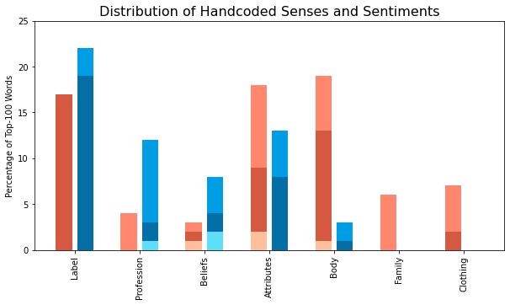

Women
Men
POS
---
NEG

Slide 2

**

