Slide 1
Signal Processing & Systems in Medical Physics
Graduate Medical Physics Program

Slide 2
Module 1: Deterministic Systems
Notes:
Welcome to the first module. We will establish the fundamental mathematical and conceptual toolkit for signal and systems analysis. Pay close attention to the definitions, as they are the building blocks for everything that follows.

Slide 3
Introduction to Signals
What is a signal? A signal is a function that conveys information about a phenomenon.
In medical physics, signals are representations of physical quantities.

Slide 4
Introduction to Signals: Examples
Voltage from a detector
X-ray intensity pattern
Magnetic resonance signal over time
Notes:
A signal is just a function. For example, the temperature in this room over the course of the day is a signal. An MR signal is a function of time. An image is a function of spatial coordinates.

Slide 5
Continuous vs. Discrete Signals
Continuous-Time Signal: Defined for all points in time. Represented as x(t).
Discrete-Time Signal: Defined only at specific, discrete points in time. Represented as x[n].

Slide 6
Continuous vs. Discrete Signals
This distinction is crucial for understanding digital acquisition and processing.
Notes:
Think of a continuous signal as a smooth, unbroken line, like a wave. A discrete signal is a series of individual points, like readings taken every second. Computers can only work with discrete signals.

Slide 7
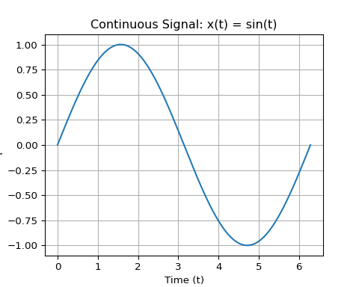
Visualization: Continuous vs. Discrete Code
import numpy as np
import matplotlib.pyplot as plt
# Continuous Signal
t_cont = np.linspace(0, 2 * np.pi, 500)
x_cont = np.sin(t_cont)
# Plot
plt.figure()
plt.plot(t_cont, x_cont)
plt.title("Continuous Signal: x(t) = sin(t)")
plt.xlabel("Time (t)")
plt.ylabel("Amplitude")
plt.grid(True)
continuous_discrete_plot_fig = plt.gcf()

Slide 8
Visualization: Continuous vs. Discrete

Slide 9
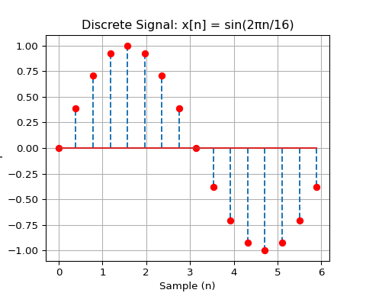
Visualization: Continuous vs. Discrete Code
import numpy as np
import matplotlib.pyplot as plt
# Discrete Signal
n_discrete = np.arange(16)
t_discrete = n_discrete * (2 * np.pi / 16)
x_discrete = np.sin(t_discrete)
# Plot
plt.figure()
(markers, stemlines, baseline) = plt.stem(t_discrete, x_discrete, linefmt='--')
plt.setp(markers, color='red')
## [None]
plt.title("Discrete Signal: x[n] = sin(2πn/16)")
plt.xlabel("Sample (n)")
plt.ylabel("Amplitude")
plt.grid(True)
discrete_plot_fig = plt.gcf()

Slide 10
Visualization: Continuous vs. Discrete
Notes:
On the left, we see the smooth sin(t). On the right, we see samples of that same function. The process of converting from continuous to discrete is called sampling, a topic we will cover in great detail.

Slide 11
Standard Functions in Signal Processing
We use a set of “building block” functions to model and analyze more complex signals.
Understanding these is essential for a deep intuition of systems.

Slide 12
Standard Functions in Signal Processing
Key Functions:
  The Rectangular Function (Rect)

Slide 13
Standard Functions in Signal processing
Key Functions:
  The Sinc Function

Slide 14
Standard Functions in Signal processing
Key Functions:
  The Dirac Delta Function

Slide 15
Standard Functions in Signal processing
Key Functions:
  The Comb Function
Notes:
These functions are like the primary colors of signal processing. We can combine them to create almost any signal we need.

Slide 16
The Rectangular Function: Math
The Rectangular function, rect(t), is a simple but vital function.
$$\text{rect}\left(t\right)=\left\{\begin{matrix}1 & \left|t\right|≤1/2 \\ 0 & \left|t\right|>1/2\end{matrix}\right.$$

Slide 17
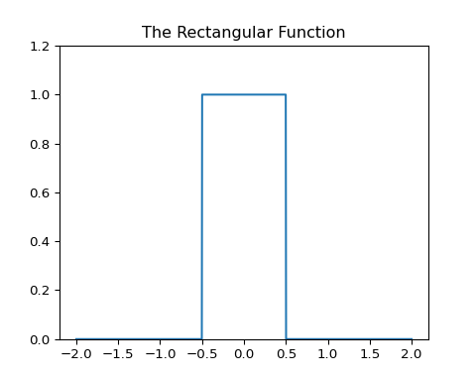
The Rectangular Function: Visualization Code
import numpy as np
import matplotlib.pyplot as plt
def rect_func(t):
return np.where(np.abs(t) <= 0.5, 1, 0)
t = np.linspace(-2, 2, 1000)
rect_data = rect_func(t)
plt.figure()
plt.plot(t, rect_data)
plt.title("The Rectangular Function")
plt.ylim(0, 1.2)
## (0.0, 1.2)
rect_function_plot_fig = plt.gcf()

Slide 18
The Rectangular Function: Visualization
Notes:
A perfect box centered at zero with a width of 1. This function can model a pulse, a pixel, or an imaging aperture.

Slide 19
The Sinc Function: Math
The Sinc function is the Fourier Transform of the Rect function. It is incredibly important in imaging and sampling theory.
$$\text{sinc}\left(t\right)=\frac{sin\left(πt\right)}{πt}$$

Slide 20
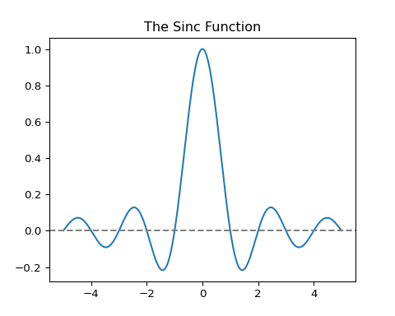
The Sinc Function: Visualization Code
import numpy as np
import matplotlib.pyplot as plt
t_sinc = np.linspace(-5, 5, 2000)
# The numpy sinc function is normalized, so we need to adjust for that
sinc_data = np.sinc(t_sinc)
plt.figure()
plt.plot(t_sinc, sinc_data)
plt.axhline(0, color='grey', linestyle='--')
plt.title("The Sinc Function")
sinc_function_plot_fig = plt.gcf()

Slide 21
The Sinc Function: Visualization
Notes:
Notice the central lobe and the decaying side lobes. The zero crossings are at integer values of t. This shape is fundamental to understanding image resolution and aliasing.

Slide 22
Pop Quiz!
What is the value of rect(1)?
1
0.5
0
Undefined
Notes:
Answer: C) 0. The function is only 1 when the absolute value of t is less than or equal to 0.5. Since 1 > 0.5, the value is 0.

Slide 23
The Dirac Delta Function: Concept
The Dirac Delta, δ(t), is a “generalized function.” It’s not a true function in the classical sense.
It is infinitely tall.
It is infinitesimally narrow.
Its total area is exactly 1.
$$δ\left(t\right)=0\text{ for }t≠0, \text{and} \int_{−∞}^{∞}{δ}\left(t\right)dt=1$$

Slide 24
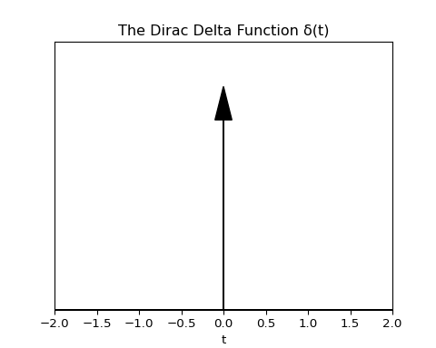
The Dirac Delta Function: Visualization Code
import numpy as np
import matplotlib.pyplot as plt
plt.figure()
plt.arrow(0, 0, 0, 1, head_width=0.2, head_length=0.15, fc='black', ec='black', length_includes_head=True)
plt.axhline(0, color='black')
plt.xlim(-2, 2)
## (-2.0, 2.0)
plt.ylim(0, 1.2)
## (0.0, 1.2)
plt.title("The Dirac Delta Function δ(t)")
plt.xlabel("t")
plt.tick_params(axis='y', which='both', left=False, right=False, labelleft=False)
dirac_delta_plot_fig = plt.gcf()

Slide 25
The Dirac Delta Function: Visualization
Notes:
Since the delta function is an idealization, we can’t plot it literally. We represent it as an arrow at t=0 to signify an impulse with an area of 1 concentrated at that single point.

Slide 26
The Dirac Delta: Sifting Property
The most important property of the delta function is the sifting property. It “pulls out” the value of a function at a single point.
$$\int_{−∞}^{∞}{f}\left(t\right)δ\left(t−t_{0}\right)dt=f\left(t_{0}\right)$$
Notes:
This property is the foundation of sampling theory. Multiplying a signal by a delta function is like taking a perfect, instantaneous sample of that signal at that exact point.

Slide 27
The Comb Function (Shah Function)
The Comb function is an infinite series of Dirac delta functions spaced at regular intervals.
$$\text{comb}\left(t\right)=\sum_{n=−∞}^{∞}{δ}\left(t−nT\right)$$
It is also known as the Shah function or an impulse train.
It is the mathematical model for the process of sampling.

Slide 28
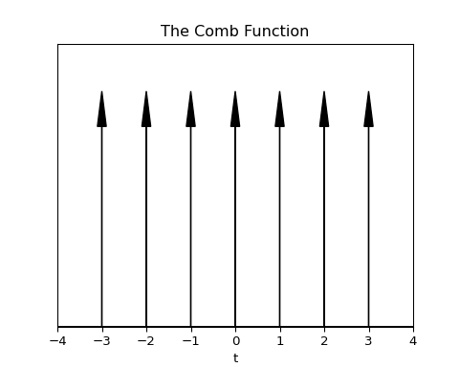
The Comb Function: Visualization Code
import numpy as np
import matplotlib.pyplot as plt
x = np.arange(-3, 4)
plt.figure()
for val in x:
plt.arrow(val, 0, 0, 1, head_width=0.2, head_length=0.15, fc='black', ec='black', length_includes_head=True)
plt.axhline(0, color='black')
plt.xlim(-4, 4)
## (-4.0, 4.0)
plt.ylim(0, 1.2)
## (0.0, 1.2)
plt.title("The Comb Function")
plt.xlabel("t")
plt.tick_params(axis='y', which='both', left=False, right=False, labelleft=False)
comb_function_plot_fig = plt.gcf()

Slide 29
The Comb Function: Visualization
Notes:
Imagine a comb’s teeth; each tooth is a delta function. When we multiply a continuous signal by a comb function, we are left with a series of discrete samples—the value of the signal at the location of each “tooth.”

Slide 30
Sampling and Aliasing
When we convert a continuous signal to a discrete one, we are sampling it.
How often do we need to sample to perfectly capture the signal?

Slide 31
The Nyquist-Shannon Sampling Theorem
Theorem: A continuous signal can be perfectly reconstructed from its samples if the sampling frequency (fs) is greater than twice the highest frequency (fmax) in the signal.
fs > 2 * fmax
The frequency 2 * fmax is called the Nyquist Rate.

Slide 32
Aliasing: The Consequence of Undersampling
If you sample below the Nyquist rate (fs < 2 * fmax), you get aliasing.
A high frequency in the original signal will masquerade as a lower frequency in the sampled version.
This is a form of irreversible information loss.

Slide 33
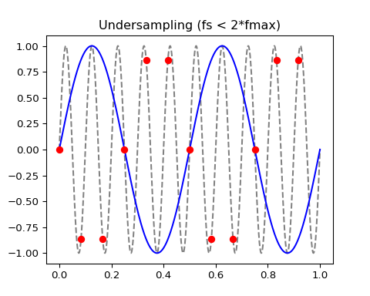
Aliasing: Visualization Code
import numpy as np
import matplotlib.pyplot as plt
# Define a high-frequency signal
f_high = 10 # Hz
t = np.linspace(0, 1, 1000)
signal_cont = np.sin(2 * np.pi * f_high * t)
# Case 1: Adequate Sampling (fs > 2 * fmax)
fs_good = 25 # Sampling freq > 2 * 10
t_good = np.arange(0, 1, 1/fs_good)
signal_good = np.sin(2 * np.pi * f_high * t_good)
# Case 2: Undersampling (fs < 2 * fmax)
fs_bad = 12 # Sampling freq < 2 * 10
t_bad = np.arange(0, 1, 1/fs_bad)
signal_bad = np.sin(2 * np.pi * f_high * t_bad)
# The aliased frequency will appear at |f_high - fs_bad| = |10 - 12| = 2 Hz
aliased_signal_cont = np.sin(2 * np.pi * 2 * t)
# Create plots
plt.figure()
plt.plot(t, signal_cont, color='gray')
plt.plot(t_good, signal_good, 'ro')
plt.title("Adequate Sampling (fs > 2*fmax)")
aliasing_plot_good_fig = plt.gcf()
plt.figure()
plt.plot(t, signal_cont, color="gray", linestyle="dashed")
plt.plot(t, aliased_signal_cont, color="blue")
plt.plot(t_bad, signal_bad, "ro")
plt.title("Undersampling (fs < 2*fmax)")
aliasing_plot_bad_fig = plt.gcf()

Slide 34
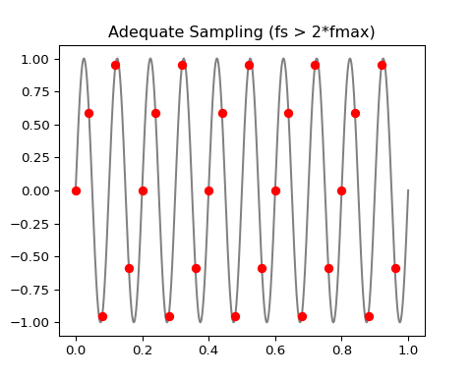
Aliasing: Adequate Sampling
A 10 Hz signal sampled at 25 Hz. The samples still capture the wave’s shape.

Slide 35
Aliasing: Undersampling

Slide 36
LSI Systems
System: A process that transforms an input signal x(t) into an output signal y(t).

Slide 37
LSI Systems
LSI System: A system that is both Linear and Shift-Invariant.

Slide 38
LSI Systems
These properties make systems much easier to analyze.

Slide 39
LSI Systems
Most imaging systems are approximated as LSI systems.
Notes:
LSI systems are the cornerstone of this field. If we know a system is LSI, we can predict its output for any input, simply by knowing its response to a single impulse.

Slide 40
Linearity
A system is linear if it obeys the principle of superposition.

Slide 41
Linearity
Homogeneity: T{a * x(t)} = a * T{x(t)}
  (Scaling the input scales the output by the same amount)

Slide 42
Linearity
Additivity: T{x1(t) + x2(t)} = T{x1(t)} + T{x2(t)}
  (The response to a sum of inputs is the sum of their individual responses)
Notes:
In simple terms: if you double the input, you double the output. If you add two inputs together, the output is the sum of the outputs you would have gotten from each one separately. No surprises.

Slide 43
Shift-Invariance (or Time-Invariance)
A system is shift-invariant if a shift in the input signal causes an identical shift in the output signal.

Slide 44
Shift-Invariance (or Time-Invariance)
If y(t) = T{x(t)}, then y(t - t_0) = T{x(t - t_0)}.

Slide 45
Shift-Invariance (or Time-Invariance)
The behavior of the system does not change over time or space.
Notes:
This is a crucial assumption. It means that the rules of the system don’t change depending on when or where you apply the input. An X-ray system should produce the same image of a phantom today as it did yesterday (assuming the same technique).

Slide 46
Discussion Question
Is the financial process of adding 5% interest to a bank account a linear system? Why or why not?
Notes:
Let’s analyze. Let the transformation T be applying interest. - Homogeneity: T{a * x} = 1.05 * (ax). And a T{x} = a * (1.05 * x). These are equal. Homogeneity holds. - Additivity: T{x1 + x2} = 1.05 * (x1 + x2). And T{x1} + T{x2} = 1.05x1 + 1.05x2. These are equal. Additivity holds. - Yes, it is a linear system.

Slide 47
Convolution: The Core of LSI Systems
Convolution is the mathematical operation that describes the output of an LSI system.

Slide 48
Convolution: The Core of LSI Systems
Every LSI system is completely characterized by its Impulse Response Function (IRF), h(t).

Slide 49
Convolution: The Core of LSI Systems
The output y(t) is the convolution of the input x(t) with the system’s IRF h(t).
Notes:
This is the single most important concept for LSI systems. If you know the system’s response to a perfect impulse (the IRF), you can calculate its response to literally any input.

Slide 50
Convolution: The Math
The convolution integral is defined as:
$$y\left(t\right)=x\left(t\right)*h\left(t\right)=\int_{−∞}^{∞}{x}\left(τ\right)h\left(t−τ\right)dτ$$
* denotes the convolution operation.
τ is a dummy variable of integration.
Notes:
This equation looks intimidating, but it has a very intuitive meaning. It’s a “weighted average” of the input signal, where the weighting function is the system’s impulse response, flipped and shifted.

Slide 51
Convolution: The Intuition
Think of h(t) as a “smearing” or “blurring” function. The convolution integral slides the flipped h(-τ) along the input x(τ) and, at each position t, calculates the overlapping area.

Slide 52
Convolution: The Intuition
Flip: Take the impulse response h(τ) and flip it to get h(-τ).
Shift: Shift it by t.

Slide 53
Convolution: The Intuition
Multiply: Multiply the input x(τ) by the shifted, flipped h(t - τ).
Integrate: Calculate the area under the product. This area is the value of the output y(t) at that specific t.
Notes:
This “flip, shift, multiply, integrate” process is the mechanical-graphical way to understand convolution. We will visualize this process to make it clearer.

Slide 54
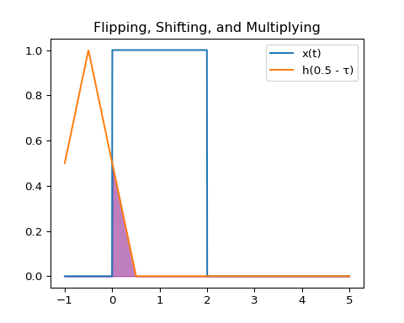
Convolution: Graphical Example Code
import numpy as np
import matplotlib.pyplot as plt
def x_func(t):
return np.where((t >= 0) & (t <= 2), 1, 0)
def h_func(t):
return np.piecewise(t, [(t >= 0) & (t <= 1), (t > 1) & (t <= 2)], [lambda t: t, lambda t: 2 - t])
t_viz = np.linspace(-1, 5, 1000)
x_val = x_func(t_viz)
h_val = h_func(t_viz)
plt.figure()
plt.plot(t_viz, x_val, label='x(t)')
plt.plot(t_viz, h_val, label='h(t)')
plt.title("Input Signal and Impulse Response")
plt.legend()
conv_viz_setup_fig = plt.gcf()
t_val = 0.5
h_flipped_shifted = h_func(t_val - t_viz)
product = x_func(t_viz) * h_flipped_shifted
plt.figure()
plt.plot(t_viz, x_func(t_viz), label='x(t)')
plt.plot(t_viz, h_flipped_shifted, label=f'h({t_val} - τ)')
plt.fill_between(t_viz, product, color='purple', alpha=0.5)
plt.title("Flipping, Shifting, and Multiplying")
plt.legend()
conv_viz_flip_fig = plt.gcf()

Slide 55
Convolution: Graphical Example Step 1
We start with an input signal x(t) (a Rect function) and an impulse response h(t) (a triangle function).

Slide 56
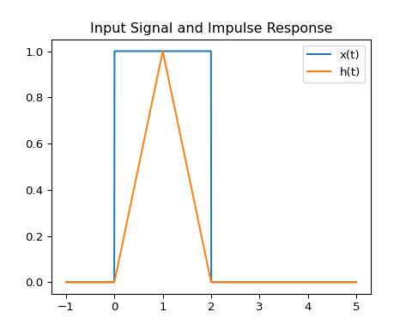
Convolution: Graphical Example Step 1 (cont.)

Slide 57
Convolution: Graphical Example Step 2
We “flip” the impulse response to get h(-τ).
The integral is y(t) = ∫ x(τ) h(t - τ) dτ. We plot for a specific time t, say t=0.5.

Slide 58
Convolution: Graphical Example Step 2 (cont.)

Slide 59
Convolution: Graphical Example Step 2 (cont.)
The purple area is the product x(τ)h(t-τ). The integral of this area is the value of the convolution y(t) at t=0.5.

Slide 60
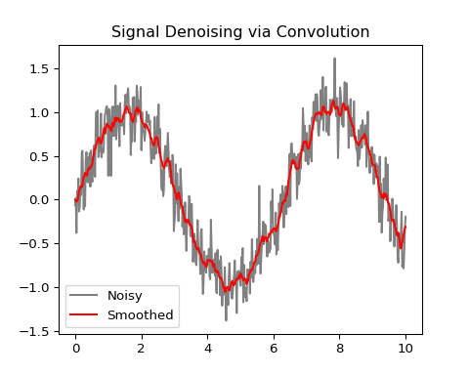
Convolution Example: Denoising Code
import numpy as np
import matplotlib.pyplot as plt
# 1. Create a noisy signal
t_conv = np.linspace(0, 10, 500)
signal = np.sin(t_conv) + 0.1 * np.cos(t_conv * 20) # Base signal + high-freq noise
noise = np.random.normal(0, 0.2, 500)
noisy_signal = signal + noise
# 2. Perform convolution in the discrete domain (moving average)
kernel = np.ones(11) / 11 # A simple 11-point averaging kernel
smoothed_signal = np.convolve(noisy_signal, kernel, mode='same')
plt.figure()
plt.plot(t_conv, noisy_signal, color="gray", label="Noisy")
plt.plot(t_conv, smoothed_signal, color="red", label="Smoothed")
plt.title("Signal Denoising via Convolution")
plt.legend()
convolution_plot_fig = plt.gcf()

Slide 61
Convolution Example: Denoising Visualization
Notes:
The result is clear. The red “Smoothed” signal is a less noisy version of the original gray signal. The convolution has averaged out the rapid fluctuations, an example of low-pass filtering.

Slide 62
Fourier Analysis
A revolutionary idea: Any signal can be represented as a sum of sines and cosines.
The Fourier Transform (FT) is the mathematical tool that decomposes a signal from its “time domain” into its constituent frequencies in the “frequency domain.”
Notes:
Fourier analysis is like taking a musical chord and figuring out the individual notes that make it up. It’s one of the most powerful tools in all of science and engineering.

Slide 63
The Fourier Transform: Math
The 1D Forward Fourier Transform:
$$X\left(k\right)=F\{x\left(t\right)\}=\int_{−∞}^{∞}{x}\left(t\right)e^{−i2πkt}dt$$
x(t): The signal in the time domain.
X(k): The signal in the frequency domain.
k: Represents frequency.
Notes:
This is the equation that takes us from the time domain to the frequency domain. The exp(-i*2*pi*k*t) term is Euler’s formula, which represents sines and cosines. This integral measures “how much” of each frequency k is present in the signal x(t).

Slide 64
The Fourier Transform: Variable Breakdown
$$X\left(k\right)=\int_{−∞}^{∞}{x}\left(t\right)e^{−i2πkt}dt$$
X(k): The output. A complex-valued function representing the frequency spectrum. Its magnitude tells you the amplitude of each frequency, and its phase tells you the alignment.

Slide 65
The Fourier Transform: Variable Breakdown
x(t): The input signal as a function of time (or space).
k: The frequency variable.

Slide 66
The Fourier Transform: Variable Breakdown
t: The time variable (or space).
i: The imaginary unit, sqrt(-1).
Notes:
The output X(k) is complex, which can be tricky. For visualization, we almost always look at the magnitude, |X(k)|, which is called the amplitude spectrum.

Slide 67
The Fourier Transform: Intuition
The FT is a “frequency machine.”
You put a time-domain signal x(t) in.
It gives you a frequency-domain spectrum X(k) out.
A peak in X(k) at k=k0 means the original signal x(t) contained a strong sinusoidal component at the frequency k0.
Notes:
Think of it as a prism for signals. A prism takes in white light (a complex signal) and splits it into its constituent colors (the frequency spectrum). The Fourier Transform does the same for any signal.

Slide 68
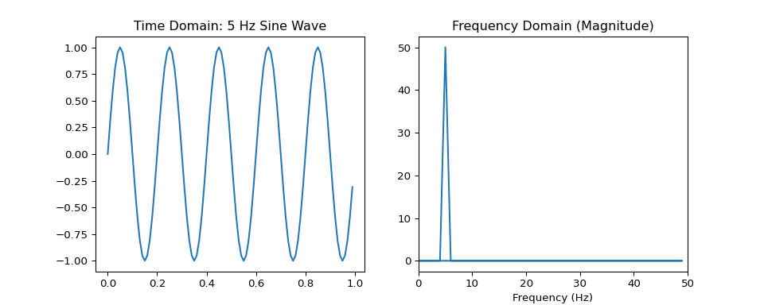
FT Example: Sine Wave Code
import numpy as np
import matplotlib.pyplot as plt
# Create a simple sine wave
fs = 100 # Sampling frequency
t_ft = np.arange(0, 1, 1/fs)
freq = 5 # 5 Hz
x_sine = np.sin(2 * np.pi * freq * t_ft)
# Calculate the Fast Fourier Transform (FFT)
fft_result = np.fft.fft(x_sine)
fft_magnitude = np.abs(fft_result)
# Create frequency axis for plotting
freq_axis = np.fft.fftfreq(len(t_ft), d=1/fs)
fig, (ax1, ax2) = plt.subplots(1, 2, figsize=(10, 4))
ax1.plot(t_ft, x_sine)
ax1.set_title("Time Domain: 5 Hz Sine Wave")
ax2.plot(freq_axis, fft_magnitude)
ax2.set_title("Frequency Domain (Magnitude)")
ax2.set_xlabel("Frequency (Hz)")
ax2.set_xlim(0, fs/2)
## (0.0, 50.0)
ft_sine_plot_fig = plt.gcf()

Slide 69
FT Example: Sine Wave Visualization
Notes:
On the left is our signal. On the right is its Fourier spectrum. Notice the strong, sharp peak at exactly 5 Hz, just as we expected. The FT correctly identified the frequency content of the signal. The second peak near 95Hz is its alias due to Nyquist theorem.

Slide 70
The 2D Fourier Transform
The concept extends to 2D signals, like images.
$$F\left(k_{x},k_{y}\right)=\int_{−∞}^{∞}{\int_{−∞}^{∞}{f}}\left(x,y\right)e^{−i2π\left(k_{x}x+k_{y}y\right)}dxdy$$
f(x,y): The 2D image.
F(kx, ky): The 2D frequency spectrum.

Slide 71
The 2D Fourier Transform
kx, ky: Spatial frequencies in the x and y directions.
Notes:
Instead of temporal frequency, we now have spatial frequencies. kx represents how fast the image intensity changes in the x-direction, and ky for the y-direction. High spatial frequencies correspond to sharp edges, and low frequencies correspond to smooth areas.

Slide 72
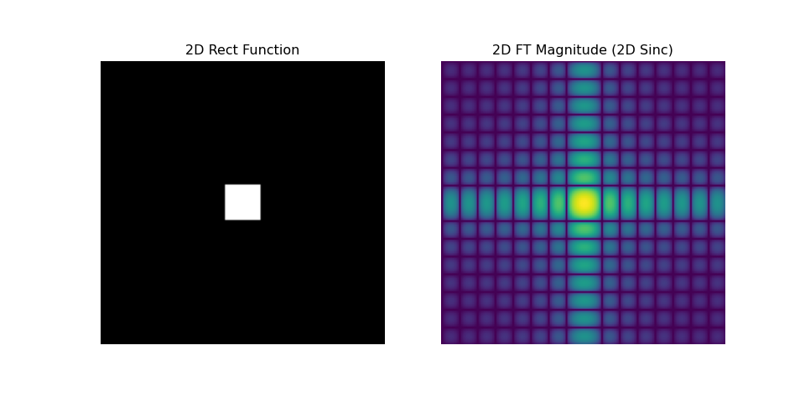
2D FT Example: 2D Rect Code
import numpy as np
import matplotlib.pyplot as plt
# Create a 2D Rect function (a white square on a black background)
matrix_size = 128
img_matrix = np.zeros((matrix_size, matrix_size))
center = matrix_size // 2
width = 16
img_matrix[center - width//2:center + width//2, center - width//2:center + width//2] = 1
# Calculate the 2D FFT
fft_2d_result = np.fft.fft2(img_matrix)
# For visualization, we want to see the magnitude and shift the zero-frequency component to the center
fft_magnitude_2d = np.log(1 + np.abs(np.fft.fftshift(fft_2d_result)))
fig, (ax1, ax2) = plt.subplots(1, 2, figsize=(10, 5))
ax1.imshow(img_matrix, cmap='gray')
ax1.set_title("2D Rect Function")
ax1.axis('off')
## (np.float64(-0.5), np.float64(127.5), np.float64(127.5), np.float64(-0.5))
ax2.imshow(fft_magnitude_2d, cmap='viridis')
ax2.set_title("2D FT Magnitude (2D Sinc)")
ax2.axis('off')
## (np.float64(-0.5), np.float64(127.5), np.float64(127.5), np.float64(-0.5))
d_ft_plot_fig = plt.gcf()

Slide 73
2D FT Example: 2D Rect Visualization
Notes:
Just as the 1D FT of a Rect is a Sinc, the 2D FT of a 2D Rect is a 2D Sinc. On the right, you can see the bright central lobe and the fainter side lobes extending in the kx and ky directions. This is a fundamental relationship in imaging.

Slide 74
The Convolution Theorem
This is one of the most powerful theorems in signal processing. It states that convolution in one domain is equivalent to multiplication in the other domain.
Convolution in Time/Space Domain <=> Multiplication in Frequency Domain \mathcal{F}\{x(t) * h(t)\} = X(k) \cdot H(k)
Multiplication in Time/Space Domain <=> Convolution in Frequency Domain \mathcal{F}\{x(t) \cdot h(t)\} = X(k) * H(k)
Notes:
This theorem is a huge deal. Convolution is a computationally expensive operation (that big integral). Multiplication is extremely fast for a computer. The convolution theorem allows us to replace a slow convolution with two FFTs, a single multiplication, and an inverse FFT. This is the basis for fast filtering algorithms used in every imaging modality.

Slide 75
Module 1 Summary
Signals can be continuous or discrete.
We use standard functions (Rect, Sinc, Delta) as building blocks.
LSI (Linear and Shift-Invariant) systems are predictable and easy to analyze.

Slide 76
Module 1 Summary
Convolution describes the output of any LSI system.
The Fourier Transform moves a signal between the time and frequency domains.
The Convolution Theorem provides a fast way to compute convolutions.
Notes:
We have laid the entire groundwork for the course. Make sure you are comfortable with these concepts before we move on to stochastic systems, where things get a bit less predictable.

Slide 77
Module 2: Stochastic Systems
Notes:
Now we move from the predictable world of deterministic signals to the unpredictable world of stochastic processes. Noise is a fundamental component of all medical images, and understanding its properties is critical to evaluating and improving image quality.

Slide 78
Deterministic vs. Stochastic
Deterministic System: The same input always produces the exact same output. The systems in Module 1 were all deterministic.
Stochastic System: The output has some element of randomness. The output is described by probability distributions, not by a single, definite function.
Noise is the primary source of stochastic behavior in medical imaging.
Notes:
In the real world, no system is truly deterministic. There’s always some random fluctuation. In this module, we will learn how to characterize and quantify that randomness.

Slide 79
Major Noise Types in Medical Imaging
Poisson Noise (Quantum Noise): Arises from the discrete nature of particles (e.g., photons, radioactive decays). It’s signal-dependent.
Gaussian Noise (Electronic Noise): Arises from thermal fluctuations in electronic components. It’s generally signal-independent.
Rician Noise: Found in MRI, resulting from the combination of a real signal with Gaussian noise in two orthogonal channels.
Notes:
We will focus on Poisson and Gaussian noise as they are the most common and form the basis for understanding more complex noise models.

Slide 80
Poisson Noise: The Math
The Poisson distribution describes the probability of a given number of events occurring in a fixed interval if these events occur with a known constant mean rate.
$$P\left(k;λ\right)=\frac{λ^{k}e^{−λ}}{k!}$$
λ (lambda) is the mean number of events.
In imaging, λ is the expected number of photons.
A key property: The variance is equal to the mean (σ² = λ).
Notes:
This is the noise of counting statistics. If you expect to detect an average of 100 photons in a pixel, the standard deviation of that measurement will be the square root of 100, which is 10. This signal-dependent nature is a defining feature.

Slide 81
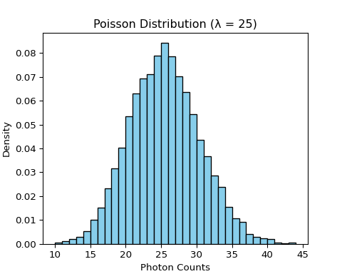
Poisson Noise: Code Example
import numpy as np
import matplotlib.pyplot as plt
# Generate data from a Poisson distribution
mean_photons = 25
num_samples = 10000
# Use rpois to generate random deviates
poisson_data = np.random.poisson(mean_photons, num_samples)
# Calculate sample mean and variance
sample_mean = np.mean(poisson_data)
sample_variance = np.var(poisson_data)
plt.figure()
plt.hist(poisson_data, bins=range(10, 45), density=True, color='skyblue', ec='black')
plt.title(f"Poisson Distribution (λ = {mean_photons})")
plt.xlabel("Photon Counts")
plt.ylabel("Density")
poisson_plot_fig = plt.gcf()

Slide 82
Poisson Noise: Visualization
Notes:
As you can see, the distribution is centered around our mean of 25. The subtitle confirms the core property of Poisson noise: the sample mean is very close to the sample variance.

Slide 83
Gaussian Noise: The Math
The Gaussian (or Normal) distribution is described by its mean (μ) and standard deviation (σ).
$$f\left(x|μ,σ^{2}\right)=\frac{1}{\sqrt{2πσ^{2}}}e^{−\frac{{\left(x−μ\right)}^{2}}{2σ^{2}}}$$
This is the classic “bell curve.”
In contrast to Poisson noise, the variance (σ²) is independent of the mean signal (μ).
Notes:
This noise is additive and constant. It comes from the electronics in the imaging chain. Whether the signal is bright or dark, the amount of electronic noise added is generally the same.

Slide 84
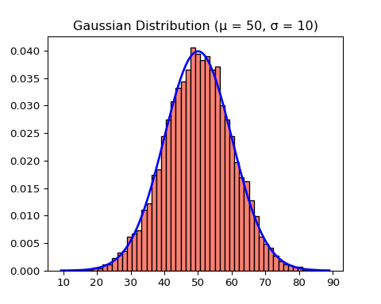
Gaussian Noise: Code Example
import numpy as np
import matplotlib.pyplot as plt
from scipy.stats import norm
# Generate data from a Gaussian distribution
mean_signal = 50
noise_std_dev = 10
num_samples = 10000
# Use rnorm to generate random deviates
gaussian_data = np.random.normal(mean_signal, noise_std_dev, num_samples)
plt.figure()
plt.hist(gaussian_data, bins=50, density=True, color='salmon', ec='black')
xmin, xmax = plt.xlim()
x = np.linspace(xmin, xmax, 100)
p = norm.pdf(x, mean_signal, noise_std_dev)
plt.plot(x, p, 'b', linewidth=2)
plt.title(f"Gaussian Distribution (μ = {mean_signal}, σ = {noise_std_dev})")
gaussian_plot_fig = plt.gcf()

Slide 85
Gaussian Noise: Visualization
Notes:
The histogram perfectly follows the classic bell curve shape, overlaid in blue. This is characteristic of electronic noise in detectors.

Slide 86
Noise Appearance: Poisson vs. Gaussian
Poisson noise is signal-dependent: Brighter areas are noisier.
Gaussian noise is signal-independent: Noise is constant everywhere.

Slide 87
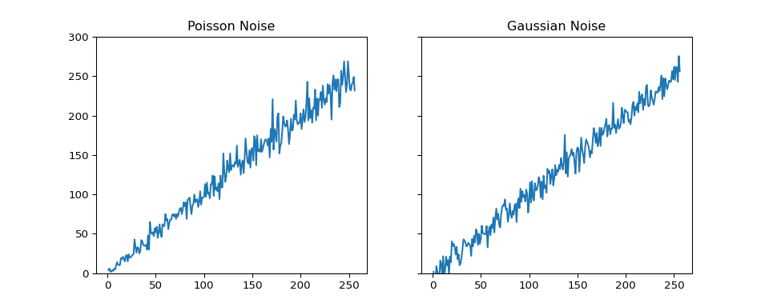
Noise Appearance: Visualization Code
import numpy as np
import matplotlib.pyplot as plt
# Create a signal that varies in brightness (a ramp)
t_ramp = np.arange(1, 257)
signal_ramp = t_ramp
# Add Poisson noise (variance = mean)
noise_poisson = np.random.poisson(signal_ramp)
# Add Gaussian noise (constant variance)
noise_gaussian = np.random.normal(signal_ramp, 10)
fig, (ax1, ax2) = plt.subplots(1, 2, figsize=(10, 4), sharey=True)
ax1.plot(t_ramp, noise_poisson)
ax1.set_title("Poisson Noise")
ax1.set_ylim(0, 300)
## (0.0, 300.0)
ax2.plot(t_ramp, noise_gaussian)
ax2.set_title("Gaussian Noise")
noise_appearance_plot_fig = plt.gcf()

Slide 88
Noise Appearance: Visualization Plot

Slide 89
Noise Appearance: Visualization Plot (cont.)
Notice how the Poisson noise gets much larger as the signal gets brighter (right side of the plot), while the Gaussian noise has a constant “fuzziness” across the entire signal.

Slide 90
Signal-to-Noise Ratio (SNR)
SNR is the most fundamental metric of image quality. It quantifies how strong the signal is relative to the background noise.
$$\text{SNR}=\frac{\text{Mean Signal}}{\text{Standard Deviation of Noise}}=\frac{μ}{σ}$$
A higher SNR means a cleaner, more reliable measurement.
Notes:
SNR is the currency of imaging. We are constantly trading other parameters—like scan time or radiation dose—to improve SNR. An SNR of 1 means the noise is as strong as the signal, making the signal very hard to detect.

Slide 91
Contrast-to-Noise Ratio (CNR)
CNR measures the ability to distinguish between two different regions or tissues, taking into account the noise level.
$$\text{CNR}=\frac{\left|{\text{Mean}}_{A}−{\text{Mean}}_{B}\right|}{\sqrt{σ_{A}^{2}+σ_{B}^{2}}}$$
A and B are two regions of interest.
High CNR is essential for detecting pathology. An object can have high contrast, but if the noise is too high, CNR will be low and it will be invisible.
Notes:
While SNR tells you about the quality in one area, CNR tells you about your ability to tell two areas apart. This is often more clinically relevant. Can I distinguish this tumor from the surrounding healthy tissue? That is a CNR question.

Slide 92
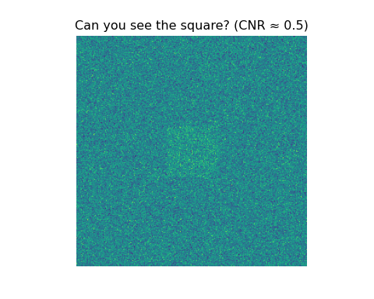
CNR: Visualization Code
import numpy as np
import matplotlib.pyplot as plt
# Create two regions with different means but the same noise
N_pixels = 256 * 256
img = np.random.normal(50, 20, (256, 256))
# Create a signal region (A) and a background region (B)
mean_A = 60
mean_B = 50
img[100:157, 100:157] = np.random.normal(mean_A, 20, (57, 57))
plt.figure()
plt.imshow(img, cmap='viridis')
plt.title(f"Can you see the square? (CNR ≈ {round((mean_A - mean_B)/20, 2)})")
plt.axis('off')
## (np.float64(-0.5), np.float64(255.5), np.float64(255.5), np.float64(-0.5))
cnr_plot_fig = plt.gcf()

Slide 93
CNR: Visualization Plot
Notes:
Whether or not you can easily see the square depends on the CNR. If we increase the difference in means or decrease the noise, the square becomes more obvious. This leads us to our next topic…

Slide 94
The Rose Criterion
How much CNR do you need? The Rose Criterion provides a rule of thumb.
It states that a CNR (or SNR for a simple detection task) of approximately 5 is required for a human observer to reliably detect a signal against a noisy background.
This is not a hard physical law, but a widely accepted psychophysical guideline.
Notes:
This is a very practical rule. If your calculated CNR for a lesion is only 1 or 2, a radiologist is very likely to miss it. We need to design our imaging systems and protocols to ensure the CNR for the targets of interest exceeds this threshold of 5.

Slide 95
Rose Criterion: Visualization
Let’s visualize the same object at different CNR levels.
The object is a faint circle in the center of the image.

Slide 96
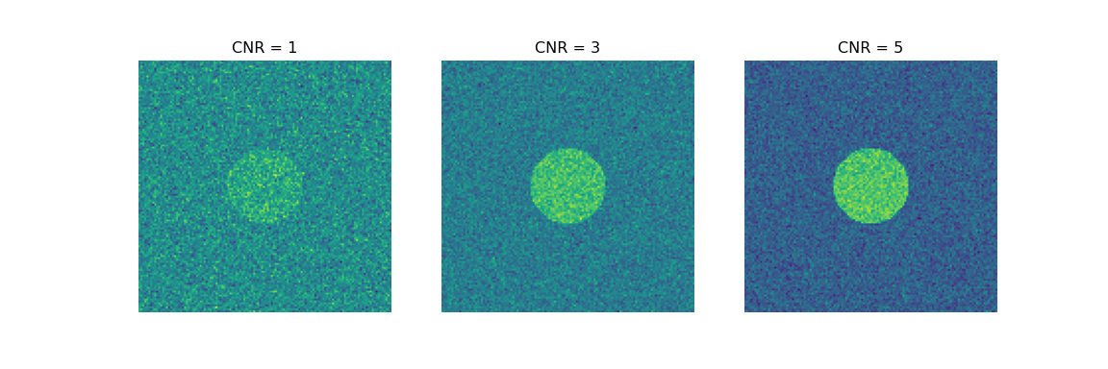
Rose Criterion: Visualization Code
import numpy as np
import matplotlib.pyplot as plt
def create_cnr_image(cnr):
bg_mean = 100
noise_sd = 20
signal_mean = bg_mean + cnr * noise_sd
img = np.random.normal(bg_mean, noise_sd, (128, 128))
# Add a circular object in the center
x = np.linspace(-1, 1, 128)
y = np.linspace(-1, 1, 128)
xx, yy = np.meshgrid(x, y)
mask = xx**2 + yy**2 < 0.3**2
img[mask] = np.random.normal(signal_mean, noise_sd, np.sum(mask))
return img
img_cnr1 = create_cnr_image(1)
img_cnr3 = create_cnr_image(3)
img_cnr5 = create_cnr_image(5)
fig, (ax1, ax2, ax3) = plt.subplots(1, 3, figsize=(12, 4))
ax1.imshow(img_cnr1, cmap='viridis')
ax1.set_title("CNR = 1")
ax1.axis('off')
## (np.float64(-0.5), np.float64(127.5), np.float64(127.5), np.float64(-0.5))
ax2.imshow(img_cnr3, cmap='viridis')
ax2.set_title("CNR = 3")
ax2.axis('off')
## (np.float64(-0.5), np.float64(127.5), np.float64(127.5), np.float64(-0.5))
ax3.imshow(img_cnr5, cmap='viridis')
ax3.set_title("CNR = 5")
ax3.axis('off')
## (np.float64(-0.5), np.float64(127.5), np.float64(127.5), np.float64(-0.5))
rose_criterion_plots_fig = plt.gcf()

Slide 97
Rose Criterion: Visualization Plots

Slide 98
Rose Criterion: Visualization Plots (cont.)
At CNR=1, the object is nearly invisible. At CNR=3, you might see it if you look closely. At CNR=5, it is clearly detectable, confirming the Rose Criterion.

Slide 99
Pop Quiz!
An image region has a mean of 100 and a standard deviation of 25. What is its SNR?
100
25
4
0.25
Notes:
Answer: C) 4. SNR = Mean / Std Dev = 100 / 25 = 4. According to the Rose Criterion, this signal would be detectable, but perhaps not with high confidence.

Slide 100
Noise Power Spectrum (NPS)
The NPS (also called the Wiener Spectrum) describes the frequency content of the noise.
It is the Fourier Transform of the noise autocorrelation function.
In simpler terms: it tells you how much noise power is present at each spatial frequency.
NPS(k_x, k_y)
Notes:
Just like a signal has a frequency spectrum, the noise in an image also has a frequency spectrum. The NPS is a critical tool for characterizing the texture and correlation of noise.

Slide 101
NPS: Concept Visualization
White Noise: Has a flat NPS. The noise power is equal at all spatial frequencies. This is typical for uncorrelated noise.
Colored Noise: Has a non-flat NPS. This indicates that the noise is correlated. For example, noise might be stronger at lower frequencies. This is common after image filtering or reconstruction.
Notes:
Think of “white light,” which has all colors (frequencies) equally. “White noise” has all spatial frequencies equally. If an image is blurry, it’s because high frequencies have been removed. If the noise is blurry, it means the high-frequency components of the noise have been removed, leading to a non-flat NPS that drops off at high frequencies.

Slide 102
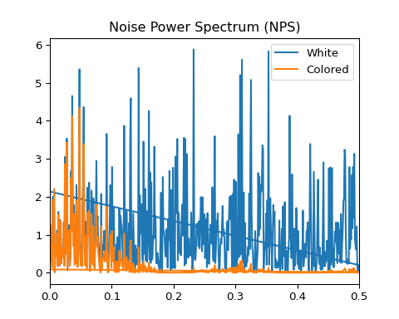
NPS: Visualization Code
import numpy as np
from scipy import signal
import matplotlib.pyplot as plt
# Generate a 1D white noise signal
white_noise = np.random.normal(size=1024)
nps_white = np.abs(np.fft.fft(white_noise))**2 / len(white_noise)
# Generate colored noise by filtering white noise (e.g., a simple moving average)
kernel = np.ones(5)/5
colored_noise = signal.convolve(white_noise, kernel, mode='same')
nps_colored = np.abs(np.fft.fft(colored_noise))**2 / len(colored_noise)
freq_axis_nps = np.fft.fftfreq(len(nps_white))
plt.figure()
plt.plot(freq_axis_nps, nps_white, label="White")
plt.plot(freq_axis_nps, nps_colored, label="Colored")
plt.title("Noise Power Spectrum (NPS)")
plt.xlim(0, 0.5)
## (0.0, 0.5)
plt.legend()
nps_plot_fig = plt.gcf()

Slide 103
NPS: Visualization Plot

Slide 104
NPS: Visualization Plot (cont.)
The white noise has a relatively flat spectrum. The colored (filtered) noise has much less power at high frequencies.

Slide 105
Detective Quantum Efficiency (DQE)
DQE is one of the most comprehensive metrics for assessing detector performance. It measures how efficiently a system transfers the SNR from its input to its output.
$$\text{DQE}\left(k\right)=\frac{{\text{SNR}}_{\text{out}}^{2}\left(k\right)}{{\text{SNR}}_{\text{in}}^{2}\left(k\right)}$$

Slide 106
Detective Quantum Efficiency (DQE)
It is a function of spatial frequency, k.
A perfect detector would have DQE(k) = 1 for all frequencies. This is impossible.
DQE tells us how much of the information present in the incoming x-ray signal is actually captured and preserved in the final image.
Notes:
DQE is the gold standard for detector characterization. It combines the effects of signal response, noise (NPS), and resolution (MTF). A high DQE means the detector is very good at producing a high-quality image with minimal dose.

Slide 107
Module 2 Summary
Stochastic Systems involve randomness, primarily from noise.
Poisson Noise is signal-dependent (variance = mean).
Gaussian Noise is signal-independent.

Slide 108
Module 2 Summary
SNR and CNR are key metrics for quantifying image quality.
The Rose Criterion suggests a CNR of ~5 is needed for reliable detection.

Slide 109
Module 2 Summary
NPS describes the frequency content of noise.
DQE is a comprehensive measure of detector efficiency.
Notes:
We’ve now covered the unpredictable aspects of imaging. We understand where noise comes from, how to describe it, and how to measure its impact on image quality. Next, we will combine our knowledge of deterministic systems and stochastic noise to understand how tomographic images are formed.

Slide 110
Module 3: Tomography
Notes:
Welcome to Module 3. Tomography is the process of creating a cross-sectional image from projection data. This is the physical and mathematical basis for CT, PET, and SPECT imaging. We will explore how we can reconstruct a 2D image from a series of 1D measurements.

Slide 111
The Core Problem of Tomography
Forward Problem: If we have an object, we can predict the measurements (projections) we will get from it. This is relatively easy.
Inverse Problem: If we have a set of measurements (projections), can we reconstruct the original object? This is hard, and it’s the fundamental challenge of tomography.

Slide 112
The Core Problem of Tomography
The answer is yes, under certain conditions, thanks to the mathematics we will explore.
Notes:
Imagine you have a semi-transparent object. You shine a light through it from many different angles and measure the shadows it casts. Tomographic reconstruction is the art of figuring out the internal structure of the object just by looking at those shadows.

Slide 113
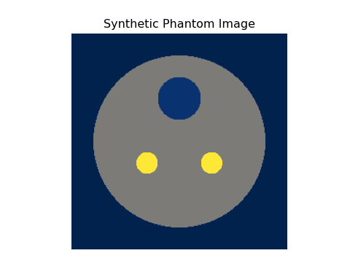
Creating a Phantom: Code
import numpy as np
import matplotlib.pyplot as plt
# Create a simple phantom: a large circle with smaller circles inside
def create_phantom(n=256):
phantom = np.zeros((n, n))
x = np.linspace(-1, 1, n)
y = np.linspace(-1, 1, n)
xx, yy = np.meshgrid(x, y)
# Large background ellipse
phantom[xx**2 + yy**2 < 0.8**2] = 0.5
# Two smaller high-density circles (e.g., bone)
phantom[(xx - 0.3)**2 + (yy - 0.2)**2 < 0.1**2] = 1
phantom[(xx + 0.3)**2 + (yy - 0.2)**2 < 0.1**2] = 1
# One smaller low-density circle (e.g., lesion)
phantom[xx**2 + (yy + 0.4)**2 < 0.2**2] = 0.1
return phantom
phantom_image = create_phantom()
plt.figure()
plt.imshow(phantom_image, cmap='cividis')
plt.title("Synthetic Phantom Image")
plt.axis('off')
## (np.float64(-0.5), np.float64(255.5), np.float64(255.5), np.float64(-0.5))
phantom_plot_fig = plt.gcf()

Slide 114
Creating a Phantom: Visualization
Notes:
Here is our test object. It’s a simple representation of a head-like structure with a gray matter background, two high-density bone-like objects, and a low-density lesion-like object. Our goal is to reconstruct this image after only measuring its projections.

Slide 115
The Radon Transform: Math
The Radon Transform is the mathematical formalization of taking a projection. It describes the process of integrating a 2D function f(x,y) along a line.
$$p\left(s,θ\right)=R\{f\left(x,y\right)\}=\int_{−∞}^{∞}{f}\left(scosθ−usinθ,ssinθ+ucosθ\right)du$$
p(s, θ) is the projection at an angle θ and a distance s from the origin.
This is the value of one point in the sinogram.
Notes:
This equation looks complex, but it’s just a line integral. For a fixed angle θ, we are summing up all the pixel values along lines that are a distance s from the center. A CT scanner physically performs this integration by shining X-rays through the patient.

Slide 116
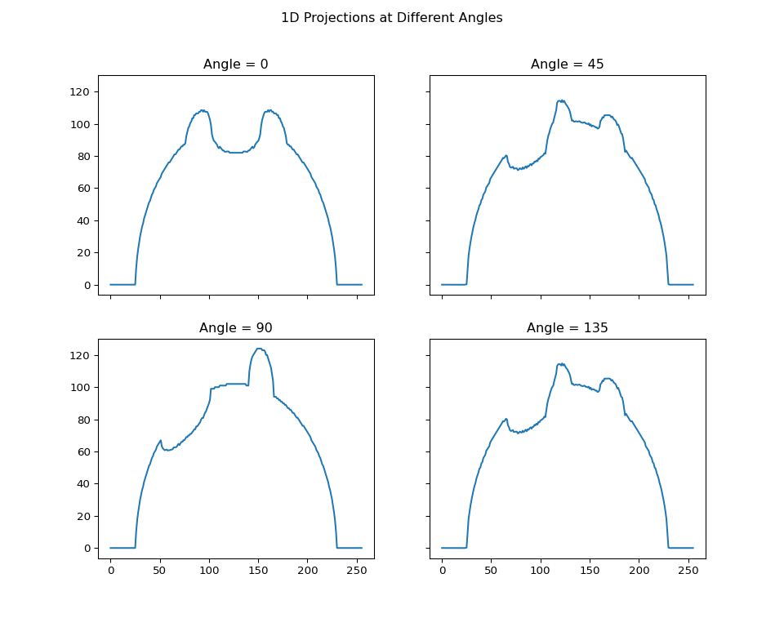
Simulating Projections: Code
from scipy.ndimage import rotate
import numpy as np
import matplotlib.pyplot as plt
# Simulate projections at a few angles
angles = np.arange(0, 180, 45)
projections = []
for angle in angles:
rot_image = rotate(phantom_image, angle, reshape=False)
projections.append(rot_image.sum(axis=0))
fig, axes = plt.subplots(2, 2, figsize=(10, 8), sharex=True, sharey=True)
for i, ax in enumerate(axes.flat):
ax.plot(projections[i])
ax.set_title(f"Angle = {angles[i]}")
fig.suptitle("1D Projections at Different Angles")
projection_plot_fig = plt.gcf()

Slide 117
Simulating Projections: Visualization
Notes:
Each plot shows the 1D “shadow” the phantom casts at that specific angle. You can see how the shape of the projection changes dramatically with the angle, encoding information about the object’s internal structure.

Slide 118
The Sinogram
A sinogram is the collection of all 1D projections stacked together as an image.
The y-axis represents the angle θ (from 0 to 180 degrees).
The x-axis represents the detector position s.
A single point in the object traces out a sinusoidal path in the sinogram. Hence the name.
Notes:
The sinogram is the raw data of a CT scanner. It’s the domain where the measurement physically happens. The job of a reconstruction algorithm is to turn this sinogram back into a meaningful cross-sectional image.

Slide 119
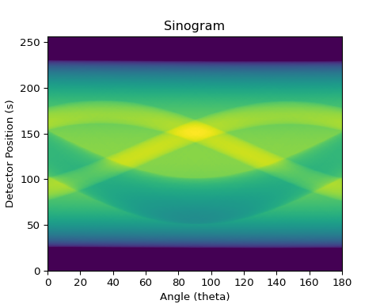
Sinogram Visualization: Code
from skimage.transform import radon
import matplotlib.pyplot as plt
import numpy as np
# Using a proper radon transform function for a better sinogram
theta = np.linspace(0., 180., max(phantom_image.shape), endpoint=False)
sinogram = radon(phantom_image, theta=theta, circle=True)
plt.figure()
plt.imshow(sinogram, cmap='viridis', extent=(0, 180, 0, sinogram.shape[0]), aspect='auto')
plt.title("Sinogram")
plt.xlabel("Angle (theta)")
plt.ylabel("Detector Position (s)")
sinogram_plot_fig = plt.gcf()

Slide 120
Sinogram Visualization: Plot
Notes:
This is a sinogram. Each of the bright sine waves corresponds to one of the high-density objects in our phantom. The wider, darker sine wave corresponds to the low-density object. All the information required to reconstruct the image is encoded here.

Slide 121
The Fourier Slice Theorem
How do we get from the sinogram back to the image? The Fourier Slice Theorem is the theoretical key.
It states that the 1D Fourier Transform of a projection at angle θ is equal to a slice through the 2D Fourier Transform of the object at that same angle θ.
P(k, θ) = F(k cosθ, k sinθ)
Notes:
This is a profound and powerful link. It connects the 1D measurements we can actually make (the projections) to the 2D frequency spectrum of the object we want to reconstruct. This theorem is the foundation of the most common reconstruction algorithm: filtered backprojection.

Slide 122
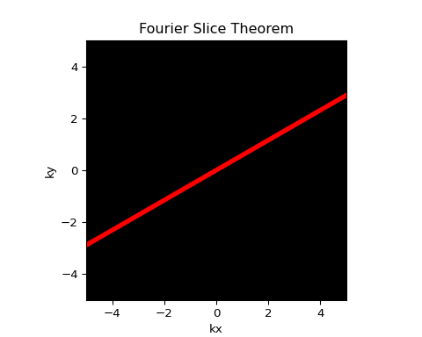
Fourier Slice Theorem: Conceptual Diagram Code
import numpy as np
import matplotlib.pyplot as plt
k_space = np.zeros((10, 10))
angle_rad = 30 * np.pi / 180
kx = np.linspace(-5, 5, 10)
ky = kx * np.tan(angle_rad)
plt.figure()
plt.imshow(k_space, cmap='gray', extent=[-5, 5, -5, 5])
plt.plot(kx, ky, 'r', linewidth=4)
plt.title("Fourier Slice Theorem")
plt.xlabel("kx")
plt.ylabel("ky")
fst_diagram_fig = plt.gcf()

Slide 123
Fourier Slice Theorem: Conceptual Diagram

Slide 124
Simple Backprojection: The Intuition
The most naive way to reconstruct the image is “simple backprojection.”
For each projection, “smear” the values back across the image at the angle from which they were acquired.
Sum up all these smeared-back projections.
Intuitive, but deeply flawed.
Notes:
Think of it as reversing the projection process. If a detector at one position measured a high value, we assume that high value must have come from somewhere along the line that hit that detector. So we draw that line on our blank image canvas. We do this for all projections and hope the true image emerges.

Slide 125
Backprojection: The “Star Artifact”
Simple backprojection doesn’t work perfectly. It produces a characteristic blurring, often called a “star artifact” or “1/r blurring.”
High-frequency information (sharp edges) is lost.
The resulting image is a blurry version of the original.
f_blurry(x,y) = f(x,y) * (1/r), where $r = \\sqrt{x^2 + y^2}$.
Notes:
The smearing process intrinsically adds a blur. Each point in the original object gets smeared out into a star-like shape in the reconstructed image. The final image is the true image convolved with this blurring function.

Slide 126
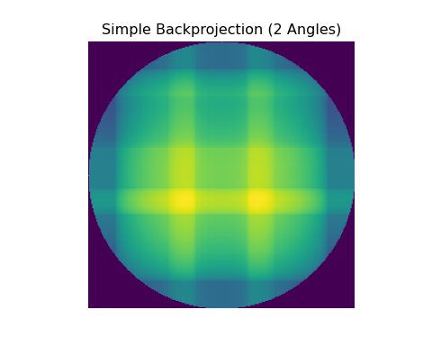
Backprojection: Visualization Code
from skimage.transform import iradon, radon
import numpy as np
import matplotlib.pyplot as plt
# We'll use a proper inverse radon transform for a better visualization
# Using the sinogram from the 0 and 90 degree projections
theta_small = np.arange(0, 180, 90)
sinogram_small = radon(phantom_image, theta=theta_small, circle=True)
recon_simple = iradon(sinogram_small, theta=theta_small, filter_name=None)
plt.figure()
plt.imshow(recon_simple, cmap='viridis')
plt.title("Simple Backprojection (2 Angles)")
plt.axis('off')
## (np.float64(-0.5), np.float64(255.5), np.float64(255.5), np.float64(-0.5))
backprojection_plot_fig = plt.gcf()

Slide 127
Backprojection: Visualization Plot
Notes:
The result is a crude, blurry outline of the original phantom. You can see the vertical and horizontal smearing. If we added more angles, the image would get less streaky and more blurry, eventually converging on that 1/r blurred version of the true object.

Slide 128
The Need for the Ramp Filter
How do we fix the blur from backprojection? We need to “un-blur” the image.
Since f_blurry = f * (1/r), we need to convolve with the inverse of (1/r).
The Fourier Transform of 1/r is 1/|k|.
To deconvolve, we multiply in the frequency domain by the inverse, which is |k|.
This |k| filter is called a Ramp Filter.
Notes:
This is the key insight. Simple backprojection gets the low-frequency information right but suppresses the high frequencies. To correct this, we need to boost the high frequencies before or during backprojection. The ramp filter does exactly that. Its shape, |k|, looks like a ramp, hence the name.

Slide 129
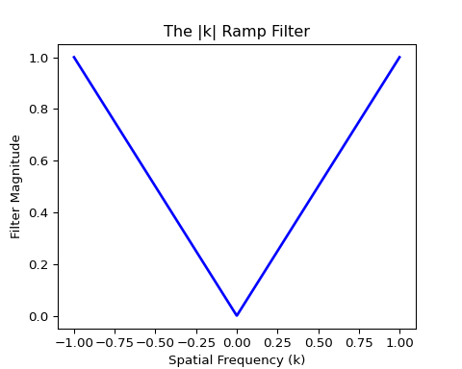
The Ramp Filter: Visualization Code
import numpy as np
import matplotlib.pyplot as plt
k = np.linspace(-1, 1, 1000)
ramp_filter = np.abs(k)
plt.figure()
plt.plot(k, ramp_filter, 'b', linewidth=2)
plt.title("The |k| Ramp Filter")
plt.xlabel("Spatial Frequency (k)")
plt.ylabel("Filter Magnitude")
ramp_filter_plot_fig = plt.gcf()

Slide 130
The Ramp Filter: Visualization

Slide 131
The Ramp Filter: Visualization (cont.)
The filter multiplies low frequencies near k=0 by almost zero, and linearly boosts the higher frequencies.

Slide 132
Filtered Backprojection (FBP)
This leads to the most common analytical reconstruction algorithm: Filtered Backprojection (FBP).
Measure all the 1D projections p(s, θ).
Take the 1D FT of each projection to get P(k, θ).
Multiply each P(k, θ) by the ramp filter |k|.

Slide 133
Filtered Backprojection (FBP)
Take the inverse 1D FT of the result.
Backproject these “filtered” projections.
This algorithm is fast, robust, and used in almost every commercial CT scanner.
Notes:
This is the complete recipe for CT reconstruction. The “filtering” step, which corrects for the backprojection blur, is the crucial addition that makes the whole process work.

Slide 134
Iterative Reconstruction
FBP is great, but it struggles with noisy or incomplete data. Iterative Reconstruction is an alternative approach.
Basic Idea:
  Start with an initial guess for the image (e.g., a blank image).
  Use the Forward Model to simulate what the projections would look like from your guess.

Slide 135
Iterative Reconstruction
Compare these simulated projections to the actual measured projections.
Update your image guess to reduce the error between the simulated and real projections.
Repeat until the error is small.
Notes:
Iterative methods are like a game of “guess and check.” You start with a guess, see how well it matches your data, and then intelligently improve your guess. This process is much slower than FBP but can produce better images in challenging situations, like low-dose CT.

Slide 136
Algebraic Formulation (Ax = b)
The iterative problem can be formulated with linear algebra.
x: A vector containing all the pixel values of the image we want to find.
b: A vector containing all the measured projection data.

Slide 137
Algebraic Formulation (Ax = b)
A: The “System Matrix.” A massive matrix where each row describes how the pixel values in x contribute to a single measurement in b.

Slide 138
Algebraic Formulation (Ax = b)
The goal is to solve the system of linear equations Ax = b for x.
Notes:
For any realistic image size, the matrix A is far too enormous to solve by direct inversion. This is why we must use iterative algorithms like MLEM to find an approximate solution.

Slide 139
MLEM (Maximum Likelihood Expectation Maximization)
MLEM is a popular iterative algorithm, especially in PET and SPECT.

Slide 140
MLEM (Maximum Likelihood Expectation Maximization)
It’s based on finding the image x that is most likely to have produced the measured data b, assuming Poisson statistics.

Slide 141
MLEM (Maximum Likelihood Expectation Maximization)
It has the desirable property of conserving counts and ensuring pixel values remain non-negative.
Notes:
We won’t go into the details of the MLEM update equation, but the key takeaway is that it’s an iterative method that is particularly well-suited to the Poisson noise statistics found in nuclear medicine.

Slide 142
Module 3 Summary
Tomography is the process of reconstructing an object from its projections.
The Radon Transform is the mathematics of creating projections.
A Sinogram is the collection of all projections.

Slide 143
Module 3 Summary
Simple Backprojection is intuitive but creates a blurry image (1/r blurring).
Filtered Backprojection (FBP) uses a Ramp Filter to correct the blur and is the standard algorithm.
Iterative Methods (like MLEM) are an alternative that can handle noise better but are computationally slower.
Notes:
We now understand the fundamental principles of how a CT scanner works, from data acquisition (projections) to the final image (reconstruction). In the final module, we will touch on more advanced applications and modern topics that build on these foundations.

Slide 144
Module 4: Advanced Applications
Notes:
In this final module, we will briefly touch upon several advanced topics and other imaging modalities. The goal is not to cover them in exhaustive detail, but to show how the fundamental concepts of signals, systems, and transforms that we’ve learned apply across all of medical imaging.

Slide 145
Magnetic Resonance Imaging (MRI)
MRI does not use ionizing radiation.

Slide 146
Magnetic Resonance Imaging (MRI)
It uses a powerful magnetic field, radiofrequency (RF) pulses, and magnetic field gradients to create images.

Slide 147
Magnetic Resonance Imaging (MRI)
The raw data collected in an MRI scan is not a projection, but a direct measurement of the object’s frequency spectrum.
Notes:
MRI is one of the most direct applications of the Fourier Transform in medical imaging. The scanner literally “collects” the Fourier space of the patient’s tissues.

Slide 148
K-Space
In MRI, the 2D Fourier space of the image is called k-space.

Slide 149
K-Space
The scanner fills k-space line by line according to a specific “pulse sequence.”

Slide 150
K-Space
The final image is simply the inverse 2D Fourier Transform of the collected k-space data.
$$\text{Image}\left(x,y\right)=F^{−1}\{\text{k-space}\left(k_{x},k_{y}\right)\}$$
Notes:
This is a critical concept. The center of k-space contains the low-frequency information (overall contrast and brightness). The periphery of k-space contains the high-frequency information (edges and fine details).

Slide 151
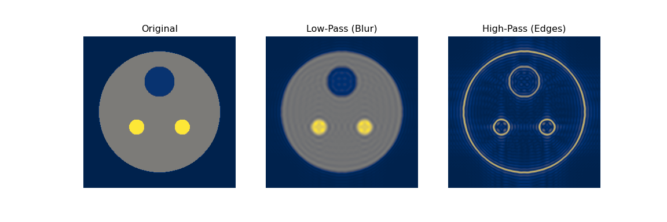
K-Space Filtering: Code
import numpy as np
import matplotlib.pyplot as plt
# We already have our phantom image and its 2D FT from Module 1 & 3
# Let's re-calculate k-space (the shifted FT) for clarity
kspace_full = np.fft.fftshift(np.fft.fft2(phantom_image))
# Create a low-pass filter (keep the center, zero out the periphery)
center_fraction = 0.2
rows, cols = kspace_full.shape
r_mid, c_mid = rows // 2, cols // 2
r_keep = int(rows * center_fraction / 2)
c_keep = int(cols * center_fraction / 2)
mask_low = np.zeros_like(kspace_full)
mask_low[r_mid-r_keep:r_mid+r_keep, c_mid-c_keep:c_mid+c_keep] = 1
kspace_lowpass = kspace_full * mask_low
# Create a high-pass filter (zero out the center, keep the periphery)
kspace_highpass = kspace_full * (1 - mask_low)
# Inverse FFT to get the images back
# Remember to shift back before inverse FFT!
img_lowpass = np.abs(np.fft.ifft2(np.fft.ifftshift(kspace_lowpass)))
img_highpass = np.abs(np.fft.ifft2(np.fft.ifftshift(kspace_highpass)))
fig, (ax1, ax2, ax3) = plt.subplots(1, 3, figsize=(12, 4))
ax1.imshow(phantom_image, cmap='cividis')
ax1.set_title("Original")
ax1.axis('off')
## (np.float64(-0.5), np.float64(255.5), np.float64(255.5), np.float64(-0.5))
ax2.imshow(img_lowpass, cmap='cividis')
ax2.set_title("Low-Pass (Blur)")
ax2.axis('off')
## (np.float64(-0.5), np.float64(255.5), np.float64(255.5), np.float64(-0.5))
ax3.imshow(img_highpass, cmap='cividis')
ax3.set_title("High-Pass (Edges)")
ax3.axis('off')
## (np.float64(-0.5), np.float64(255.5), np.float64(255.5), np.float64(-0.5))
kspace_filter_plot_fig = plt.gcf()

Slide 152
K-Space Filtering: Visualization
Notes:
The results perfectly illustrate the properties of k-space. - Original: Our clear phantom. - Low-Pass: Keeping only the center of k-space removes the high frequencies, resulting in a blurry image that only preserves the basic contrast. - High-Pass: Keeping only the periphery of k-space removes the low frequencies, resulting in an image that only shows the sharp edges.

Slide 153
Discussion Question
A patient moves during an MRI scan. This corrupts the data being acquired at that moment. If the motion occurs while the center of k-space is being acquired, what is the likely artifact on the final image?
Notes:
Answer: Widespread blurring or “ghosting” artifacts. The center of k-space holds the most signal energy and determines the overall contrast of the image. Corrupting this data has a severe, global impact on the image quality, much more so than corrupting the periphery.

Slide 154
Ultrasound Imaging
Uses high-frequency sound waves and their echoes to create images.

Slide 155
Ultrasound Imaging
The core principle is beamforming.

Slide 156
Ultrasound Imaging
Beamforming: By introducing microscopic time delays to the signals from individual elements in a transducer array, a focused ultrasound beam can be formed and steered electronically.
Notes:
Ultrasound is a beautiful example of using time-shifting and superposition—core concepts from our systems analysis—to physically shape and direct energy.

Slide 157
Delay and Sum Beamforming
Transmission: A pulse is sent from each transducer element, but with slightly different start times (delays). The wavefronts from all elements interfere constructively at a desired focal point.
Reception: The returning echo hits each element at a slightly different time. By applying the reverse delays to the received signals and summing them, the system can “listen” preferentially from that same focal point.
Notes:
This “delay and sum” process is a form of spatial filtering. It allows the ultrasound machine to scan a beam through the tissue to build up an image line by line, all without any moving parts.

Slide 158
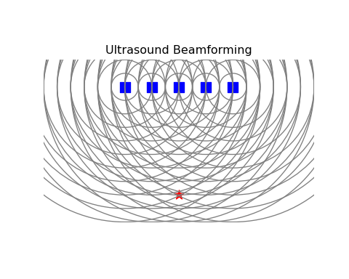
Beamforming: Conceptual Diagram Code
import numpy as np
import matplotlib.pyplot as plt
from matplotlib.patches import Circle
elements = np.array([[-2, 0], [-1, 0], [0, 0], [1, 0], [2, 0]])
focal_point = np.array([0, -4])
fig, ax = plt.subplots()
ax.scatter(elements[:, 0], elements[:, 1], s=100, marker='s', c='blue')
ax.scatter(focal_point[0], focal_point[1], s=100, marker='*', c='red')
for el in elements:
dist = np.linalg.norm(el - focal_point)
for r in np.arange(0.5, 5.5, 0.5):
ax.add_patch(Circle(el, r, fill=False, color='gray'))
ax.set_aspect('equal', adjustable='box')
ax.set_xlim(-5, 5)
## (-5.0, 5.0)
ax.set_ylim(-5, 1)
## (-5.0, 1.0)
ax.set_title("Ultrasound Beamforming")
ax.axis('off')
## (np.float64(-5.0), np.float64(5.0), np.float64(-5.0), np.float64(1.0))
beamforming_diagram_fig = plt.gcf()

Slide 159
Beamforming: Conceptual Diagram

Slide 160
Modern Topics: Compressed Sensing
A relatively new paradigm in signal acquisition.
Core Idea: If a signal is sparse in some domain (meaning most of its values are zero), it can be reconstructed from far fewer measurements than required by traditional sampling theory (Nyquist theorem).
For example, many medical images are sparse in the wavelet domain.
Notes:
Compressed Sensing (CS) has had a huge impact on MRI. It allows us to intentionally undersample k-space (i.e., scan faster) and then use a sophisticated non-linear reconstruction algorithm to recover a high-quality image. It breaks the old rules of sampling, but only if the signal has a sparse structure.

Slide 161
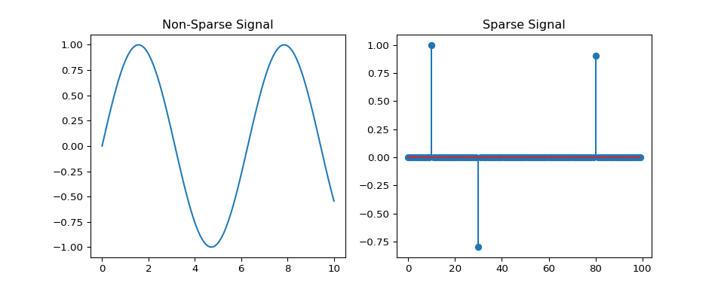
Sparsity: Conceptual Diagram Code
import numpy as np
import matplotlib.pyplot as plt
# Non-sparse signal (e.g., sine wave)
x_dense = np.linspace(0, 10, 100)
y_dense = np.sin(x_dense)
# Sparse signal (e.g., a few spikes)
x_sparse = np.arange(100)
y_sparse = np.zeros(100)
y_sparse[[10, 30, 80]] = [1, -0.8, 0.9]
fig, (ax1, ax2) = plt.subplots(1, 2, figsize=(10, 4))
ax1.plot(x_dense, y_dense)
ax1.set_title("Non-Sparse Signal")
ax2.stem(x_sparse, y_sparse)
ax2.set_title("Sparse Signal")
sparsity_diagram_fig = plt.gcf()

Slide 162
Sparsity: Conceptual Diagram

Slide 163
Sparsity: Conceptual Diagram (cont.)
A sparse signal is one where most of the values are zero (or very close to it). Compressed sensing works by finding a transform domain where the signal becomes sparse.

Slide 164
Modern Topics: Deep Learning
Deep Learning, particularly Convolutional Neural Networks (CNNs), has revolutionized medical image analysis.

Slide 165
Modern Topics: Deep Learning
A CNN is a type of neural network that uses convolution as its primary operation.

Slide 166
Modern Topics: Deep Learning
Instead of using a fixed filter (like a ramp filter or a smoothing filter), a CNN learns the optimal filter kernels directly from training data to perform a specific task.
Notes:
Think back to our convolution examples. We designed a simple averaging filter for denoising. A CNN might learn thousands of different, complex filter shapes that are perfectly optimized for a specific type of noise from a CT image, or for highlighting the texture of a tumor. They are essentially “learned filters.”

Slide 167
The Role of CNNs
CNNs are used for a huge variety of tasks: - Image Reconstruction: Learned alternatives to FBP or iterative methods. - Denoising: Learning to remove noise more effectively than traditional filters. - Segmentation: Automatically outlining organs or tumors. - Classification: Diagnosing whether a lesion is benign or malignant.
Notes:
The field is moving incredibly quickly, but the core mathematical operations inside these complex networks are still convolutions and non-linear transformations—concepts that are extensions of the material we have covered in this course.

Slide 168
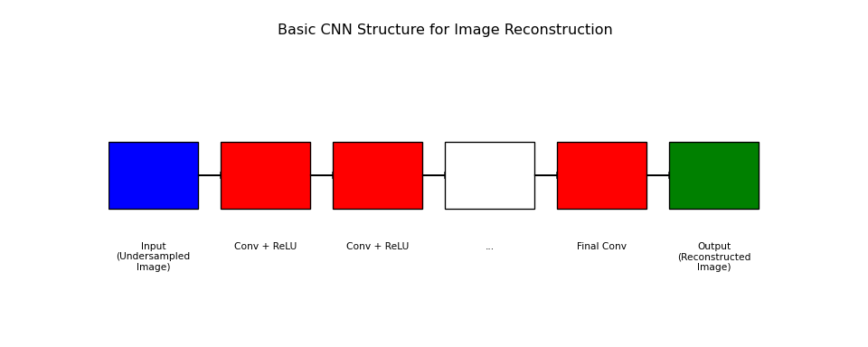
CNN Architecture: Conceptual Diagram Code
import matplotlib.pyplot as plt
from matplotlib.patches import Rectangle
fig, ax = plt.subplots(figsize=(10, 4))
layers = [
("Input\n(Undersampled\nImage)", "blue"),
("Conv + ReLU", "red"),
("Conv + ReLU", "red"),
("...", "white"),
("Final Conv", "red"),
("Output\n(Reconstructed\nImage)", "green")
]
for i, (label, color) in enumerate(layers):
ax.add_patch(Rectangle((i, 1.5), 0.8, 1, facecolor=color, edgecolor='black'))
ax.text(i + 0.4, 1, label, ha='center', va='top', fontsize=8)
if i < len(layers) - 1:
plt.arrow(i + 0.8, 2, 0.2, 0, head_width=0.1, head_length=0.1, fc='black', ec='black')
ax.set_xlim(0, len(layers))
## (0.0, 6.0)
ax.set_ylim(0, 4)
## (0.0, 4.0)
ax.axis('off')
## (np.float64(0.0), np.float64(6.0), np.float64(0.0), np.float64(4.0))
ax.set_title("Basic CNN Structure for Image Reconstruction")
cnn_diagram_fig = plt.gcf()

Slide 169
CNN Architecture: Conceptual Diagram

Slide 170
CNN Architecture: Conceptual Diagram (cont.)
Input Layer: Takes the corrupted/undersampled image.
Hidden Layers: A series of convolutional layers (often with non-linear activation functions like ReLU) extract features and learn the image structure.
Output Layer: Produces the final, high-quality reconstructed image.

Slide 171
Course Summary
Module 1: We defined deterministic signals and LSI systems, and established convolution and the Fourier Transform as our core analytical tools.
Module 2: We introduced the reality of stochastic systems, characterizing noise and its impact on image quality through metrics like SNR and DQE.

Slide 172
Course Summary
Module 3: We applied these tools to understand tomography, the process of image reconstruction from projections, using algorithms like FBP.
Module 4: We saw how these fundamental concepts extend to other modalities like MRI and form the basis for modern techniques like compressed sensing and deep learning.
Notes:
Congratulations on completing the course. You now have the foundational knowledge to understand the physics and mathematics behind virtually any medical imaging system.

