Slide 1
The Fourier Transform in Medical Imaging
From Principles to Practice Graduate Medical Physics Program

Slide 2
Module 1: The Foundation
Intuition First: The Musical Chord
Notes:
“Good morning, everyone. Welcome to what is arguably the most important mathematical concept in medical imaging: The Fourier Transform.
I want to start by asking you to close your eyes for a second. Imagine I am sitting at a grand piano. I strike three keys simultaneously—a C, an E, and a G. You hear a single, rich sound—a chord. Your ear doesn’t need to do any calculations to understand this. Instantly, your brain processes that complex pressure wave hitting your eardrum and breaks it down: you hear the bass of the C, the harmony of the E, and the treble of the G.
Open your eyes. What your ear just did is exactly what we need to do in MRI.”

Slide 3
The Concept: Decomposition
Signals (sound, light, MR echoes) are often composites.
Imagine a C-Major chord: one sound, but composed of three distinct notes (C, E, G).
The Fourier Transform is the mathematical “ear” that identifies the constituent frequencies and their amplitudes.

Slide 4
Visual Aid: Prism Analogy
A prism splits white light into a rainbow.
The Fourier Transform acts like a prism, splitting a complex signal into its simple frequency components.
Notes:
“In Magnetic Resonance Imaging, we do not take a picture of the brain. We cannot simply ‘photograph’ protons. Instead, we listen to them. We record the ‘musical chord’ sung by the hydrogen atoms in your body. This signal is a complex, jumbled mess of radio waves.
The Fourier Transform is the mathematical machine that acts like your ear. It takes that complex signal and unmixes it. It tells us: ‘This much signal came from the left ear, and this much came from the nose.’ It acts like a prism, splitting the white light of the raw data into the color spectrum of the final image. Without Fourier, MRI is just a noisy radio recording. With it, it is a diagnostic miracle.”

Slide 5
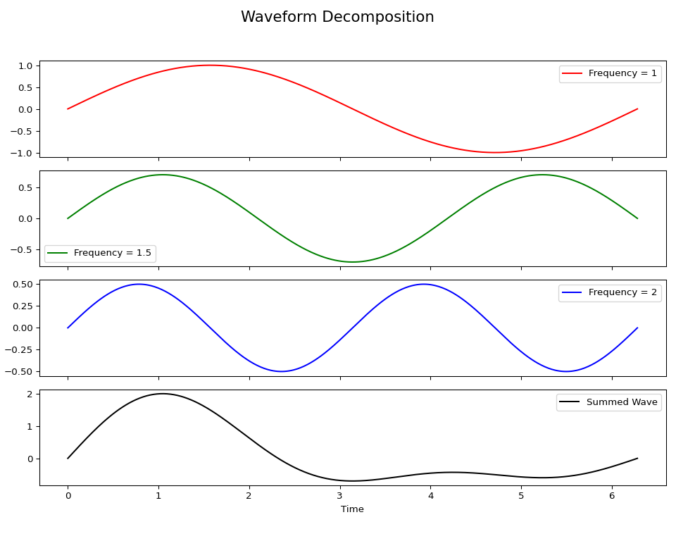
Python Code: Waveform Decomposition
import numpy as np import matplotlib.pyplot as plt # Time base t = np.linspace(0, 2 * np.pi, 500) # Frequencies f1 = 1 f2 = 1.5 f3 = 2 # Individual sine waves wave1 = np.sin(f1 * t) wave2 = 0.7 * np.sin(f2 * t) wave3 = 0.5 * np.sin(f3 * t) # Summed wave summed_wave = wave1 + wave2 + wave3 # Plotting fig, axs = plt.subplots(4, 1, figsize=(10, 8), sharex=True) # Plot individual waves axs[0].plot(t, wave1, 'r', label=f'Frequency = {f1}') axs[0].legend() axs[1].plot(t, wave2, 'g', label=f'Frequency = {f2}') axs[1].legend() axs[2].plot(t, wave3, 'b', label=f'Frequency = {f3}') axs[2].legend() # Plot summed wave axs[3].plot(t, summed_wave, 'k', label='Summed Wave') axs[3].legend() plt.xlabel('Time') fig.suptitle('Waveform Decomposition', fontsize=16) plt.tight_layout(rect=[0, 0.03, 1, 0.95]) plt.show()

Slide 6
The Fourier Series
Notes:
“Let’s formalize this. In the early 1800s, Joseph Fourier proposed an idea that his contemporaries thought was insane. He claimed that you could build any repeating shape using only smooth, curving waves.”

Slide 7
The Concept: Building Blocks
Joseph Fourier’s insight: Any periodic function can be constructed by adding together infinite smooth sine and cosine waves.
This applies even to jagged, discontinuous, or square functions.

Slide 8
The Math: Fourier Series Equation
The Fourier Series for a periodic function $f\left(t\right)$ with period $T$:
$$f\left(t\right)=a_{0}+\sum_{n=1}^{∞}{\left(a_{n}cos\left(nω_{0}t\right)+b_{n}sin\left(nω_{0}t\right)\right)}$$

Slide 9
The Math: Equation Breakdown
$a_{0}$: The “DC offset” or average value of the signal.
$ω_{0}$: The fundamental frequency ($2π/T$).
$n$: The harmonic index (1st, 2nd, 3rd…).
$a_{n},b_{n}$: The “weights” or amplitudes of each frequency component.
Notes:
“Look at the equation on the board. a_0 is simply the average. If we are imaging a liver, a_0 is the average brightness of the whole liver. Then we have the summation. We start with a fundamental frequency—a simple sine wave. It’s too round to look like a square pixel. So, what do we do? We add a second wave, twice as fast, but maybe with a smaller amplitude. Then a third, three times as fast.”

Slide 10
Crucial Point: Resolution
To build a square wave (representing a sharp edge in an image), we need many sine waves.
Low-frequency waves give the general shape.
High-frequency waves (large $n$) sharpen the corners.
Notes:
“If I want to build a square wave—which represents a sharp edge in an image—I need to stack many sine waves. The low-frequency waves give me the general ‘up and down’ shape. The high-frequency waves—the ones where n is large—sharpen the corners.
Crucial Point: If we stop the summation early—say we only add the first 5 waves—our square wave looks ‘wobbly.’ The corners are soft. In MRI, this corresponds to a low-resolution image. If we want sharp edges (high resolution), we need to collect high values of n. We need the high frequencies.”

Slide 11
Euler’s Formula: The Rotation Machine
Notes:
“Now, we transition from the Series (for repeating signals) to the Transform (for any signal). And we meet the equation that scares every undergraduate: the complex exponential.”

Slide 12
The Concept: Oscillation as Rotation
Sines and cosines can be difficult to manipulate.
Euler’s formula lets us treat oscillation as rotation.
This allows us to visualize the Fourier Transform as a “winding” process.

Slide 13
The Math: Euler’s Identity
$$e^{iθ}=cos\left(θ\right)+isin\left(θ\right)$$
Notes:
“Don’t let the imaginary number i intimidate you. In this class, we treat e^{i\theta} physically. It is a rotation machine. Imagine a clock hand spinning on a face. If you look at that clock from the side, the tip of the hand traces a sine wave moving up and down.”

Slide 14
The Math: The Fourier Transform
The General Fourier Transform equation:
$$F\left(ω\right)=\int_{−∞}^{∞}{f}\left(t\right)e^{−iωt}dt$$

Slide 15
The Intuition: Winding the Signal
What is this equation doing? 1. We take our signal, $f\left(t\right)$. 2. We multiply it by a ‘winding machine’, $e^{−iωt}$, which spins at a specific speed $ω$. 3. We sum up (integrate) the result over time.
Notes:
“So, look at the Transform equation: \int f(t) e^{-i\omega t} dt. What is this actually doing?
We take our signal, f(t).
We multiply it by a ‘winding machine’, e^{-i\omega t}, which spins at a specific speed \omega.
We sum up (integrate) the result over time.
Think of it this way: We wrap our signal around a circle. If the signal has a periodic pattern that matches the winding speed \omega, all the ‘bumps’ in the signal line up on one side of the circle. The center of mass shifts. The integral becomes large. We get a spike in the spectrum. If the winding speed \omega doesn’t match the signal, the signal wraps around the circle randomly. The positive parts cancel the negative parts. The average is zero.
The Fourier Transform is effectively asking: ‘If I wind this signal at speed \omega, does it pile up?’ If yes, that frequency exists in the signal.”

Slide 16
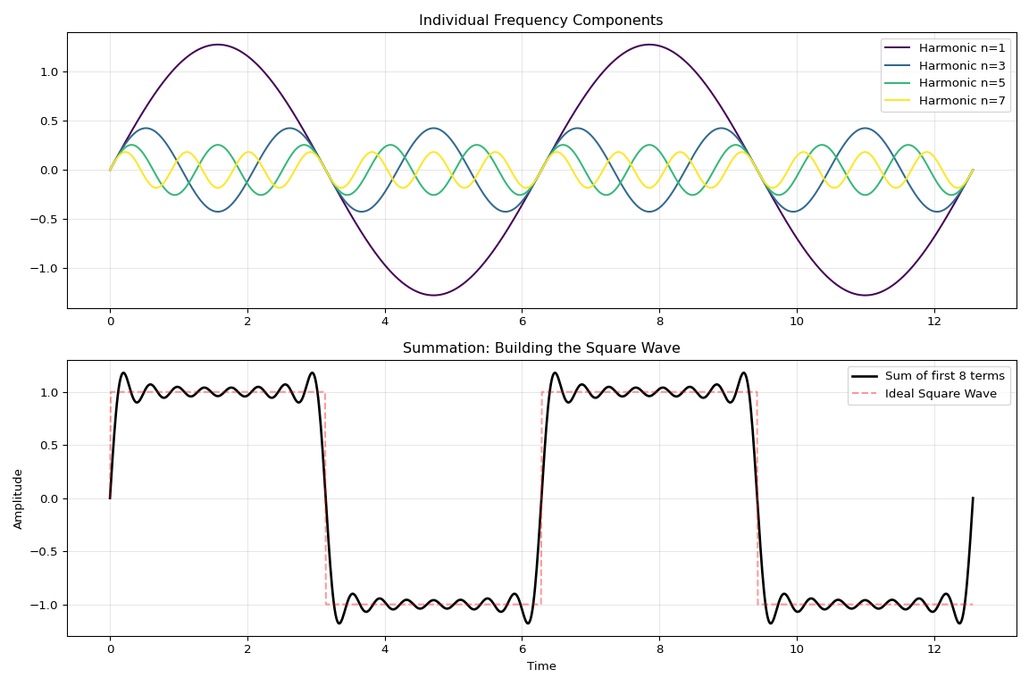
Python Code: Square Wave Approximation
import numpy as np import matplotlib.pyplot as plt # Setup time domain t = np.linspace(0, 4*np.pi, 1000) square_approx = np.zeros_like(t) # We use odd harmonics for a square wave (1, 3, 5, etc.) terms = [1, 3, 5, 7, 9, 11, 13, 15] plt.figure(figsize=(12, 8)) # Subplot 1: The individual components plt.subplot(2, 1, 1) plt.title("Individual Frequency Components") colors = plt.cm.viridis(np.linspace(0, 1, len(terms[:4]))) for i, n in enumerate(terms[:4]): # Plot first 4 components amplitude = (4/np.pi) * (1/n) component = amplitude * np.sin(n * t) plt.plot(t, component, label=f'Harmonic n={n}', color=colors[i], linewidth=1.5) plt.legend(loc='upper right') plt.grid(True, alpha=0.3) # Subplot 2: The Summation plt.subplot(2, 1, 2) plt.title("Summation: Building the Square Wave") for n in terms: square_approx += (4/np.pi) * (1/n) * np.sin(n * t) plt.plot(t, square_approx, 'k-', linewidth=2, label=f'Sum of first {len(terms)} terms') # Overlay the ideal square wave for comparison ideal_square = np.sign(np.sin(t)) plt.plot(t, ideal_square, 'r--', alpha=0.4, label='Ideal Square Wave') plt.xlabel('Time') plt.ylabel('Amplitude') plt.legend(loc='upper right') plt.grid(True, alpha=0.3) plt.tight_layout() plt.show()

Slide 17
Module 2: The Digital Domain & FFT
Continuous to Discrete
Notes:
“The integral we just looked at is mathematically beautiful, but computationally impossible. A computer cannot store a continuous function; it has finite memory. It can only store a list of numbers. In MRI, the scanner reads the signal at specific time points: t_0, t_1, t_2... This is called sampling.”

Slide 18
The Concept: Sampling
Real life physics is continuous (analog).
Computers and MRI scanners are discrete (digital).
We cannot integrate from $−∞$ to $+∞$. We must take snapshots (samples) at fixed intervals.

Slide 19
The Math: The Discrete Fourier Transform (DFT)
$$X_{k}=\sum_{n=0}^{N−1}{x_{n}}e^{−i2πkn/N}$$
Notes:
“Consequently, we must swap our tools.
The Integral (\int) becomes a Summation (\sum).
The continuous time t becomes an index n (sample number 1, sample number 2…).
The infinite range becomes a finite number of samples N.
This equation on the slide—the DFT—is the workhorse of modern medical imaging. Every time you see a reconstructed MR image, this specific summation has been calculated millions of times.”

Slide 20
Sampling and Aliasing
Notes:
“We have to be careful when we sample. Has anyone ever watched a video of a car driving on the highway, and the wheels look like they are spinning backwards? That is Aliasing.”

Slide 21
The Nyquist-Shannon Theorem
To accurately digitize a signal of frequency $f$, you must sample at a rate of at least $2f$.
If you sample too slowly, high-frequency signals are misinterpreted as low-frequency signals. This is Aliasing.

Slide 22
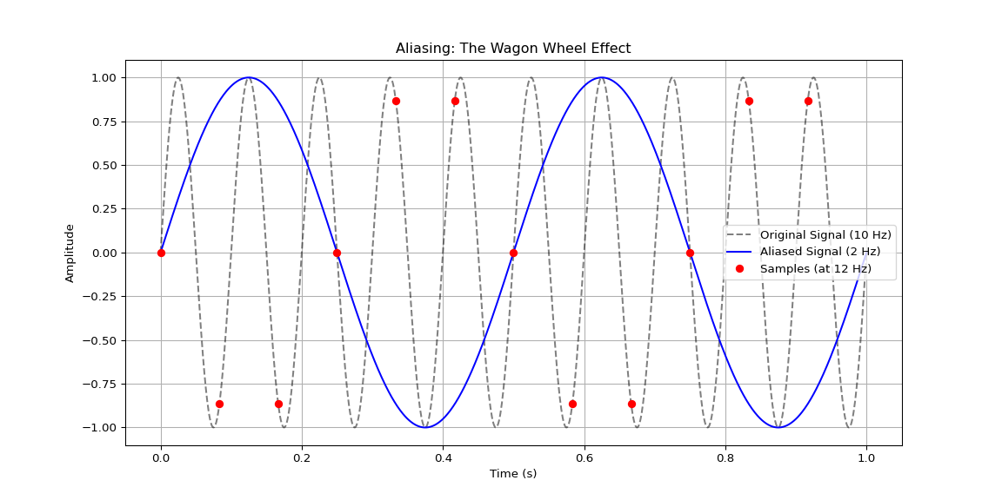
Python Code: The “Wagon Wheel” Effect (Aliasing)
import numpy as np import matplotlib.pyplot as plt # High-frequency signal f_high = 10 # Hz t_cont = np.linspace(0, 1, 1000) signal_cont = np.sin(2 * np.pi * f_high * t_cont) # Undersampling fs_bad = 12 # Sampling freq < 2 * f_high t_bad = np.arange(0, 1, 1/fs_bad) signal_bad = np.sin(2 * np.pi * f_high * t_bad) # Aliased frequency f_alias = abs(f_high - fs_bad) signal_alias = np.sin(2 * np.pi * f_alias * t_cont) # Plotting plt.figure(figsize=(12, 6)) plt.plot(t_cont, signal_cont, 'k--', label=f'Original Signal ({f_high} Hz)', alpha=0.5) plt.plot(t_cont, signal_alias, 'b-', label=f'Aliased Signal ({f_alias} Hz)') plt.plot(t_bad, signal_bad, 'ro', label=f'Samples (at {fs_bad} Hz)') plt.title('Aliasing: The Wagon Wheel Effect') plt.xlabel('Time (s)') plt.ylabel('Amplitude') plt.legend() plt.grid(True) plt.show()

Slide 23
Notes:
“The camera is taking pictures (sampling) at 30 frames per second. The wheel is spinning faster than that. Between one frame and the next, the wheel spins almost all the way around, so it looks like it moved slightly backward.
The camera—the sampler—lied to you. It told you the frequency was -5 Hz when it was actually +100 Hz.
In MRI, this is a disaster. If the signal from the patient changes faster than our scanner samples it, that high-frequency data (usually edges or noise) will ‘fold over’ and appear as low-frequency data in the wrong part of the image. This leads to the ‘Wrap-Around Artifact,’ where a patient’s nose might wrap around and appear inside the back of their head.”

Slide 24
The Fast Fourier Transform (FFT)
Notes:
“You will often hear ‘DFT’ and ‘FFT’ used interchangeably. They result in the same numbers, but the difference is speed.”

Slide 25
The Concept: An Efficient Algorithm
The FFT is not a new concept; it is an efficient algorithm for calculating the DFT.
Naive DFT: Complexity $O\left(N^{2}\right)$.
FFT: Complexity $O\left(NlogN\right)$.
This speed difference makes real-time MRI possible.
Notes:
“Imagine you have an image that is 256 \times 256 pixels. If you use the standard DFT definition, the computer has to do roughly N squared operations. For high-resolution medical images, this would take minutes, maybe hours on older hardware.
In 1965, Cooley and Tukey popularized the FFT. They realized that the calculation repeats itself. By dividing the samples into even and odd groups, computing them separately, and combining them, you save massive amounts of time. The FFT allows us to reconstruct an MRI slice in milliseconds. Without this algorithm, MRI would be a slow, academic curiosity, not a clinical tool used in emergency rooms.”

Slide 26
Module 3: Higher Dimensions & K-Space
The Leap to 2D
Notes:
“Now we move from sound to sight. From 1D to 2D.”

Slide 27
The Concept: 2D Waves
A 1D signal is a ripple on a string.
A 2D signal is a “corrugated sheet” or a pattern of stripes.
It has three properties:
Amplitude: How bright the stripes are.
Frequency: How close the stripes are packed.
Orientation: The angle of the stripes.

Slide 28
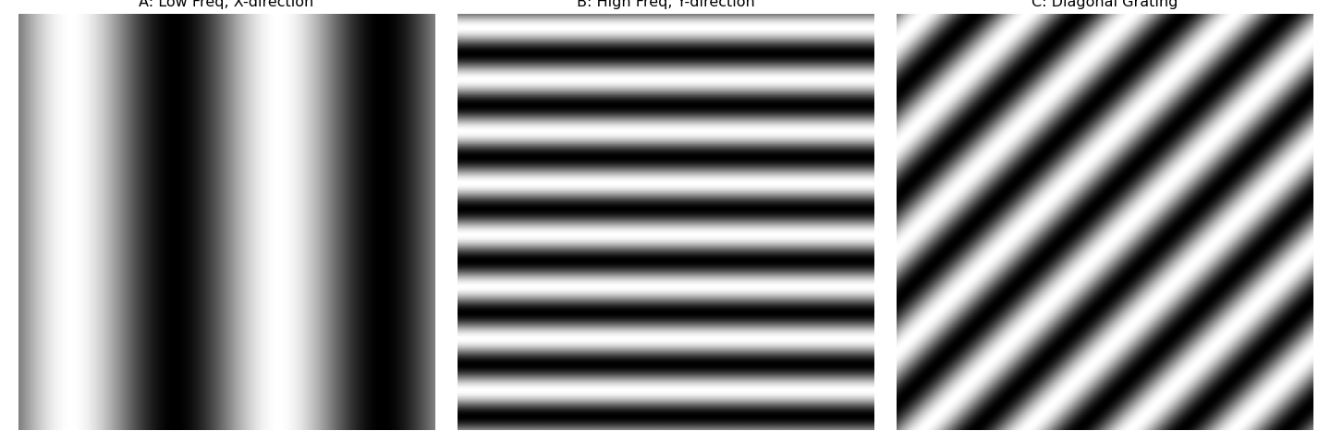
Python Code: 2D Sine Waves (“Gratings”)
import numpy as np import matplotlib.pyplot as plt # Grid x = np.linspace(-np.pi, np.pi, 256) y = np.linspace(-np.pi, np.pi, 256) X, Y = np.meshgrid(x, y) # Gratings # A: Low frequency, x-direction grating_A = np.sin(2 * X) # B: High frequency, y-direction grating_B = np.sin(8 * Y) # C: Diagonal grating_C = np.sin(4 * X + 4 * Y) # Plotting fig, axs = plt.subplots(1, 3, figsize=(15, 5)) axs[0].imshow(grating_A, cmap='gray') axs[0].set_title('A: Low Freq, X-direction') axs[0].axis('off')
## (np.float64(-0.5), np.float64(255.5), np.float64(255.5), np.float64(-0.5))
axs[1].imshow(grating_B, cmap='gray') axs[1].set_title('B: High Freq, Y-direction') axs[1].axis('off')
## (np.float64(-0.5), np.float64(255.5), np.float64(255.5), np.float64(-0.5))
axs[2].imshow(grating_C, cmap='gray') axs[2].set_title('C: Diagonal Grating') axs[2].axis('off')
## (np.float64(-0.5), np.float64(255.5), np.float64(255.5), np.float64(-0.5))
plt.tight_layout() plt.show()

Slide 29
Notes:
“When we perform a Fourier Transform on an image, we are decomposing the picture into layers of stripes. I want you to imagine a clear plastic sheet with wide vertical black bars painted on it. Now imagine another sheet with thin horizontal bars. If I stack thousands of these sheets—some with diagonal bars, some thick, some thin—and I look through the whole stack, the overlapping patterns will form a picture. That is the Inverse 2D Fourier Transform. We are building an image out of gratings.”

Slide 30
Defining K-Space
Notes:
“This is the concept that trips up most students. When you look at the raw data file coming off an MRI scanner, you do not see a brain. You see a galaxy of bright dots. This is K-Space.”

Slide 31
The Concept: A Frequency Map
K-Space is the “frequency domain” map of the image.
It is a coordinate system $\left(k_{x},k_{y}\right)$.
$k_{x}$ axis: Horizontal frequencies (vertical stripes).
$k_{y}$ axis: Vertical frequencies (horizontal stripes).

Slide 32
Navigating K-Space
Center $\left(0,0\right)$: Zero frequency. Average brightness (contrast). Contains the most energy.
Periphery: High frequencies. Fine details and sharp edges.
Notes:
“K-space is a map. But it’s not a map of ‘where things are’ (like a nose or an ear). It is a map of ‘how fast things change.’
Let’s navigate this map:
Stand in the center: You are at low frequency. This data tells us about the large, smooth shapes. The general contrast of the brain vs the skull. If we delete the center of K-space, the image turns grey and ghostly; we lose the contrast.
Walk to the edge: You are at high frequency. This data tells us about sharp changes—the edges of the ventricles, the boundary of a tumor. If we delete the edges of K-space, the image gets blurry. The details vanish.”

Slide 33
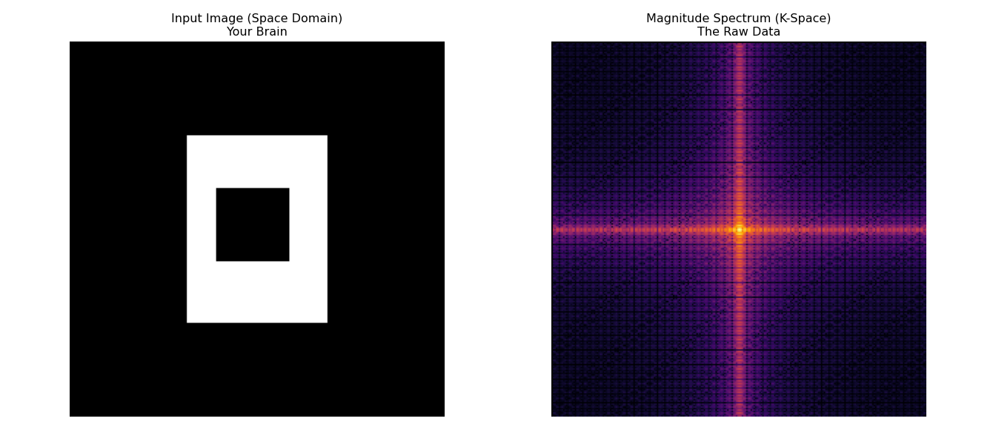
Python Code: 2D FFT and K-Space
import numpy as np import matplotlib.pyplot as plt from scipy import fftpack # 1. Create a simple 2D phantom phantom = np.zeros((256, 256)) phantom[64:192, 80:176] = 1 # Big rectangle phantom[100:150, 100:150] = 0 # Hole in the middle # 2. Perform 2D FFT f_transform = fftpack.fft2(phantom) # 3. Shift the zero-frequency component to the center f_shift = fftpack.fftshift(f_transform) # 4. Calculate magnitude spectrum (log scale) magnitude_spectrum = 20 * np.log(np.abs(f_shift) + 1) # Visualization plt.figure(figsize=(14, 6)) plt.subplot(1, 2, 1) plt.imshow(phantom, cmap='gray') plt.title('Input Image (Space Domain)\nYour Brain') plt.axis('off')
## (np.float64(-0.5), np.float64(255.5), np.float64(255.5), np.float64(-0.5))
plt.subplot(1, 2, 2) plt.imshow(magnitude_spectrum, cmap='inferno') plt.title('Magnitude Spectrum (K-Space)\nThe Raw Data') plt.axis('off')
## (np.float64(-0.5), np.float64(255.5), np.float64(255.5), np.float64(-0.5))
plt.tight_layout() plt.show()

