Slide 1
Data Preparation
Dataset Information
DATASET : 4340 rows and 8 columns
name : The car’s brand including its model.
selling_price : This is the current selling price of the car.
year : The year that the car was initially bought.
km_driven : The number of kilometers that the car has accumulated while being driven.
fuel : The type of fuel that the car consumes.
seller_type : The person selling the car whether it is the owner or a dealer.
transmission : This is how the car’s power moves from the engine to the wheels-Automatic or Manual transmission
Owner : The number of people that have owned the car since its manufacture.
Splitting the Car Make attribute (column : name) name and model.
Check incompleteness in the dataset (NULL values).
Check the duplicate data points
The Dataset after cleaning has 3577 rows and 9 columns

Slide 2
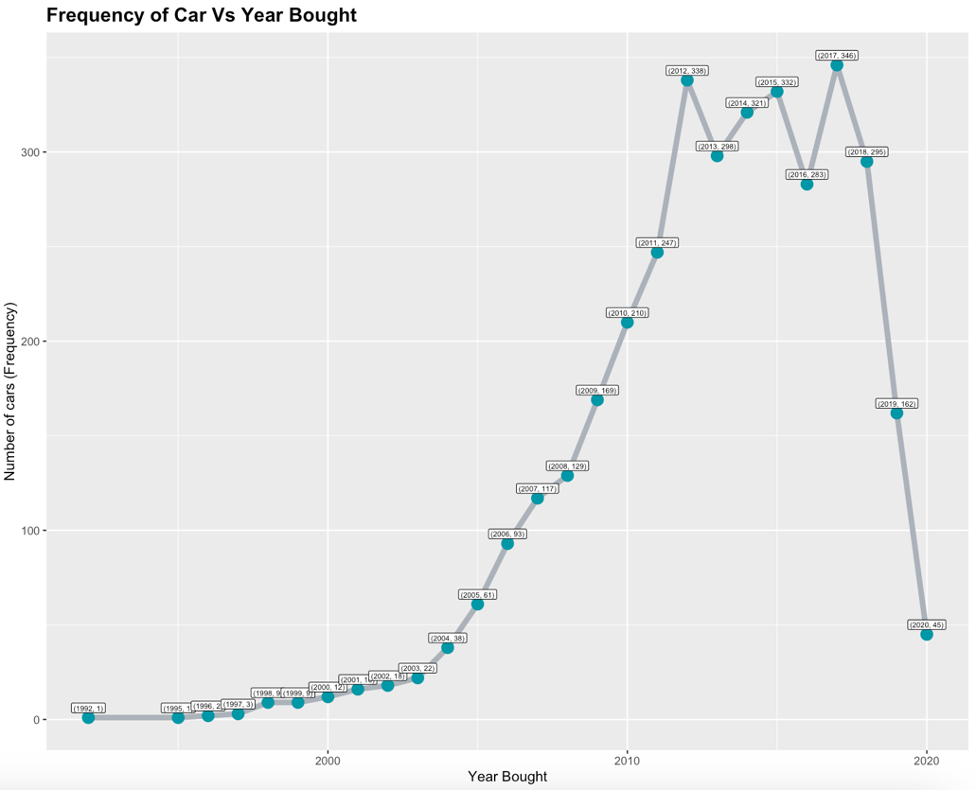
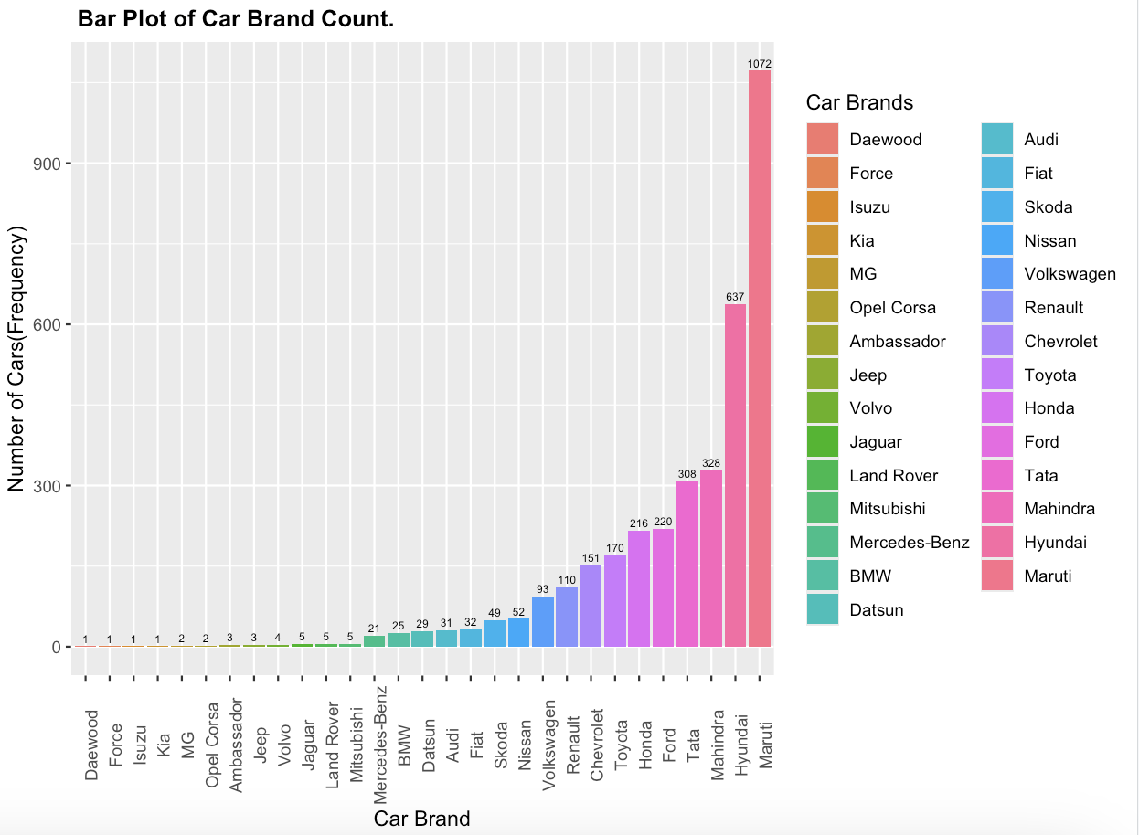
Data Distribution
Figure 1 :
Figure 2 :
This shows that most number of cars varying between the years 2011 to 2018.
Bar Chart showing the frequency of car brands in ascending order

Slide 3
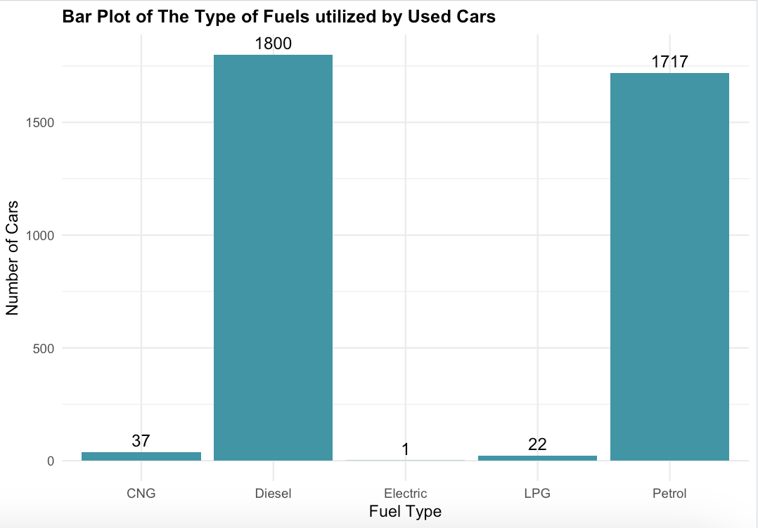
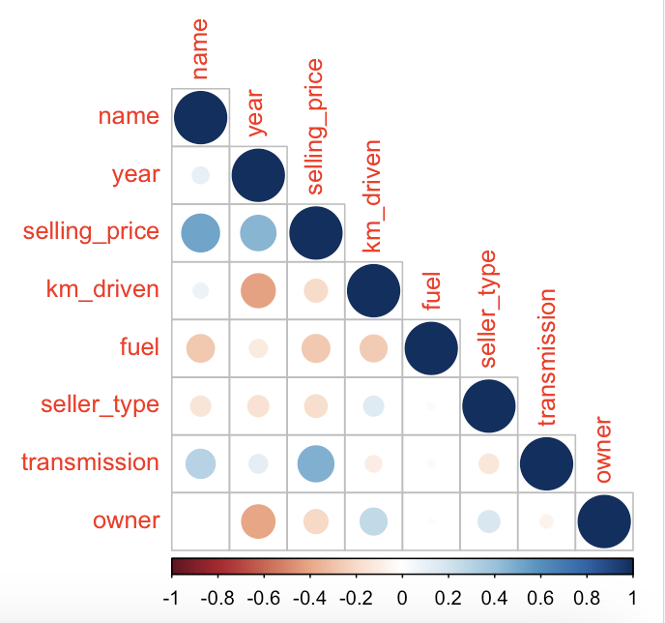
Data Transformation
Figure 3 :
Correlation Diagram :
From the resulting correlation plot, we can see that the target variable(selling_price)
is very positively correlated with three predictor variables : name, transmission, and year. Then, ‘km_driven’ and ‘owner’, ‘km_driven’ and ‘seller_type’, ‘owner’ and ‘seller_type’, ‘name’ and ‘transmission’ all had very little correlation respectively.
From the bar chart we see that the fuel type is divided into approximately into 2 group : Diesel and Petrol

Slide 4
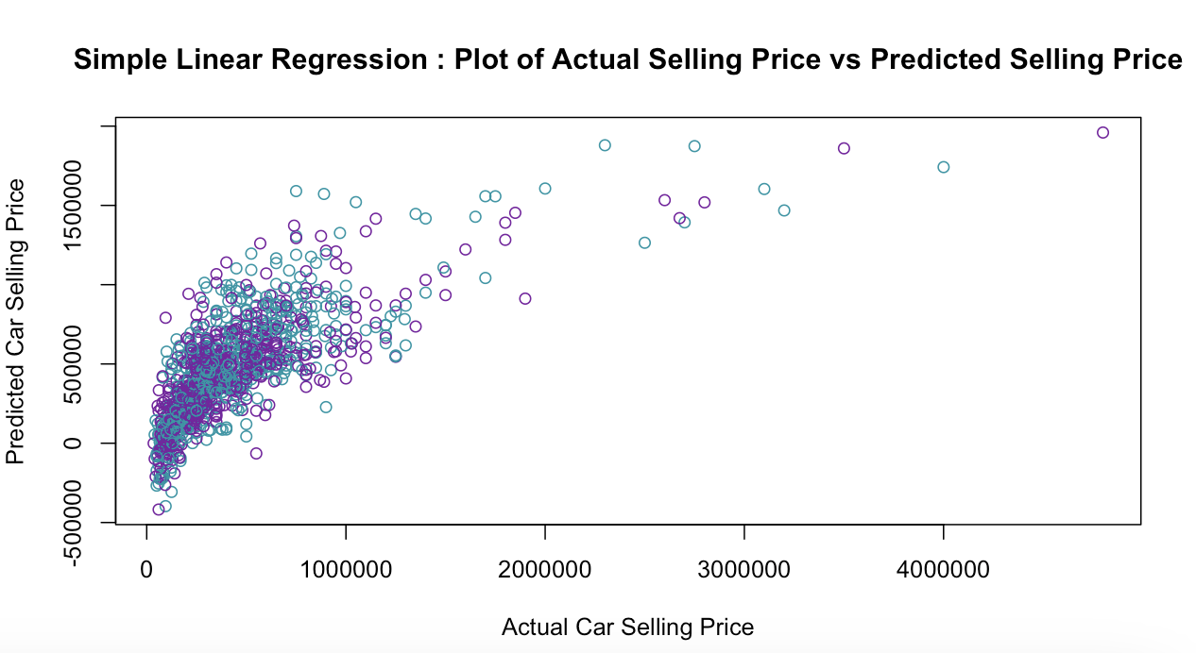
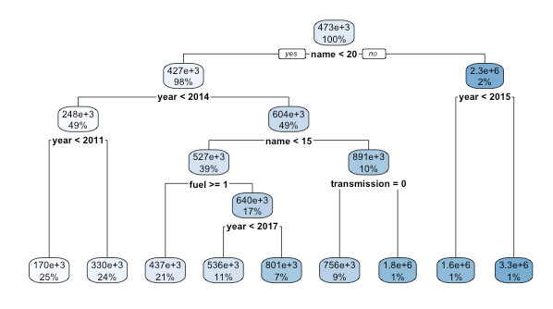
Machine Learning Model
Model 1 : Simple Linear Regression
Model 2 : Basic Regression Tree
Regression_tree_model1 <- rpart(selling_price ~ year + name + km_driven + fuel + seller_type + transmission + owner,data = train_car, method = "anova")
Simple_Linear_Regression_1 <- lm(selling_price ~ year + name +
km_driven + fuel + seller_type + transmission + owner,data = train_car)
The R square value of the predicted test data using this model is : 0.595194613660132
The Root Mean Square value of the predicted test data using this model is : 261760.840138064
The R square value of the predicted test data using this model is : 0.535625752140327
The Root Mean Square value of the predicted test data using this model is : 280359.70764486

Slide 5
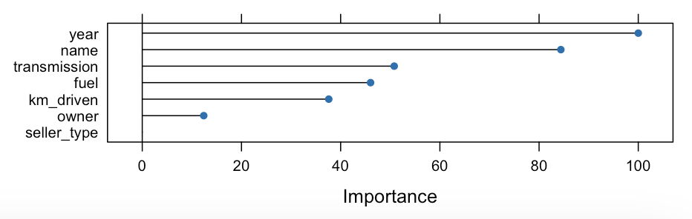
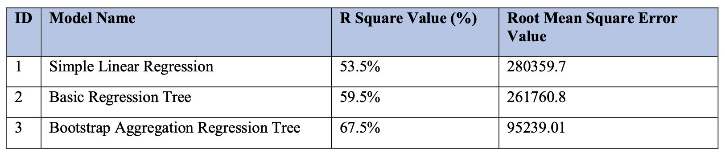
Conclusion :
Model 3 : Bagging Regression Tree
Comparing the 3 models :
We see that using the Bootstrap Aggregation Regression Tree had a significant improvement in R square value than using Simple Linear Regression. Also the RMSE shows improvement. The bagged Regression Tree model’s accuracy is superior as compared to the Linear Regression model or the basic Regression Tree.
Also the top two attribute for predicting the selling price for all the models was : Year (column : year) and Car Brand (column : name), and next three features was the Mileage (column: km_driven), Fuel Type(column: fuel), Transmission (column: transmission). The Ownership Type (column: owner) and Seller Type(column: seller_type) was not considered as significant by all the models.
crossValidated_baggingModel <- train(
selling_price ~ year + name + km_driven + fuel
+ seller_type + transmission + owner,data = train_car, method = "treebag", trControl = ctrl, importance = TRUE) #Rank the predictor variable importance in the model
The R square value of the predicted test data using this mode is : 0.675882531876479
The Root Mean Square value of the predicted test data using this model is : 95239.0151303883

