Slide 1







How it Works
You have an empty
driveway
We manage the rest and you get cash!
Enter listing details
You need parking
Search listings
Book!

Slide 2
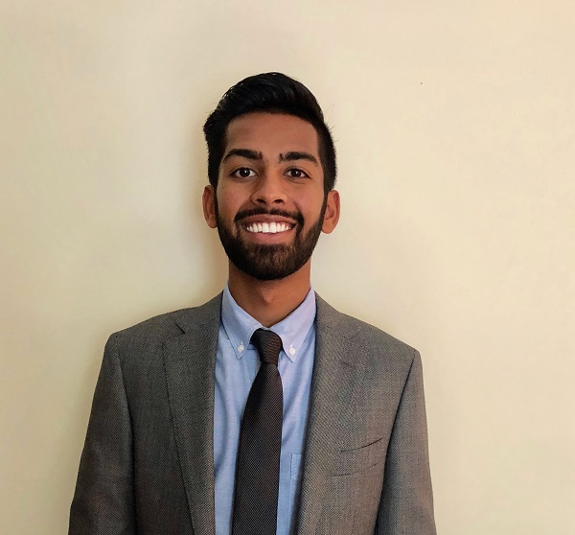
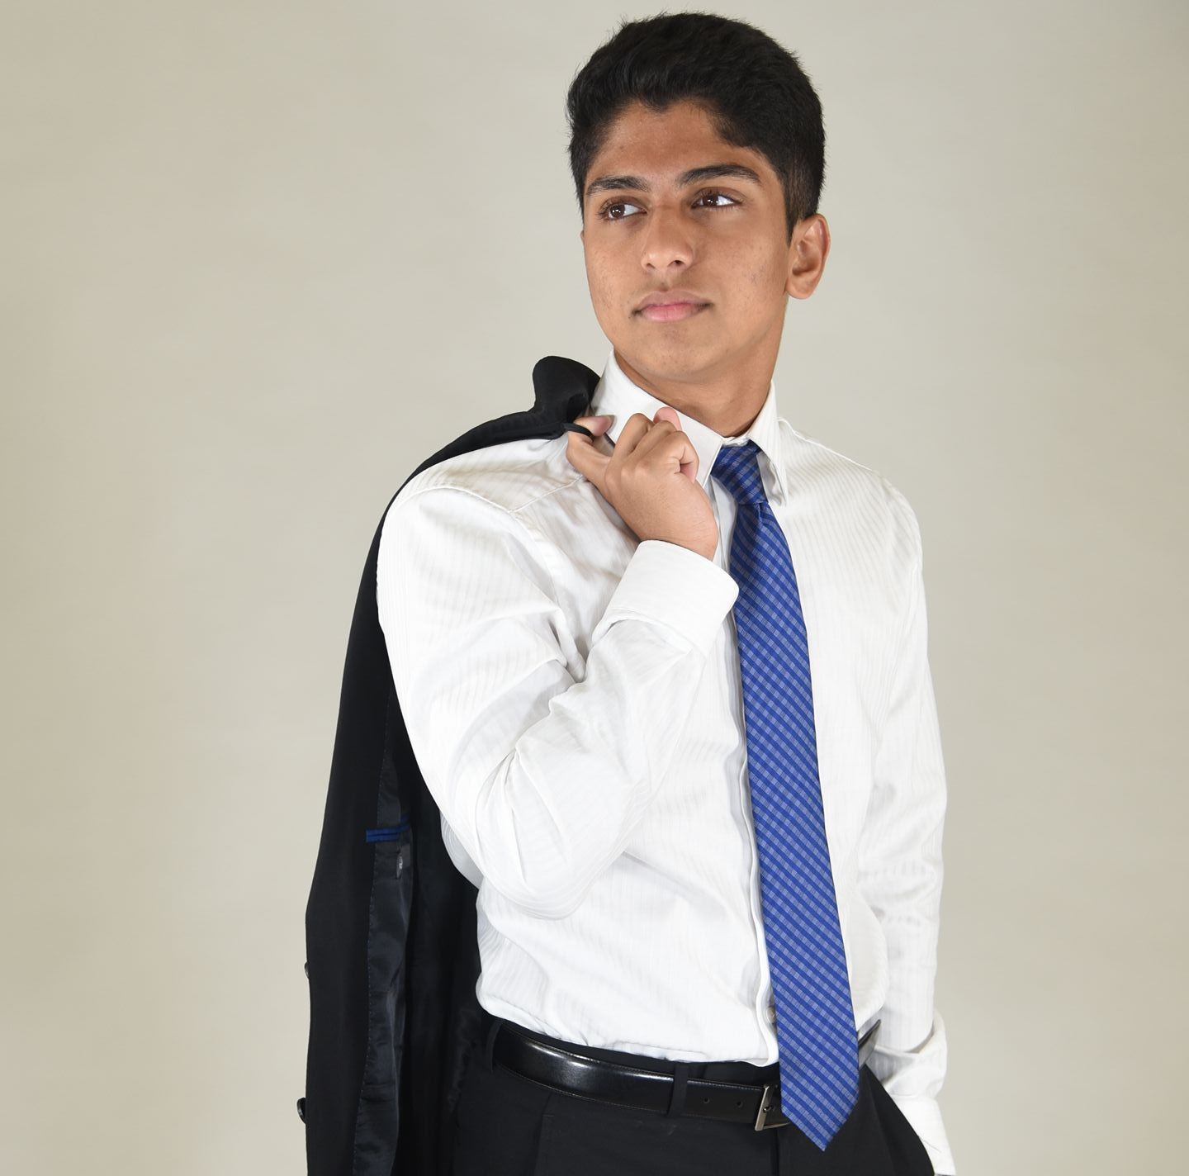
Who we are
Sameer Gupta is an undergraduate at the University of Virgina. He has experience with executing his vision and strategy with real estate startups. He enjoys impacting as many people possible by improving the status quo.
Stephen Palathingal is an undergraduate at the University of Virginia. He has extensive experience in software development and entrepreneurial experience through working at start-ups.

