Slide 1
Webex Contact Center
Admin/Supervisor Training
Customer Solution Assurance Team
[PRESENTER]
[DATE]

Slide 2
Supervisor Agenda
WxCC Overview
What it does?
Different portals
User enrollment
Add/Delete users
Licenses and administrator roles
Provisioning
Provisioning framework
Teams
User profiles
Agent profiles
Multimedia profiles
Aux codes(wrap up and idle)
Skills
Routing Strategies, Flows and Resources
Audio files
Flows
Routing Strategies
Advanced Provisioning
Dashboard
Call monitoring
Call recording
Q&A

Slide 3
WxCC Overview

Slide 4
What does Webex Contact Center do?
For the caller
Call routing based on menu prompts and selections
Call queuing and distribution
For the agent
Call management (hold, consult, conference and transfer)
Make calls (out)
Agent state management (available, break, etc.)
Personal statistics
For the system administrators
ACD administration
Access control rights
Agent provisioning
For the management team (supervisors)
Call monitoring
Call recording
Real-time reports
Historical reports

Slide 5
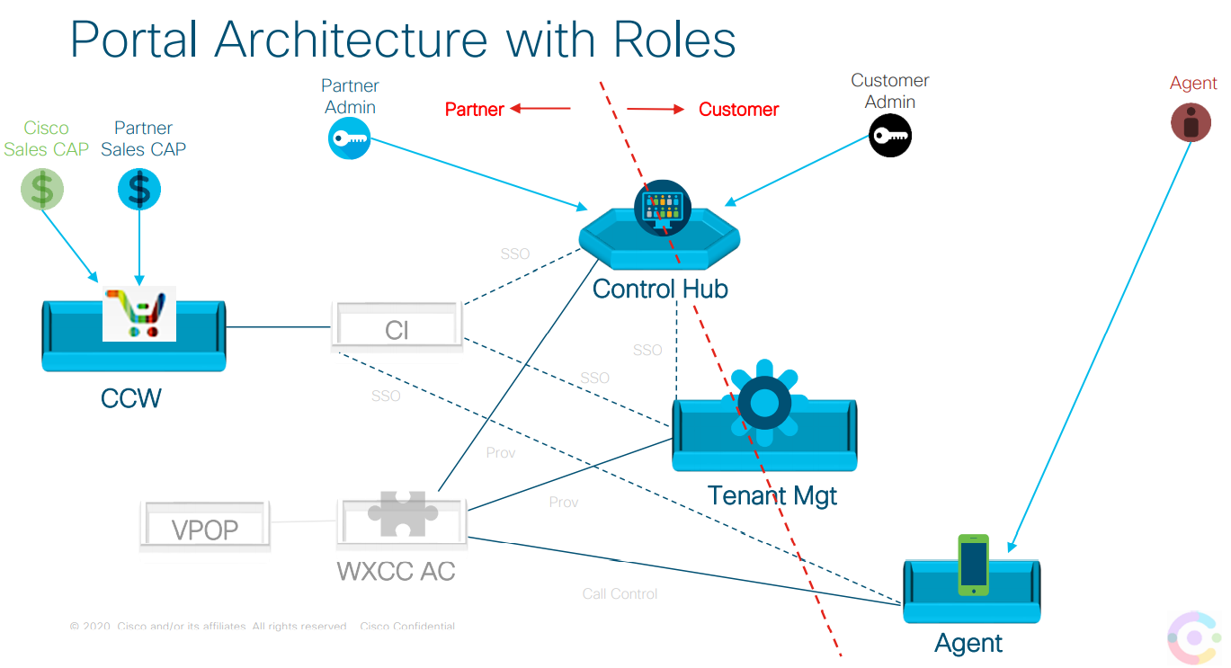

Slide 6
Webex Contact Center
Admin/Supervisor Training
Customer Solution Assurance Team
[PRESENTER]
[DATE]

Slide 7
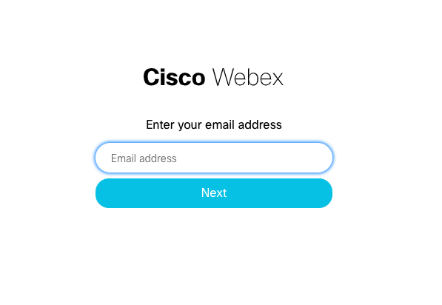
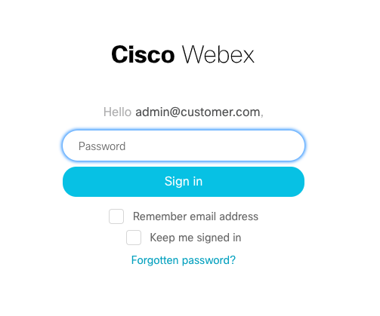
Access URLs
Production URLS
Control Hub: https://admin.webex.com/
*Management Portal: https://portal-v2.wxcc-us1.cisco.com/
**Agent Desktop: https://desktop.wxcc-us1.cisco.com/
*Agents have a restricted view
**You need to have the Contact Center enabled for your user

Slide 8
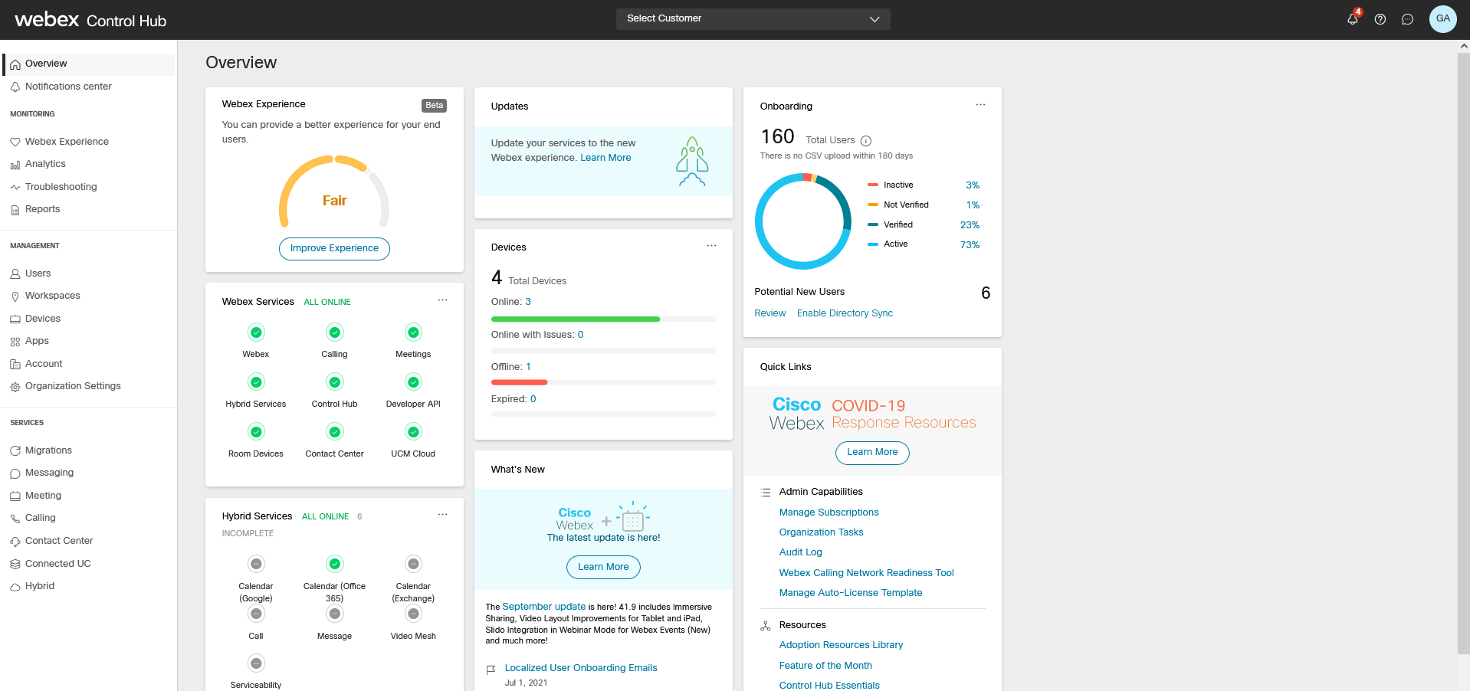
Control Hub

Slide 9
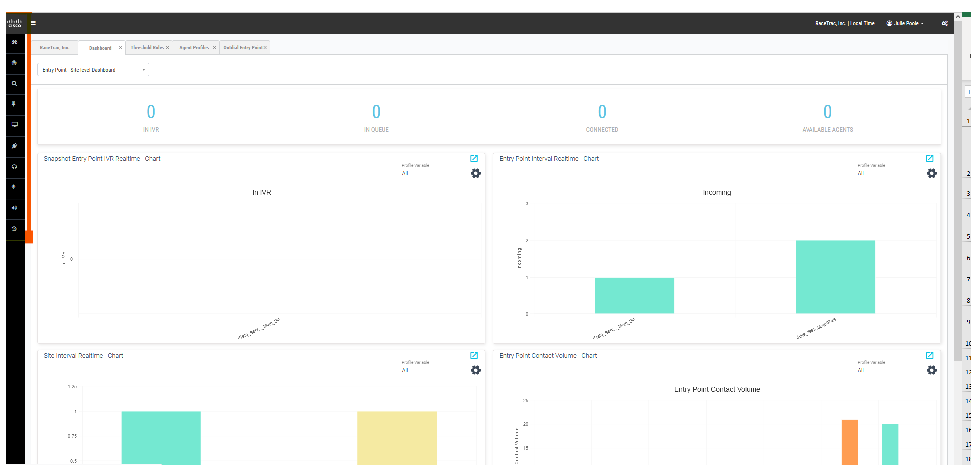
Management Portal

Slide 10
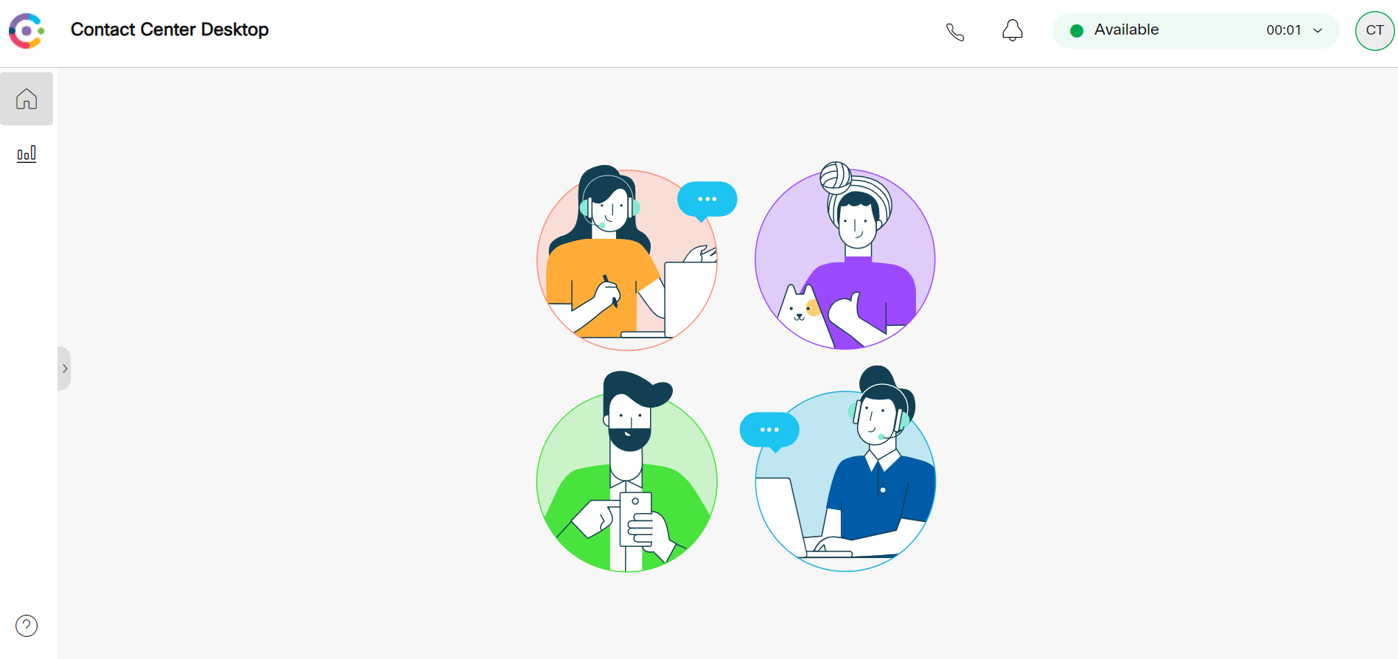
Agent Desktop

Slide 11
User enrollment

Slide 12
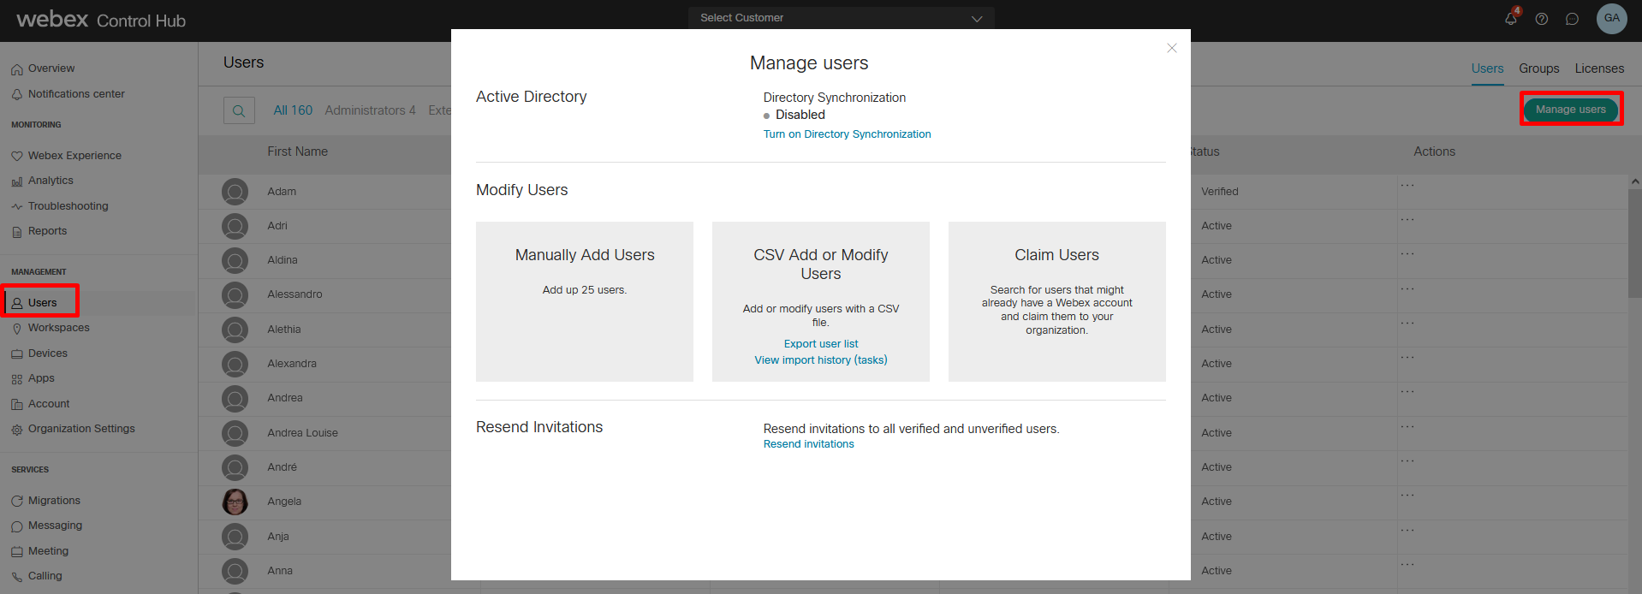
Add/Delete Users
Users must be added/deleted in Control Hub
After deleting the user, the system will put that user in “InActive” status, but will not disappear from the system
Will synchronize to the WxCC admin portal
User profile and agent profile can be modified as well as assignment of team and any skill profile → In the Management Portal
Manually: Add users mail
Bulk: Upload CSV files with data and services

Slide 13
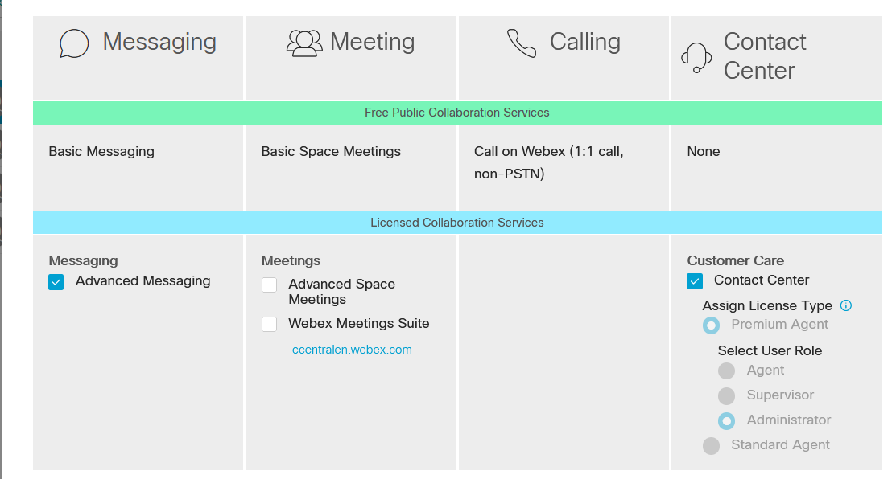
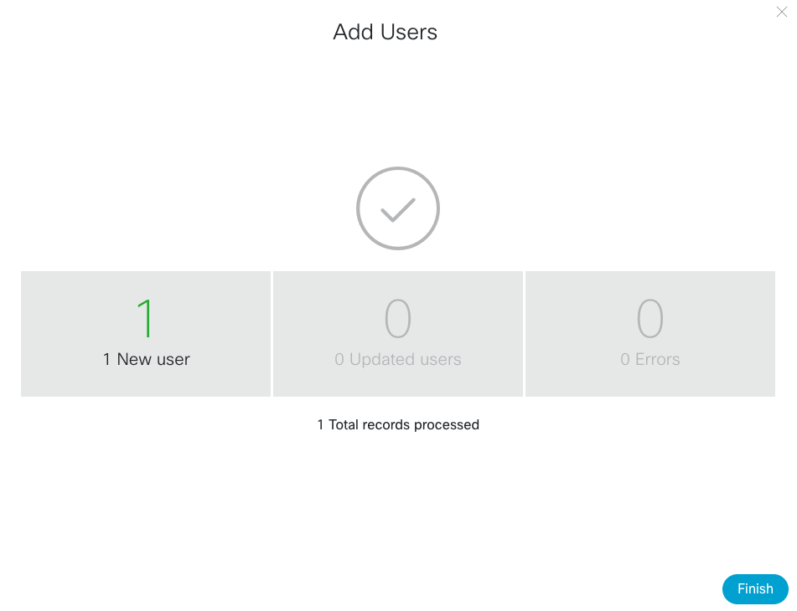
Licenses
Webex Teams service needs to be enabled because chat feature uses the Webex Teams Infrastructure
Select the appropriate agent license under ‘Contact Center’ card
Select ‘Finish’

Slide 14
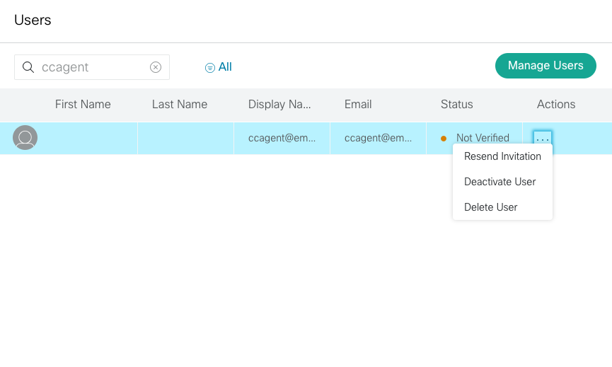
User Status
User Status will be ‘Not Verified’ → Will change to ‘Active’ once the user verification/activation is completed
Customer admin has an option to resend the invitation
Customer admin also has the option to deactivate or delete the user in this status

Slide 15
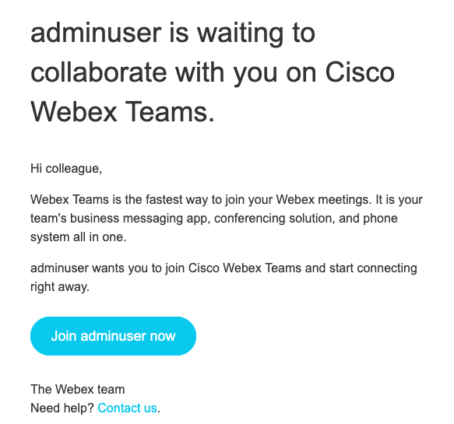
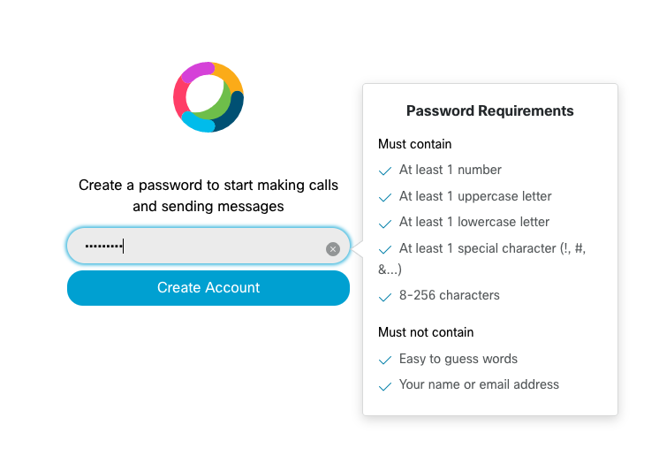
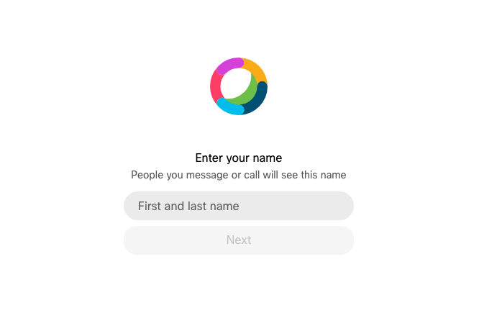
Password setup
End customer to complete enrollment using the activation link received in mail.
Set password as per requirements
Set First and last Name and select ‘Next’

Slide 16
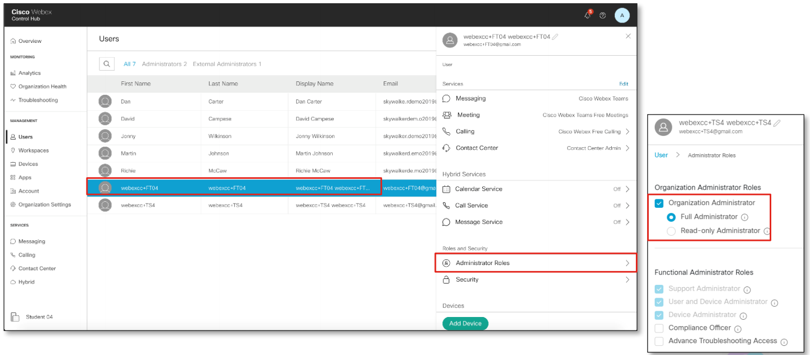
Administrator Roles
Select ‘Edit’ under services to change Webex services for a user
Roles & Responsibilities – Assign the “Full Administrator” role for being able to edit everithing.

Slide 17
Provisioning

Slide 18
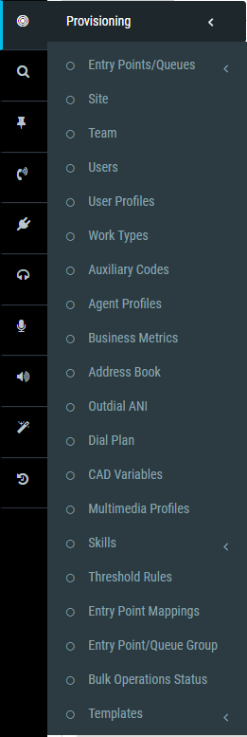
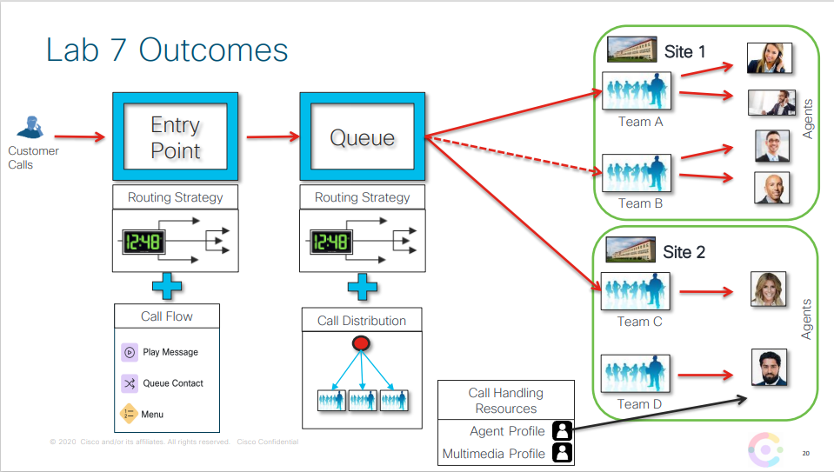
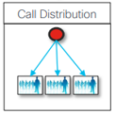
List of settings

Slide 19
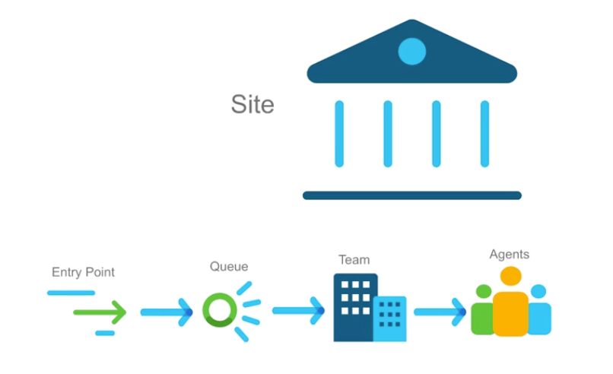
Basics
An ‘Entry Point’ is the initial landing place for customer call
A ‘Queue’ is where active calls are stored before being connected to Teams and Agents
A ‘Team’ is a group of Agents at a specific site who handles calls
An ‘Agent’ is the person at the end of the call flow who is handling the call
A ‘Site is a physical Contact Centre location under control of the Tenant.
Teams shall be provisioned under Sites. Sites are not used for Routing Strategies but they can be used to run specific reports.
Every single inbound call will consist of at least one Entry Point and one Queue
Entry Point Mapping: DN (where customers will make the calls) associated with an Entry Point

Slide 20
Teams
Calls in queues are distributed to teams
Specific queue can be routed to one or more teams
Routing strategy determines which the grouping, order, and timing of team distribution
Calls can be distributed to agents in a team based on longest available, skills based, load based or priority based.
Types of teams:
Agent-based
Composed of agents who select that team when logging in to the phone console
When an agent is selected, a call is placed to the phone number he or she entered at the log in
An agent can only log into one team at a time
The call is redirected to a Team -> Anyone from the team can pick-up the call
Capacity-based
Used for third-party contact centers
Each capacity-based team has an associated phone number
When a capacity-based team is selected, a call is redirected to that specific phone number
Calls in excess of the specified capacity for the team will be queued

Slide 21
User Profiles
Defines the users level of access within the application for each module
Several types of profiles
Administrator – full access to the Tenant
Supervisor – full access to the Tenant except Tenant Settings
Premium Agent – only access to the Agent Desktop app and MM
Standard Agent – only access to the Agent Desktop app
By default the system will set up Admin, Supervisor, Premium Agent and Standard Agent Profile
Different types of supervisor profiles can be created
Profiles are then assigned to each user

Slide 22
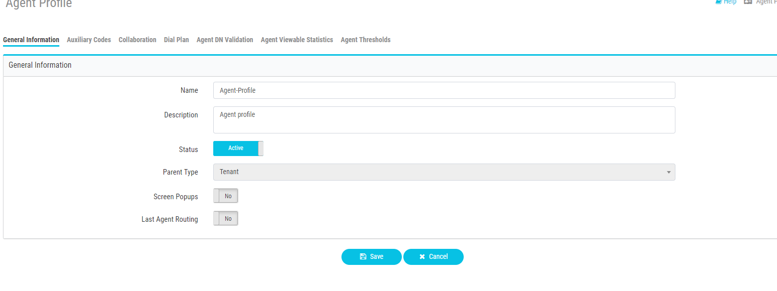
Agent Profiles
Collaboration settings to enable conference/transfer for selected queues if needed
Select agent’s available idle / wrapup codes
Enable Outdial if agent should have outdial capabilities
Outdial ANIs
Adress Book
DN validation to restrict the agent’s DN to use at sign on
Agent viewable statistics

Slide 23
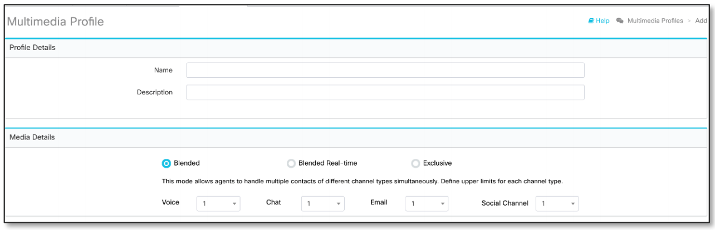
Multimedia Profiles
Each profile specifies the number of each type of media the agent can handle depending on the mode selected.
Blended: Specify the number of contacts per media channel
Blended Real-Time: 1 real-time media channel (voice or chat) + other media channels (email and social)
Exclusive: Single contact across all media channels
You can assign multimedia profiles to sites, teams, or individual agents.

Slide 24
Aux codes
Idle code examples:
Meeting
Lunch
Break
Training
Wrap Up Code examples:
Sale
Product inquiry
Customer complaint
Agent access to the codes can be restricted in agent profile
Idle codes and wrap up codes can be modified to fit your business model if you wish to use them for reporting
Auto wrap up can also be assigned via the Agent auto wrap up profile

Slide 25
Skills
You can route the call based on the skills of each team or agent
Steps needed:
Create the definition for each skill. There are different types of skills:
Text
Proficiency: value between 0 and 10
Boolean: True/False
Enum: Different selectable options
Create the skill profile with the values of each skill
Each agent/team only can have 1 skill profile, so you need to combine several skills in the profile
Assign skill profiles to agents/teams
Create a Skills Based queue. Depending how you want to redirect the call, you can choose between Long Available and Best Available Agent options
Configure the Flow with the skills restrictions and relaxations
Restriction: The call is only redirected to teams/agents with specific skill conditions
Relaxation: After some time in the queue, the skill conditions can be reduced

Slide 26
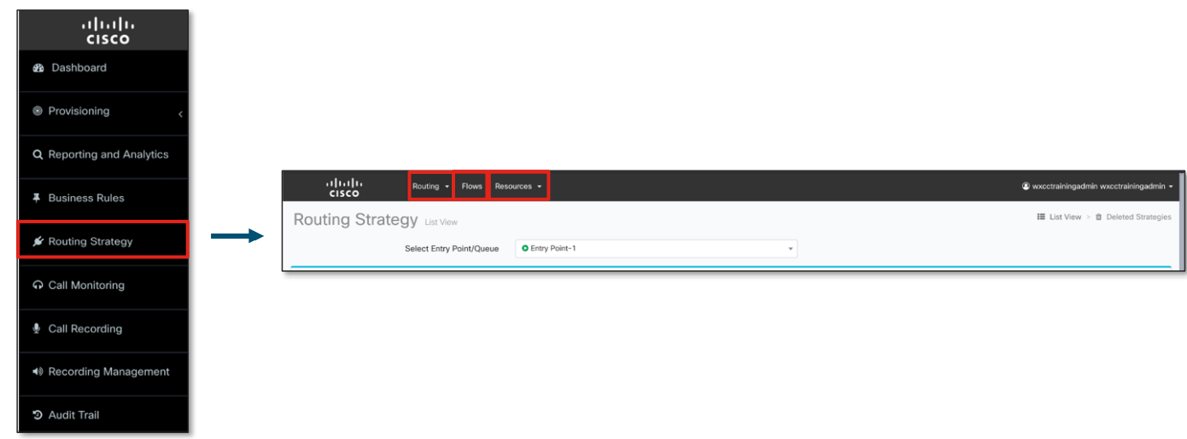
Routing Strategies, Flows and Resources

Slide 27
Resources - Message & Music Files (.wav)
All audio files the caller hears within WxCC are in the format of a .wav file
Music on hold
IVR message
Closed messages
Message while on hold
All wav files are stored in application under Routing Strategy>Resources
If supervisors/admins need to implement a new wav file, they need to upload it to the resources tab and then attach it to the correct RS
Use the following file formats and settings:
wav: u-Law, 8.000 kHz. 64 Kbps, mono – 100MB max
wave: a-Law, 8 kHz, 16bit, 64 Kbps, mono – 100MB max
No spaces or Special Characters in the file name.

Slide 28
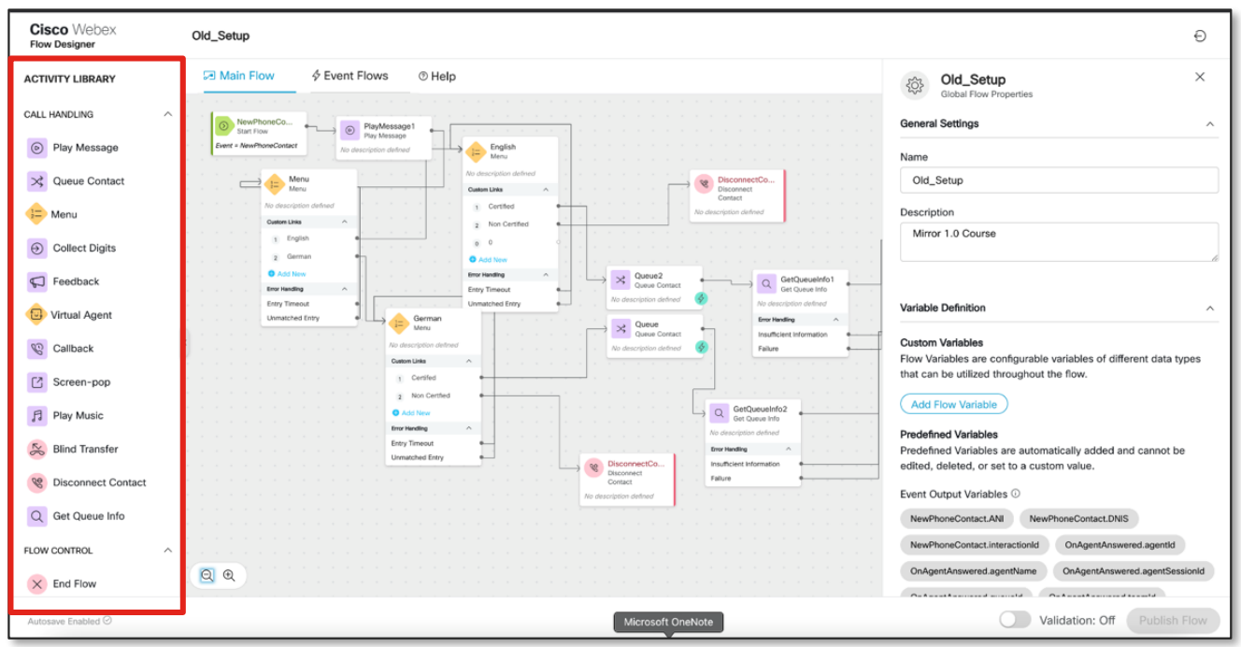
Flows
It defines how a call is handled when it arrives at an Entry Point and how it will be subsequently dealt with in a Queue
Once published, may be used in multiple Entry Point Routing Strategies
The Flow Designer is a drag-and-drop UI used to define flows that orchestrate and automate the components
Activity Library
Flow map
Settings
Validation and Publish

Slide 29
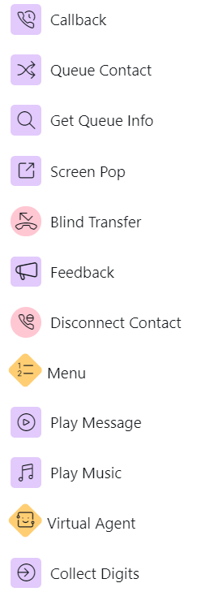
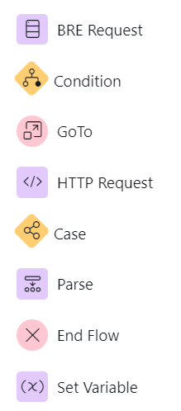
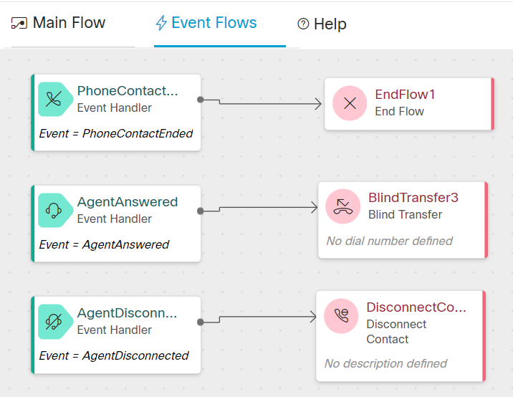
Activities
Call Handling
Flow Control
Event Flow
*More info about the Flow Designer options in the Admin Guide

Slide 30
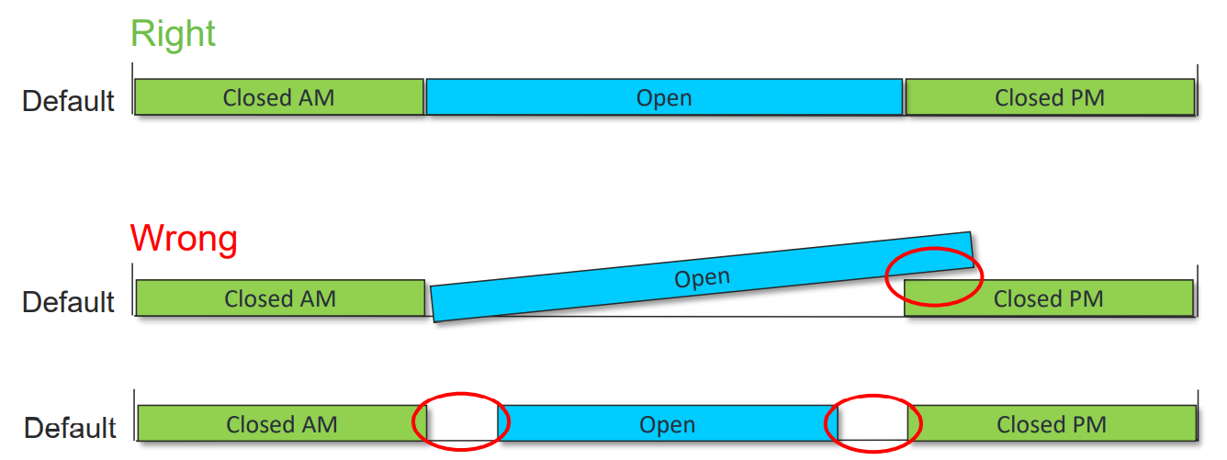
Routing Strategies
Entry Point Routing Strategies determine schedules and call flow selection
Routing Strategies only must be configured for Entry Points (inbound and outbound)
RS for an EP must cover a 24hour period
Call distribution in Queue is not longer configured as Routing Strategy
A single entry point or queue may have more than one routing strategy (and typically does)
Closed, holidays, etc
As a supervisor you can turn an inactive RS to active for emergency purposes or inclement weather closures

Slide 31
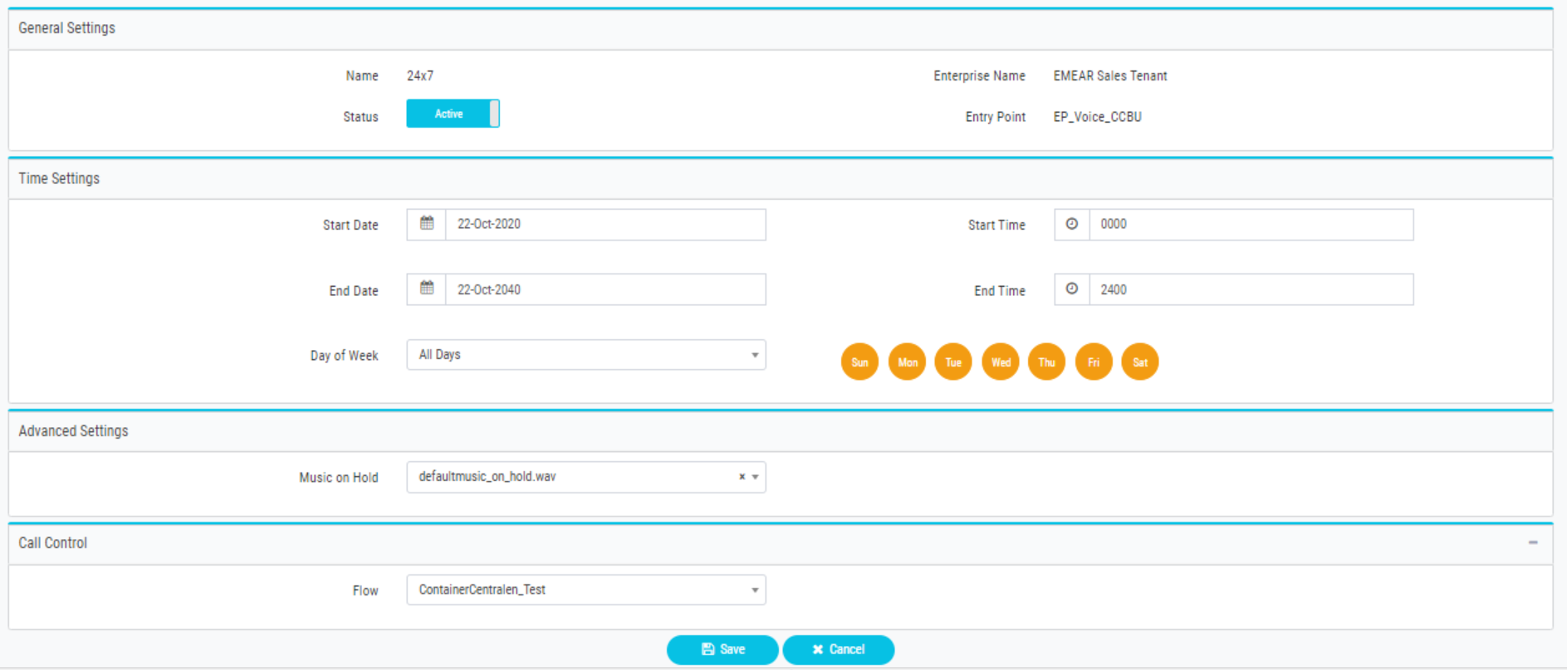
Routing Strategies configuration

Slide 32
Default vs Non-Default RSs
Default routing strategies cannot overlap with one another
Non-default routing strategies can overlap with Default ones
Non-default take precedence
Active Non-default routing strategies cannot overlap with other Active non-default ones
Non-Default
Emergency Closed
Default
Closed AM
Open
Closed PM

Slide 33
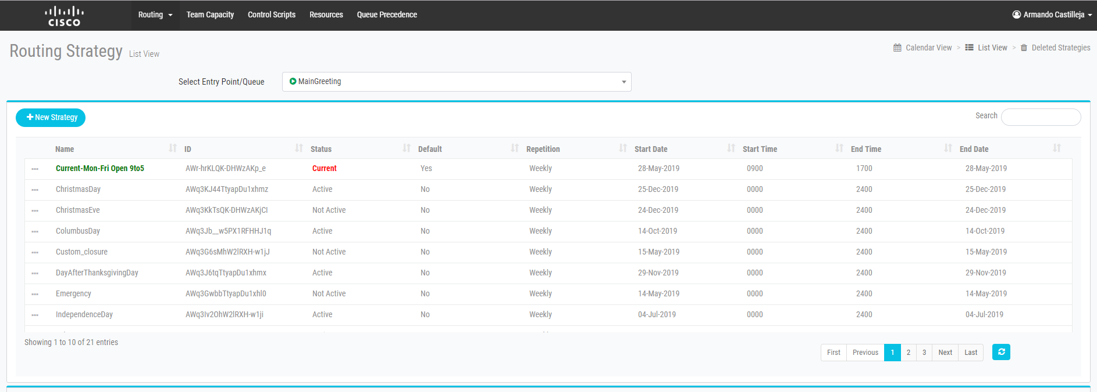
Current Routing Strategies
The Current routing strategy is the ACTIVE routing strategy
It is a working copy, created by the system, based on attributes such as status, default, start date, start time, etc
IMPORTANT: In order to apply changes to a Routing Strategy, you may need to delete the current copy
A new current routing strategy will be created automatically, assuming an active routing strategy for that time period exists
The current routing strategy will be regenerated periodically

Slide 34
Advanced Provisioning – Supervisor common tasks

Slide 35
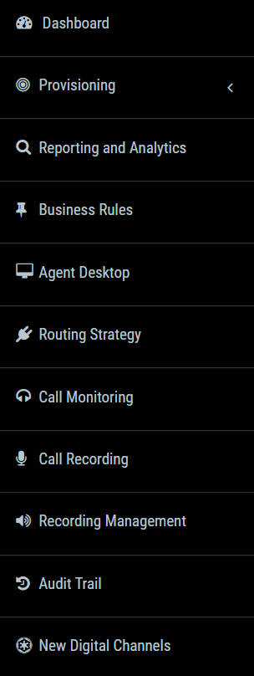

Extra modules
Analyzer platform: Explained in the next training session
Tenants can store their data in WxCC database and make HTTP requests to it for custom routing
Provides an interface for authorized users to view details about the configuration changes made to the enterprise during any seven-day period
Access to the new platform for configuring digital channels: Facebook Messenger, WebChat, Email and SMS

Slide 36
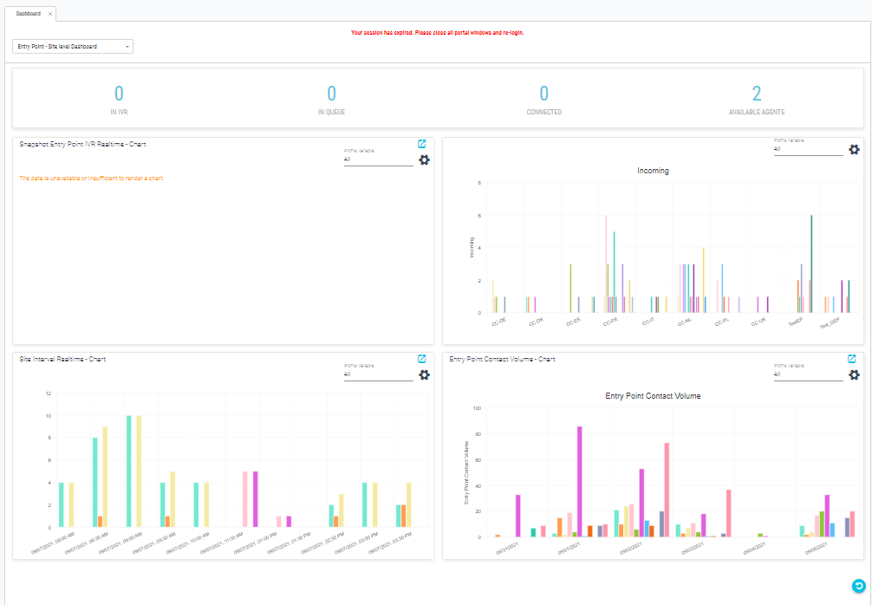
Dashboard
Supervisors/Administrators can see some default and general dashboards about the Agents/Teams behavior through the Management Portal

Slide 37
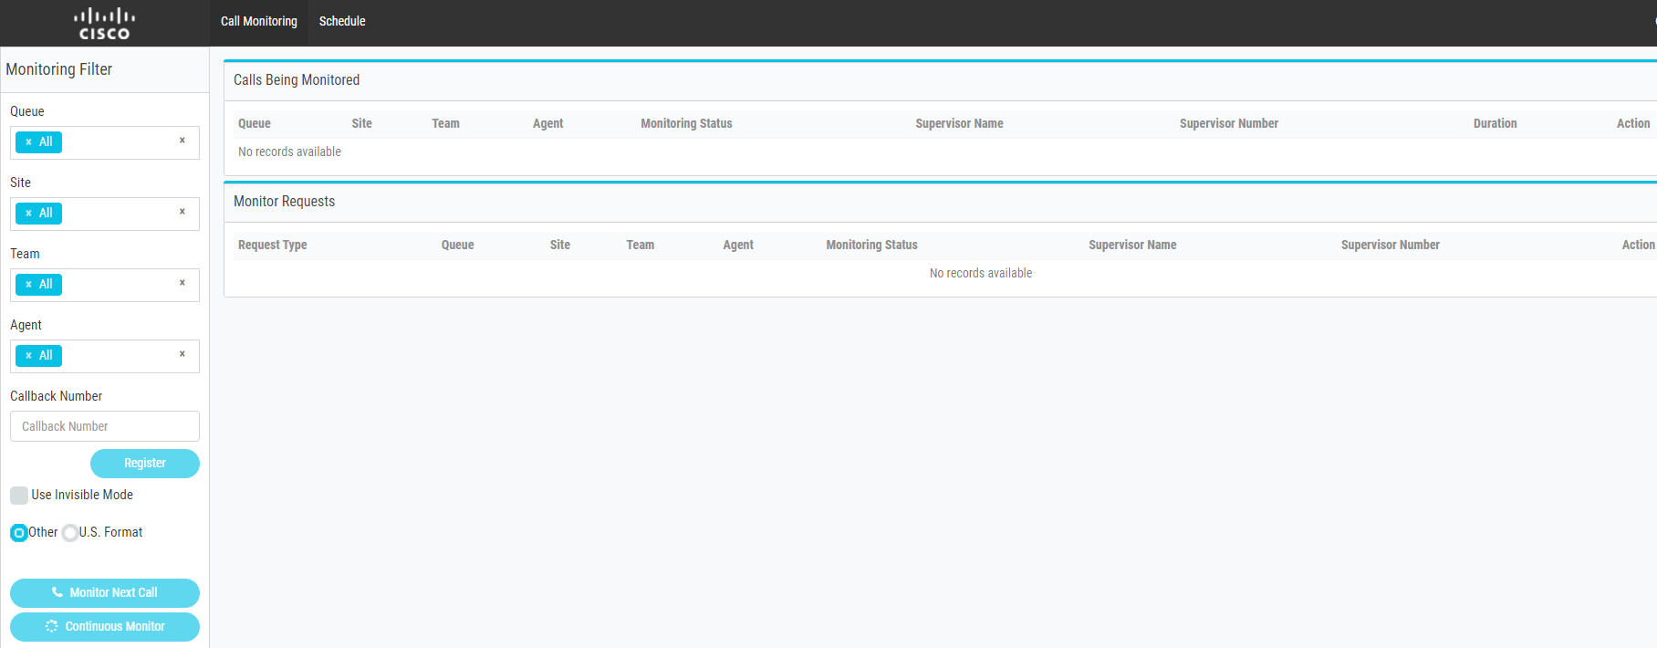
Call monitoring
Specify the criteria (filters) of calls you want to monitor
Indicate a Callback Number, the number where you will receive a call to listening the conversation
2 monitoring requests types: “Monitor next call” and “Continuous monitoring”
When the calls appear listed, click the button in “Action” column to start monitoring
There are 2 monitoring types:
Barge-In: The supervisor participates in the conversation
Whisper coach: The supervisor can speak with the agent, without the customer hearing him

Slide 38
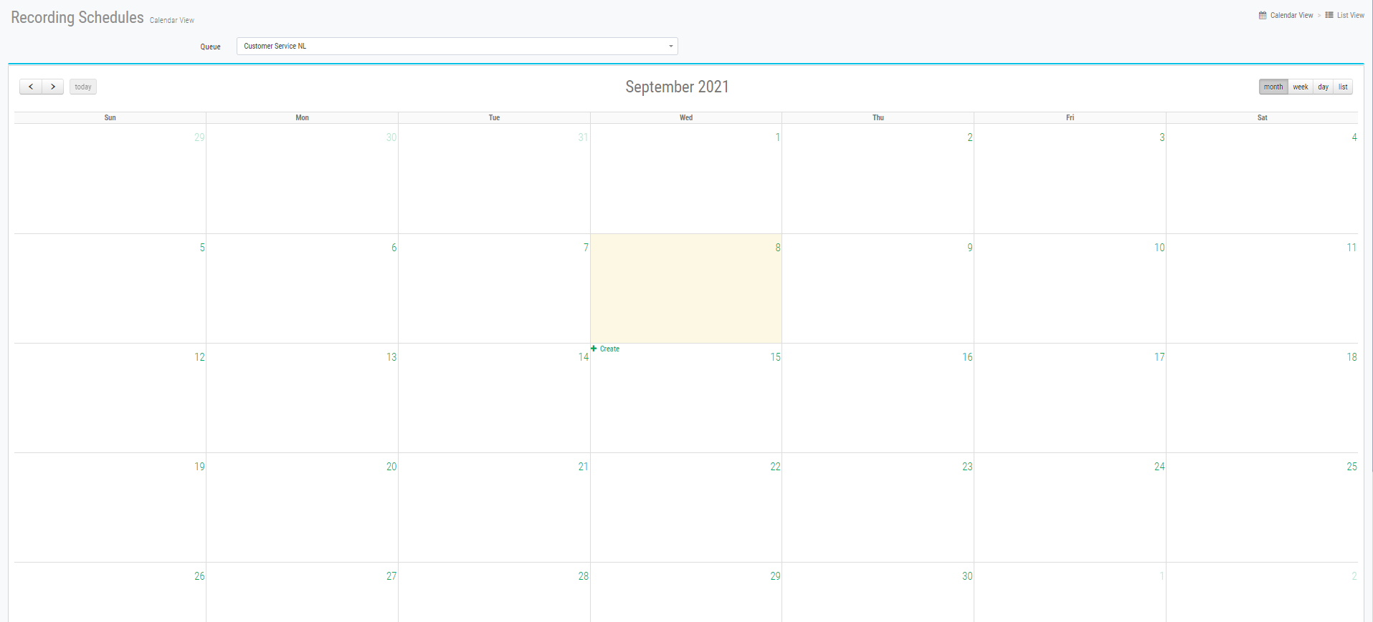
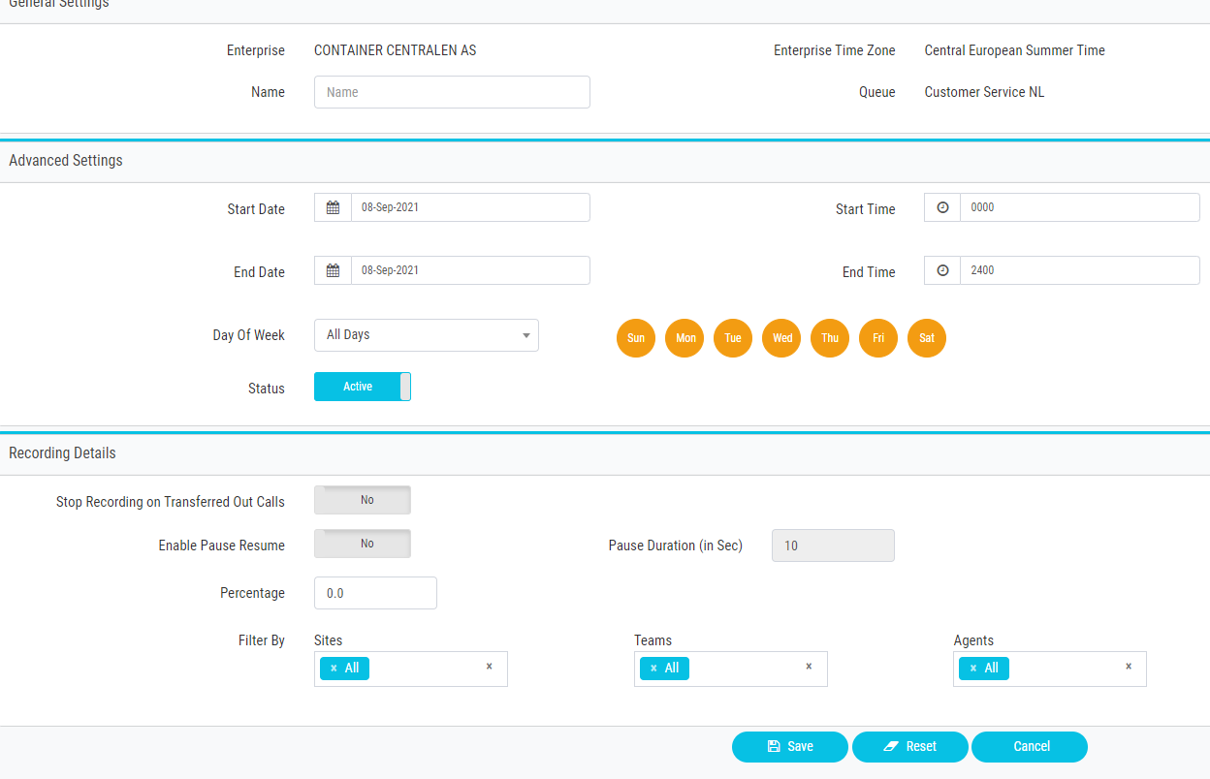
Recording and Monitoring Schedules
Authorized users can select which queue, team, site, and agent they want to record/monitor, and for what time period.
The recordings are stored in standard .wav format
You can also use the “Recording Management” module to search and play recorded files

Slide 39
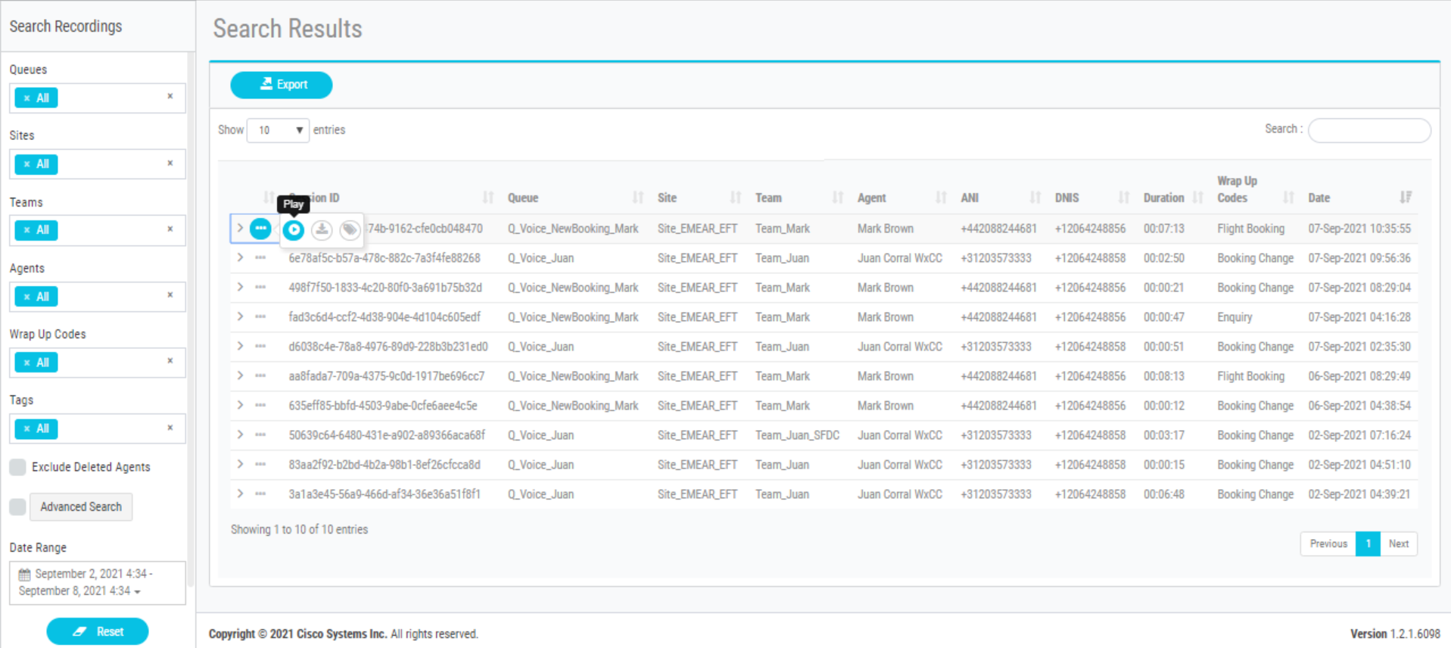
Call Recordings
Search recordings to playback
Based on sites, teams or queues
Between a data range
Or tenant may be set to Record all calls
You can Play, Download and tag the recordings
All the recordings searched can also be exported

Slide 40
Questions?

