Slide 1
Cisco Webex Contact Center Agent Access
Customer Solution Assurance Team
July 21

Slide 2
Agent Agenda
Agent Login
Take inbound contact
Agent States
Agent Desktop Control and Indicators
Call Hold, Consult and Transfer
Outbound Call
Agent Personal Statistics
Help

Slide 3
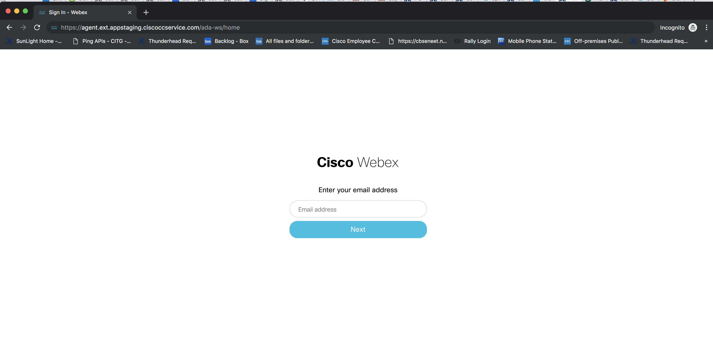
Agent Desktop Accessed by Agent
Login to the URL - <Replace with your AppCenter URL>using agent credentials
Agent Desktop UrL US: https://desktop.wxcc-us1.cisco.com

Slide 4
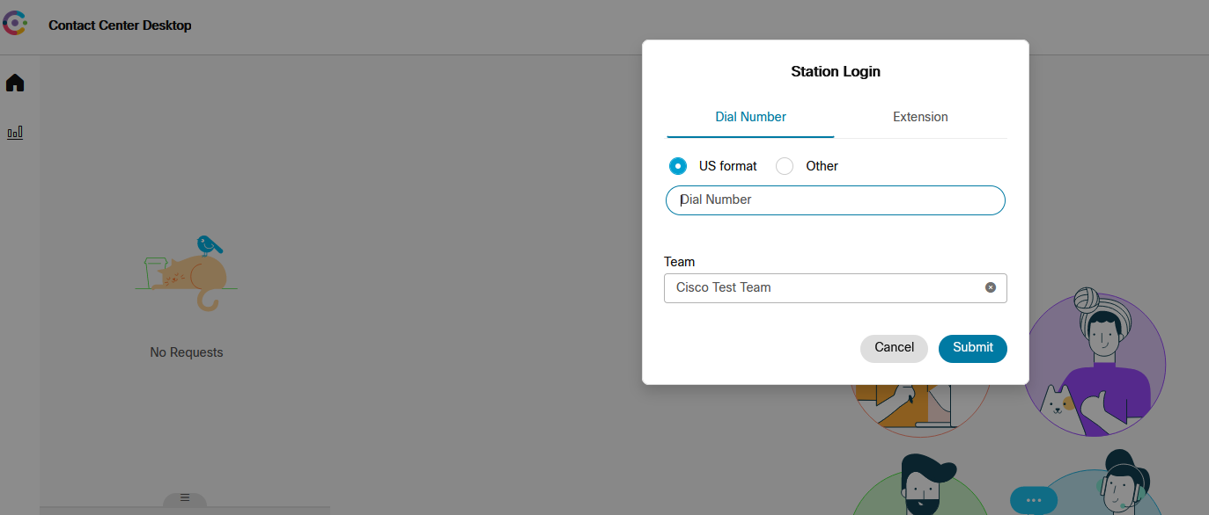
Agent Desktop Accessed by Agent
Enter a DN, Select a Team and Save changes. The DN is the Dialed Number where the agent can be reached for voice interactions.

Slide 5
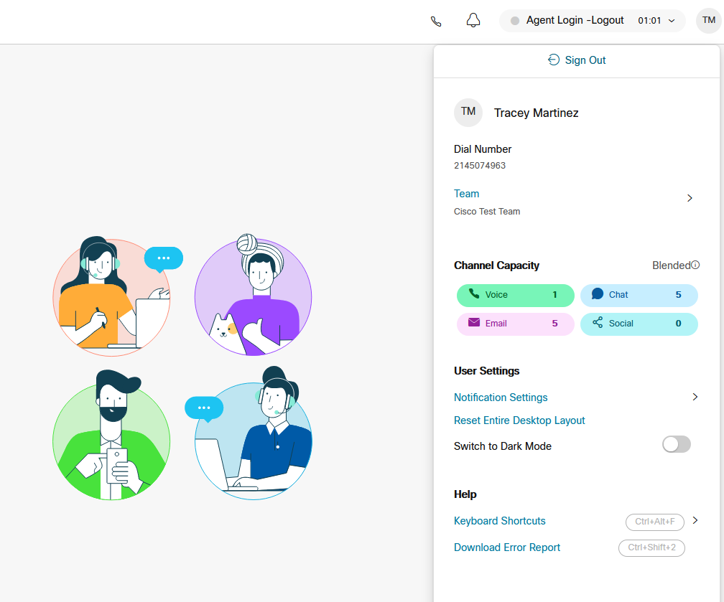
Agent Desktop Accessed by Agent

Slide 6
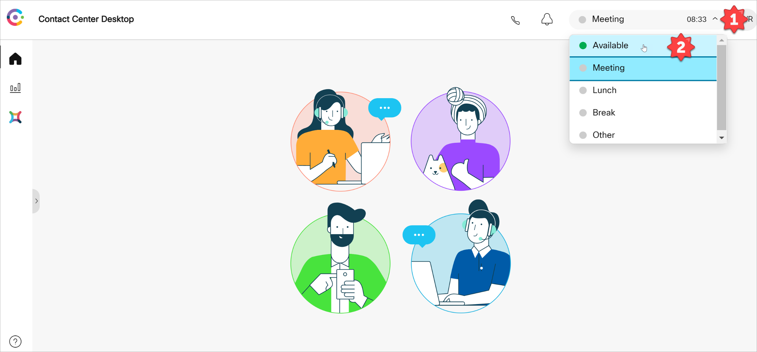
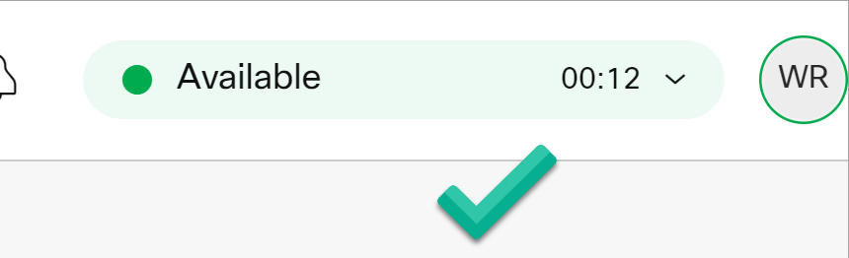
Agent Desktop
Set status to ‘Available’ state to receive interactions (calls) from the queue

Slide 7
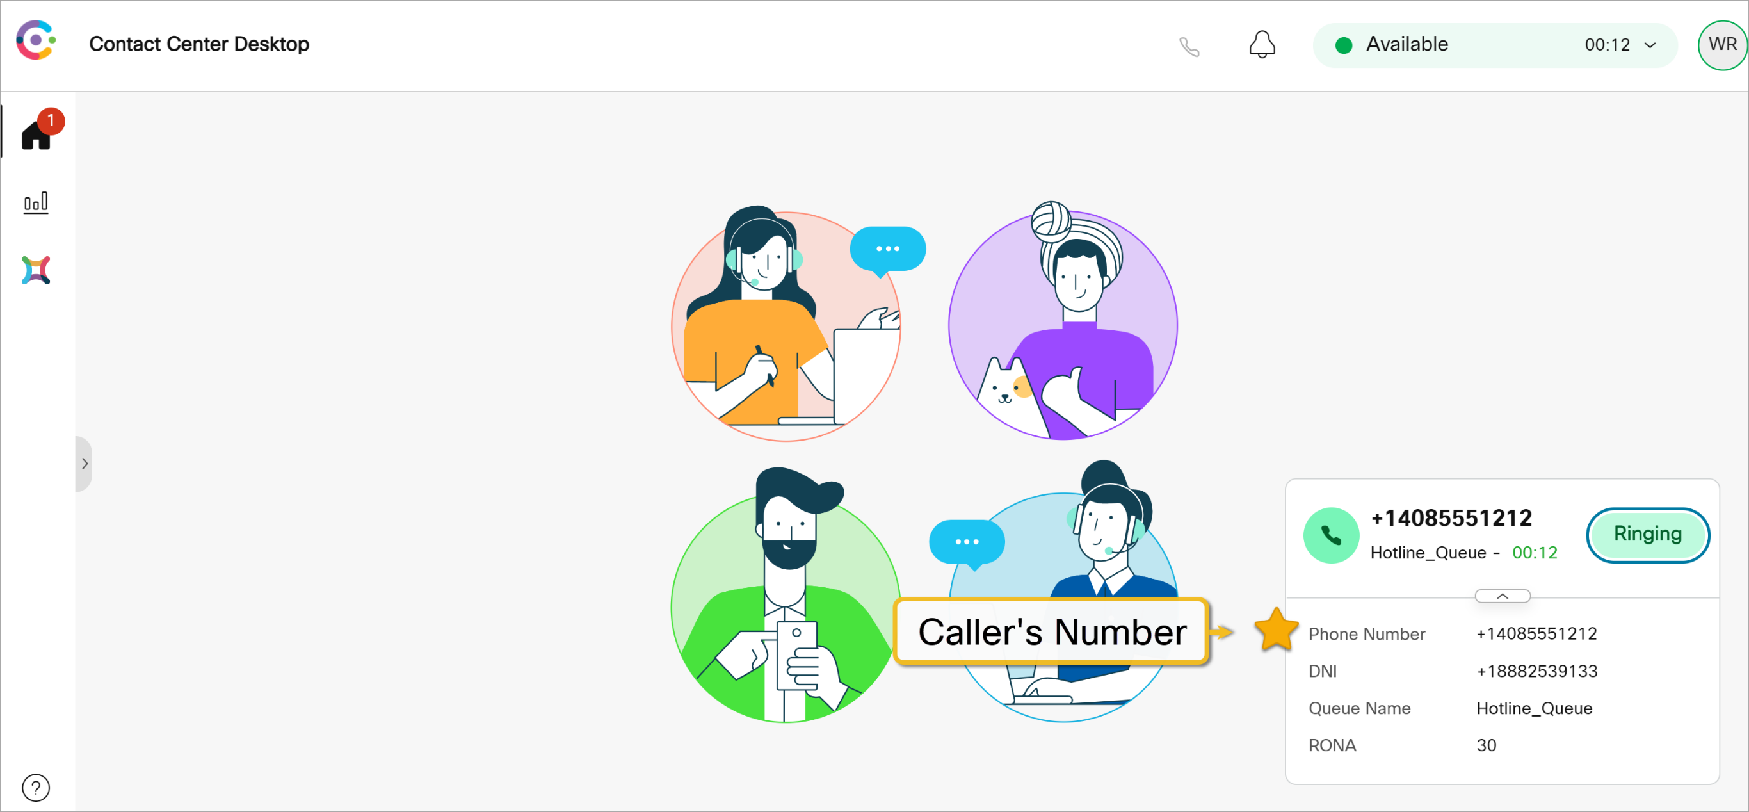
Receiving an Incoming Call
Notes:
When a call is directed to an agent their phone will ring and they will see their agent desktop screen will say Ringing.
They will answer the call on their phone and desktop will now say Connected.

Slide 8
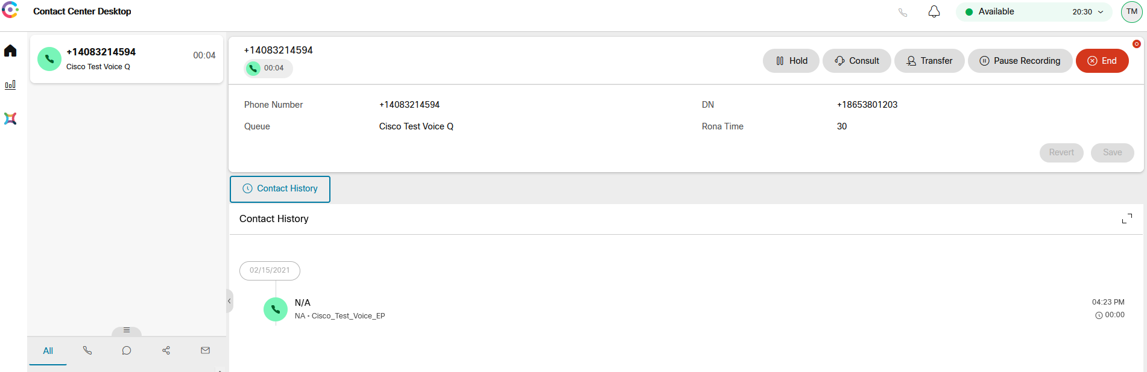
Window Controls and Indicators
Controls are available in the call
Hold will place the caller on hold and they will hear music
Consult will do a consult transfer allowing you to consult with the person you are transferring TO before connecting the end customer
Transfer will do a blind transfer
Conference (if enabled) will conference several on the same call
Pause Recording will pause recording for a few seconds to allow prevention of sensitive information being recorded
End call will hang up and put you in Wrap-Up

Slide 9
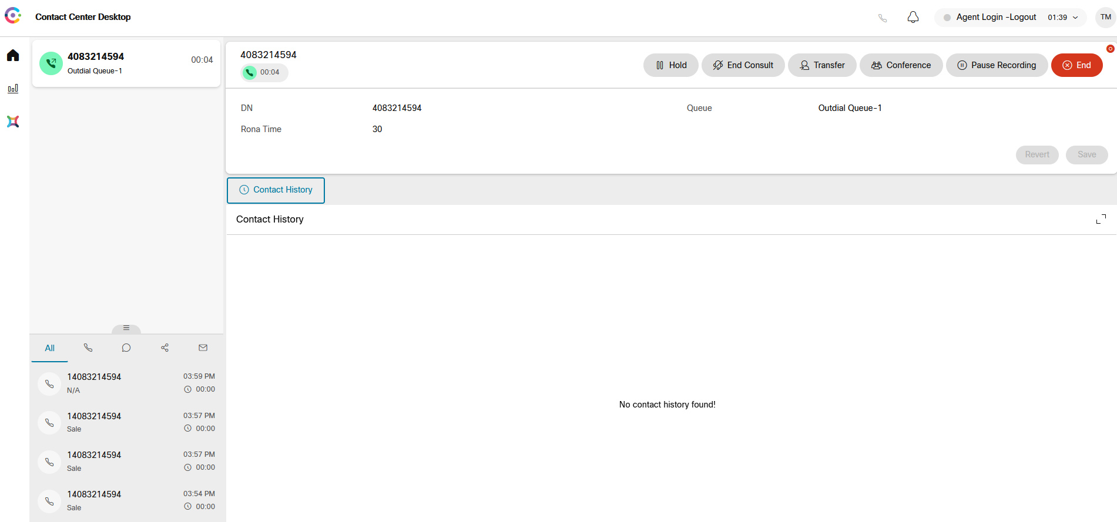
Outbound Call in Progress
Notes:
Agent interface will look the same for out bound calls as inbound.
Queue name will show as Outdial queue

Slide 10
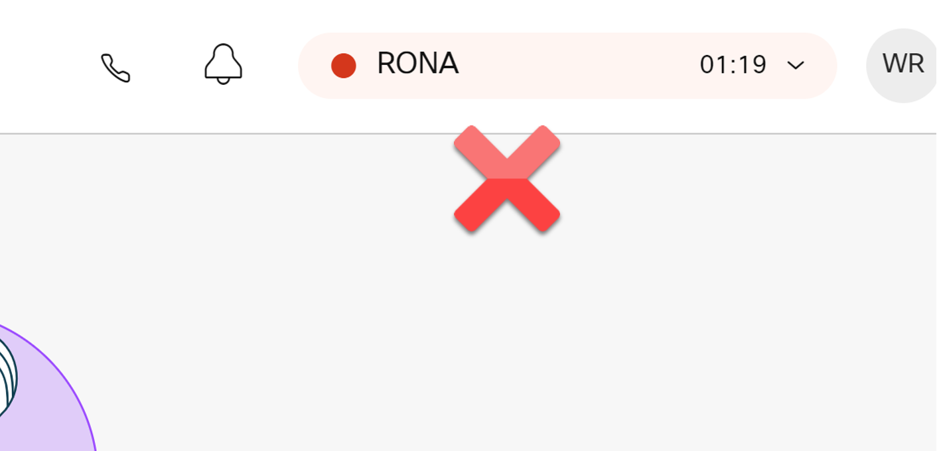
Ring On No Answer status
Indicates the system tried to deliver a call but the connection was not established
Common Causes
Not Answering the phone when it rings (timer expires – 30 seconds)
Forgetting to go to an idle state when
Leaving your desk (restroom break, etc.)
Using phone to make other calls (direct calls, multi-line phones, etc)
Reachability issues with DN/phone line

Slide 11
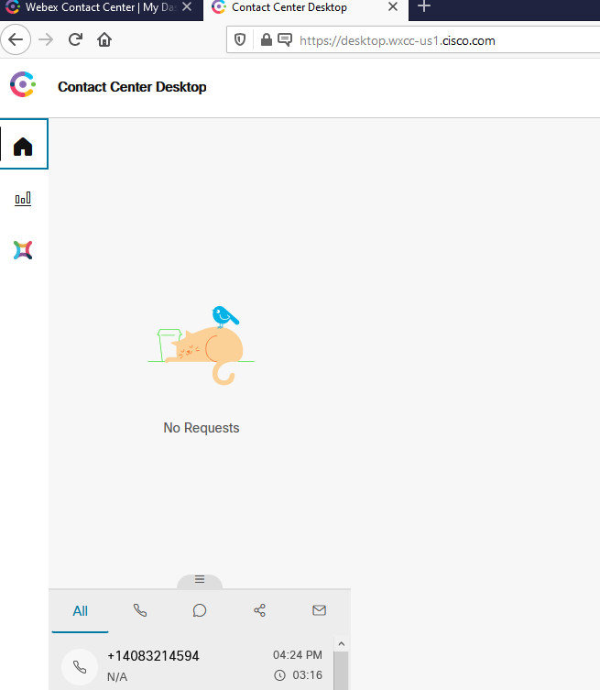
Agent Statistics
Notes:
Agents can access their own personal stats as well as realtime and historical queue and team information.

Slide 12
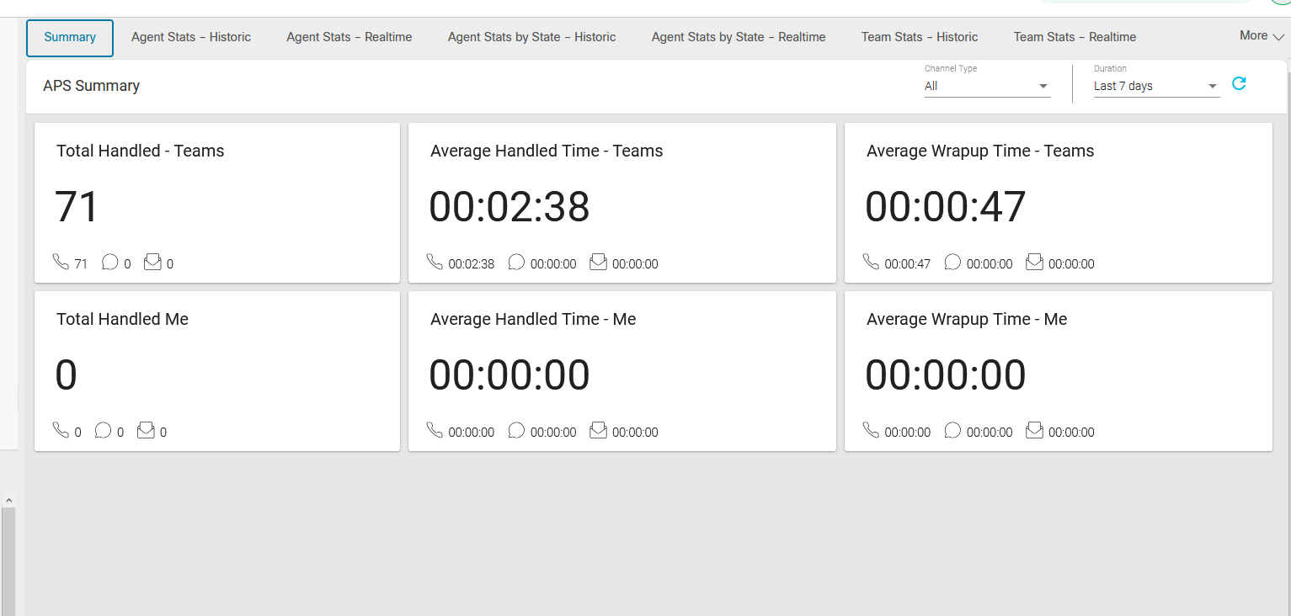
Agent Statistics
Notes:
Summary tab of the Agent Statistics

Slide 13
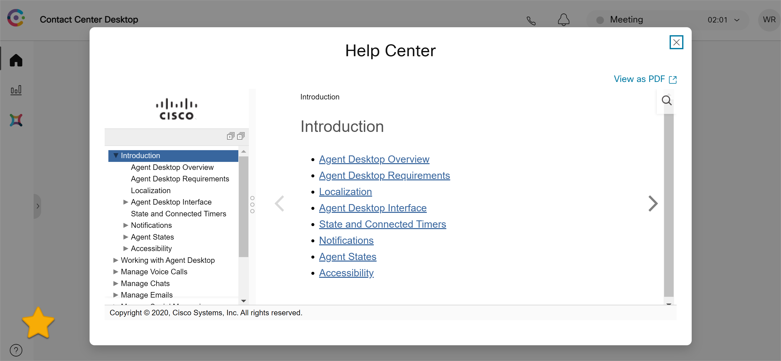
Built In Help

Slide 14
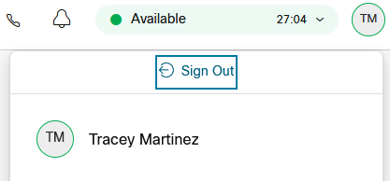
Sign Out
When an agent has finished a shift or needs to sign-out from the contact center for any other reason (like to change phone numbers), they can select their avatar bubble in the top-right, and then “Sign Out”

Slide 15
Operational Procedures to Remember
Agents must be provided with url and login information (check email for initial credentials)
Agents must know phone number where they are sitting
Phone numbers should be entered as numeric only (no dashes)
Agent use of Idle state
before leaving their desk
before placing outbound calls
when taking non-call center calls (direct calls; multi-line phones, etc.)
Log-out – need to log out at the end of your work session

Slide 16
Questions?

