Slide 1
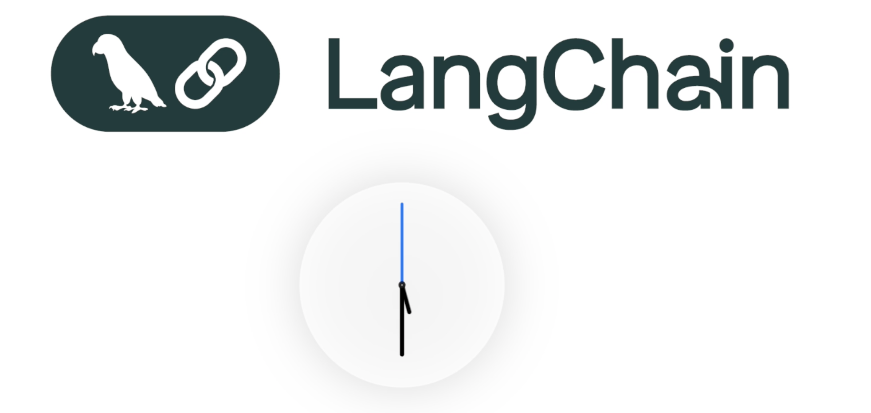
https://python.langchain.com/docs/introduction/

Slide 2
What is LangChain
LangChain is an open-source framework for developing applications powered by large language models (LLMs).
It simplifies the process of "chaining" together different components, allowing you to create complex, multi-step workflows.
LangChain gives LLMs the power to reason, remember, and act through tools and retrieval. It turns simple chatbots into true problem-solving agents that deliver real outcomes.
From Fixed Workflows to Adaptive Intelligence
They connect APIs, knowledge bases, and reasoning in one loop.
➡ Assistant plans your Paris trip end-to-end, not just flights.
From Static Answers to Contextual Understanding
They bring in memory and retrieval so answers are grounded and personalized.
➡ Support bot remembers which laptop you bought and when.
From Isolated Tasks to Orchestrated Solutions
They combine multiple tools dynamically to deliver outcomes, not just answers.
➡ One query → Weather + Flight + Hotel in one seamless answer.
Notes:
1.Syntax for LLM Wrapper:
from langchain_openai import ChatOpenAI
llm = ChatOpenAI(model="gpt-4o", temperature=0)
print(llm.invoke("Hello!").content)
Real-world Example: A bank chatbot can start on GPT-4, later switch to a cheaper open-source LLaMA model seamlessly.
2. Prompt templates Syntax
from langchain.prompts import PromptTemplate
template = PromptTemplate.from_template("Find me flights from {source} to {destination} on {date}.")
print(template.format(source="Delhi", destination="Paris", date="2025-09-10"))

Slide 3
🔑 Core Concepts of LangChain
1. LLM Wrapper
Standard interface to connect with OpenAI, Gemini, Anthropic, Hugging Face, etc.
Benefit: Swap models easily without changing your code.
2. Prompt Templates
Predefined text patterns with placeholders that structure queries consistently.
Why important?
Without templates, prompts vary in wording → inconsistent responses.
With templates, every query follows the same structure.
Using raw strings for prompts is like writing SQL with string concatenation — it works, but it’s messy and error-prone. Prompt emplates are like prepared statements — safe, reusable, and production-ready.”
Real-world Example:
Travel bot → “Book ticket from Delhi to Paris on 10th Sept.”
Normalizes user input into consistent API-ready text.

Slide 4
3. Chains
Multi-step pipelines that combine LLM + tools.
Benefit: Deterministic workflows (not just one-off queries).
Real-world Example:
Search Tesla news →Summarize articles →Write investor report.
4. Memory
Stores conversation state.
Types:
Short-term (current session during a chat bot)
Long-term (database/vector-backed Example: Pincecone/Chroma for low level environemnts)
Real-world Example: Customer support bot remembers you bought a laptop yesterday when you later say, “It’s not working.”
5. Agents
LLM dynamically decides next steps (search, call API, or answer).
Benefit: Flexibility vs fixed chains.
Real-world Example: Travel planner decides:
Call flight API → if booking.
Call weather API → if weather.
Use LLM directly → if summarization.
Notes:
3. Syntax for chains : Syntax:
from langchain.schema.runnable import RunnableSequence
chain = RunnableSequence(first=llm, middle=llm, last=llm)
result = chain.invoke("Research Tesla and summarize")
4. Syntax for memory
from langchain.memory import ConversationBufferMemory
memory = ConversationBufferMemory()
memory.save_context({"input": "I bought a laptop"}, {"output": "Great!"})
print(memory.load_memory_variables({}))
5. Syntax for Agents
from langchain.agents import initialize_agent, load_tools
tools = load_tools(["llm-math"], llm=llm)
agent = initialize_agent(tools, llm, agent="zero-shot-react-description")
agent.run("What is 45 * 12?")

Slide 5
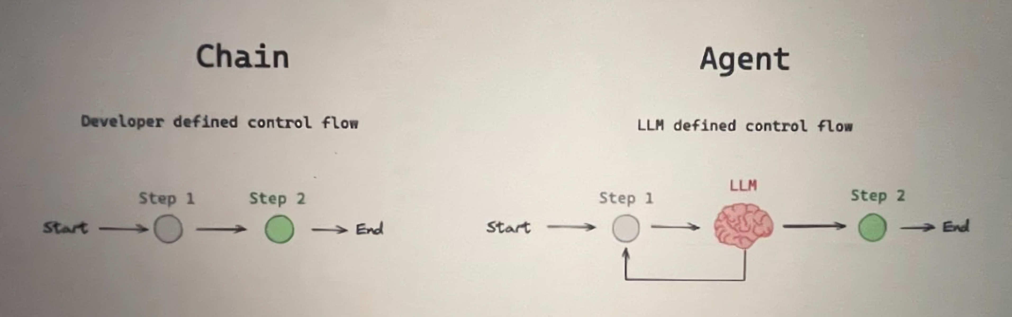
5a. Chains vs Ai Agent (ReAct)
Developer-driven, fixed workflows. (Straight arrow)
➡ Example: “Always fetch user profile → summarize → display.”
Agents (ReAct) = LLM-driven, dynamic workflows.(Decision Trees)
➡ Example: “Decides whether to call Weather API, Flight API, or DB depending on query.”

Slide 6
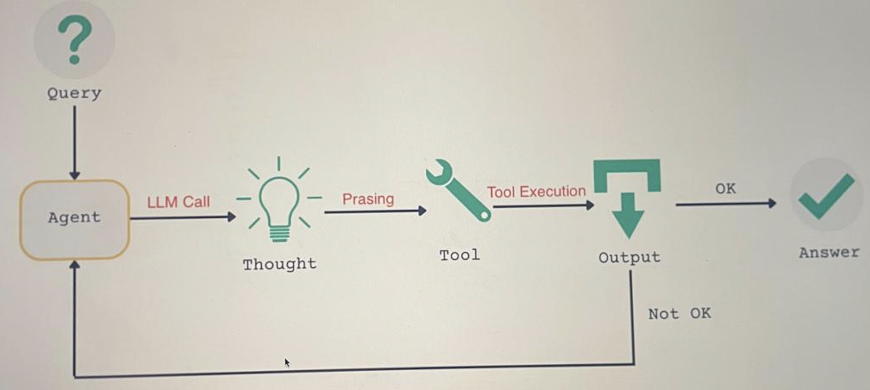
5b. ⚡ReAct
ReAct (Reasoning + Acting) is a design Pattern where a Large Language Model (LLM) alternates between:
Reasoning (Thoughts) – explaining in natural language what it is trying to do, step by step.
Acting (Actions) – executing a tool call (API, calculator, database, etc.) based on that reasoning.
This cycle (Thought → Action → Observation) repeats until the model has enough information to give a final answer.

Slide 7
6. Tools
Definition: External functions/APIs the LLM can use.
Real-world Example: Healthcare bot uses:
Tool 1: Medical KB lookup
Tool 2: Appointment history check
Tool 3: API to book doctor visits
7. Retrieval (RAG – Retrieval-Augmented Generation)
Retrieval - The process of fetching relevant information from an external source (like a database, vector store, or API).
Role: Brings facts or context into the LLM pipeline.
Augmented - The retrieved information is added (augmented) to the user’s query before sending it to the LLM.
Role: Ensures the model doesn’t rely only on memory but has fresh and domain-specific knowledge.
Generation - The LLM generates the final response, using both the retrieved context and its own reasoning ability.
Role: Produces a natural-language answer that is grounded in the external data.
Example: What is the refund policy for flight tickets?
Retrieval (R): From database or PDF: "Refunds are processed within 7 business days after cancellation."
Augmentation (A): Build the final prompt to the LLM:
User Question: What is the refund policy for flight tickets?
Context: Refunds are processed within 7 business days after cancellation.
Generation (G):
LLM responds:
"The refund policy states that flight cancellations are refunded within 7 business days."
Notes:
6. Tools Syntax
from langchain.tools import tool
@tool
def greet(name: str) -> str:
return f"Hello {name}!”
7. Rag Syntax
from langchain_chroma import Chroma
retriever = Chroma(persist_directory="db").as_retriever()
docs = retriever.invoke("What’s the refund policy?")

Slide 8
7a. Types of Retrievers in RAG
1. Vector DB Retriever (Semantic Search)
Stores unstructured docs as embeddings.
Example: PDF in Pinecone → Query: “forgot login key” → Finds chunk “reset password.”
Metric: cosine similarity.
2. SQL Retriever (Structured Data)
LLM generates SQL → Database executes → returns rows.
Example: “List customers from Hyderabad with balance > 1 lakh”
SQL:
SELECT name, balance FROM customers WHERE city='Hyderabad' AND balance>100000;
Generator: LLM explains → “23 customers match this criteria
3. API Retriever (External Systems)
LLM calls external APIs to fetch real-time data.
Example: “What’s the weather in Paris?”
API: OpenWeather returns JSON.
Generator: LLM says → “It’s 18°C and cloudy in Paris right now.”
4. File/Knowledge Base Retriever (Confluence, Wiki, SharePoint)
Use APIs or ingestion → retrieve matching documents.
Example: “How to reset password?”
Retriever: Confluence API returns IT policy page.
Generator: LLM → “You can reset your password via the IT Helpdesk portal.”

Slide 9
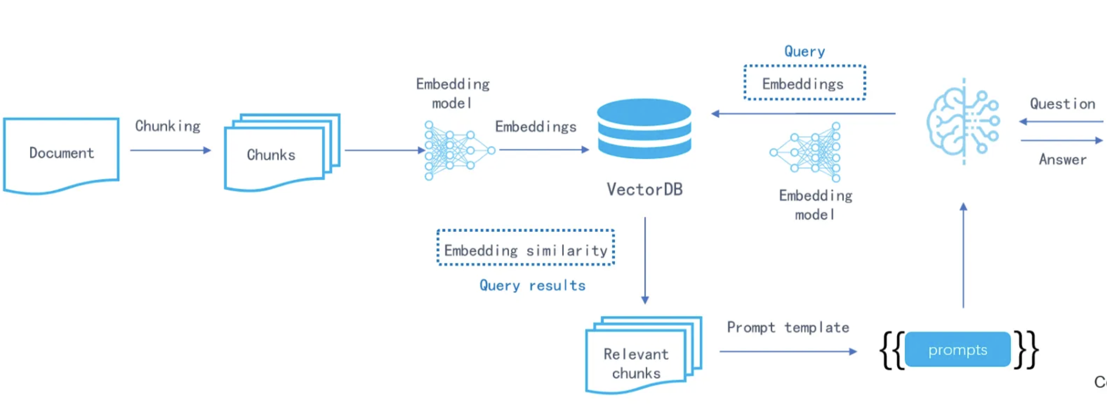
How Vector DB Stores and Retrieves the Data

Slide 10
Vector DB
What is a Vector Database?
Stores data as vectors (mathematical arrays).
Captures semantic meaning (e.g., “car” ≈ “automobile”).
Supports similarity search instead of exact keyword matches.
✅ Why Vector DB is Useful vs Normal DBs
Search → “red car” matches “crimson vehicle.”
Recommendation → Suggest movies/books with similar themes.
Chatbots → Retrieve relevant docs even if phrased differently.
Image search → Find visually similar images, not by filename.
✅ How Vector DB Stores Data
Text/images/audio → converted into embeddings (vectors).
Stored with metadata (id, source, timestamp).
Search works via nearest neighbor matching.

Slide 11
Core Concepts of Vector Databases
1. Embeddings
Numeric vectors (128–4096+ dimensions) representing meaning.
Similar items → close together; unrelated items → far apart.
2. Embedding Models
AI models trained on massive corpora.
Convert raw data (text, images, audio, video) → embeddings.
Examples:
Text → OpenAI text-embedding-3, SentenceTransformers
Images → CLIP, ResNet, ViT
Audio → Wav2Vec, Whisper
Video → VideoCLIP, TimeSformer
3. Similarity Metrics
Measure how close vectors are.
Cosine similarity → semantic closeness (text).
Euclidean distance → geometric closeness (images/audio).
Dot product → ranking & recommendations.

Slide 12
4. Indexing (Approximate Nearest Neighbor Search)
Organizes vectors so queries are fast at scale.
Common methods: HNSW, IVF, PQ.
Without index → brute-force = slow.
With index → millisecond search across millions.
6. Metadata & Hybrid Search
Vector DBs also store metadata (tags, IDs, timestamps).
Enable semantic + filter queries.
Example: “Find articles about ‘AI’ published after 2023.”
7. Training Data (Corpora)
Embedding models learn from corpora (Wikipedia, books, images, speech).
Knowledge baked into weights, not stored as raw text.
At runtime, embeddings computed on-the-fly.
8. Use Cases
Semantic document search (PDFs, FAQs, Confluence).
Product & image similarity (Amazon, Pinterest).
Audio/video retrieval (music search, speaker verification).
Recommendations (Netflix, Spotify).
RAG → retrieving chunks from Vector DB to ground LLMs.

Slide 13
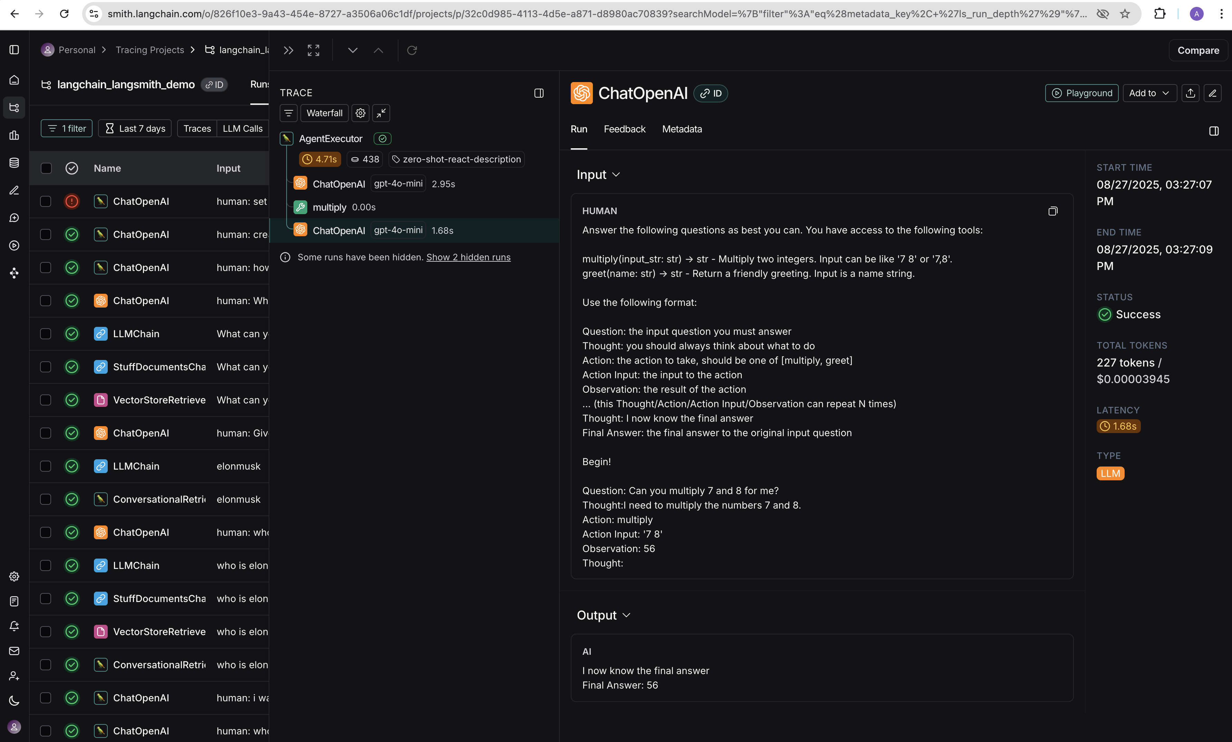
LangSmith
Definition: Debugging, testing, monitoring platform for LangChain apps.
Real-world Example: In production, chatbot gives wrong answer → LangSmith shows:
Prompt → Retrieval → Tool call → LLM response
Helps debug root cause quickly.

