Slide 1


Simple Health

Slide 2
Iteration 1
Requirement Analysis
Structure
Sign up
Log in
Forgot password
Password hashing
Database
QA test

Slide 3
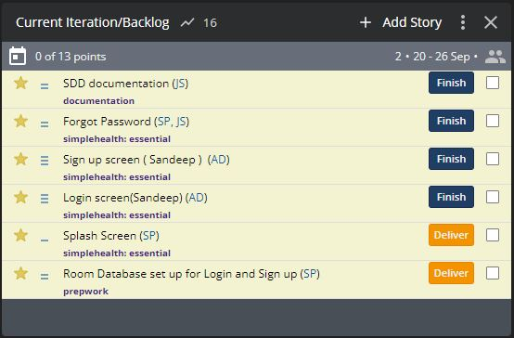
User Stories
Requirement Analysis

Slide 4
User Stories
“As a new user, I want to create an account so that I can access the simple health application features.”
“As a user, I want to be able to login so that I can access the simple health application features.”
“As a registered user, I want to reset password when current password is locked/forgotten, so the updated password can be used for next login.”
Requirement Analysis

Slide 5
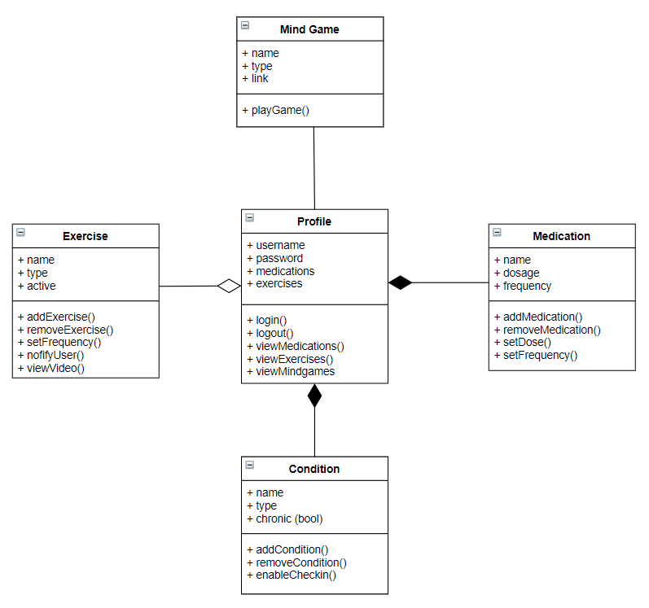
Structure

Slide 6
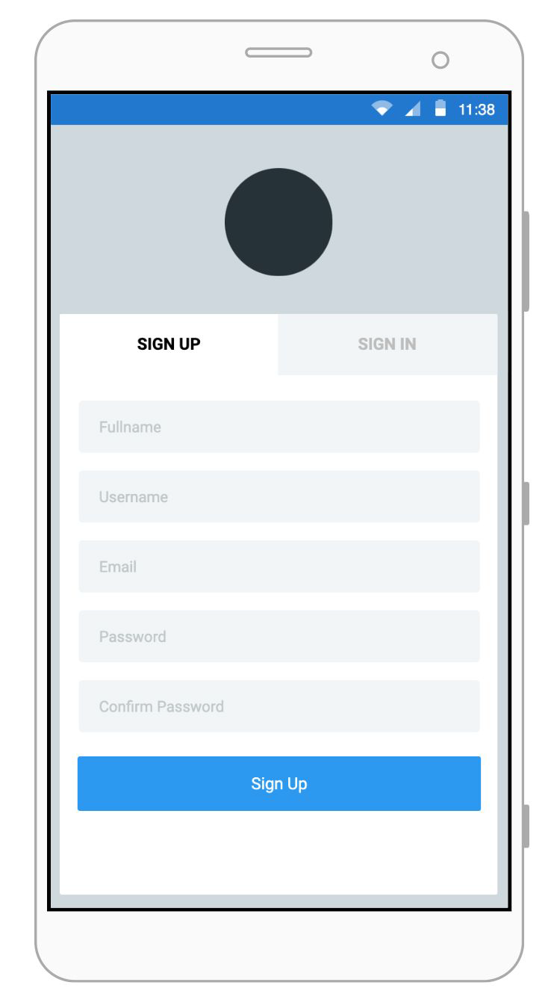
Sign up

Slide 7
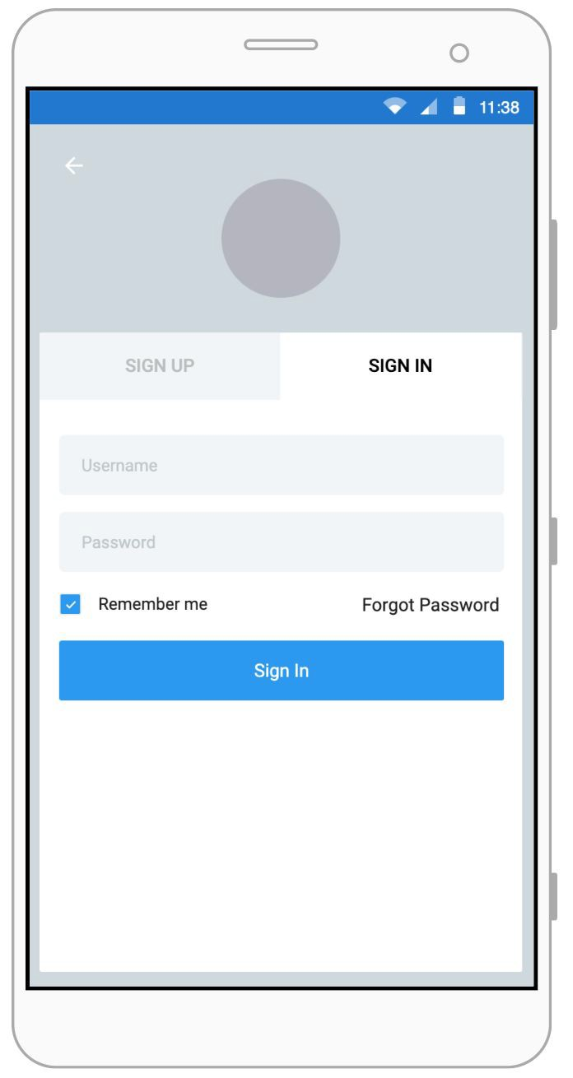
Log in

Slide 8
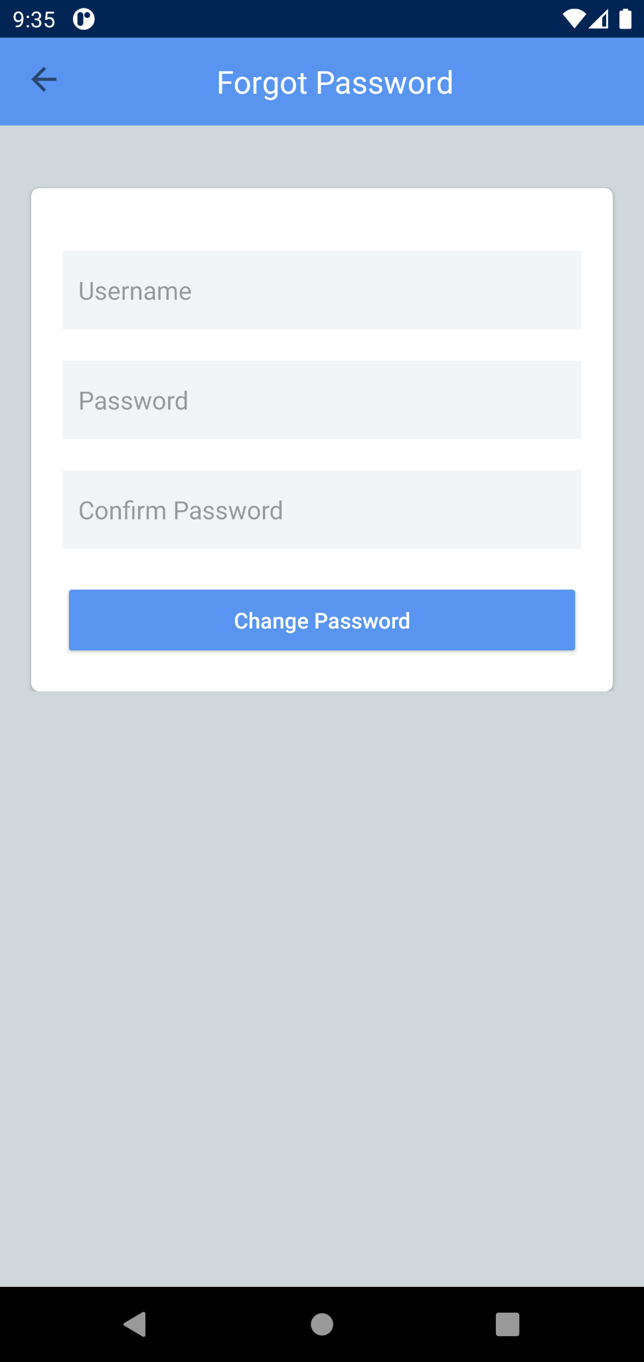
Forgot Password

Slide 9
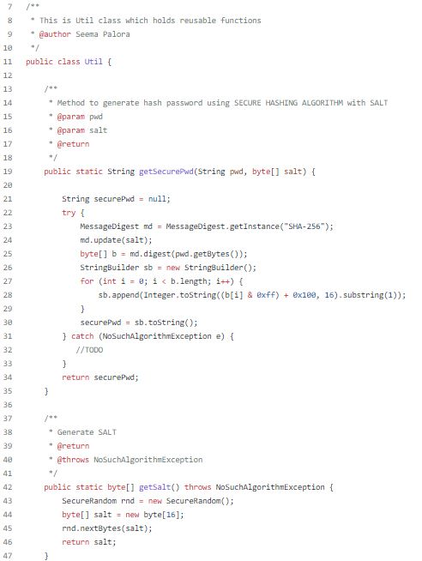
Password Hashing
SHA with Salt

Slide 10
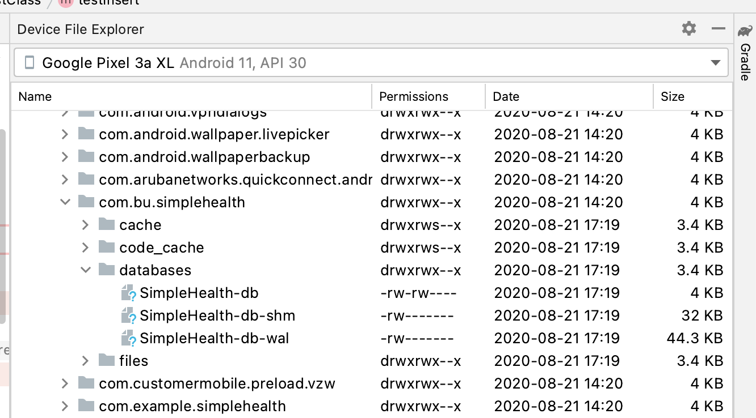
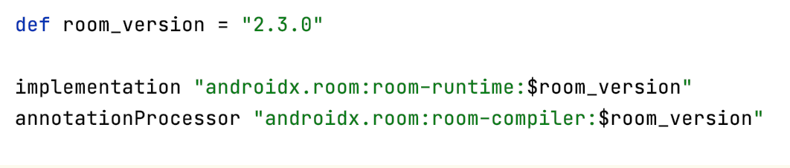
Database
Room

Slide 11
Test Case | Priority | Status
Sign up | High | Pass
Sign up empty fields | Medium | Pass
Sign up user already registered | High | Fail - Fixed
Sign in | High | Pass
Forgot password change | High | Pass
Forgot password screen buttons | Low | Fail - Fixed
QA Test

Slide 12
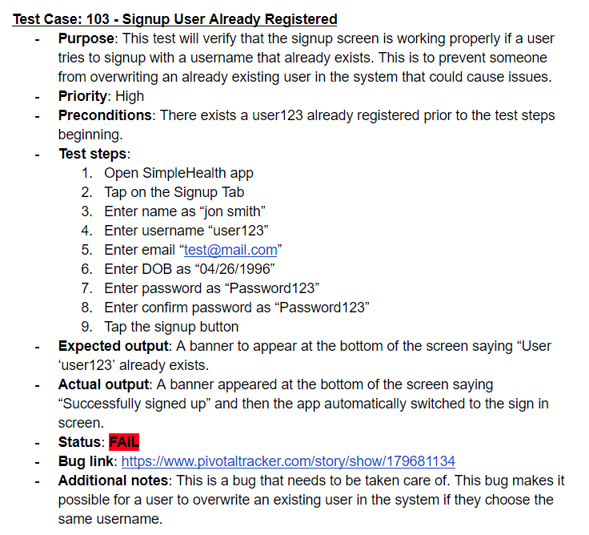
Testing

Slide 13
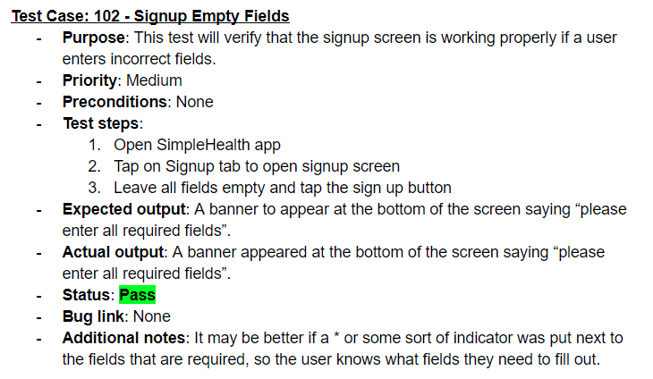
Testing

Slide 14

Thank you

