Slide 1
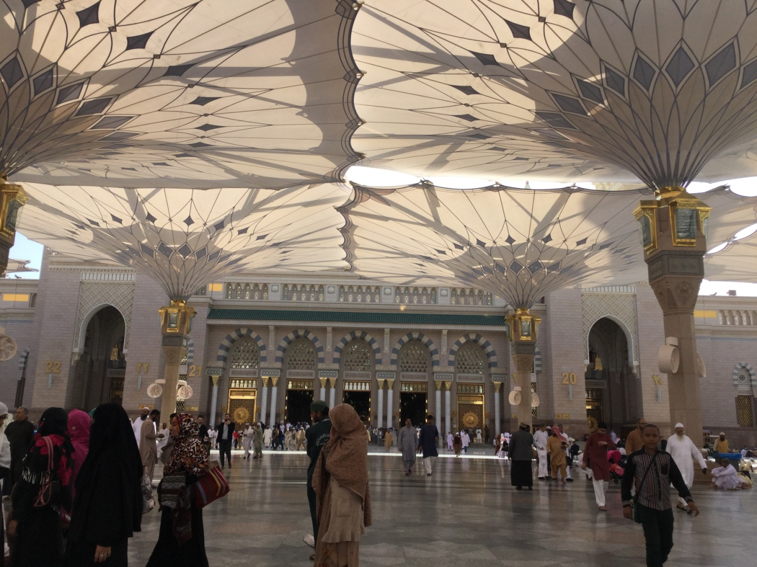
THE ARCHITECTURE OF MADINA MOSQUE

Slide 2
Introduction
The Madani Masjid An-Nabawī is home to the Prophet Mohammed’s (peace and blessings be upon him) resting place. To the right of the resting place is the resting place of the Prophet’s best friend, Abu Bakr Siddiq, and to the right of that is the resting place of Hazrat ‘Umar ibn Al-Khattab.
Masjid An-Nabawī also houses a graveyard for any diseased person in the community (one of which is my Aunt’s husband). It also holds the resting places of many sahābā (companions of the Prophet).

Slide 3
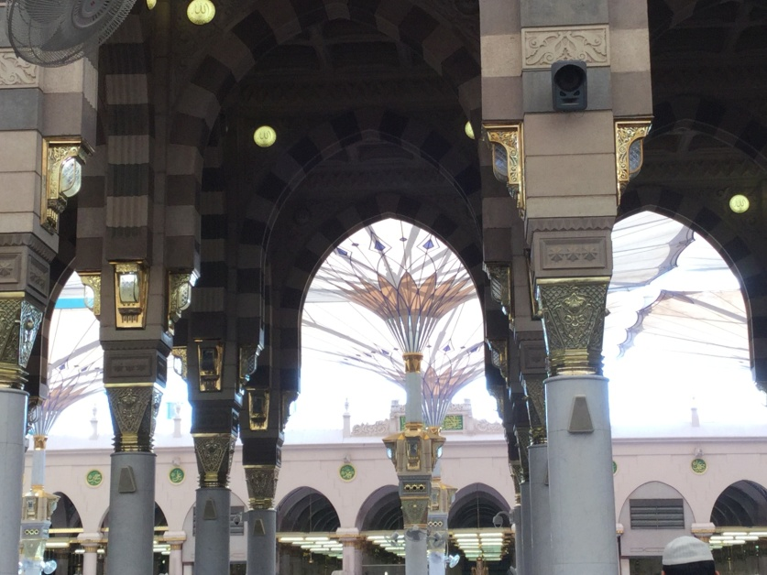
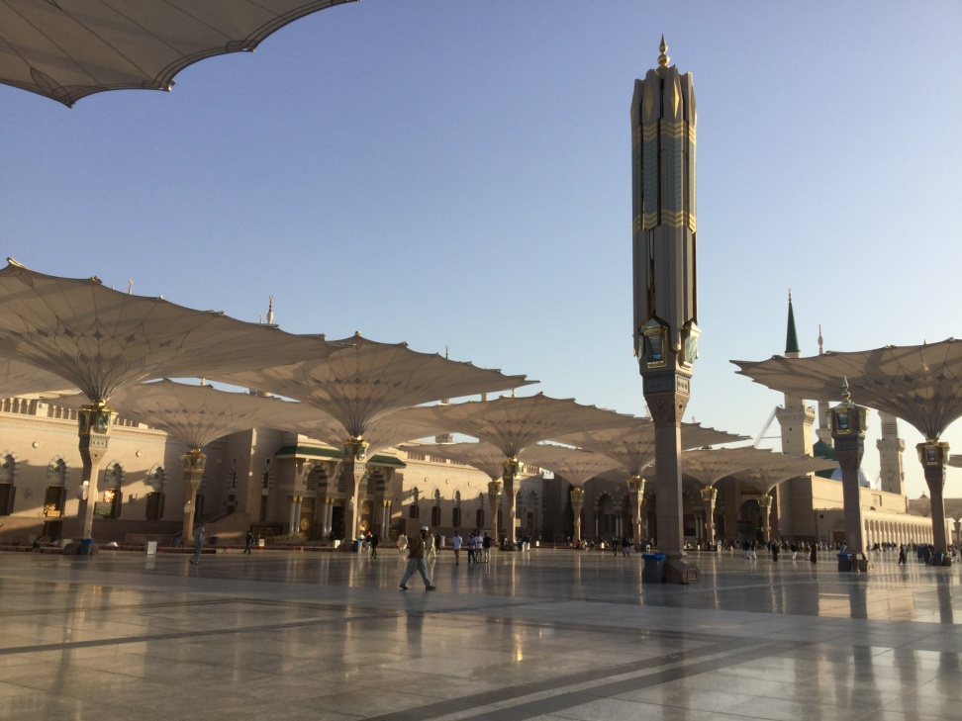
Umbrella Shades
Prevents sunlight from reaching praying persons
The closing and opening of the shades is fully automated
Designed by a German architect named Mahmoud Bodo Rasch and his firm SL Rasch GmbH and Buro Happold

Slide 4
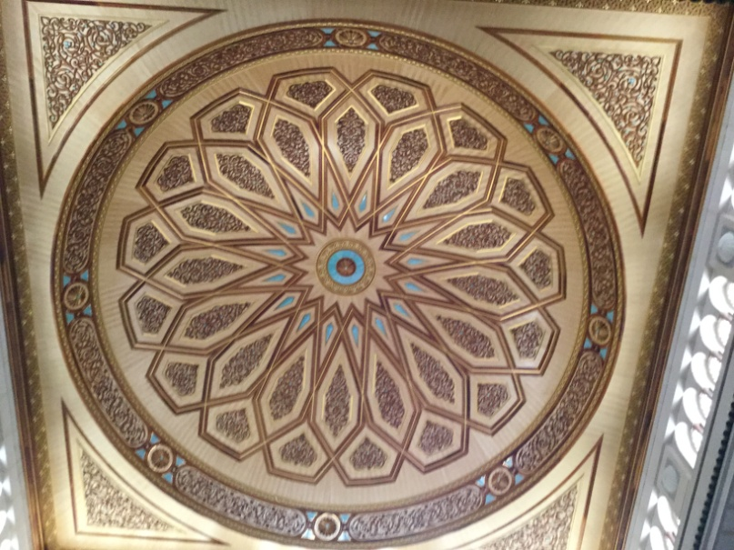
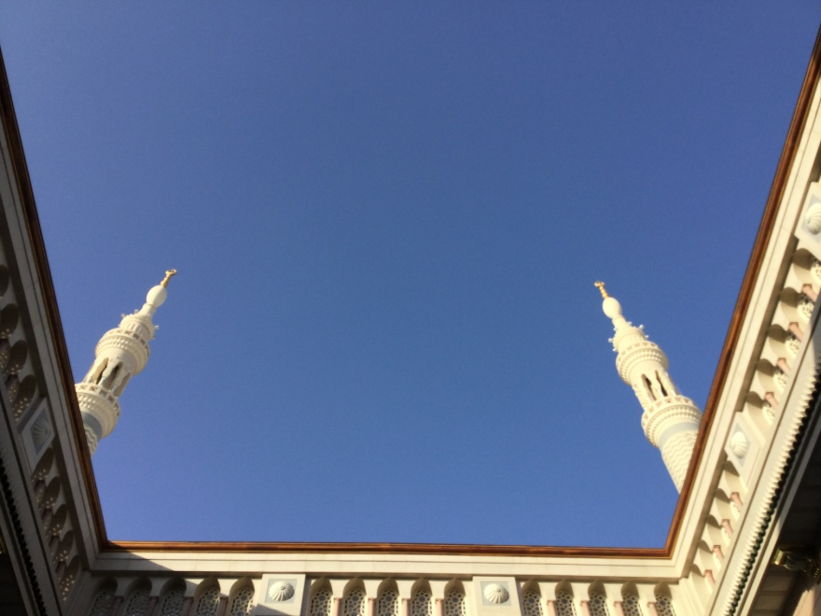
Moving Domes
Designed by Mahmoud Bodo Rasch and his firm SL Rasch GmbH and Buro Happold
Opens up between Dohr and Asr prayers
Opening and closing is fully autonomous
Notes:
I just realized that the font I’m using in the body of the slides is called “Andalus.” We stayed in Al-Andalus Suites when we were at Madina. What a coincidence!

Slide 5
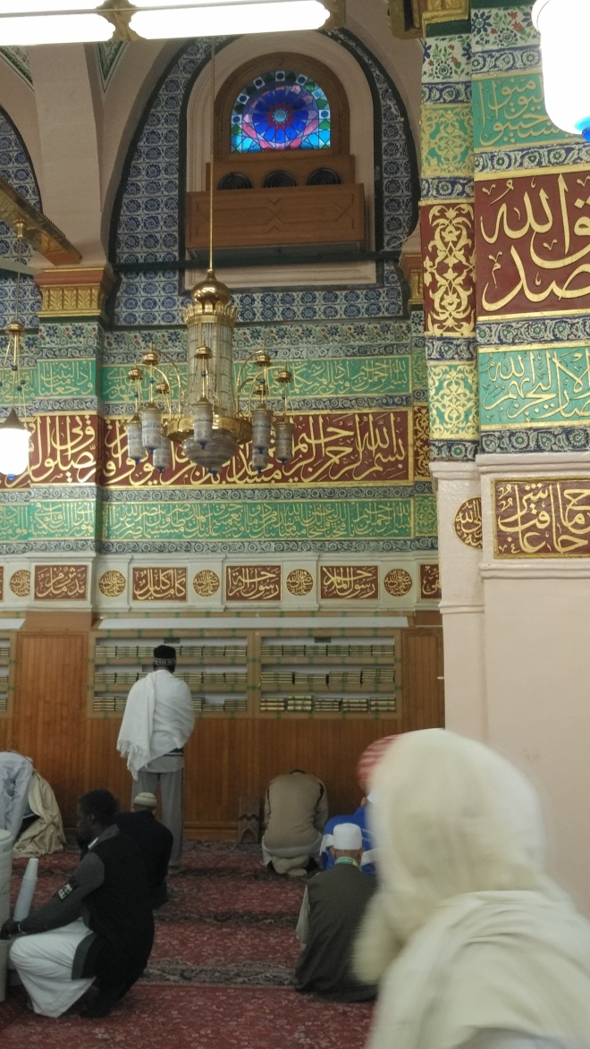
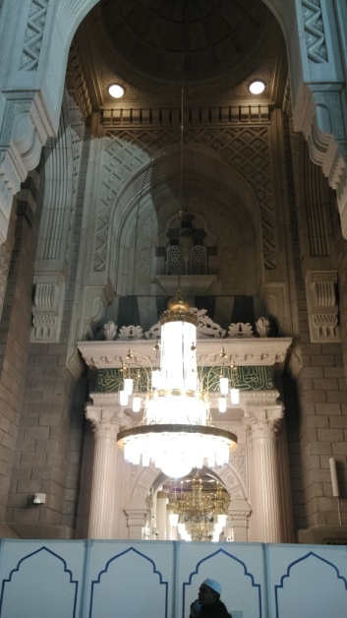
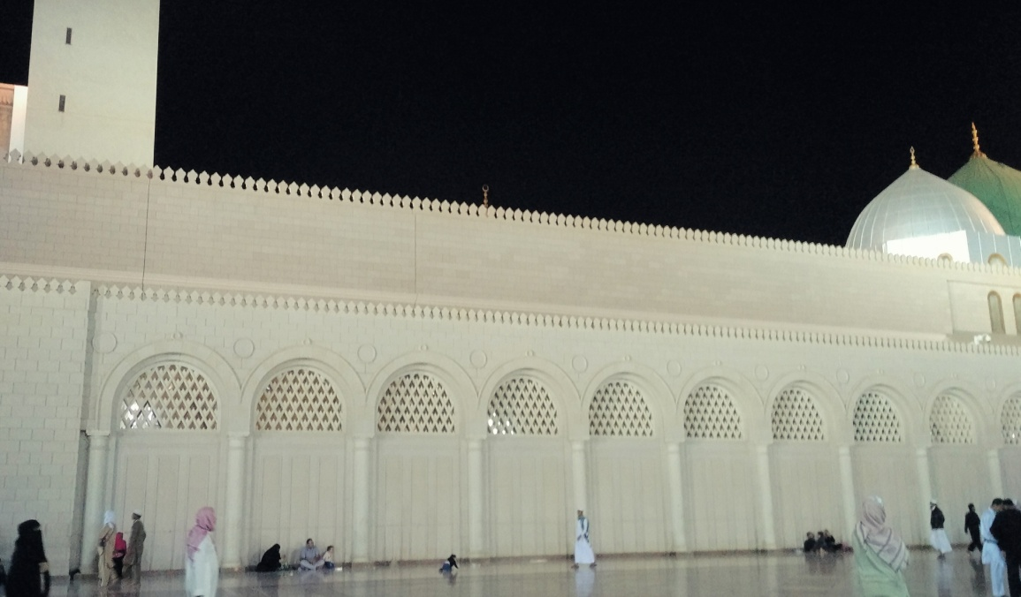
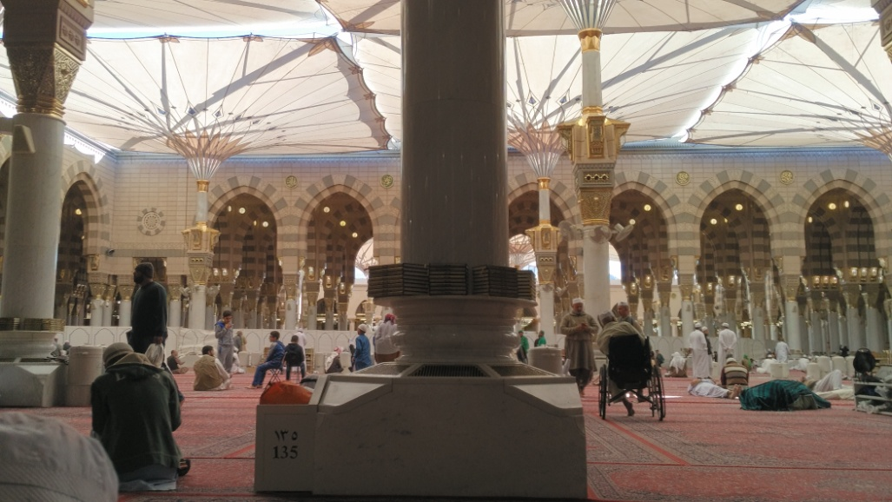
Turkish Architecture
Much of it has been destroyed as the Turkish/Abassid architecture in Makkah (Saudi is to blame)
Built by Ottomans and Abbasids 170 years back
Behind view of Turkish part of Mosque
Inside of the Turkish part of the Mosque. Keep in mind that it is largely changed.
Riyāzul Jannah (part of land which is from Heaven and first to lift on the Day of Judgment) is located inside.
One of the original entrances

Slide 6
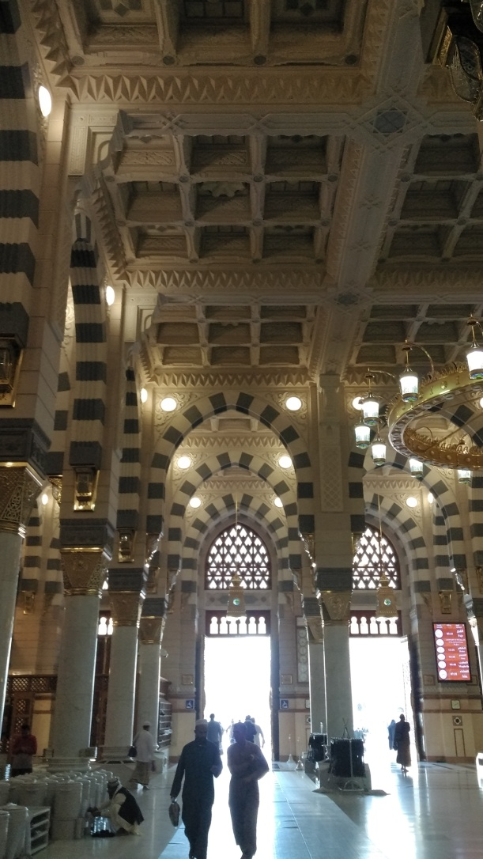
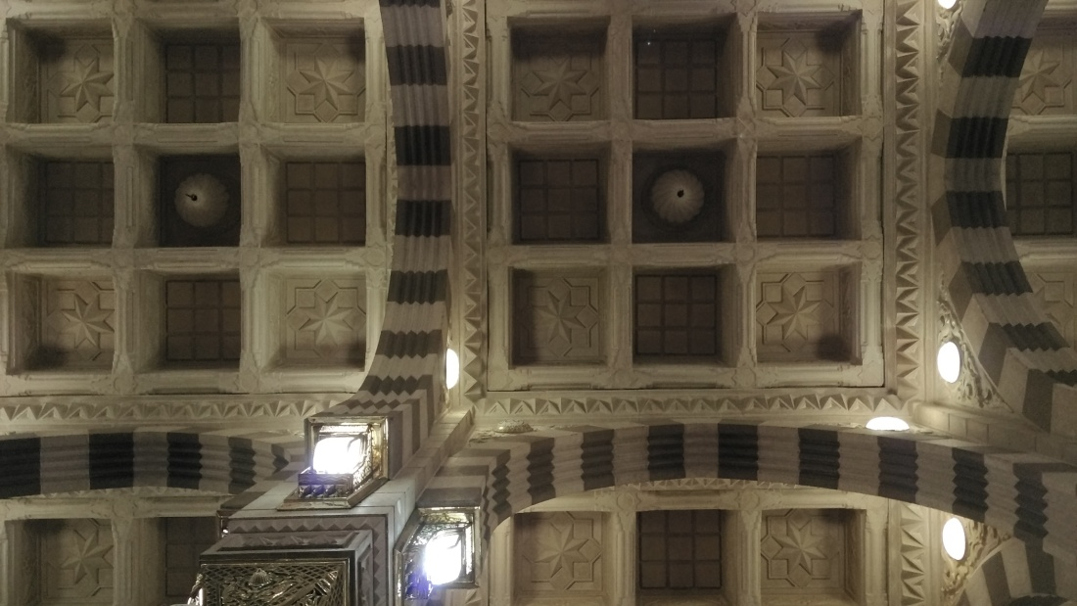
Saudi architecture
7o year old part of the Masjid is Saudi architecture. It has black accents on its arches.
The picture you see on the left is the 30-year-old part of the Mosque. The arches are blue. It may be a little difficult to differentiate the color of the arches depending on your monitor and its color profile. Or maybe it’s the camera…

Slide 7

thanks For viewing!

