Slide 1

WGCNA analysis of Lung Microarray data (GSE21933)
Spandan Pandya

Slide 2
Background
Spandan Pandya

Slide 3
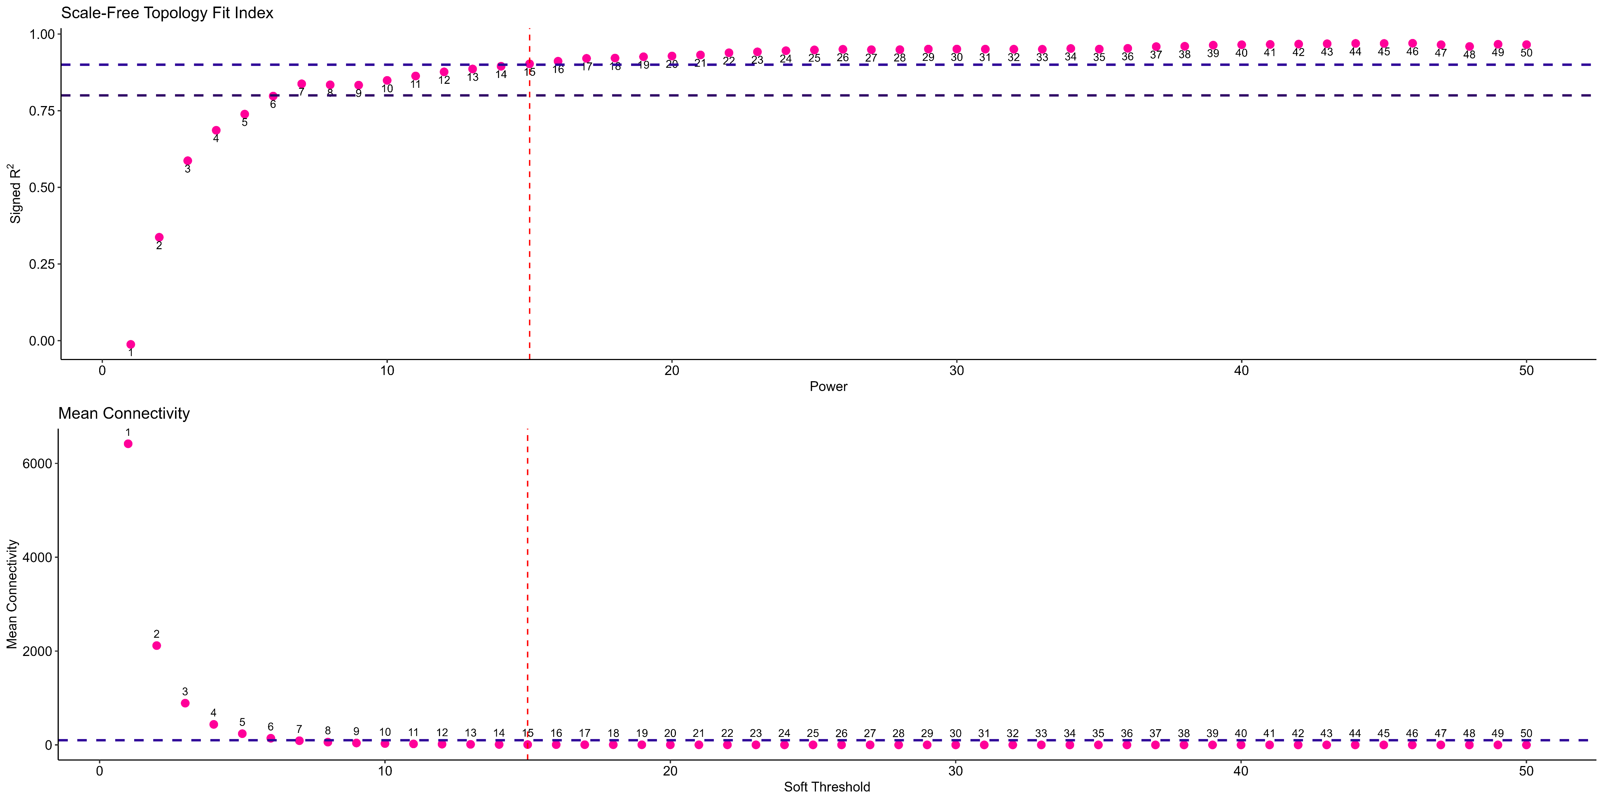
WGCNA: Soft-Threshold Analysis
Spandan Pandya

