Slide 1

WGCNA analysis of Lung Microarray data (GSE21933)
Spandan Pandya

Slide 2
Background
Spandan Pandya

Slide 3
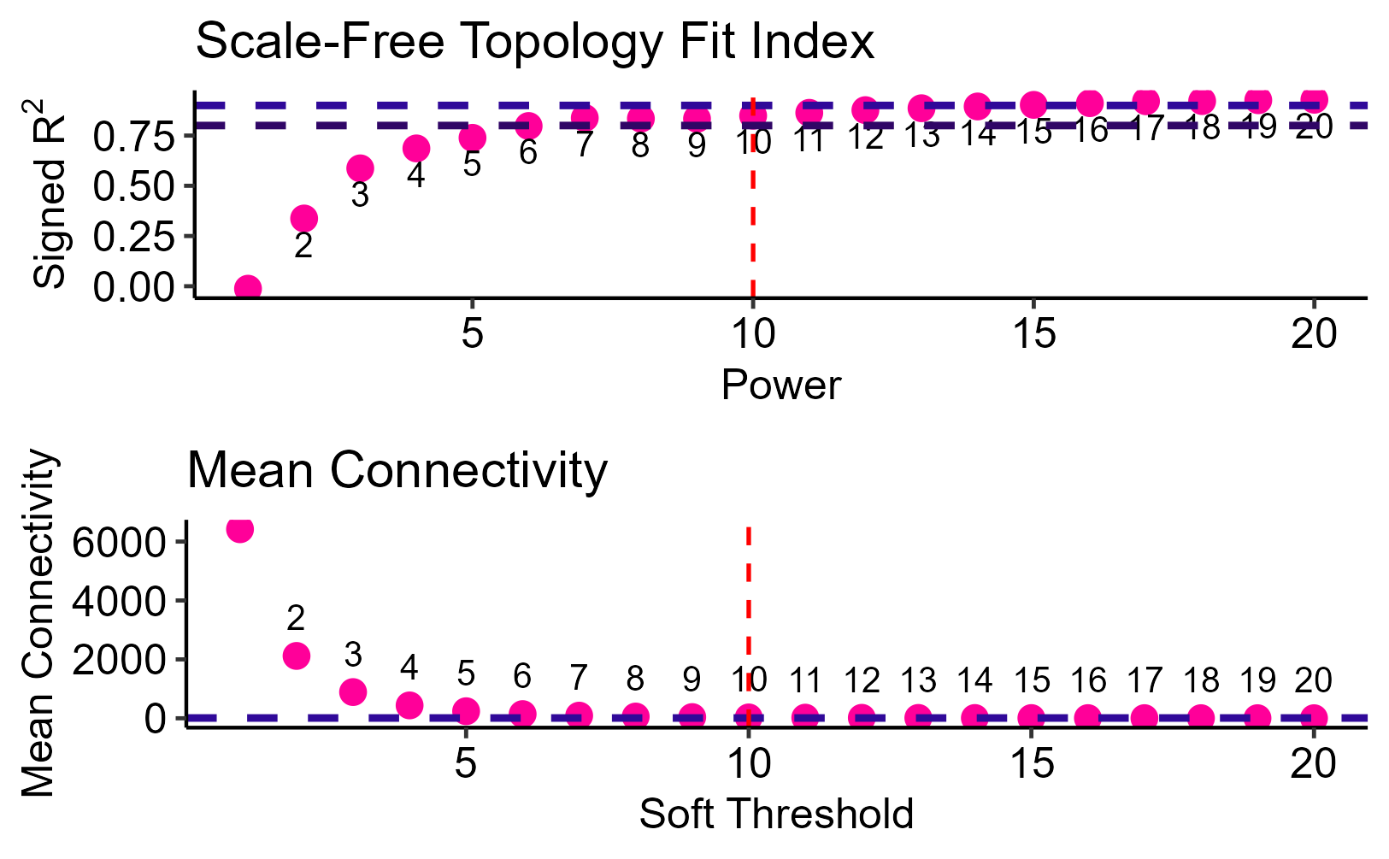
Background
Optimal topology index and mean connectivity approaches at the threshold value of 7. However, I chose 15 as an optimal.
Spandan Pandya

