Slide 1
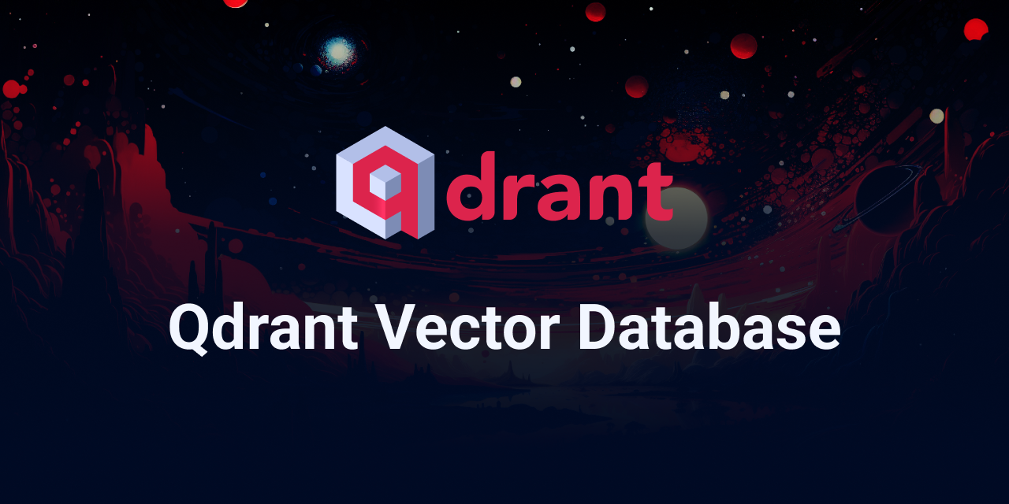
Healthcare Vector Search Architecture
API Service
Embedding
Memory
Qdrant Cloud
API Service
Trust Layer
Contextual Retrieval & Memory Layer
Long term memory
Long term & Session memory stored using Collections
Personalized knowledge
Qdrant Cloud
User Memory & Context
Stored Document Embeddings (Image, text, audio)
Payload Metadata
Query Vector + Filters
User Query Embeddings & Search filters
Top-K Similar Matches
Similarity Search & Filtering
Embedding Model
Relevant Results
Text, Images, Video
Text Encoder
BERT, SBERT, etc
Image Encoder
CLIP, VIT, etc
Audio Encoder
Whisper, Wav2vec, etc
Responsible Use & Trust Layer
Dataset Ethics – PMC Open Access
Deployment – Hackthon (not diagnosis)
Vector Generation

