Slide 1
Image Forgery Detection over Online Social Networks
Supervised by :
Mr. Biswajit Senapati
Presented by:
422143 - E.Spandana
422127 - Ch.Pavithra
422154 - G.Kovida

Slide 2
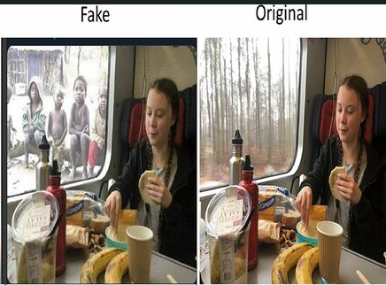
Introduction
Image forgery is widespread due to various editing tools.
Online Social Networks (Facebook, Instagram) spread fake images.
Need robust detection against Online Social Networks(OSN) distortions(manipulations).
‘Image’ is a visual representation of an object, scene, or person, typically in the form of a photo.
Forgery Detection’ is identifying manipulated images.
‘Online Social Networks(OSN)’ is real-world challenge where images are altered by platforms like Facebook, Instagram.
Fig 1: The image compares an original photo with a manipulated version where the background has been altered to create a misleading narrative.
Residual Learning is a technique where a neural network is trained to predict the difference (or residual) between an input and its desired output, rather than predicting the output directly. The key idea is to make the network focus on learning the small changes needed to transform the input into the output.
An adversarial algorithm is an algorithm in which two neural networks, called the generator and the discriminator, are trained simultaneously in a competitive manner. The generator creates synthetic data (e.g., images) that mimics real data, while the discriminator tries to distinguish between real data and the synthetic data produced by the generator. This competition drives both networks to improve.
[1].Fake vs. Original manipulated image. Retrieved from https://www.researchgate.net/profile/SatyendraSingh53/publication/379540056/figure/fig1/AS:11431281260708525@1721183279271 /

Slide 3

Title | Year | Model | Journal/Conference | Advantages | Disadvantages
Comparision and analysis of photo image forgery detection techniques | 2012 | Discrete Cosine Transform | International Journal on Computational Sciences & Applications Vo2, No.6 | Detect forgery in Joint Photographic Experts Group compressed image. | Fails in case of rotation, scaling
Fast, automatic and fine-grained tampered JPEG image detection via DCT coefficient analysis | 2009 | Discrete Cosine Transform and Data quality | Pattern Recognition | Fast, Robust against Joint Photographic Experts Group compression and various forgery methods, fine grained detection. | Not tested for rotation, scaling, intensity change.
Detection of Copy-Move Forgery in Digital Images | 2003 | Exhaustive Search and Autocorrelation | Digital Forensic Research Workshop | It detects duplicate or copied regions in an image without requiring any additional filtering, enhancement, or corrections after detection. | Time complexity. Cannot detect if changes is subjected to post processing operations.

Slide 4
Title | Year | Model | Journal/Conference | Advantages | Disadvantages
Deep Learning-Based Image Forgery Detection System | 2024 | CNN-based model (ResNet50v2 with YOLO weights) | International Journal of Electronic Security and Digital Forensics | High accuracy (85%) on CASIA datasets, robust detection | Fails in case of rotation, scaling
Image Forgery Detection on Multi-Resolution Splicing Attacks Using DCT and DWT | 2024 | DCT and DWT-based partitioning model | International Journal of Information and Computer Security | Effective in detecting splicing attacks, robust against rotation and scaling | High computational cost for large images
Image Forgery Detection Based on Fusion of Lightweight Deep Learning Models | 2023 | Fusion of lightweight deep learning models | International Journal of Communication Networks and Information Security | Improved accuracy and efficiency, adaptable to different forgery types | Requires extensive training data for best performance

Slide 5
Problem Statement
In this digital age, where fake images spread misinformation easily. Common forgery techniques include splicing, copy-move, resampling, and retouching. Traditional methods rely on handcrafted features but struggle to generalize across different forgeries. Existing surveys mainly classify detection methods without providing insights into advanced architectures, and coverage of challenges like deepfake detection, double JPEG compression, and camera identification remains limited.
With the rise of Artificial Intelligence-generated content and the increasing ease of manipulating digital media, image forgery has become a significant challenge in ensuring authenticity. Fake images are widely used in misinformation campaigns, social media, and even legal disputes, making image forgery detection (IFD) a critical research area. While traditional approaches rely on handcrafted features, they lack adaptability to evolving forgery techniques.
False images are raising concerns about digital media authenticity, exposing the limitations of conventional methods, and necessitating forgery detection techniques.

Slide 6
Motivation and Objective
Motivation:
In today’s world, it is hard to tell if an image is real or fake. Since we rely on media, online news, and digital platforms, it’s important to create accurate ways to detect fake images. With so much false information around, it’s tough to know which photos are real and which are edited.
Objective:
Developing a robust image forgery detection for Online Social Network using residual learning.

Slide 7
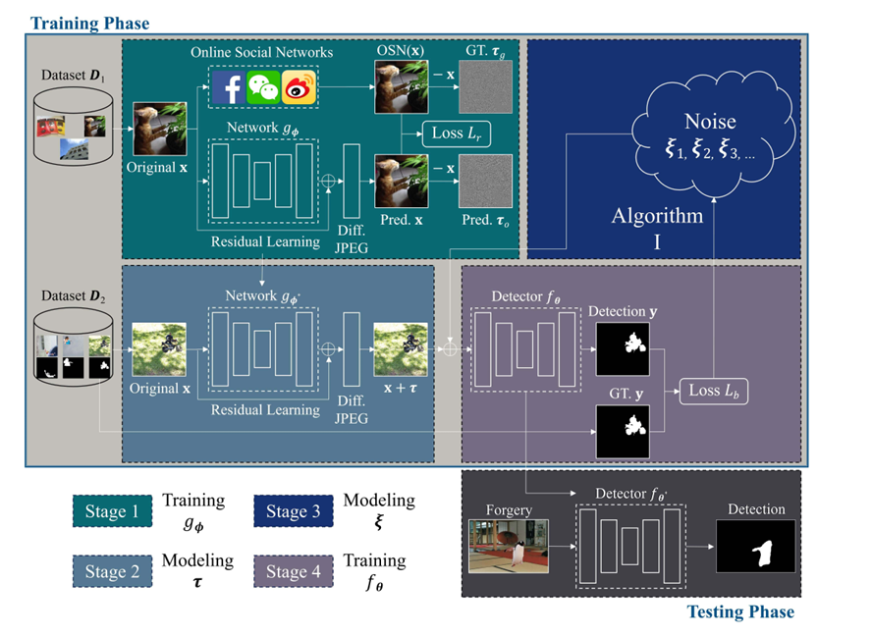
Existing Model Architecture
Fig 2: Architecture of existing model
[2]. Haiwei Wu, Jiantao Zhou, Jinyu Tian, and Jun Liu “Robust Image Forgery Detection over Online Social Network Shared Images”,[Refer fig: 2]

Slide 8
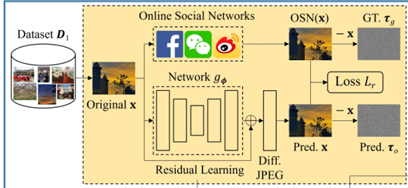
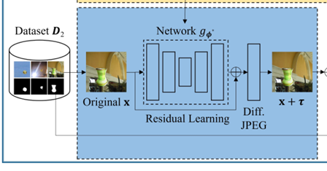
This Architecture divided into two phases
1)Training Phase 2) Testing Phase
Training Phase:
divided into four stages
Stage 1: Data Preparation and Processing through OSNs
Dataset (D₁):
A collection of original images is used as input.
These images serve as the training data for the model.
Original Image (x):
An image is selected from the dataset to be passed through the system.
Online Social Networks (OSNs):
The original image is uploaded to OSNs (Facebook, WeChat, Weibo, etc.).
Each platform applies its own compression and processing techniques.
The output from OSNs is denoted as OSN(x).
Residual Learning with Deep Network (g_φ):
A neural network is used to learn the transformation applied by OSNs.
The model aims to predict the difference between the original image (x) and its processed version OSN(x).
This transformation is referred to as "Diff. JPEG", indicating that lossy compression (similar to JPEG artifacts) is learned.
Ground Truth (GT, τᵧ) and Predicted Image (Pred. x, τₐ):
The goal is to train the network to predict how OSNs alter the original image.
The ground truth τᵧ represents the actual compression difference applied by the OSN.
The predicted transformation τₐ is learned by the deep network.
A loss function (Lᵣ) compares the prediction with the ground truth to refine learning.
Stage 2 Breakdown:
Dataset (D₂) Input:
A new dataset D₂ is used, which contains different images.
These images are used to train the network to understand the transformations.
Original Image (x):
An image is selected from D₂ as the input to the model.
Residual Learning Network (g_φ'):
A deep learning model is used to predict the transformation applied by compression.
The network learns the residual difference between the original image (x) and its altered version.
Transformation Prediction (Diff. JPEG):
The model predicts how compression or processing affects the image.
The difference (τ) between the original and processed image is estimated.
Final Output (x + τ):
The network adds the predicted transformation τ to the original image.
This results in a reconstructed or predicted processed image.

Slide 9
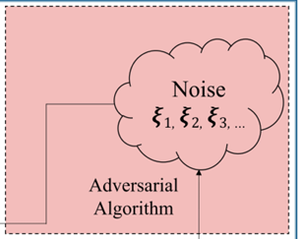
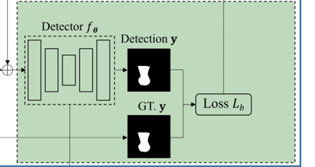
Stage 3 :
Adversarial Algorithm:
This stage involves an adversarial approach where an algorithm deliberately generates perturbations.
These perturbations are designed to degrade image quality, mislead a model, or simulate real-world distortions.
Noise Generation (ξ₁, ξ₂, ξ₃, ...):
The adversarial algorithm injects noise into the system.
Different noise components (ξ₁, ξ₂, ξ₃, ...) represent various forms of perturbations that can affect an image.
The noise can be designed to mimic compression artifacts, adversarial attacks, or distortions from social media processing.
Purpose of This Stage:
This stage tests the robustness of the system by introducing adversarial noise.
It evaluates whether the model can still predict transformations or recover images despite these distortions.
The adversarial noise is likely meant to degrade the image in a way similar to real-world social media compression, cyberattacks, or unexpected distortions.
Stage 4:
Detector f𝜃:
A deep learning-based detector network processes the image.
The detector is trained to identify specific features, objects, or anomalies.
It takes the input image with possible perturbations and generates a detection output.
Detection Output Y:
The detector’s prediction is represented as a binary mask (white object on black background).
This detection could represent segmentation, object detection, or feature extraction.
Ground Truth 𝐺𝑇, 𝑦:
The expected correct output (from the dataset).
This serves as a reference to compare against the detector’s prediction.
Loss Function 𝐿𝑏:
The difference between the detected output (y) and the ground truth (GT_y) is calculated.
This loss function penalizes errors, helping to optimize the detector during training.

Slide 10
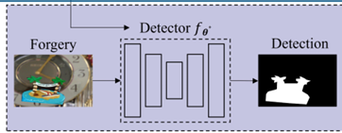
Testing Phase:
Input Image (Forgery):
A forged or manipulated image is fed into the system.
This could be an image that has undergone tampering, such as splicing, copy-move forgery, or other alterations.
Detector 𝑓𝜃∗ :
This is a pre-trained neural network model designed to detect forged regions.
The network has already been trained on datasets containing both real and forged images in previous stages.
It processes the input image and extracts discriminative features to identify forged areas.
Detection Output (Forgery Map):
The output is a binary mask where:
White regions indicate detected forgery.
Black regions represent unaltered parts.
The model tries to accurately highlight tampered areas while avoiding false detections.

Slide 11


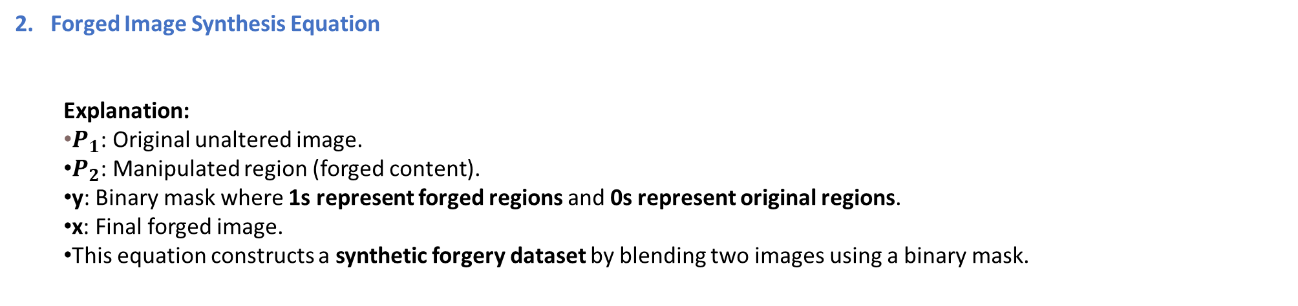
EQUATIONS
Compound Noise Model Equation
Explanation:
δ: Total noise introduced into the training process.
τ: Predictable noise (from known transformations like JPEG compression, resizing).
ξ: Unseen noise (from unknown distortions caused by OSNs or adversarial attacks).
This equation represents the two-part noise model, which helps train the forgery detector to be Robust against OSN distortions.
2. Forged Image Synthesis Equation
Explanation:
$P_{1}$​: Original unaltered image.
$P_{2}$​: Manipulated region (forged content).
y: Binary mask where 1s represent forged regions and 0s represent original regions.
x: Final forged image.
This equation constructs a synthetic forgery dataset by blending two images using a binary mask.

Slide 12


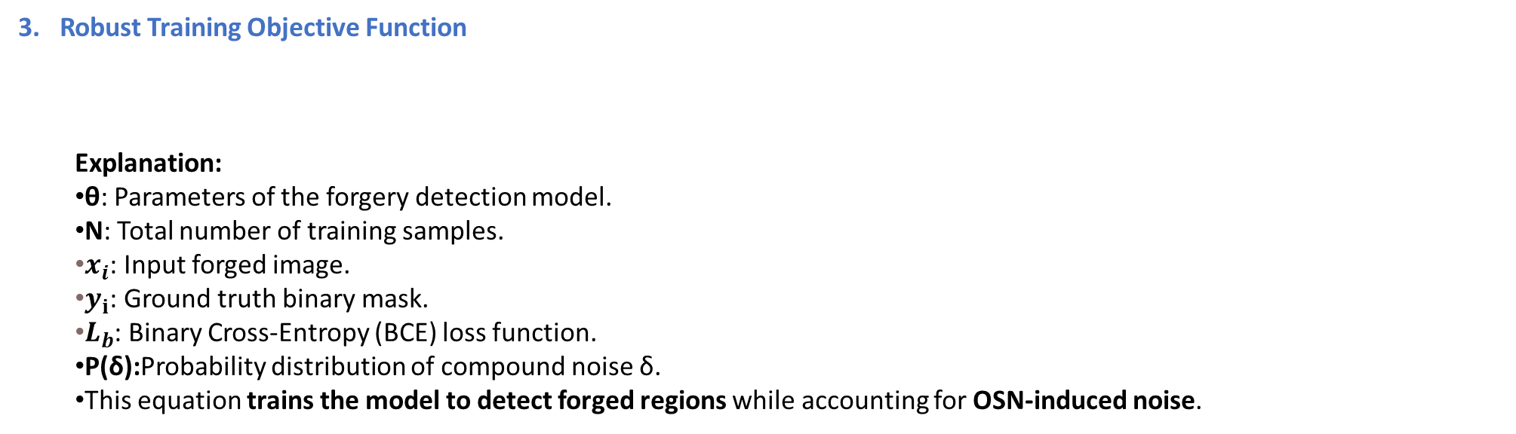
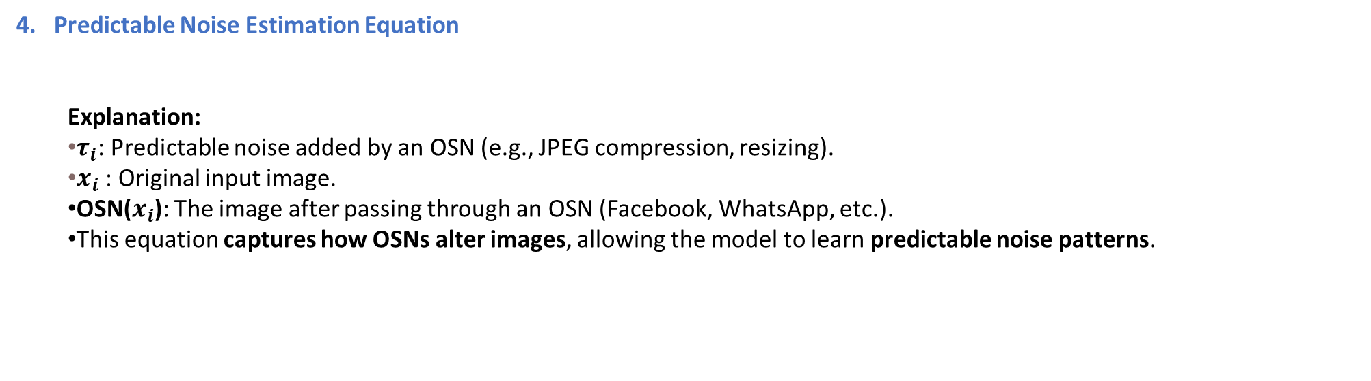
3. Robust Training Objective Function
Explanation:
θ: Parameters of the forgery detection model.
N: Total number of training samples.
$x_{i}$: Input forged image.
$y_{ⅈ}$​: Ground truth binary mask.
$L_{b}$​: Binary Cross-Entropy (BCE) loss function.
P(δ):Probability distribution of compound noise δ.
This equation trains the model to detect forged regions while accounting for OSN-induced noise.
4. Predictable Noise Estimation Equation
​Explanation:
$τ_{i}$​: Predictable noise added by an OSN (e.g., JPEG compression, resizing).
$x_{i}$​: Original input image.
OSN($x_{i}$): The image after passing through an OSN (Facebook, WhatsApp, etc.).
This equation captures how OSNs alter images, allowing the model to learn predictable noise patterns.

Slide 13
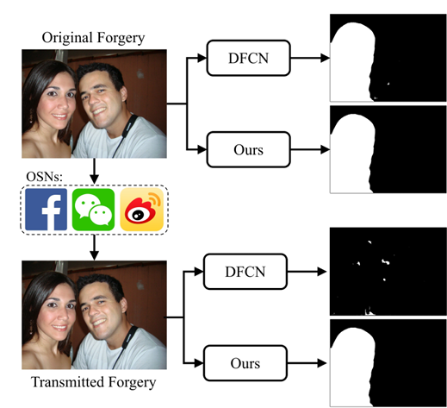
This image compares two forgery detection models (Deep Fully Convolutional Network(DFCN) vs Ours) on both original and OSN-transmitted forgeries. First Row: The original forged image is input into both models. Our model produces a clearer forgery mask than DFCN. Second Row: The same image is uploaded to OSNs (Facebook) and then downloaded, introducing compression artifacts. Our model still detects forgeries accurately, while DFCN struggles.
Fig 3:The detection results of our model vs DFCN
[3]. Haiwei Wu, Jiantao Zhou, Jinyu Tian, and Jun Liu “Robust Image Forgery Detection over Online Social Network Shared Images”,[Refer fig: 1]

Slide 14
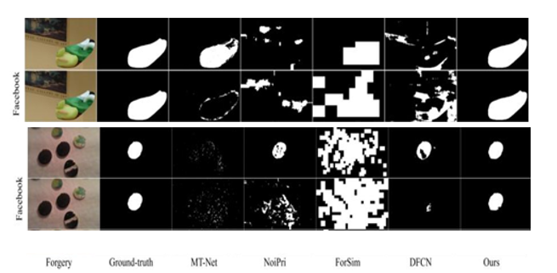
1)Forgery (First Column)
Shows the original forged image before detection.
This image has been uploaded and processed by Facebook, which applies compression, resizing, and noise.
2)Ground Truth (Second Column)
Displays the actual tampered regions (white areas indicate manipulated regions).
This serves as the ideal reference for detection models.
3)MT-Net (Third Column - Multi-task Network)
Fails to detect most of the tampered areas after Facebook processing.
Produces a very weak and noisy response, showing its inefficiency under OSN compression.
4)NoiPri (Fourth Column - Noise Prior-based Model)
Struggles with blocky detection due to Facebook-induced distortions.
Identifies some manipulated areas but has inconsistent and incomplete detection.
5)ForSim (Fifth Column - Forgery Simulation Model)
Detects some forgery regions, but introduces many false positives (extra white areas).
Blocky pattern suggests it struggles with Facebook's noise and compression effects.
6)DFCN (Sixth Column - Deep Fully Convolutional Network)
More accurate than MT-Net, NoiPri, and ForSim, but still fails to fully capture the forged region.
Some areas remain undetected or incorrectly marked.
7)Ours (Seventh Column - Proposed Model)
Best performance in forgery detection after Facebook processing.
Clearly identifies the manipulated regions, closely matching the ground truth.
Shows strong robustness against Facebook compression artifacts.
Fig 4:OSN-transmitted forgery detection results from various methods
[4]. Haiwei Wu, Jiantao Zhou, Jinyu Tian, and Jun Liu “Robust Image Forgery Detection over Online Social Network Shared Images”,[Refer fig: 4]

Slide 15
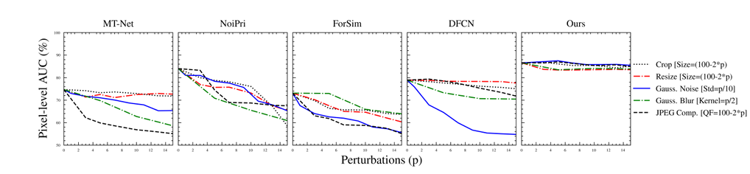
The y-axis represents Pixel-level AUC (Area Under the Curve) in percentage, indicating the detection accuracy, while the x-axis represents increasing levels of perturbations (p) applied to the images.
Each subplot corresponds to a different forgery detection model:
MT-Net (Multi-task Network)
NoiPri (Noise-aware Prior-based Model)
ForSim (Forgery Simulation-based Model)
DFCN (Deep Fully Convolutional Network)
Ours (Proposed Model)
Each model is tested under different perturbation types, which are represented using different colored lines:
Black Dotted Line: Crop – Measures the model's ability to detect forgeries when part of the image is cropped.
Red Dashed Line: Resize – Evaluates how the model performs when the image is resized.
Blue Solid Line: Gaussian Noise – Tests the model's robustness against added random noise.
Green Dash-Dot Line: Gaussian Blur – Examines performance when the image is blurred.
Black Dash-Dash Line: JPEG Compression – Evaluates detection accuracy after lossy compression is applied.
Fig5:Performance evaluation against cropping, resizing, blurring, noising, and JPEG compression.
[5]. Haiwei Wu, Jiantao Zhou, Jinyu Tian, and Jun Liu “Robust Image Forgery Detection over Online Social Network Shared Images”,[Refer fig: 5]

Slide 16
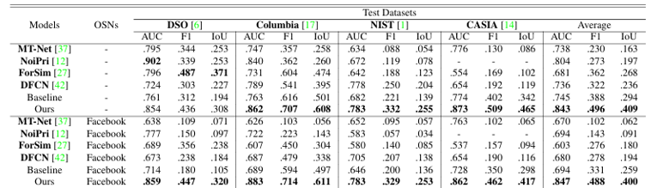
1. Performance Without OSN Transmission
The proposed model (Ours) achieves the best performance across all datasets.
AUC: 0.854 (DSO), 0.862 (Columbia), 0.783 (NIST), 0.873 (CASIA)
F1: 0.436 (DSO), 0.308 (Columbia), 0.329 (NIST), 0.462 (CASIA)
IoU: 0.409 (Average), highest among all models
The baseline model lags behind in all metrics, proving the superiority of more advanced methods.
2. Impact of OSN Transmission
Facebook Transmission:
Performance drops across all models, but the proposed model still outperforms others.
The average IoU of "Ours" is 0.400, which is higher than other models.

Slide 17
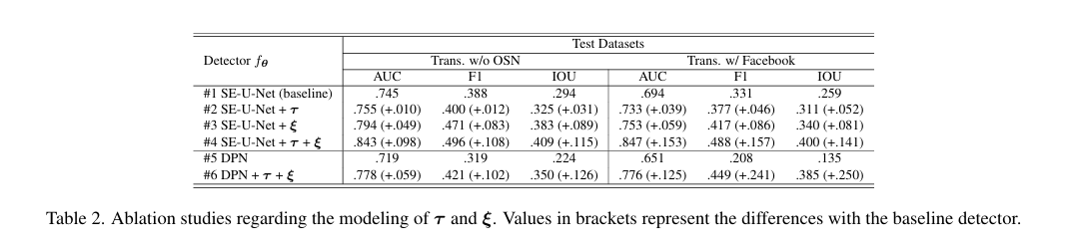
This table evaluates different variations of the detector fθ for image forgery detection using AUC, F1, and IoU metrics on datasets with and without Facebook transformations.
Baseline (#1 SE-U-Net) shows the lowest performance.
Adding τ (#2 SE-U-Net + τ) provides slight improvements.
Adding ξ (#3 SE-U-Net + ξ) improves results more significantly.
Combining τ and ξ (#4 SE-U-Net + τ + ξ) achieves the best performance.
DPN alone (#5 DPN) underperforms, but adding τ + ξ (#6 DPN + τ + ξ) significantly boosts accuracy.
[Table1][Table2]. Haiwei Wu, Jiantao Zhou, Jinyu Tian, and Jun Liu “Robust Image Forgery Detection over Online Social Network Shared Images”,[Refer Table1,Table2]

Slide 18
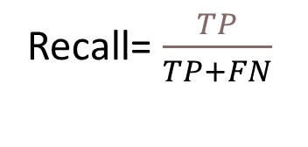
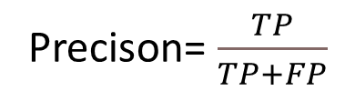
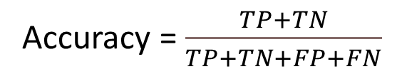
Precision: The ratio of true positive predictions to all predicted positives.
Evaluation metrics
Precison= $\frac{TP}{TP+FP}$
Recall: The ratio of true positive predictions to all actual positives.
Recall= $\frac{TP}{TP+FN}$​
Accuracy: The ratio of correctly predicted instances to the total instances
Accuracy = $\frac{TP+TN}{TP+TN+FP+FN}$

Slide 19
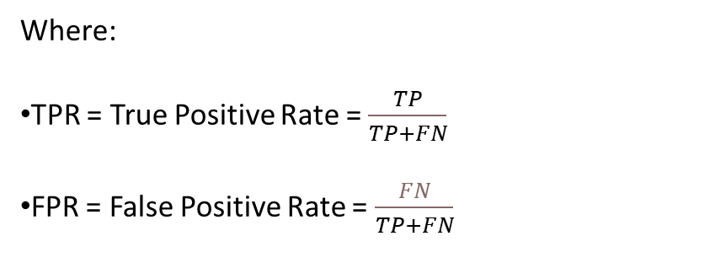
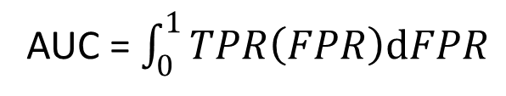
Area Under the Curve (AUC): Measures the ability of a classifier to distinguish between classes, typically under the ROC curve.
AUC = $\int_{0}^{1}{TPR\left(FPR\right)dFPR}$
Where:
TPR = True Positive Rate = $\frac{TP}{TP+FN}$
FPR = False Positive Rate = $\frac{FN}{TP+FN}$​

Slide 20
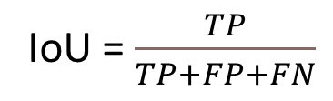
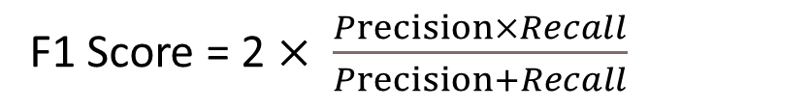
F1 Score: The harmonic mean of precision and recall, balancing both metrics.
F1 Score = 2 $× \frac{Precision×Recall}{Precision+Recall}$
Intersection over Union (IoU):The ratio of overlap between predicted and ground truth areas to their union, used in object detection.
IoU = $\frac{TP}{TP+FP+FN}$

Slide 21
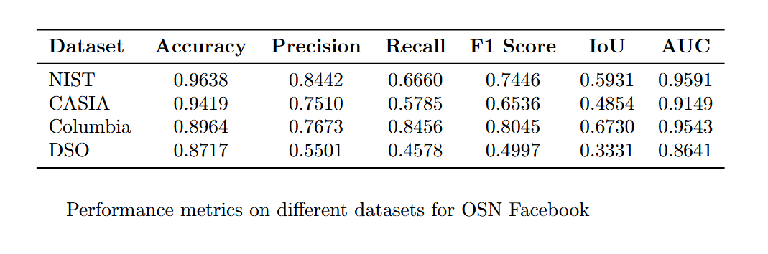
Results
Model Used: ResNet-34
Performance metrics on different datasets for OSN Facebook

Slide 22
THANK YOU

