Slide 1
Cognivia:AI-Driven Intelligent Academic Support and Query Resolution Framework
Team - 07
2420030153
2420030417
2420090150

Slide 2
Introduction
1. AI-Powered Smart Helpdesk is an intelligent college support system.
2. Uses Artificial Intelligence (AI) and Natural Language Processing (NLP).
3. Provides quick and accurate answers to students' queries.
4. Helps students get information about academics, examinations, fees, hostels, library and transportation.
5. Understands student questions and identifies their intent.
6. Provides relevant answers using a college-specific knowledge base.
7. Creates support tickets for unanswered queries and reduces the workload of helpdesk staff.

Slide 3
Objectives
1. To develop an AI-powered chatbot for college-related student support.
2. To provide quick and accurate responses to student queries.
3. To implement Artificial Intelligence and Natural Language Processing (NLP).
4. To understand student questions and identify their intent.
5. To provide relevant information through a college-specific knowledge base.
6. To reduce the workload of college helpdesk staff.
7. To create support tickets and escalate queries that cannot be answered confidently.

Slide 4
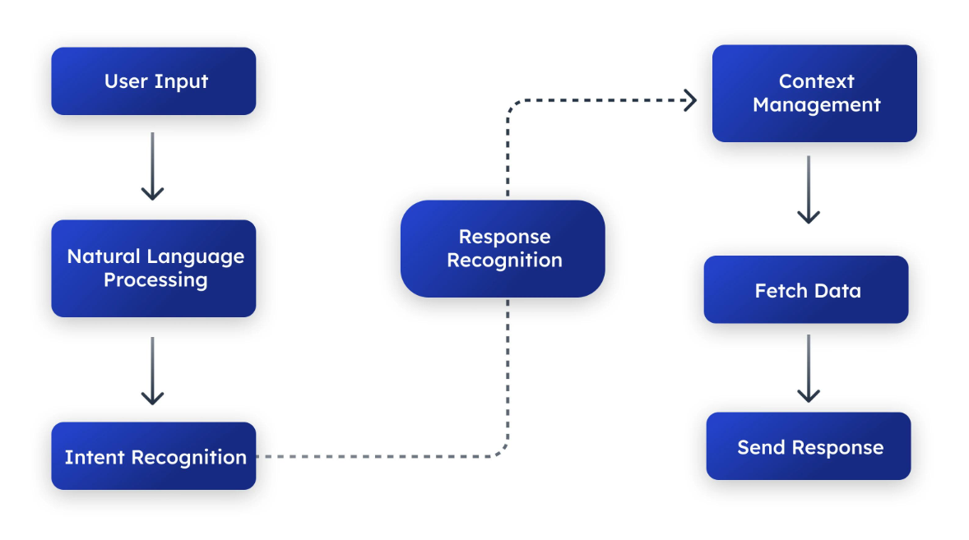

Slide 5
System flow
Student opens the AI-Powered Smart Helpdesk.
Student enters a college-related question.
The system receives the query.
NLP processes the question and identifies the user's intent.
The system searches the college-specific knowledge base.
If a relevant answer is found, it is displayed to the student.
If the system cannot confidently answer, a support ticket is created and forwarded to the concerned staff.

Slide 6
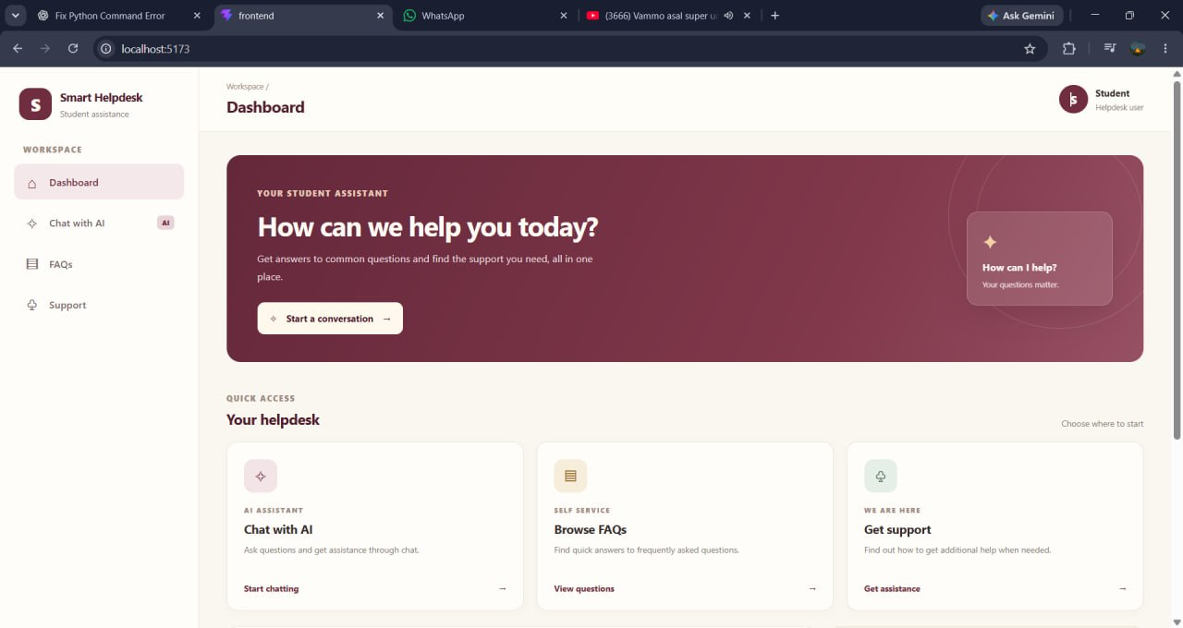

Slide 7
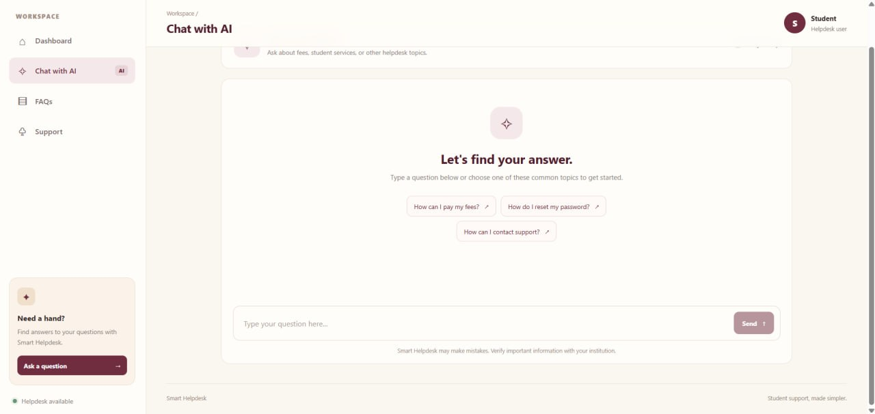

Slide 8
Conclusion
1. AI-Powered Smart Helpdesk provides an intelligent solution for college-related student queries.
2. Uses AI and NLP to understand questions and identify student needs.
3. Provides quick and relevant answers through a college-specific knowledge base.
4. Covers academics, examinations, fees, hostels, library, certificates and transportation.
5. Creates support tickets when queries cannot be answered confidently.
6. Reduces the workload of college helpdesk staff.
7. Improves the student support experience by making information easily accessible.

Slide 9
Thank you

