Slide 1
Introduction
JavaScript is well known for client-side scripts running inside the browser
node.js is JavaScript running on the server-side
SSJS -> Server-Side JavaScript
  Use a language you know
  Use the same language for client side and server side

Slide 2

Why node.js ?
● Non Blocking I/O
● V8 Javascript Engine
● Single Thread with Event Loop
● Windows, Linux, Mac
● 1 Language for Frontend and Backend

Slide 3
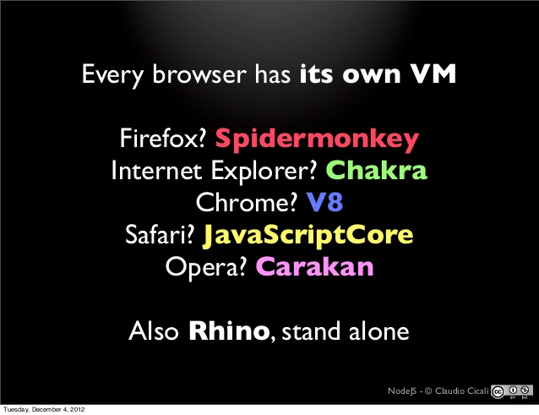
JavaScript Engines……

Slide 4
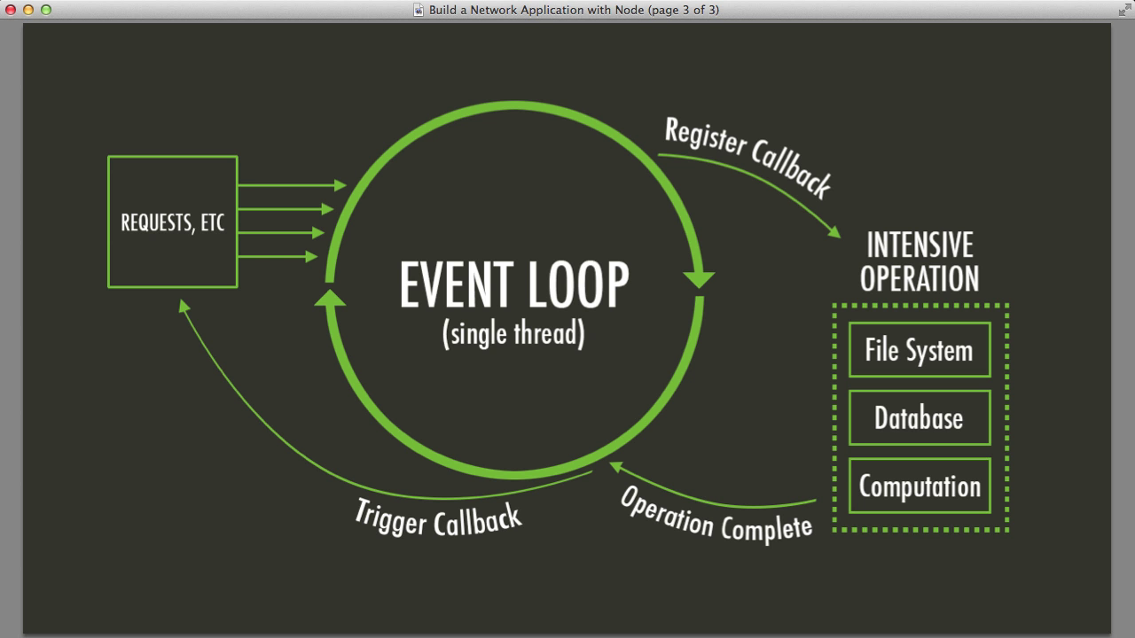
Node.js Event Loop
There are a couple of implications of this apparently very simple and basic model
  Avoid synchronous code at all costs because it blocks the event loop
  Which means: callbacks, callbacks, and more callbacks

Slide 5
What is node.js?
Asynchronous i/o framework
Can handle thousands of Concurrent connections with Minimal overhead (cpu/memory) on a single process
It’s NOT a web framework, and it’s also NOT a language

Slide 6
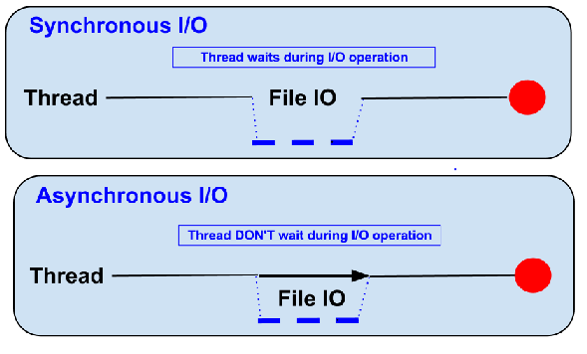
Blocking vs Non-Blocking……
Example :: Read data from file and show data

Slide 7
Blocking…..
● Read data from file
● Show data
● Do other tasks
var data = fs.readFileSync( “test.txt” );
console.log( data );
console.log( “Do other tasks” );

Slide 8
Non-Blocking……
Callback
● Read data from file
When read data completed, show data
● Do other tasks
fs.readFile( “test.txt”, function( err, data ) {
console.log(data);
});

Slide 9
HTTP Method……
● GET
● POST
● PUT
● DELETE

Slide 10
File package.json…..
Project informations
• Name
• Version
• Dependencies
• Licence
• Main file
Etc...

Slide 11
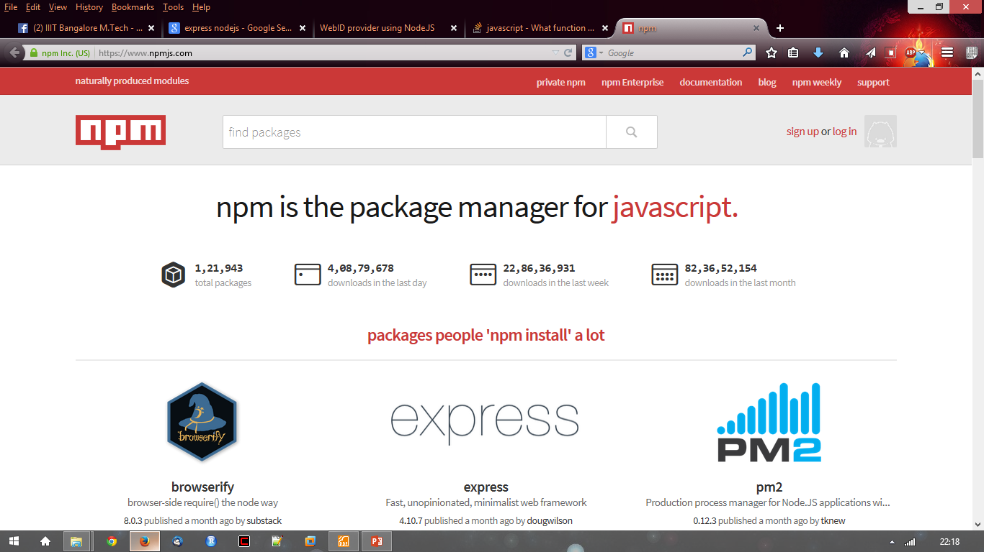
Node.js Modules…..
● https://npmjs.org/
● # of modules = 1,21,943

Slide 12
Install module…..
$npm install <module name>

Slide 13
Using module…..
var http = require(‘http’);
var fs = require(‘fs’);
var express = require(‘express’);

