Slide 1
What is MongoDB?
It is a NoSQL database
A document-oriented database
It uses BSON format

Slide 2
The Basics
A MongoDB instance may have zero or more databases
A database may have zero or more ‘collections’.
A collection may have zero or more ‘documents’.
A document may have one or more ‘fields’.
MongoDB ‘Indexes’ function much like their RDBMS counterparts.

Slide 3
MongoDB vs. RDBMS
Collection vs. table
Document vs. row
Field vs. column
Collection isn't strict about what goes in it (it's schema-less)

Slide 4
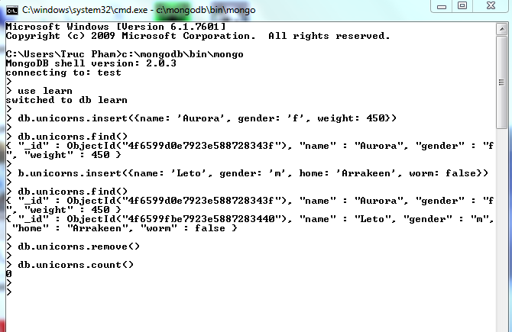
MongoDB in action…

Slide 5
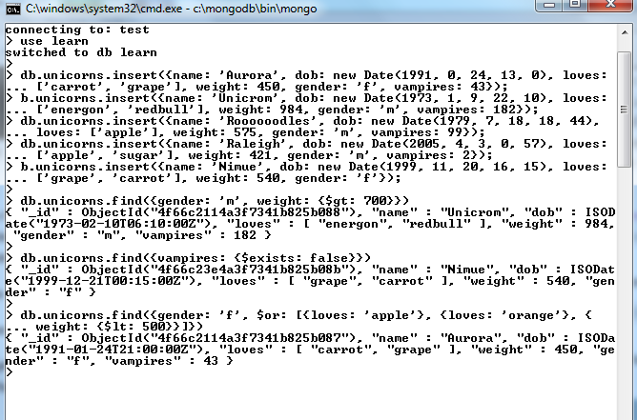
More actions…

Slide 6
Why use MongoDB
Simple queries
Makes sense with most web applications
Easier and faster integration of data
Not well suited for heavy and complex transactions systems.

