Slide 1
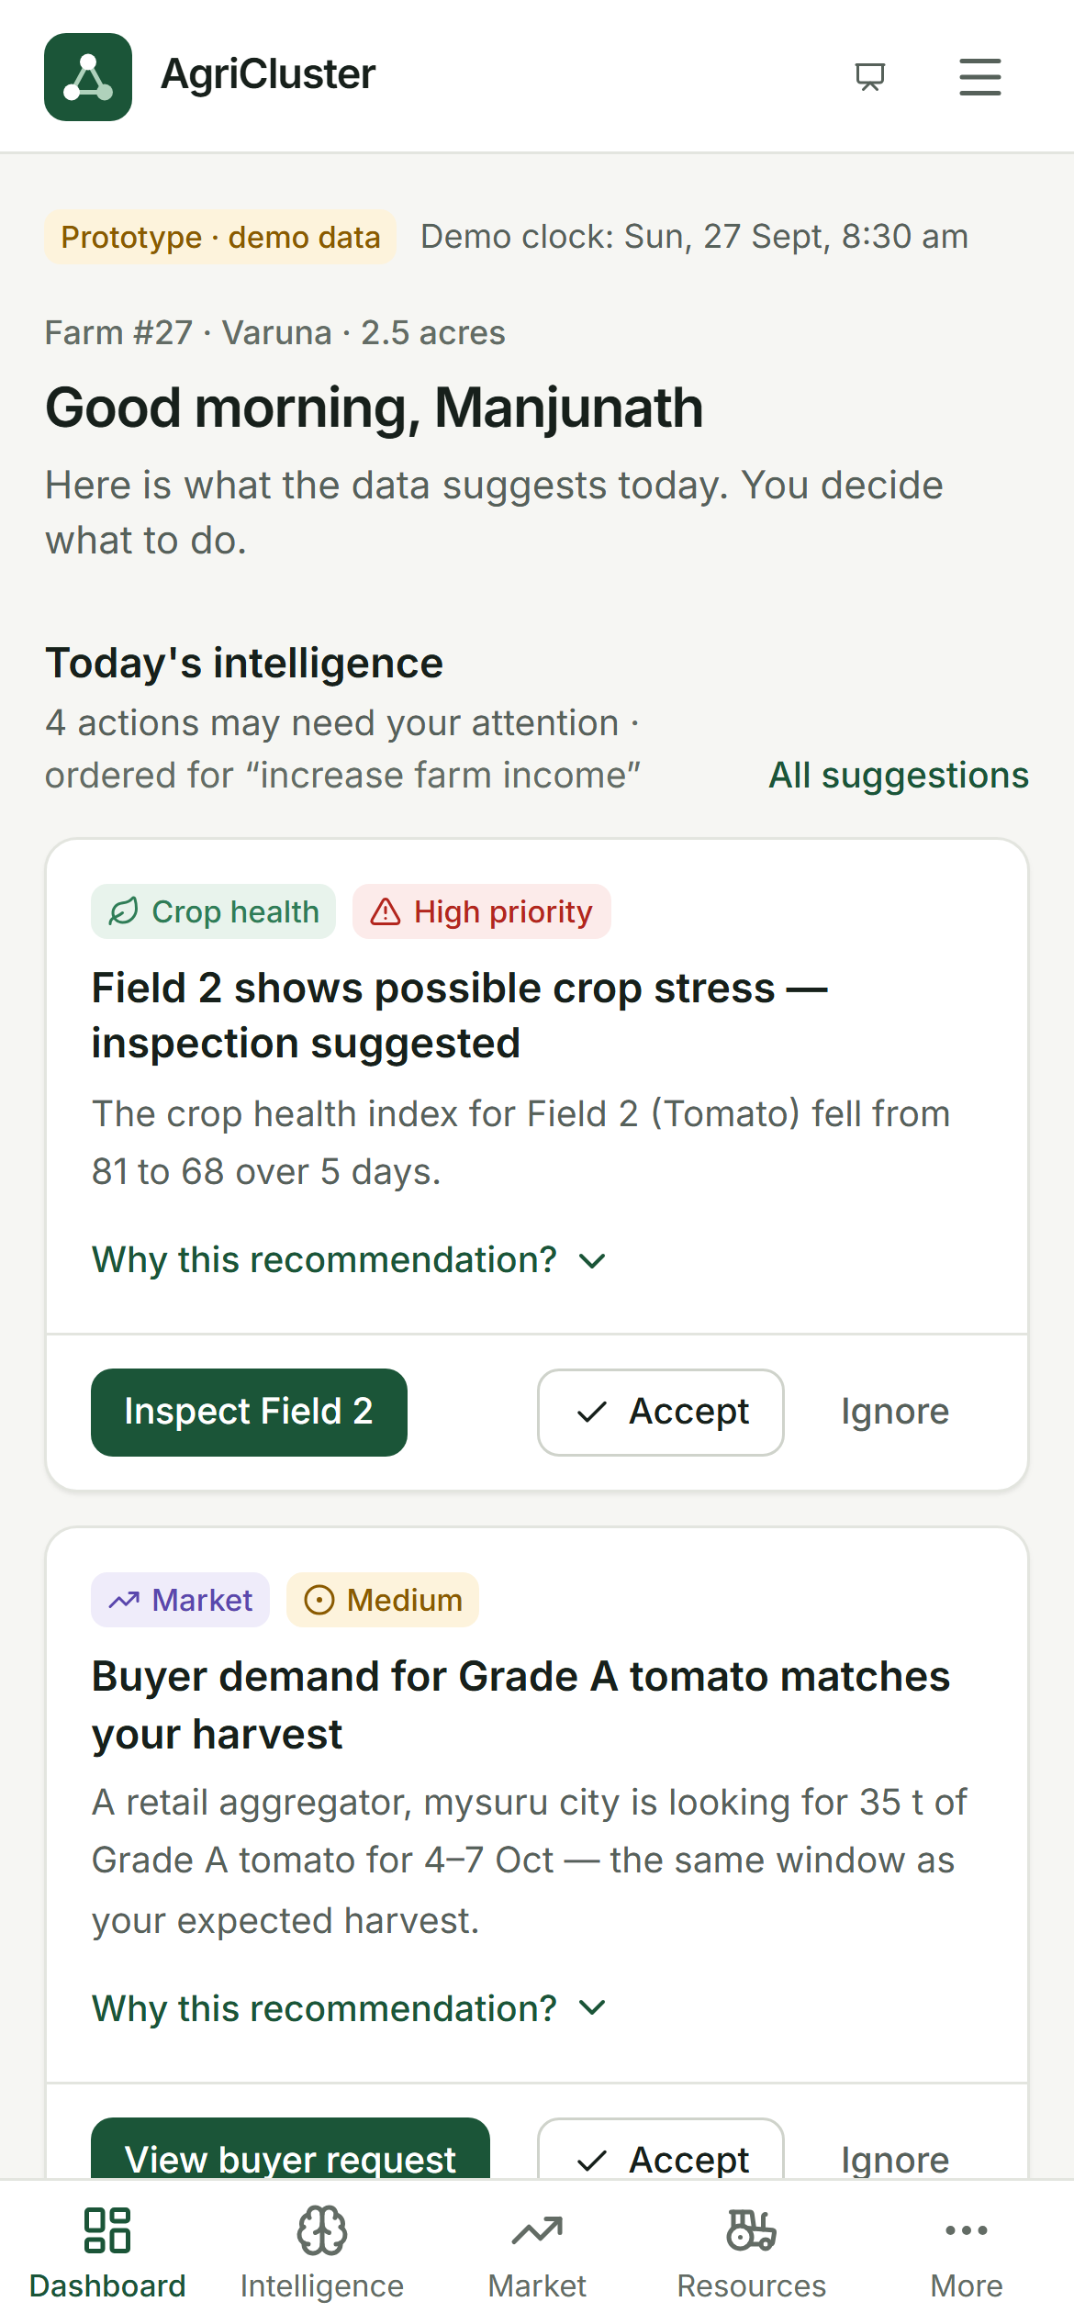
AgriCluster
Small Farms. Shared Resources. Smarter Decisions.
Cluster intelligence that connects neighbouring small farms, shares their machinery, labour and expertise, and coordinates their harvests with buyers.
Competition prototype · Demonstration cluster: Mysuru Vegetable Cluster, Karnataka
Notes:
AgriCluster is a smart-farming platform for small farms. Instead of trying to make every small farm a fully equipped smart farm on its own, we connect nearby farms into one intelligent cluster. The cluster shares data, machinery, labour, expertise and market access. What you see on the phone is a working prototype: a farmer's dashboard in our demonstration cluster in Mysuru district.

Slide 2
02 PROBLEM
Small farms face big decisions alone
Fragmented decisions
Each farmer decides alone when to irrigate, spray and harvest, often without timely data.
OUR DEMONSTRATION CLUSTER
128
Fragmented resources
Tractors, labour and technology are hired or bought farm by farm, and everyone needs them in the same week.
farmers
312
Fragmented information
acres, about 2.4 acres per farm
Weather, soil and crop signals rarely reach the field in a form a farmer can act on today.
Tomato · Chilli · Onion · Leafy vegetables
Fragmented markets
Small lots mean weak bargaining power, uncertain buyers and avoidable post-harvest loss.
Fictional demonstration data, Mysuru district
AgriCluster
2 / 12
Notes:
Indian agriculture is dominated by small holdings. On a small farm, every decision is taken alone: irrigation, spraying, when to harvest. Machinery and labour are hired farm by farm, so everyone competes for the same tractor in the same week. Information arrives late or in a form that doesn't say what to do. At harvest, small lots mean weak bargaining power. Our demonstration cluster has 128 farmers on 312 acres, about 2.4 acres each. [Optional: add a national figure on small and marginal holdings from the Agriculture Census, after verifying the latest numbers.]

Slide 3
03 WHY EXISTING SOLUTIONS FALL SHORT
Smart-farming tools are built for one farm at a time
Weather apps
Farm IoT dashboards
Crop advisory apps
Solves Tell you it may rain.
Misses What that means for today's irrigation.
Solves Detailed field data.
Misses A sensor kit per 2-acre farm is hard to justify.
Solves General crop guidance.
Misses Your field's actual condition.
Equipment rental
Market platforms
AI chatbots
Solves Finding a tractor.
Misses That 14 farms need one on the same day.
Solves Listing a crop.
Misses Pooling small lots into buyer-sized supply.
Solves Answering questions.
Misses The farm data and follow-through behind a decision.
Each tool solves one piece. None coordinates the farms around it.
AgriCluster
3 / 12
Notes:
Existing smart-farming tools each solve one piece of the problem, and almost all of them are designed around a single farm. A weather app tells you it may rain but not what to do about today's irrigation. A sensor kit per farm is hard to justify on two acres. Rental apps find a tractor but can't see that fourteen farms need one on the same day. Market platforms list a crop but don't pool small lots into what buyers need. Nothing coordinates the farms around each other.

Slide 4
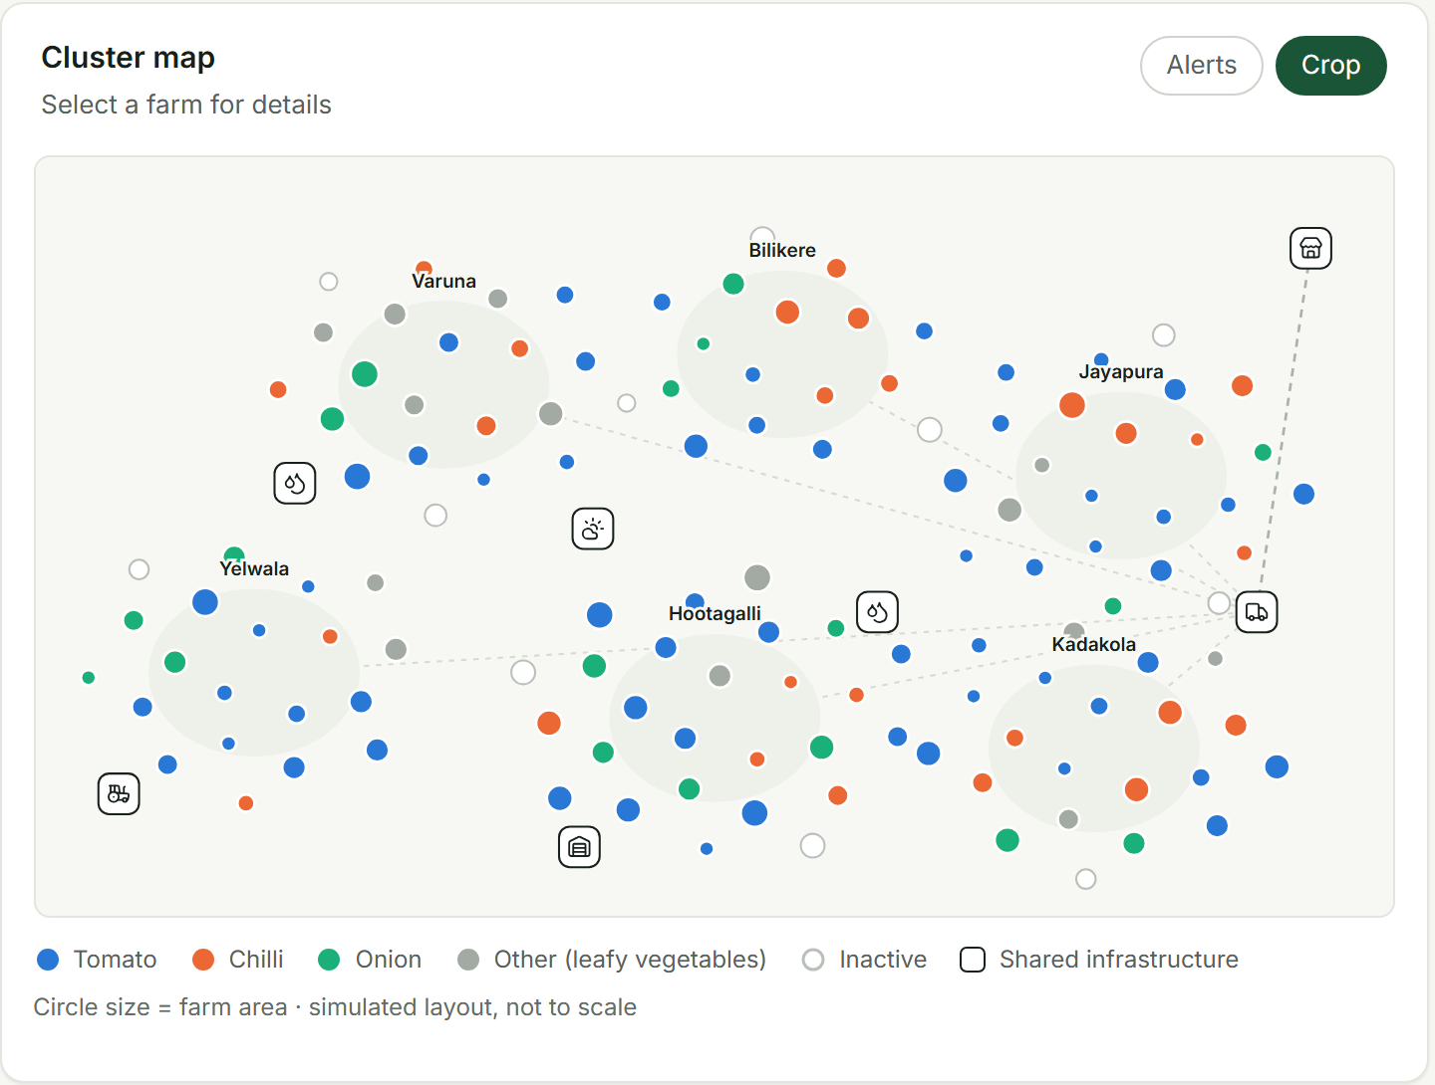
04 SOLUTION
AgriCluster makes the cluster smart, not every farm
A shared intelligence and coordination layer for a group of neighbouring farms.
Connect
Farmers, farms, machinery, labour, experts and buyers in one cluster.
Understand
Farm, weather, sensor, resource and market data turned into suggestions that explain themselves.
Coordinate
Shared machinery, labour and expertise, and pooled harvests matched to buyer demand.
The platform recommends. The farmer decides.
128 farms in six villages, with shared water sources, machinery, cold storage and a collection centre
AgriCluster
4 / 12
Notes:
Our answer is to make the cluster smart rather than every individual farm. AgriCluster is a shared layer around a group of neighbouring farms. It connects the people and resources, turns farm, weather, sensor and market data into suggestions that explain themselves, and coordinates what is shared: machinery, labour, expertise and harvests. The map shows our demonstration cluster: 128 farms in six villages around shared infrastructure. One principle runs through everything: the platform recommends, the farmer decides.

Slide 5
05 HOW IT WORKS
From data to coordinated action
Connect
Collect
Analyze
Recommend
Coordinate
Act
Measure
Farms, resources, experts and buyers join the cluster
Farmer input, weather, sensors, energy and market data
Rules check the data against each crop and plan
A suggestion with its reasons and data
Shared machinery, labour and buyers across farms
The farmer accepts, ignores or checks first
Water, energy, inputs, loss and prices
ONE EXAMPLE FROM THE PROTOTYPE
Signal
Suggestion
Decision
Measured
Rain 82% likely from 6:30 pm. Field 1 soil moisture 64%; tomato needs at least 55%.
→
Consider delaying Field 1 irrigation by 24 hours, with the data shown.
→
The farmer accepts. The schedule moves; one tap undoes it.
→
About 36,000 L of water and 11 kWh of pumping avoided (indicative).
AgriCluster
5 / 12
Notes:
The platform works in seven steps: connect, collect, analyze, recommend, coordinate, act and measure. Here is one real example from the prototype. Rain is 82 percent likely this evening, and Field 1's soil moisture is already above what the tomato crop needs. So AgriCluster suggests delaying irrigation by a day, and shows exactly which data led to that. The farmer accepts with one tap, and the schedule moves. That single decision avoids roughly 36,000 litres of water and 11 kilowatt-hours of pumping, an indicative estimate.

Slide 6
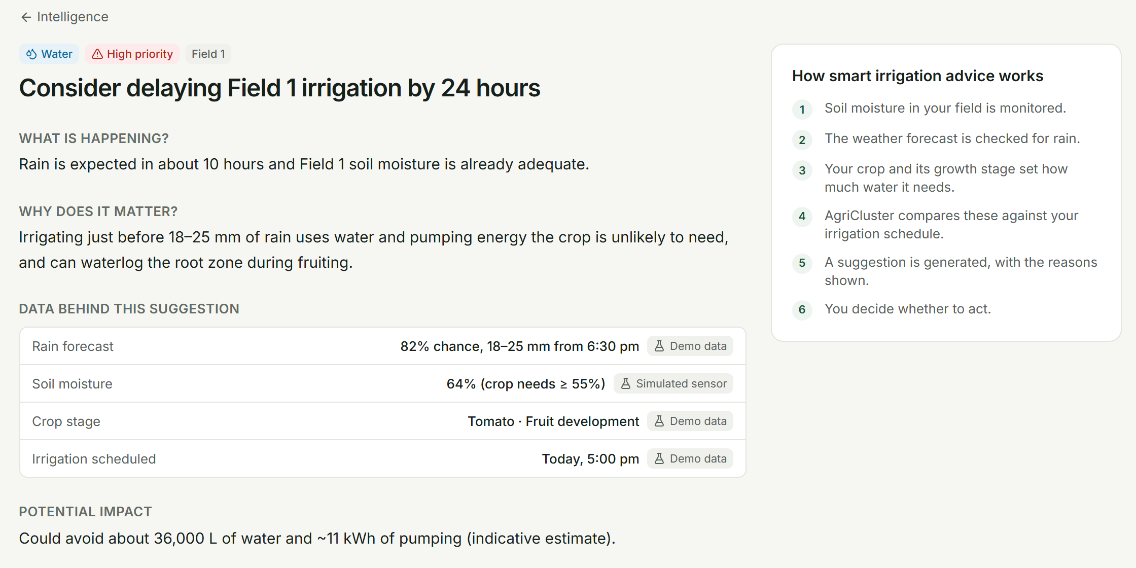
06 CLUSTER INTELLIGENCE
One signal on one farm becomes a pattern across the cluster
DATA COMBINED
Farm & crop stage
Soil moisture
Weather
Water & energy
Machinery
Labour
Experts
Market demand
ACROSS THE CLUSTER TODAY
24 farms plan to irrigate before tonight's rain
6 tomato farms show possible crop stress
14 tractor requests for 9 tractors tomorrow
42 t of tomato expected against 35 t of buyer demand
Every suggestion shows what is happening, why it matters, and the data behind it, with each value's source labelled.
Demonstration data
AgriCluster
6 / 12
Notes:
This is what we call cluster intelligence. AgriCluster combines farm and crop data, soil moisture, weather, water and energy, machinery, labour, experts and market demand. For one farmer, it produces a suggestion that explains itself, as on the right. Across the cluster the same signals become patterns a coordinator can act on: 24 farms about to irrigate before rain, 6 tomato farms under stress, 14 tractor requests for 9 tractors, and 42 tonnes of tomato coming against 35 tonnes of buyer demand.

Slide 7
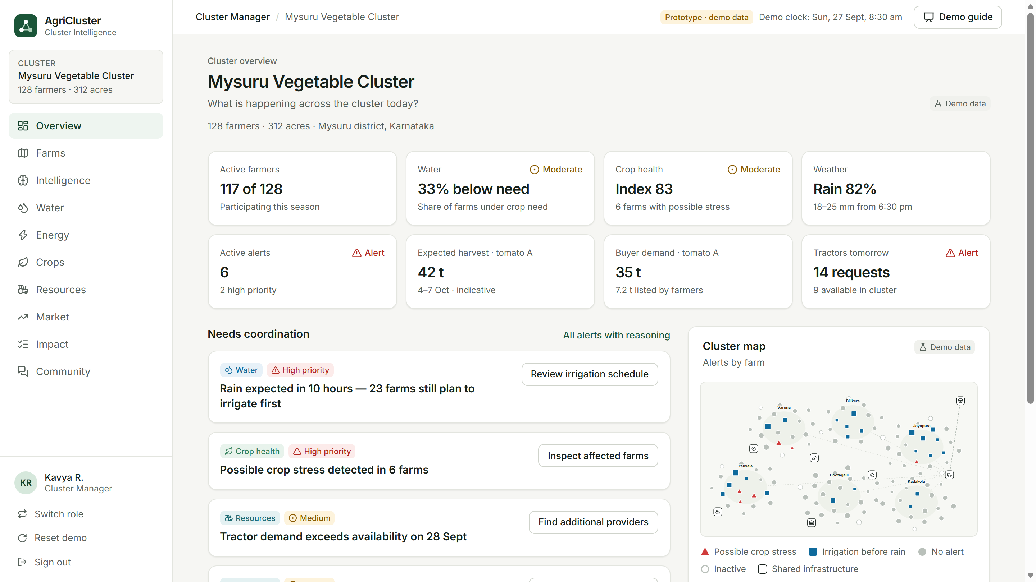
07 PRODUCT
Six roles, one connected cluster
Farmer
Decisions with reasons; requests resources; lists harvests.
Cluster manager
Sees all 128 farms; coordinates water, resources, buyers.
Buyer
Posts requirements, sees pooled supply, accepts offers.
Machinery owner
Lists equipment and availability, accepts bookings.
Labour
Lists skills and availability, accepts and tracks work.
Expert
Cluster overview in the working prototype. A farmer's decision updates what every other role sees.
Answers questions with farm data in view; schedules visits.
AgriCluster
7 / 12
Notes:
The product has six connected roles: farmer, cluster manager, buyer, machinery owner, labour and expert. They all work on the same shared records. When the farmer requests a tractor, the owner accepts it. When the farmer lists a harvest, the buyer sees it. When the farmer delays irrigation, the cluster dashboard updates. [If showing the live demo, switch now: open the prototype and use the Guided demo button.]

Slide 8
08 IMPACT
Impact we will measure against a baseline
15–20%
10–15%
10%
5–10%
less avoidable water use
better input efficiency
less crop loss
better market realisation
Pilot target
Pilot target
Pilot target
Pilot target
Pilot targets are illustrative goals, not guaranteed outcomes. Improvements are claimed only against a measured baseline season.
WHAT THE PROTOTYPE ALREADY SHOWS
≈36,000 L
42 t vs 35 t
14 vs 9
water and ≈11 kWh pumping avoided by one accepted irrigation suggestion (indicative)
pooled tomato supply against buyer demand, visible a week before harvest
tractor requests against available tractors, flagged a day ahead
AgriCluster
8 / 12
Notes:
We will measure impact against a baseline, not promise it. The pilot targets are 15 to 20 percent less avoidable water use, 10 to 15 percent better input efficiency, 10 percent less crop loss, and 5 to 10 percent better market realisation. These are illustrative goals, not guaranteed outcomes. The prototype already shows the mechanism: one accepted suggestion avoids about 36,000 litres of water; the cluster sees 42 tonnes of tomato against 35 tonnes of demand a week ahead; and a tractor shortage is visible a day before it happens.

Slide 9
09 BUSINESS MODEL
Revenue follows coordination
REVENUE STREAM
WHO PAYS
MODEL
Cluster services
FPOs, cluster organisations, agriculture programmes
Subscription per cluster
Equipment marketplace
Equipment owners and renters
Commission on completed bookings
Expert services
Farmers or sponsoring institutions
Commission or subscription
Market linkage
Buyers
Service fee on agreed deals
Technology & analytics
Institutions and agricultural organisations
Implementation fees and cluster analytics
Start simple. The pilot runs on a cluster subscription and a marketplace commission. The rest follows as volume grows.
AgriCluster
9 / 12
Notes:
Revenue follows coordination. Cluster organisations such as FPOs pay a subscription for the cluster layer. The equipment marketplace earns a commission on completed bookings. Expert services and market linkage earn a commission or fee when they create value, and institutions can pay for implementation and cluster analytics. We keep the start simple: the pilot needs only the cluster subscription and the marketplace commission.

Slide 10
10 PILOT
Pilot: one cluster, measured over a season
100+
1
Baseline season
WHAT WE TRACK
Record water, energy, input costs, crop loss, prices and machinery use before AgriCluster.
farmers
Water use
Energy use
Input costs
Crop loss
Machinery utilisation
Market realisation
Farmer adoption
250+
2
Pilot season
Farmers use AgriCluster. The same measures are recorded the same way.
acres
1
3
Compare and decide
Report against the targets, and decide on expansion to more clusters in the district.
cluster
AgriCluster
10 / 12
Notes:
The pilot is one cluster of more than 100 farmers on more than 250 acres. We measure a baseline season first, recording water, energy, input costs, crop loss, prices and machinery use. Then farmers use AgriCluster for a season and we record the same measures the same way. We report against the targets and only then decide on expanding to more clusters. We also track farmer adoption, because a suggestion that isn't used has no impact.

Slide 11
11 SCALABILITY
The intelligence layer scales. The farms stay small.
Simulation-first
Works from farmer input and shared sensors today. Real sensors and data feeds plug into the same interfaces later.
Same engine, every cluster
A new cluster reuses the intelligence rules, roles and screens. Only local data changes.
Pilot starts here
Network effects
Each new cluster brings more buyers, equipment providers and experts to every member.
One farm
Local cluster
District clusters
Multiple regions
Agricultural network
AgriCluster
11 / 12
Notes:
The model scales from one farm to a local cluster, then district clusters, multiple regions and a larger network. What scales is the intelligence and coordination layer; the farms stay small. We are simulation-first: the platform runs today on farmer input and shared sensors, and real sensors and data feeds plug into the same interfaces later. Every new cluster reuses the same engine, roles and screens, and brings more buyers, providers and experts to everyone.

Slide 12
12 VISION
Connected agricultural clusters across India
Today
With AgriCluster
Future
Fragmented farms
Fragmented information
Fragmented resources
Fragmented decisions
Fragmented markets
Connected farms
Shared resources
Integrated data
Cluster intelligence
Coordinated decisions and markets
More efficient, more resilient agricultural clusters, where farmers keep the decisions and technology does the coordination.
→
→
Small Farms. Shared Resources. Smarter Decisions.
The platform recommends. The farmer decides.
Notes:
Our vision is a network of intelligent agricultural clusters across India. Today, farms, information, resources, decisions and markets are fragmented. With AgriCluster they are connected: shared resources, integrated data, cluster intelligence and coordinated decisions and markets. The result is more efficient, more resilient clusters, where farmers keep the decisions and technology does the coordinating. Small farms, shared resources, smarter decisions. Thank you.

