Slide 1
System Architecture
Top-level data flow across all four modules
APB Master (SoC Bus)
RF Front-End (external)
PADDR/PWDATA ↔ PRDATA
① apb_wrapper
rfid_rx_bit ↔ rfid_tx_bit
PCLK / PRESETn domain — APB register decode, R/W FSM
ctrl_mode, crypto_key, apb_data_in ↔ apb_read_data, status_flags
② loopback_mux
clk / rst_n domain — routes RF ↔ test ↔ crypto paths by ctrl_mode[1:0]
dbb_rx_in ↔ dbb_framed_data, dbb_data_ready
crypto_data_in, crypto_start ↔ crypto_ciphertext, crypto_done
③ dbb_top
④ crypto_top
clk / rst_n domain
sync → oversample → vote → Manchester decode → frame (64b)
clk / rst_n domain
PRESENT-80: S-box → permutation → key schedule, 31 rounds

Slide 2
Front-End Verification & Logic Synthesis
baseband_crypto_macro · 1/4
A · VERIFICATION SUITE — 9 TESTBENCHES
B · SYNTHESIS — DESIGN COMPILER (Synopsys)
Golden_Vectors.sv
Mode_0.sv
SCL 180nm CMOS · SS 1.62V 125°C / FF 1.98V −40°C
PT/Key = 0 and all F's golden vectors; PRESENT-80 cipher loopback
Live RF streaming receiver; 432-bit oversampled packet reception
clocks.sdc 50 MHz, jitter, latency
io_constraints.sdc I/O delays, drivers
exceptions.sdc false paths or MCPs
design_rule.sdc slew/cap/fanout
case_analysis.sdc mode
Mode_0_async_data.v
Mode_1.sv
Async RF antenna with 3.7 ns phase shift; DBB synchronizer test
Digital Baseband (DBB) loopback over the APB slave interface
C · SYNTHESIS SIGNOFF
Mode_switching.sv
Preamble_Validation_TB.sv
Setup · SS
Hold · FF
Dynamic mode transition permutations: M0 → M1 → M2 → M0
Preamble 0xAB detection, corrupt frame rejection
+4.00 ns
+0.14 ns
Corner_Cases_TB.sv
Reset_stress.sv + Reset_Stress_final.sv
LEC / Formality: 100% equivalent, RTL vs netlist with library cells
Carrier drift (OSR=5, OSR=7, ±16.7%), timing jitter, APB polling race
Pre-layout GLS: VCS with tsl18fs120_scl.v, gate netlist and testbench suite
Hostile mid-transaction async reset and pipeline recovery
Outputs: gate netlist (.v), synthesized SDC, area/power reports

Slide 3
Physical Design (PnR) & PrimeTime Closure
baseband_crypto_macro · 2/4
A · ICC2 PNR EXECUTION PIPELINE
1 ›
2 ›
3 ›
4 ›
5 ›
build_ndm_std.tcl
build_ndm_filler.tcl
design_setup.tcl
floorplanning.tcl
powerplanning.tcl
placement.tcl
Design setup
Floorplan
PG rings / straps
Congestion driven
NDM libraries
6 ›
7 ›
8 ›
9 ›
10
cts.tcl
route.tcl
metal_fill.tcl
fix_antenna.tcl
pv.tcl
Clock tree, skew balance
Detail route M1–TOP_M
Track-based dummy fill
Antenna fixing
Streamout + signoff checks
B · PNR DELIVERABLES & REPORTS
C · SIGNOFF PRIMETIME (STA)
Congestion: under 1.3% overflow, clean routability on all metal channels
Inputs: SPEF parasitics, post-route netlist, corner .db libraries, SDCs
Layout: final merged tapeout GDSII · SDC: back-annotated, SS and FF
Setup · SS · closed
Hold · FF · closed
GLS/STA netlist: functional, no power pins or physical-only cells
+2.30 ns
+0.20 ns
LVS netlist: explicit VDD/VSS pins and physical layout instances

Slide 4
Physical Verification & Post-PnR GLS
baseband_crypto_macro · 3/4
A · POST-PNR GLS (SDF BACK-ANNOTATION)
B · PHYSICAL SIGNOFF — MENTOR CALIBRE
Flow
Design Rule Check (DRC)
CLEAN
Post-route Verilog netlist simulated with VCS / Cadence Xcelium
Spacing, enclosure and width rules pass
SDF back-annotation
Dummy Metal Fill
CLEAN
ss.sdf (max delays) and ff.sdf (min delays) annotated to the DUT
SCL 180nm density met on M1, M2, M3, TOP_M
Layout vs Schematic (LVS)
CLEAN
Verification scope
100% net, device and pin matching
Full testbench matrix with -negdelay and timing checks on: zero setup, hold or recovery violations under post-layout RC parasitics
Antenna Ratio Check
Documented, under review; other macro violations resolved by multi-layer metal hopping
CLEAN

Slide 5
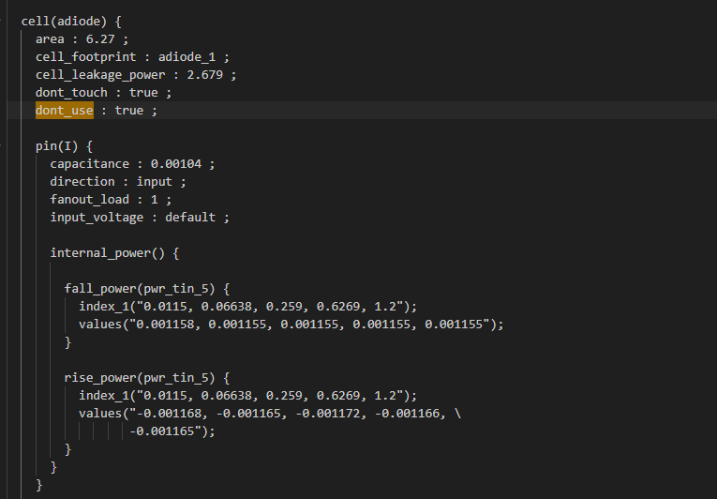
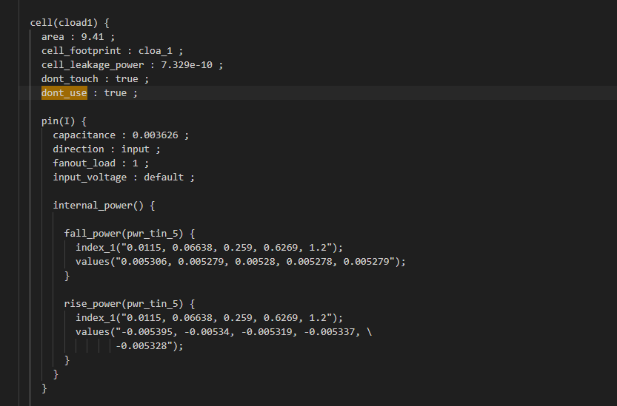
Engineering Challenges & Resolution
baseband_crypto_macro · 4/4
1 · FRONT-END / RTL ARCHITECTURE
2 · LOGIC SYNTHESIS
Challenge: packet start undetectable in an unguided RF stream.
Solution: 8-bit preamble 0xAB (8'b1010_1011).
Challenge: Mode 1 oversampled stream (432 bits) did not fit the APB register map.
Solution: Expanded memory map(ADDR_DATA_0 to 13) with APB stall logic.
Challenge: 31-cycle PRESENT execution vs multicycle paths (MCPs).
Solution: states are single-cycle enabled loops under FSM feedback; unneeded MCP constraints removed so critical setup paths stay visible.
3 · PLACE & ROUTE / PHYSICAL SIGNOFF
Filler cells
Challenge: overlap and boundary DRC errors.
Solution: rebuilt filler NDMs; tuned insertion order in build_ndm_filler.tcl.
Calibre LVS case
Challenge: default case-insensitive extraction broke matching.
Solution: case-sensitive name mapping in the runset.
Hold closure
Challenge: tight across corners.
Solution: ICC2 post-route hold fix with buffer sizing and balanced clock delay: +0.20 ns.
Antenna & diodes
Challenge: read-only LEF lacked 'adiode' antenna properties.
Solution: Calibre antenna rules plus metal hopping across M2/M3/TOP_M.

Slide 6
Group2 — BASEBAND AND CRYPTOGRAPHIC SUBSYSTEM
Thank You
Baseband and Cryptographic Subsystem

Slide 7
Group2 — BASEBAND AND CRYPTOGRAPHIC SUBSYSTEM
Backup Slides
Baseband and Cryptographic Subsystem

Slide 8
Memory Map
Address | Register | Access | Description
0x00 | CTRL_REG | R/W | Bits [1:0]: Mode (0=Live, 1=DBB Loopback, 2=Crypto Loopback)
0x04 | STATUS_REG | R/O | Bit 0: DONE (Crypto), Bit 1: DATA_READY (DBB)
0x08 | ADDR_KEY_0 | W/O | Lower 32 bits of PRESENT-80 Key
0x0C | ADDR_KEY_1 | W/O | Middle 32 bits of PRESENT-80 Key
0x10 | ADDR_KEY_2 | W/O | Upper 16 bits of PRESENT-80 Key
0x14 | ADDR_DATA_0 | W/O | Bits [31:0] of Plaintext / Raw DBB Oversample stream
0x18 | ADDR_DATA_1 | W/O | Bits of Plaintext/DBB (Writing this triggers Mode 2 FSM)
0x1C - 0x44 | ADDR_DATA_2 to ADDR_DATA12 | W/O | Bits of Raw DBB Oversample stream
0x48 | ADDR_DATA_13 | W/O | Upper 16 bits [431:416] of DBB stream (Writing this triggers Mode 1 FSM)
0x4C | ADDR_DATA_OUT_0 | R/O | Lower 32 bits of Ciphertext / Decoded DBB bytes
0x50 | ADDR_DATA_OUT_1 | R/O | Upper 32 bits of Ciphertext / Decoded DBB bytes
Entries in Green are newly added, while those in Red have a changed address value.

Slide 9
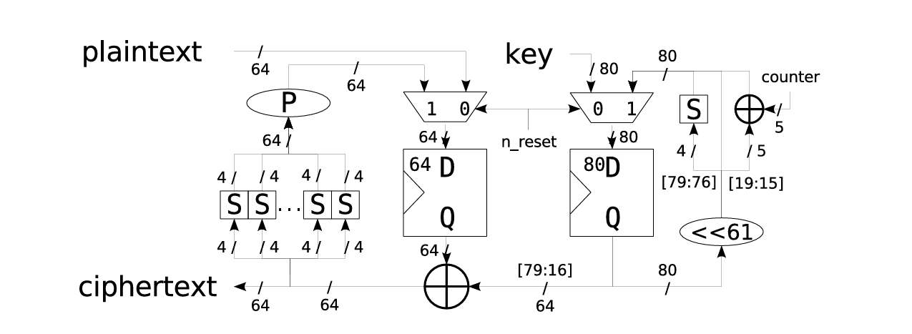
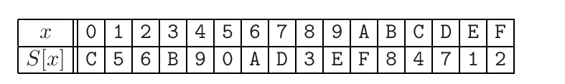
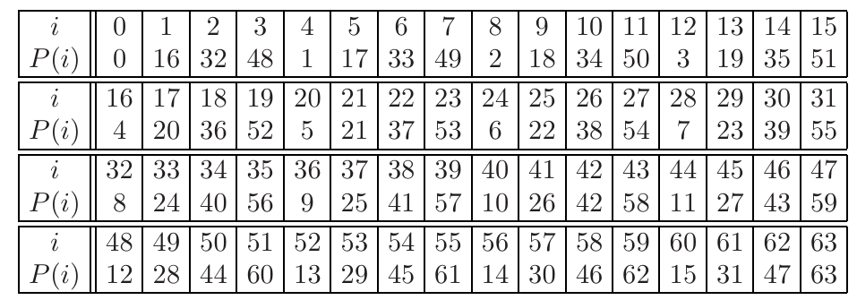
CRYPTOGRAPHIC ENGINE
PRESENT-80 SPN Cipher
BEHAVIORAL DESCRIPTION
HARDWARE DESCRIPTION
An ultra-lightweight Substitution-Permutation Network operating on a 64-bit plaintext with an 80-bit key over 31 rounds, utilizing an avalanche effect for extreme data diffusion.
A 32-cycle hardware-optimized datapath. Contains a 64-bit State Register and an 80-bit Key Register. Utilizes 16 parallel 4-bit S-Boxes (LUTs). The permutation layer (pLayer) is achieved via 0-cost wire routing. The key schedule uses a hardwired 61-bit left rotation, a single 4-bit S-Box, and a 5-bit XOR round counter.
Project 4: Baseband and Cryptographic Subsystem
5

Slide 10
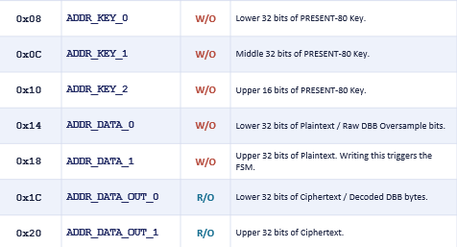
SYSTEM OVERVIEW
System Architecture & Data Flow
Loopback
Multiplexer
(Live / Test) – Mode - 0
rfid_rx_bit
(Async Input)
CDC
Synchronizer
Oversampler
Shift Register
Majority
Voter
Manchester
Decoder FSM +
Byte Framer
APB Slave
Wrapper
PRESENT-80
Crypto Engine
(31-round datapath)
CPU (Memory-Mapped Register File)
Linear pipeline: async RF input → DBB front end → loopback routing → PRESENT-80 crypto → APB slave → CPU.
Project 4: Baseband and Cryptographic Subsystem
2

Slide 11
SYSTEM OVERVIEW
System Architecture & Data Flow
Loopback
Multiplexer
(Live / Test) – Mode - 1
Parallel Data from ADDR_DATA_0 & ADDR_DATA_1
Parallel to Serial
Oversampler
Shift Register
Majority
Voter
APB Slave
Wrapper
Manchester
Decoder FSM +
Byte Framer
CPU (Memory-Mapped Register File)
.
Project 4: Baseband and Cryptographic Subsystem
2

Slide 12
SYSTEM OVERVIEW
System Architecture & Data Flow
Loopback
Multiplexer
(Live / Test) – Mode - 2
Parallel Data from ADDR_DATA_0 & ADDR_DATA_1
PRESENT-80
Crypto Engine
(31-round datapath)
APB Slave
Wrapper
CPU (Memory-Mapped Register File)
.
Project 4: Baseband and Cryptographic Subsystem
2

