Slide 1
PROJECT 4 : BASEBAND AND CRYPTOGRAPHIC SUBSYSTEM
By Group 2
M1
M2
M3
Spandan Bharadwaj
Shreyas Sagar
Patel Dhruv Utkarsh
Project 4: Baseband and Cryptographic Subsystem
2

Slide 2
PROJECT 4
Baseband and Cryptographic Subsystem
A digital hardware macro bridging a front-end Digital Baseband (DBB) and a back-end lightweight cryptographic engine (PRESENT-80).
Design Aim
Buffer Constraint
Physical Design
Bridge DBB front end with PRESENT-80 crypto back end in a single digital macro.
APB Streaming-Only Buffer Constraint — no large SRAM buffers permitted.
P&R executed with standard cells of low combinatorial depth.
System control: Master–Slave APB configuration for strict data flow control.
Project 4: Baseband and Cryptographic Subsystem
1

Slide 3
System Interface: IP Block Diagram & Memory Map
Top-Level Macro Partitioning and APB Register Interface
IP Block Diagram
Crypto Memory Map (APB Wrapper)
Offset | Register Name | R/W | Description
0x00 | CTRL_REG | R/W | Bits [1:0]: Mode (0=Live, 1=DBB Loopback, 2=Crypto Loopback).
0x04 | STATUS_REG | R/O | Bit 0: DONE (Crypto), Bit 1: DATA_READY (DBB).
0x08 | ADDR_KEY_0 | W/O | Lower 32 bits of PRESENT-80 Key.
0x0C | ADDR_KEY_1 | W/O | Middle 32 bits of PRESENT-80 Key.
0x10 | ADDR_KEY_2 | W/O | Upper 16 bits of PRESENT-80 Key.
0x14 | ADDR_DATA_0 | W/O | Lower 32 bits of Plaintext / Raw DBB Oversample bits.
0x18 | ADDR_DATA_1 | W/O | Upper 32 bits of Plaintext. Writing this triggers the FSM.
0x1C | ADDR_DATA_OUT_0 | R/O | Lower 32 bits of Ciphertext / Decoded DBB bytes.
0x20 | ADDR_DATA_OUT_1 | R/O | Upper 32 bits of Ciphertext.
Top-Level IP Macro
dbb_top
apb_wrapper
loopback_mux
reg_cfg / mode_sel
APB BUS
PADDR / PWDATA
PRDATA
PSEL / PENABLE
PWRITE / PREADY
RF I/O
rfid_rx_bit
rfid_tx_bit
crypto_top
■ Control/Interface ■ Routing Crossbar ■ Datapath Engines
All registers are 32-bit, word-aligned on the APB address map. Streaming-only operation: PREADY is held low until the current transaction completes.
Notes:
Slide: System Interface & Memory Map. Left: top-level IP macro block diagram showing apb_wrapper, loopback_mux, dbb_top, crypto_top and the external APB/RF boundaries. Right: full register map for the APB wrapper (CTRL_REG through ADDR_DATA_OUT_1).

Slide 4
System Architecture
Top-level data flow across all four modules
APB Master (SoC Bus)
RF Front-End (external)
PADDR/PWDATA ↔ PRDATA
① apb_wrapper
rfid_rx_bit ↔ rfid_tx_bit
PCLK / PRESETn domain — APB register decode, R/W FSM
ctrl_mode, crypto_key, apb_data_in ↔ apb_read_data, status_flags
② loopback_mux
clk / rst_n domain — routes RF ↔ test ↔ crypto paths by ctrl_mode[1:0]
dbb_rx_in ↔ dbb_framed_data, dbb_data_ready
crypto_data_in, crypto_start ↔ crypto_ciphertext, crypto_done
③ dbb_top
④ crypto_top
clk / rst_n domain
sync → oversample → vote → Manchester decode → frame (64b)
clk / rst_n domain
PRESENT-80: S-box → permutation → key schedule, 31 rounds
Note: RFID signals terminate in loopback_mux only — apb_wrapper never touches rfid_rx_bit / rfid_tx_bit directly.

Slide 5
① apb_wrapper
PCLK / PRESETn clock domain — APB4 slave register interface
INPUTS
OUTPUTS
REGISTER MAP
PCLK — bus clock
PRESETn — sync active-low reset
PSEL — slave select
PENABLE — transfer enable
PWRITE — 0=read / 1=write
PADDR[7:0] — register address
PWDATA[31:0] — write data
apb_read_data[63:0] ← loopback_mux
status_flags[1:0] ← loopback_mux
PRDATA[31:0] → APB master
PREADY → APB master
ctrl_mode[1:0] → loopback_mux
crypto_key[79:0] → crypto_top
apb_data_in[63:0] → loopback_mux
apb_write_trigger → loopback_mux
0x00
CTRL_REG
ctrl_mode, write triggers
0x04
STATUS_REG
mirrors status_flags (RO)
0x08–0x10
INTERNAL LOGIC
ADDR_KEY
loads crypto_key[79:0]
Address-decode / read-write FSM. PSEL · PENABLE handshake drives PREADY and steers each register access.
0x14–0x18
ADDR_DATA
loads apb_data_in[63:0]
0x1C–0x20
ADDR_DATA_OUT
reads apb_read_data[63:0]

Slide 6
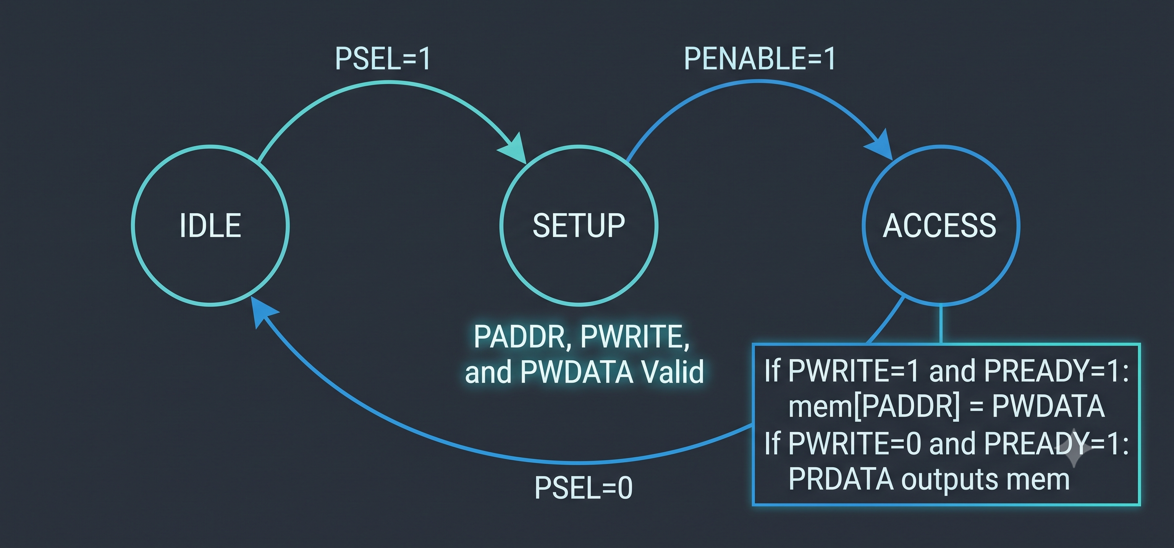
SYSTEM INTERFACE
APB Interface & Streaming Constraint
BEHAVIORAL DESCRIPTION
HARDWARE DESCRIPTION
Acts as the slave interface to the system CPU. Decodes addresses to update control/key registers and triggers the cipher on the final data write. It enforces the “Streaming-Only” constraint by stalling the CPU if it reads ciphertext before encryption is complete.
Address decoder mapping registers 0x00 to 0x20. Contains physical flip-flops for state retention. The stall logic actively pulls the pready signal low to freeze the APB bus during the 32-cycle crypto operation, pulling it high only when crypto_done is asserted.
Project 4: Baseband and Cryptographic Subsystem
6

Slide 7
OPERATIONAL MODES
Operational Modes & Loopback Testing
BEHAVIORAL DESCRIPTION
HARDWARE DESCRIPTION
Reroutes internal data paths to isolate and unit-test the DBB and Crypto blocks without requiring live analog RF signals.
Combinational routing multiplexers controlled by CTRL_REG[1:0].
Mode 0 — Live
rfid_rx_bit → DBB → Crypto
Mode 1 — DBB Loopback
APB synthetic bits → Serializer → DBB → APB Read
Mode 2 — Crypto Loopback
APB 64-bit Plaintext → Crypto → APB Read (bypassing DBB)
Project 4: Baseband and Cryptographic Subsystem
7

Slide 8
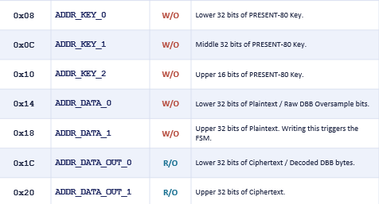
SYSTEM OVERVIEW
System Architecture & Data Flow
Loopback
Multiplexer
(Live / Test) – Mode - 0
rfid_rx_bit
(Async Input)
CDC
Synchronizer
Oversampler
Shift Register
Majority
Voter
Manchester
Decoder FSM +
Byte Framer
APB Slave
Wrapper
PRESENT-80
Crypto Engine
(31-round datapath)
CPU (Memory-Mapped Register File)
Linear pipeline: async RF input → DBB front end → loopback routing → PRESENT-80 crypto → APB slave → CPU.
Project 4: Baseband and Cryptographic Subsystem
2

Slide 9
SYSTEM OVERVIEW
System Architecture & Data Flow
Loopback
Multiplexer
(Live / Test) – Mode - 1
Parallel Data from ADDR_DATA_0 & ADDR_DATA_1
Parallel to Serial
Oversampler
Shift Register
Majority
Voter
APB Slave
Wrapper
Manchester
Decoder FSM +
Byte Framer
CPU (Memory-Mapped Register File)
.
Project 4: Baseband and Cryptographic Subsystem
2

Slide 10
SYSTEM OVERVIEW
System Architecture & Data Flow
Loopback
Multiplexer
(Live / Test) – Mode - 2
Parallel Data from ADDR_DATA_0 & ADDR_DATA_1
PRESENT-80
Crypto Engine
(31-round datapath)
APB Slave
Wrapper
CPU (Memory-Mapped Register File)
.
Project 4: Baseband and Cryptographic Subsystem
2

Slide 11
② loopback_mux
clk / rst_n domain — routes RF, test, and crypto data paths
INPUTS
ROUTING — decoded from ctrl_mode[1:0]
rfid_rx_bit ← RF front-end
apb_data_in[63:0] ← apb_wrapper
apb_write_trigger ← apb_wrapper
ctrl_mode[1:0] ← apb_wrapper
dbb_framed_data[63:0] ← dbb_top
dbb_data_ready ← dbb_top
crypto_ciphertext[63:0] ← crypto_top
crypto_done ← crypto_top
0
Mode 0 — Live RF
rfid_rx_bit ↔ APB read.
1
Mode 1 — DBB Loopback
apb_data_in → dbb_rx_in via test_shift_reg — exercises the baseband pipeline with software-driven bits.
OUTPUTS
dbb_rx_in → dbb_top
crypto_data_in[63:0] → crypto_top
crypto_start → crypto_top
apb_read_data[63:0] → apb_wrapper
status_flags[1:0] → apb_wrapper
rfid_tx_bit → RF front-end
2
Mode 2 — Crypto Loopback
apb_data_in → crypto_data_in — exercises the PRESENT-80 engine directly, bypassing RF and baseband.
INTERNAL REGISTER: test_shift_reg[63:0] — staging buffer, Modes 1 & 2

Slide 12
③ dbb_top — Digital Baseband Pipeline
clk / rst_n domain — five-stage sequential pipeline
Input: dbb_rx_in Output: dbb_framed_data[63:0], dbb_data_ready
dbb_rx_in →
dbb_sync
dbb_oversampler
dbb_voter
dbb_manchester_fsm
dbb_framer
reg: 2× DFF
synchronizer
reg: shift_reg[7:0]
comb: majority
adder (no reg)
states:
IDLE → SKIP → ARMED
extracts valid bits
states:
HUNTING → FRAMING
groups into 64-bit word
solid = registered stage outline = combinational (dbb_voter)
dbb_framed_data[63:0], dbb_data_ready
→ loopback_mux

Slide 13
DIGITAL BASEBAND
DBB: Oversampling & Noise Filtering
BEHAVIORAL DESCRIPTION
HARDWARE DESCRIPTION
Safely pulls the asynchronous RF bit into the clock domain to prevent metastability, then rapidly samples the signal (e.g., 8x or 16x the data rate) to create a sliding historical window. The voter filters high-frequency noise by deciding the logical bit based on the majority of the samples.
Utilizes a 2-stage D-Flip-Flop synchronizer to prevent metastability, feeding into an 8-bit shift register. The voter is a purely combinational adder-tree that checks if the sum is ≥ the threshold (e.g., ≥ 4).
OPEN QUESTION
What is the exact expected data rate from the RF front end? The oversampling ratio (OSR) clock frequency strictly depends on this missing specification.
Project 4: Baseband and Cryptographic Subsystem
3

Slide 14
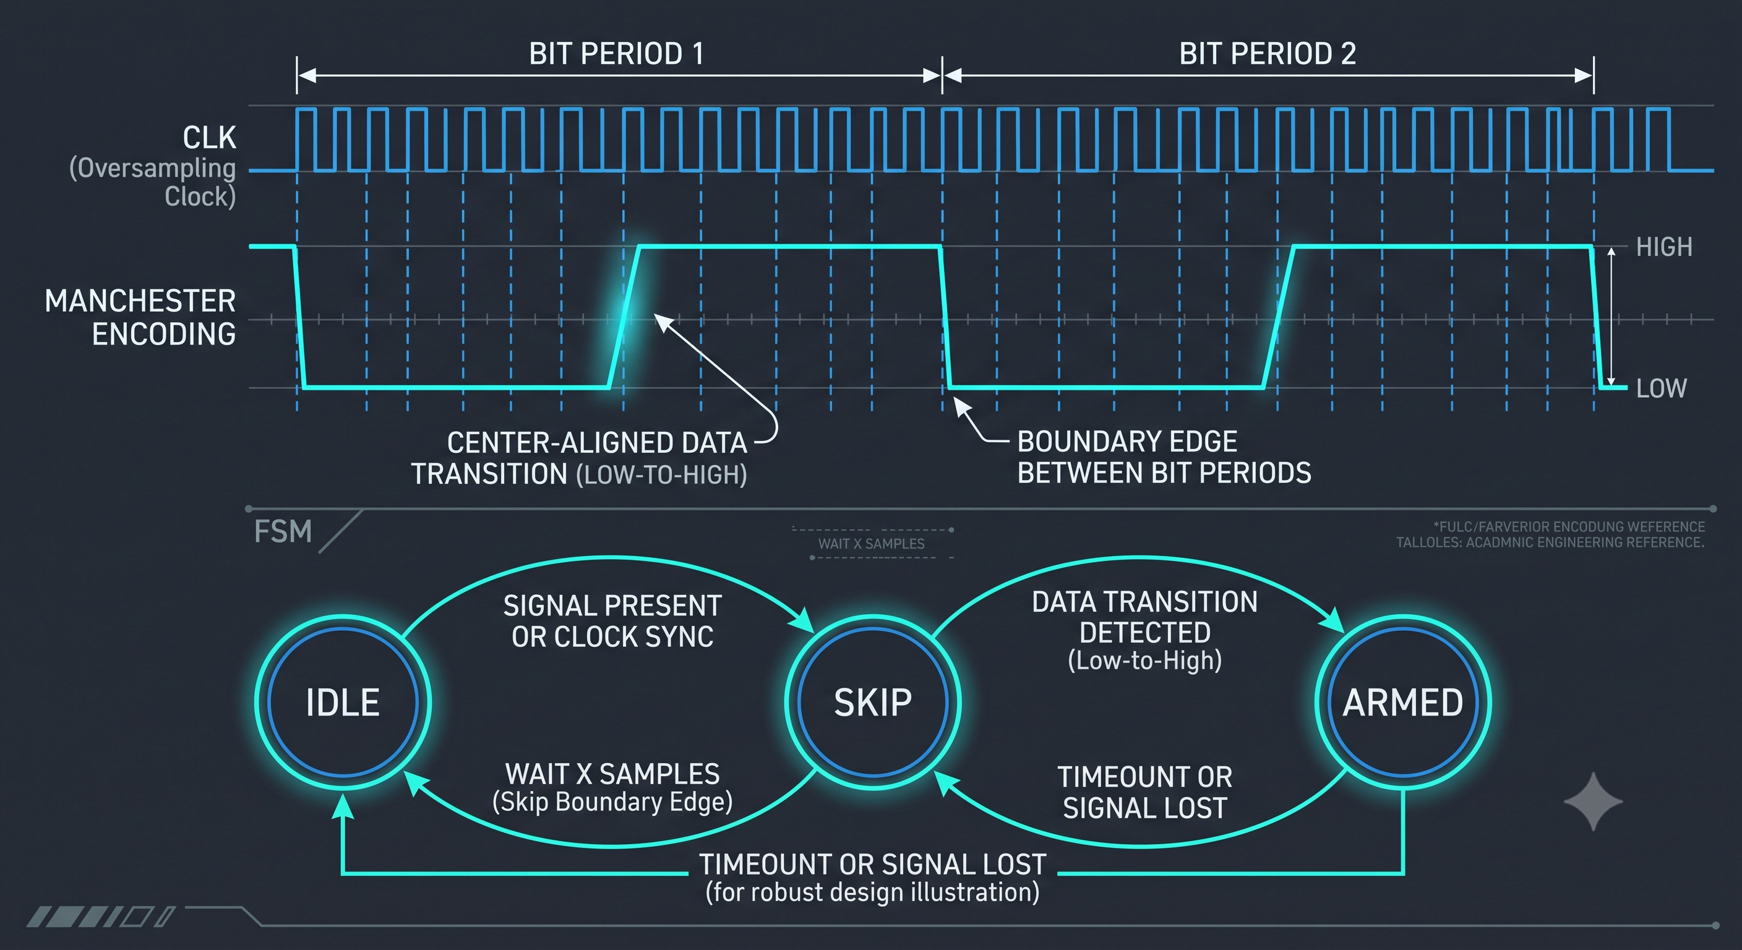
DIGITAL BASEBAND
DBB: Manchester Decoding & Framing
BEHAVIORAL DESCRIPTION
HARDWARE DESCRIPTION
Decodes IEEE 802.3 Manchester signals where a low-to-high transition is a logical '1'. The FSM isolates center “data edges” while blinding itself to “boundary edges” between identical consecutive bits. It then groups 8 valid bits into a byte.
A 3-state FSM (IDLE, SKIP, ARMED). Uses an internal counter based on the OSR to skip ~75% of the bit period (avoiding boundary edges) before arming for the next data edge. The framer uses an 8-bit shift register and asserts a data_ready pulse upon filling.
Project 4: Baseband and Cryptographic Subsystem
4

Slide 15
④ crypto_top — PRESENT-80 Crypto Engine
clk / rst_n domain — iterative round-based datapath
Input: crypto_data_in[63:0], crypto_key[79:0], crypto_start Output: crypto_ciphertext[63:0], crypto_done
next round (round_counter++) until round_counter = 31
state_reg[63:0]
sbox_layer
player
STATUS / CONTROL REGISTERS
PSTATE — round-updated register
4-bit S-box substitution
bit permutation layer
round_counter[4:0]
0 – 31
key_reg[79:0]
active key
key_schedule
rotates key_reg[79:0]; XORs round constant into state_reg each round
busy_flag
1 while active
crypto_key[79:0] →
crypto_done
1 at round 31
crypto_ciphertext[63:0] = state_reg at round 31 → loopback_mux

Slide 16
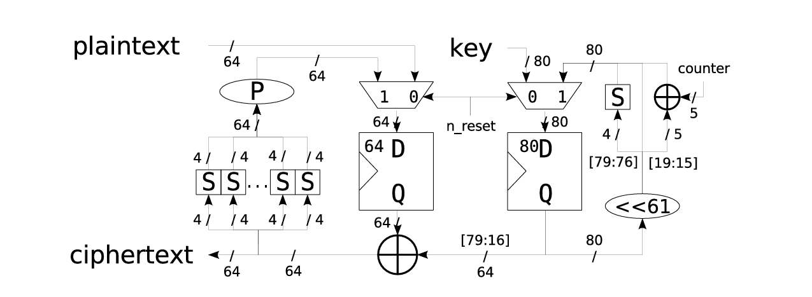
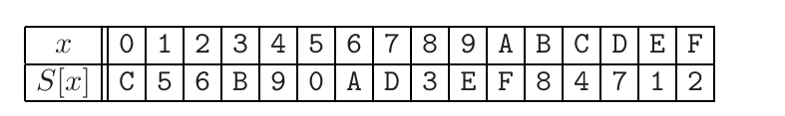
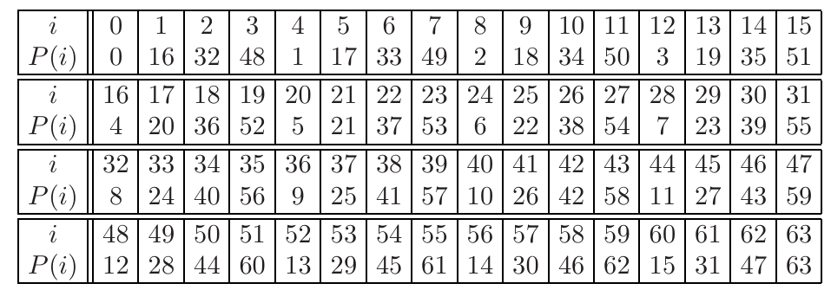
CRYPTOGRAPHIC ENGINE
PRESENT-80 SPN Cipher
BEHAVIORAL DESCRIPTION
HARDWARE DESCRIPTION
An ultra-lightweight Substitution-Permutation Network operating on a 64-bit plaintext with an 80-bit key over 31 rounds, utilizing an avalanche effect for extreme data diffusion.
A 32-cycle hardware-optimized datapath. Contains a 64-bit State Register and an 80-bit Key Register. Utilizes 16 parallel 4-bit S-Boxes (LUTs). The permutation layer (pLayer) is achieved via 0-cost wire routing. The key schedule uses a hardwired 61-bit left rotation, a single 4-bit S-Box, and a 5-bit XOR round counter.
Project 4: Baseband and Cryptographic Subsystem
5

Slide 17
LOW-POWER RTL ARCHITECTURES
Dynamic Power Optimization: Gating & Isolation
Objective: dynamic power is consumed only when transistors toggle. The architecture applies architectural clock gating and operand isolation — freezing sequential logic and clamping combinational inputs whenever a module is inactive.
1
apb_wrapper
2
loopback_mux
Bus Gating
Operand Isolation
HARDWARE LOGIC
HARDWARE LOGIC
PSEL (peripheral select) acts as a strict clock-enable for every internal memory-mapped register — CTRL_REG, ADDR_KEY, ADDR_DATA, and the rest. The APB bus itself runs continuously, but this peripheral's flip-flops freeze whenever the CPU is addressing other peripherals on the bus.
Clock gating alone doesn't stop power waste from toggling inputs into idle combinational logic. Driven by ctrl_mode, the mux acts as an operand isolator: in Mode 1 (DBB test) it clamps crypto_data_in[63:0] to 64'h0, preventing synthetic bit-bang traffic from rippling through the 16 parallel crypto S-boxes.
3
dbb_top
4
crypto_top
Always-On vs. Sleep Domain
Architectural Clock Gating
HARDWARE LOGIC
HARDWARE LOGIC
The front-end (dbb_sync, dbb_oversampler, dbb_voter) stays always-on to hunt for the preamble. The heavier dbb_framer sits in a sleep domain: rx_active from dbb_manchester_fsm gates its clock enable, freezing every framer flip-flop whenever the RF line is idle.
An internal crypto_busy flag goes high on crypto_start and low on crypto_done. state_reg[63:0] and key_reg[79:0] only clock while crypto_busy is high — the RTL infers Integrated Clock Gating (ICG) cells to physically gate the clock tree.
Caution: ICG placement needs tight synthesis constraints — done carelessly, it introduces clock glitches and skew.
Caution: ICG placement needs tight synthesis constraints — done carelessly, it introduces clock glitches and skew.

Slide 18
OPEN QUESTIONS
Doubts & Clarifications
Q1
What exactly does the "streaming-only" buffer constraint mean for the APB interface and overall system architecture?
No buffers needed
Q2
How does the data flow operate during Mode 1 (DBB Loopback), and at which exact point does data enter the internal modules?
TI paper as Golden
Q3
How is the preamble handled differently between a live RF reception (Mode 0) and a synthetic CPU test (Mode 1)?
Has to be decided and notified
Q4
What is the specific hardware objective of the rfid_tx_bit, and how does it function during active transmission?
Q5
What is the system clock, data rate, and oversampling ratio for the oversampler block?
For now parametrarize
Q6
How does the preamble recognizer in Mode 0 operate within the DBB module?
Manchester encoded( has to decode it) match it and then begin data transmission. And to let us know that the data has stopped is when byte framer has completed the 64 bit packet
Project 4: Baseband and Cryptographic Subsystem
7

Slide 19
PROJECT 4 — BASEBAND AND CRYPTOGRAPHIC SUBSYSTEM
Thank You
Project 4: Baseband and Cryptographic Subsystem
10

