Slide 1

Workplace Mental Health Dashboard
DATA 551: INFORMATION VISUALIZATION
Chongwen Sun
Manpreet Singh
Spandan Dey
Notes:
Good morning, everyone. We're excited to present our Workplace Mental Health Dashboard today. This project, developed for DATA 551, aims to illuminate the complex relationship between workplace environments and mental health treatment within the tech sector. We'll guide you through our research, the interactive dashboard we've built, and the critical insights we've discovered. Chongwen Sun will kick us off.

Slide 2




BACKGROUND & MOTIVATION
Why Mental Health Matters in Tech
Pervasive Stress
Hidden Costs
Support Gaps
High-pressure environments, rapid cycles, and intense cognitive demands create unique challenges for mental well-being.
Unaddressed issues lead to quantifiable losses in productivity, engagement, and talent retention across the industry.
A significant disconnect exists between high-level company policies and actual employee awareness of available resources.
Proactive health strategies are essential to prevent burnout and long-term turnover.
Notes:
The tech industry is known for its innovation, but it's also notorious for its high-pressure culture. Our motivation stems from the realization that mental health is often overlooked until it reaches a crisis point. By visualizing this data, we aim to provide organizations with the evidence they need to move from reactive to proactive support systems. This is why understanding mental health in tech isn't just a nice-to-have; it's a business imperative. Chongwen will continue with our next slide.

Slide 3

DEFINING OUR SCOPE
Primary Research Questions
01
Demographic Trends
How do age and gender correlate with the likelihood of seeking mental health treatment in the tech sector?
02
Work Environment
Does company size or remote work status significantly impact the availability and awareness of support?
03
Interference & Action
How strongly does perceived work interference predict the transition from "needing help" to "seeking treatment"?
Understanding these intersections is key to effective organizational intervention.
Notes:
To focus our analysis, we established several core research questions. We wanted to know if certain demographic groups are more or less likely to seek help. Furthermore, we explored how organizational factors—like the size of the company or the flexibility of remote work—influence the support infrastructure available to employees. Understanding these intersections is key to effective organizational intervention. Manpreet Singh will now discuss our data foundation.

Slide 4
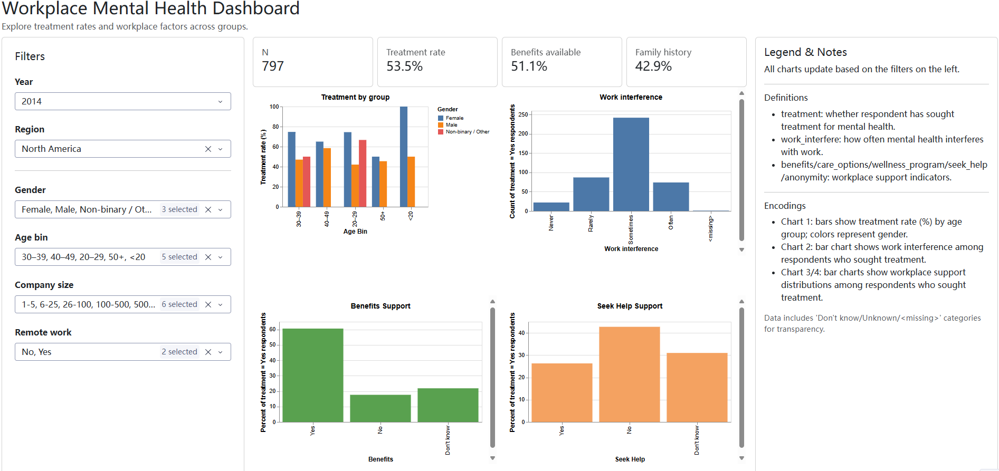
DATA FOUNDATION
The OSMI 2014 Survey
DATASET HIGHLIGHTS
1,200+ Global Tech Professionals
20+ Mental Health Variables
Industry-Standard OSMI Source
KEY VARIABLES
Age, Gender, & Location
Company Size & Remote Status
Benefits & Work Interference
DATA INTEGRITY
Rigorous cleaning and missing-value handling ensure a reliable foundation for analysis.
A statistically significant dataset providing a deep look at industry health.
Notes:
Our analysis is built upon the OSMI 2014 survey, which is one of the most comprehensive datasets on this topic. It captures a wide array of variables, from personal demographics to specific workplace policies. We took great care in the data cleaning phase to ensure that our visualizations are based on clean, reliable information. This robust dataset provides a statistically significant look at industry health. Manpreet will now hand it over to Spandan Dey to talk about our dashboard architecture.

Slide 5




SYSTEM ARCHITECTURE
Interactive Dashboard Design
Input Control
Dynamic Visualization
Multi-dimensional sidebar filters for Region, Gender, and Age.
Cross-filtering logic: all charts update instantly upon filter selection.
Organizational segmentation by Company Size and Remote Work status.
Linked views between demographics and workplace support factors.
Temporal analysis through Year-based data selection.
Contextual legends and definitions for data transparency.
Core Metrics
High-level KPI indicators for Sample Size (N) and Treatment Rates.
Real-time tracking of Benefits Awareness and Family History.
Intuitive design enables multi-dimensional exploration through real-time filtering.
Notes:
Now, let's dive into the tool itself. The Workplace Mental Health Dashboard is designed for interactivity. The left sidebar allows users to filter the data across multiple dimensions, making it easy to compare different groups. At the top, we provide high-level KPIs that give an immediate snapshot of the current data segment. This architecture allows for both broad overviews and deep-dive analysis. Spandan will now walk us through some key insights.

Slide 6




DATA INSIGHTS
Treatment & Demographics
Gender Variance
KEY OBSERVATION
Female and non-binary respondents consistently report higher rates of seeking professional help compared to their male counterparts.
20–49
The Tipping Point
Younger and early-career respondents are more likely to seek mental health treatment compared to older workers.
A clear correlation exists where perceived work interference acts as a direct trigger for employees to transition from awareness to action.
Mid-Career Peak
Treatment rates peak during mid-career years, potentially reflecting a combination of increased life pressure and greater health literacy.
Demographic trends highlight the need for targeted, group-specific health initiatives.
Notes:
Chongwen Sun: We've just explored how our dashboard helps visualize data; now let's dive into what that data actually tells us about treatment and demographics. We found that mid-career professionals, specifically those between 30 and 49, show the highest rates of proactive mental health management. This might reflect a greater awareness or perhaps increased life pressures during these years. Also, it's clear that female and non-binary employees are more likely to seek professional help, which suggests different approaches to mental health across genders. And here's a critical point: work interference often acts as a direct trigger for someone to seek care. This leads us right into understanding the organizational factors at play.

Slide 7
ORGANIZATIONAL SUPPORT GAPS
Gender gap in treatment seeking
Female
Gender Differences
Females consistently report higher mental health treatment rates than males across all age groups.
Gender Gap
Female respondents consistently report higher mental health treatment rates than male respondents across age groups, suggesting gender differences in help-seeking behavior.
Non-binary Representation
In several age groups, non-binary individuals show the highest treatment rates, suggesting a greater need for mental health support within this population.
Benefits awareness is as critical as availability; transparency drives utilization.
Notes:
Chongwen Sun: Building on those demographic insights, we now turn our attention to the organizational environment and where support gaps exist. One of our most striking findings is that over 40% of employees don't even know if their company offers mental health benefits. This isn't just about having benefits; it's about communicating them effectively. We also observed that larger organizations are much better at providing structured wellness programs. And perhaps most importantly, having mental health insurance coverage is the strongest predictor of whether an employee will actually seek help. So, what does all this mean for actionable strategies? Let's look at our recommendations.

Slide 8




STRATEGIC ROADMAP
Recommendations & Conclusion
Communication
Tailored Programs
Culture First
Implement clear, regular messaging regarding available mental health resources to bridge the awareness gap.
Design support initiatives that address the specific needs of different demographic segments and company sizes.
Focus on reducing stigma to encourage early intervention before health issues reach a critical tipping point.
Final Insight:
Transparency, targeted support, and cultural normalization are the pillars of a healthy workplace.
Notes:
Manpreet Singh: To wrap up, our data points toward three key actions for creating a healthier workplace. First, transparency is essential—employees must know their options. Second, support shouldn't be "one size fits all." Finally, we must foster a culture where seeking help is seen as a sign of strength, not weakness. Thank you for your attention, and we are now open for questions.

