Slide 1
Algorithm
Implementation and Evaluation
Group 1
Izzy Beers, Yang Chen, Han Gao, Yimeng Qiu, Chun Zhai
Notes:
Today we are going to talk about our project 4: Algorithm implementation and evaluation.

Slide 2
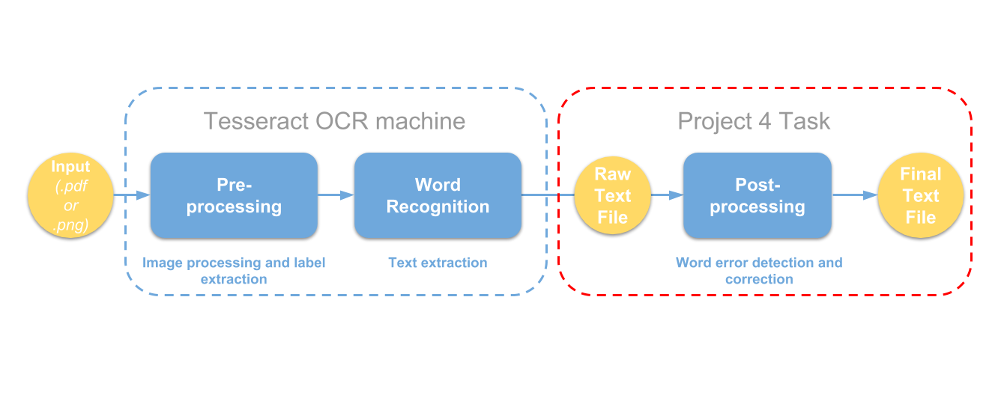
Introduction
Optical character recognition (OCR) is the process of converting scanned images of machine printed or handwritten text (numerals, letters, and symbols), into machine readable character streams, plain (e.g. text files) or formatted (e.g. HTML files).
In this project, we are going to focus on the post-processing, includes two tasks: error detection and error correction.
Notes:
OCR is the process of converting scanned images into machine readable character streams.In this project, we focus on the post-processing which includes two tasks: error detection and error correction.

Slide 3
Error
Detection
Error
Correction

Slide 4
Error
Detection
Rule-based techniques (Assigned)
Letter n-gram
Probabilistic techniques – SVM garbage detection
Notes:
The first part of this project is error detection, there are three workable techniques: Rule-based techniques, letter n-gram and SVM garbage detection.

Slide 5
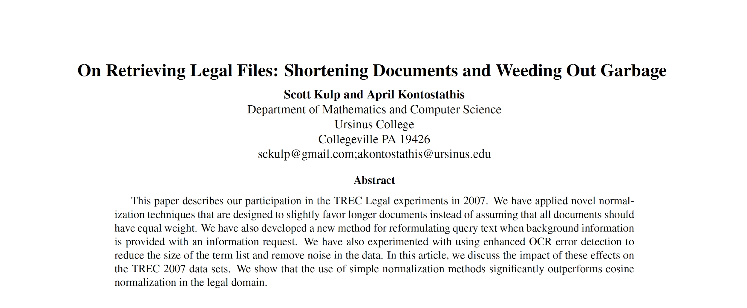
Assigned Paper
Notes:
Our assigned paper is: Shortening documents and weeding out garbage, this paper offers a rule-based technique, it clearly defines eight rules to determine whether a string is garbage or not.

Slide 6
Rule-based techniques
#If the number of punctuation characters in a string is greater than the number of alphanumeric characters, it is garbage
#Ignoring the first and last characters in a string, if there are two or more different punctuation characters in the string, it is garbage
#A string composed of more than 20 symbols is garbage
#If there are three or more identical characters in a row in a string, it is garbage
#If the number of uppercase characters in a string is greater than the number of lowercase characters, and if the number of uppercase characters is less than the total number of characters in the string, it is garbage
#If all the characters in a string are alphabetic, and if the number of consonants in the string is greater than 8 times the number of vowels in the string, or vice-versa, it is garbage
#If there are four or more consecutive vowels in the string or five or more consecutive consonants in the string, it is garbage
#If the first and last characters in a string are both lowercase and any other character is uppercase, it is garbage.
Notes:
Theses are the garbage detection rules we can find in the paper, they are based on the rmgarbage system with additional rules in order to find more items.

Slide 7
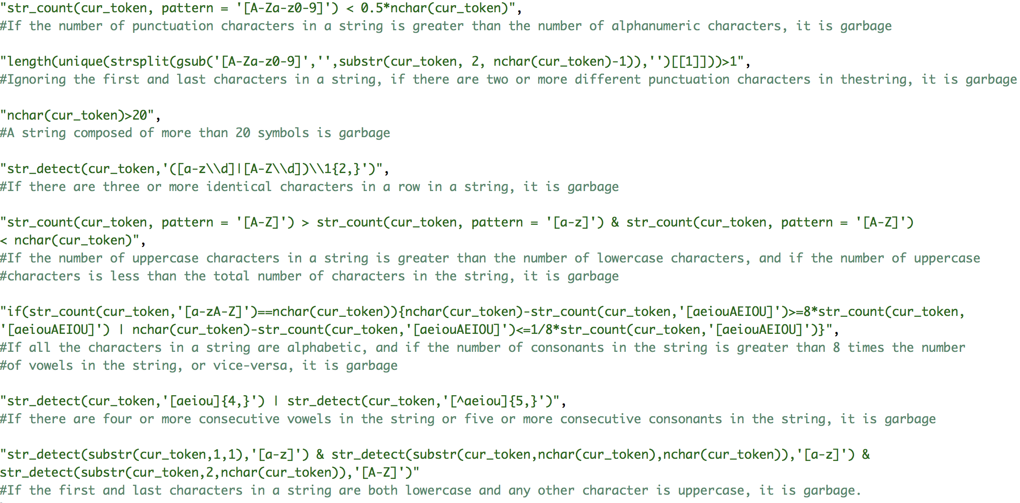
Notes:
The job we did here is just “play with strings”, we use regular expression as a tool to apply the rules on each word and determine whether it is garbage or not, it is pretty much the same as what we did in the course “introduction to data science” when we do “web scraping”.

Slide 8
str_count(cur_token, pattern = '[A-Za-z0-9]') < 0.5*nchar(cur_token)
#1 If the number of punctuation characters in a string is greater than the number of alphanumeric characters, it is garbage.
Notes:
Ok, I’ll skip the details of the code and move to next part since I don’t want to waste your time and this class is about something advanced.

Slide 9
length(unique(strsplit(gsub('[A-Za-z0-9]','',substr(cur_token, 2, nchar(cur_token)-1)),'')[[1]]))>1
#2 Ignoring the first and last characters in a string, if there are two or more different punctuation characters in the string, it is garbage.

Slide 10
nchar(cur_token)>20
#3 A string composed of more than 20 symbols is garbage.

Slide 11
str_detect(cur_token,'([a-z\\d]|[A-Z\\d])\\1{2,}')
#4 If there are three or more identical characters in a row in a string, it is garbage.

Slide 12
str_count(cur_token, pattern = '[A-Z]') > str_count(cur_token, pattern = '[a-z]') & str_count(cur_token, pattern = '[A-Z]') < nchar(cur_token)
#5 If the number of uppercase characters in a string is greater than the number of lowercase characters, and if the number of uppercase characters is less than the total number of characters in the string, it is garbage

Slide 13
if(str_count(cur_token,'[a-zA-Z]')==nchar(cur_token)){nchar(cur_token)-str_count(cur_token,'[aeiouAEIOU]')>=8*str_count(cur_token,'[aeiouAEIOU]') | nchar(cur_token)-str_count(cur_token,'[aeiouAEIOU]')<=1/8*str_count(cur_token,'[aeiouAEIOU]')}
#6 If all the characters in a string are alphabetic, and if the number of consonants in the string is greater than 8 times the number of vowels in the string, or vice-versa, it is garbage.

Slide 14
str_detect(cur_token,'[aeiou]{4,}') | str_detect(cur_token,'[^aeiou]{5,}')
#7 If there are four or more consecutive vowels in the string or five or more consecutive consonants in the string, it is garbage.

Slide 15
str_detect(substr(cur_token,1,1),'[a-z]') & str_detect(substr(cur_token,nchar(cur_token),nchar(cur_token)),'[a-z]') & str_detect(substr(cur_token,2,nchar(cur_token)),'[A-Z]')
#8 If the first and last characters in a string are both lowercase and any other character is uppercase, it is garbage.

Slide 16
Error
Correction
Letter n-gram
Supervised model – correction regressor
Probability scoring without context
Probability scoring with contextual constraints (Assigned)
Topic models
Notes:
The second part of this project is error correction, there are 5 possible techniques

Slide 17
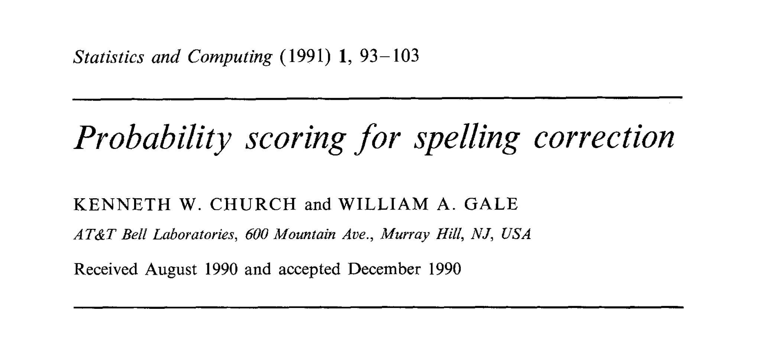
Assigned Paper
Notes:
Our assigned paper is Probability scoring for spelling correction.

Slide 18
How it works
Word counts
calculated word frequencies
Highest score search
Look for highest word frequency and bigram frequencies
Bigram counts
Calculated bigram frequencies
Correction
Replace the misspelled word with the highest score correction
Notes:
Here is a flow chart showing how it works

Slide 19
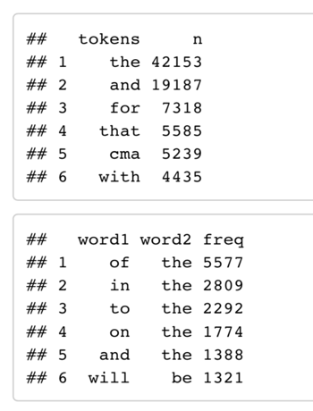
Word Counts and Bigram Counts
Took all words in the groundtruth papers and calculated word frequencies
Looked at the two neighboring words for each word and calculated bigram frequencies
Notes:
The entire word list of all the papers in groundtruth serves as our training data, we can call it a ”dictionary” from where we check for the existence of a word, then we can calculate the frequencies for each word and bigram frequencies of its neighbors.

Slide 20
Correcting the Words
To correct the words, we take each misspelled word, and use the word index to find the left and right neighbors of that word, to provide bigram information
3 techniques to find a possible correct spelling:
• Deletion: Sees if removing an unnecessary character from the word will create a correctly spelled word
• Insertion: Sees if adding a missing character to a word will create a correctly spelled word
• Substitution: Sees if replacing a character with a different character will create a correctly spelled word
(These techniques only work for words off by one character)
• If there are multiple potential corrections that come from these three techniques, the one with the highest word frequency and bigram frequencies (with the left and right neighbors) is chosen
Notes:
To correct the words, we take each misspelled word, and use the word index to find the left and right neighbors of that word, to provide bigram information
3 techniques to find a possible correct spelling:
• Deletion: Sees if removing an unnecessary character from the word will create a correctly spelled word
• Insertion: Sees if adding a missing character to a word will create a correctly spelled word
• Substitution: Sees if replacing a character with a different character will create a correctly spelled word
(These techniques only work for words off by one character)
• If there are multiple potential corrections that come from these three techniques, the one with the highest word frequency and bigram frequencies (with the left and right neighbors) is chosen

Slide 21
Example of substitution technique
“from thn house”
The misspelled word and its neighbors
Score of “the”：
(600+299+1)/3 = 300
The mean of the 3 frequencies will be the score
“the” : 600
“from the”: 299
“the house”: 1
frequencies of word and bigram
Notes:
Here is an example of substitution technique.
The score we are looking for is a combination of how commonly the word was used in the papers, and how often it was used in that context.
Suppose we wanna find the correct spelling for the middle word in the phrase "from t-h-n house". If we want to test the word "the" as a possible correction, we would look at the word frequency of "the", the bigram frequency for "from the", and the bigram frequency for "the home".
Then we take the mean of those 3 frequencies and that's the score for the word “the”.
Then we do that for all possible corrections and whichever has the highest "score" is the one to be chosen as a correction.

Slide 22
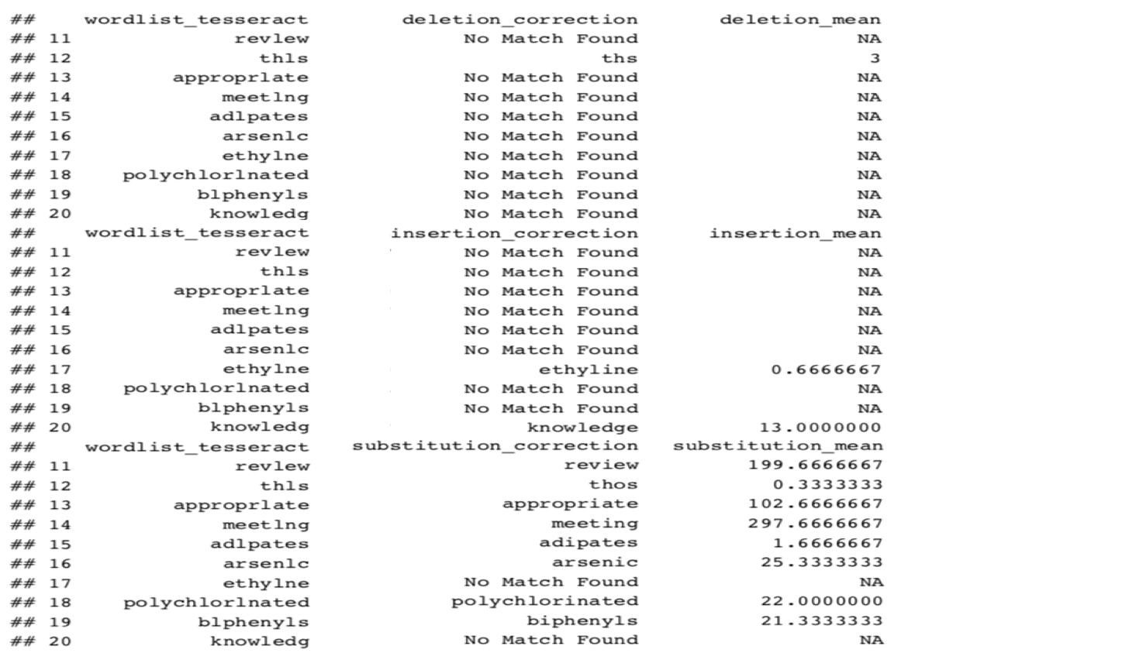
Best deletion, insertion, and substitution corrections for words off by one character
Deletion mean, insertion mean, and substitution mean are the means of the word’s frequency and bigram frequency, and this is how we “score” the correction
Notes:
As we can see from this output table, for the misspelled word m-e-e-t-l-n-g, there is no match found for deletion and insertion technique, the highest score for substitution technique is 297.66, so we will choose the correction from substitution technique as our final correction.

Slide 23
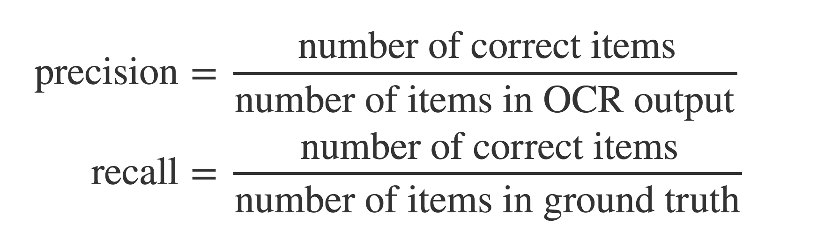
Performance Measure
Notes:
we use these two function to measure the performance of our project

Slide 24
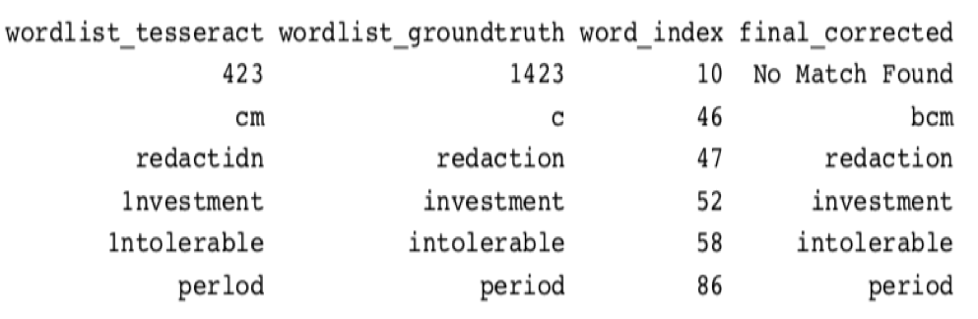
Performance
Correct the first two papers in group 1:
Notes:
We chose the first two papers in group 1 as our test input and corrected them, the table shows misspelled word, correct word, word location, and correction attempt, as we can see that some of the of misspelled words are corrected perfectly while some are not.

Slide 25
Performance
Correct the first two papers in group 1:
 | Tesseract | Tesseract_with_postprocessing
word_wise_recall | 0.58 | 0.72
word_wise_precision | 0.57 | 0.69
character_wise_recall | 0.79 | 0.91
character_wise_precision | 0.71 | 0.93
Notes:
But generally we got a pretty good result, the recall and precision both increased a lot after our post-processing.

Slide 26
Thank you!

