Slide 1
PREDICTIVE ANALYSIS
Group 2
Yang Cai | Yang Chen | Yiming Shi | Kehui Zhu | Siyu Zhu

Slide 2
Baseline Model (60 IMAGES)
Feature
Depth = 11
Prediction Algorithm
GBM
PSNR | Time
19.07427 | 87.104s

Slide 3
Feature Detector
Classification Algorithm
GBM
XGBOOST
Canny
Diagonal
Large neighborhood
Canny + Diagonal
Canny + large neighborhood

Slide 4
GBM (60 IMAGES)
Feature | PSNR | Time
Canny + Sampling | 19.07427 | 13.436+12.114+61.554=87.104s
Diagonal | 18.76836 | 148.53s
Large Neighborhood | 19.52101 | 187.76s
Canny+diagonal | 21.0425 | 198.52s
Canny+large neighborhood | 20.20425 | 123.512s

Slide 5
XGBOOST (60 IMAGES)
Feature | PSNR | Time
Canny+Sampling | 25.23255 | 13.436+1.49+16.235=31.361s
Diagonal | 20.92569 | 32.47s
Large Neighborhood | 20.11069 | 38.66s
Canny+diagonal | 22.89102 | 58.52s
Canny+large neighborhood | 23.99228 | 41.642s
Notes:
the canny edge detector is an edge detection operator which detects the edge of the objects on the image and transforms the image into black and white: the white part is the edge part, and the black part is other part. Based on Shannon's sampling theorem, we should have higher sample rate for high frequency signals. In image analysis, we can think of frequency as the rate of color change, which is edges in this case. Therefore, we put a higher weights on the edges that we have detected and a lower weights on other parts during sampling.

Slide 6
Best Model
Feature: Canny+Sampling
Classify Algorithm: XGBoost
PSNR
Time
PSNR
Time
PSNR | TIME
25.23255 | 31.361s

Slide 7
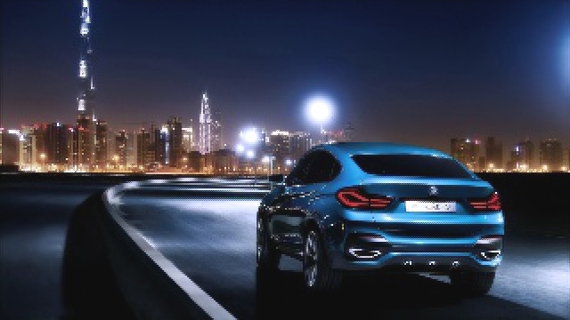

Performance
Notes:
the canny edge detector is an edge detection operator which detects the edge of the objects on the image and transforms the image into black and white: the white part is the edge part, and the black part is other part. Based on Shannon's sampling theorem, we should have higher sample rate for high frequency signals. In image analysis, we can think of frequency as the rate of color change, which is edges in this case. Therefore, we put a higher weights on the edges that we have detected and a lower weights on other parts during sampling.

Slide 8
CNN
After we read an amazing paper regarding the SRCNN in Cornell University Library. Reference (https://arxiv.org/abs/1501.00092v3).
We sample based on the original resolution image and construct the low-resolution image. We pick 33X33 pixels with duplicates as the input and 21X21 pixels as label.And we take the mean variance as our Loss function.
Here we take 14 to be our strides in the training process and strides to be 21 in the test process in order to relief block artifacts.
In the training model, we use several parameters, we choose epchos to be 100 which has loss for 0.0016
Eventually we have the PSRN roughly 34.3 for 1500 images

Slide 9
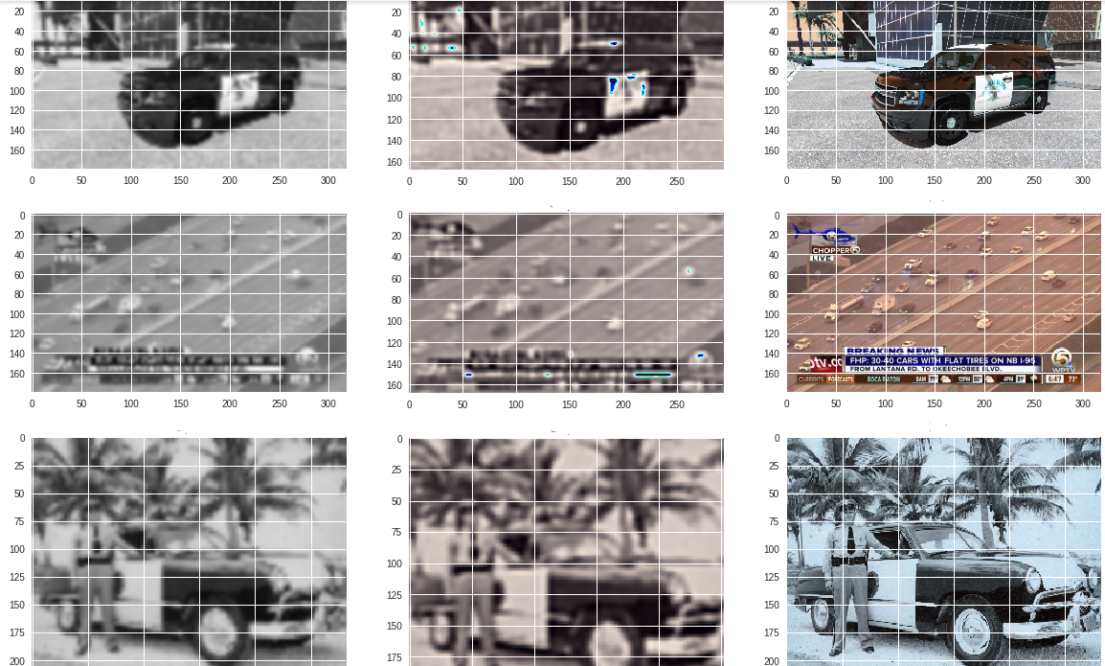

Slide 10
However..
Here the CNN model will super-resolution based on the same dimension. In the prediction test today, we will output the same dimension as the LR, which means it is not satisfied with instructor’s requirement, therefore here we did not use as a improvement test. But definitely, we can hand over this problem by predicting or changing the layer, we will do this research for that problem later.

