Slide 1
Team:Beyond Infinity
Name: Shivant Kumar Pandey
Theme: Developers Velocity with Cloud Native Application
Problem: For Gaming Industry, all the data processing, graphics and video rendering is one challenge for develops to manage and scale it to end-user across availability zone.

Slide 2
Solution:
We can solve this challenge by bringing the data closer to where it is being used.
Automate the data streaming using azure
Streaming the data through the data of azure and solution based on on-promises.
Latency will decreased by 70–80% when data closer to user.
server closest to the end-user pulls content file and swiftly streams without any buffering.

Slide 3
Services Going to used to solve Problem:
Azure CosmeDB
Azure kubernetes service
Azure active directory
Azure monitor
KEDA (autoscaler)
Azure insights
Azure log analytics workspaces.
Azure DevOps pipeline for automation
Azure Boards for work item management
Azure Repos for code.

Slide 4
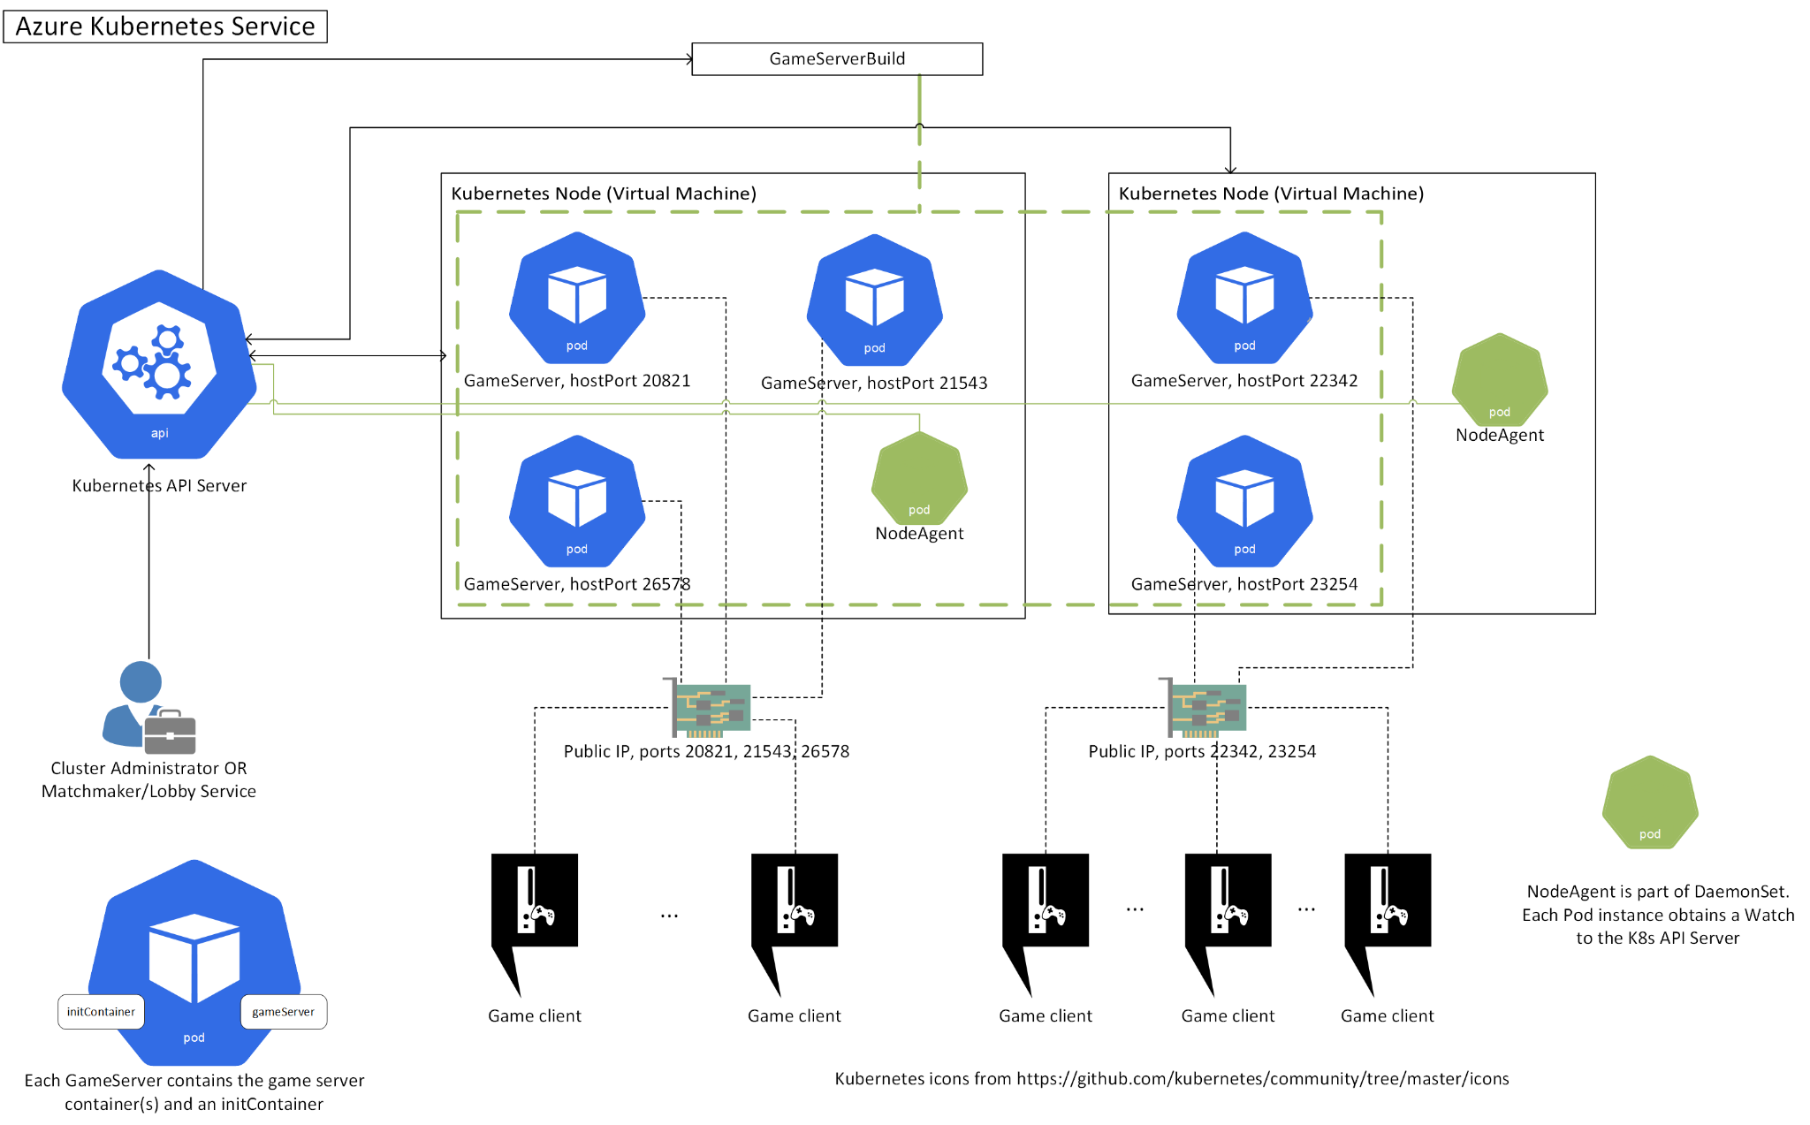
Solve The problem using Azure Services:

Slide 6
Process Of Execution:
Hosting a webapp on Azure Cloud Platform
For source code, using Github
Automate with website using CI/CD pipelines
Run services on Docker and creating containers on EKS
Stream Videos and store it on Azure

