Slide 1
Project 01 – Why so rotten, Rotten Tomatoes?
ASU Data Boot Camp
Marilu Montalvo
Jordan Banks
Jonathan Gilbert
Sachin Pandya

Slide 2

Primary Objectives
Review of top 10,000 movies rated on Rotten Tomatoes to answer the following questions
Is there one genre of movie that is more popular than another?
How does the certificate rating affect average overall movie rating?
What countries have the most popular rating certificates?
How does the Rotten Tomatoes score compare to critic ratings?
Secondary Objectives
What makes the top 5 movies unique?
How does movie duration compare to rating certificate and other measures?

Slide 3








Methods, Websites, and Modules Used
Jupyter Notebook
GitHub
Python
NumPy
MatPlotLib
Excel
Pandas
Kaggle

Slide 4
Data Search
Initially we discussed running an API for most up to date data from IMDB, after looking into our wallets we determined that wouldn’t be financially responsible.
Next, we reviewed publicly available datasets from Data.gov, but unfortunately could not identify an available dataset with the information we needed to answer our questions.
Finally, we reviewed available data on Kaggle and were able to identify the “Rotten Tomatoes 400k” dataset which appeared to have enough raw data to be cleaned and also have a large enough remaining set to complete our analysis.

Slide 5
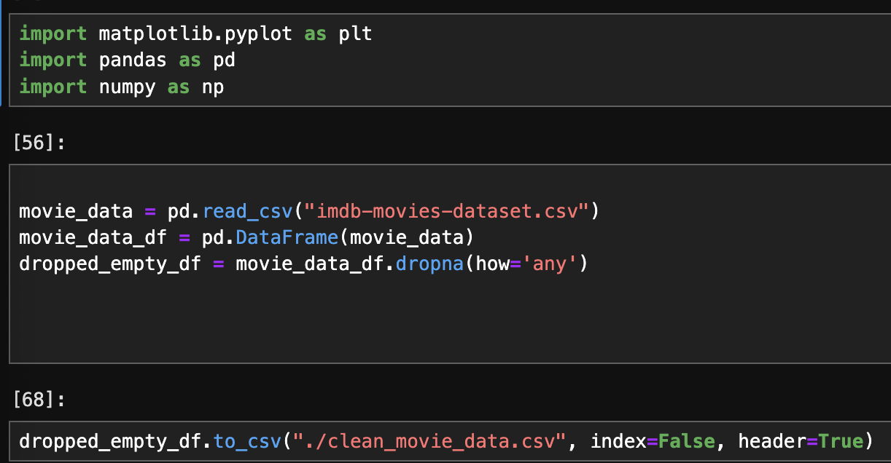
Data Cleaning
To begin, we reviewed our dataset as a group to identify any discrepancies, empty data fields, and otherwise “dirty” data that could interfere with our objectives.
1. Removal of rows with empty fields

Slide 6
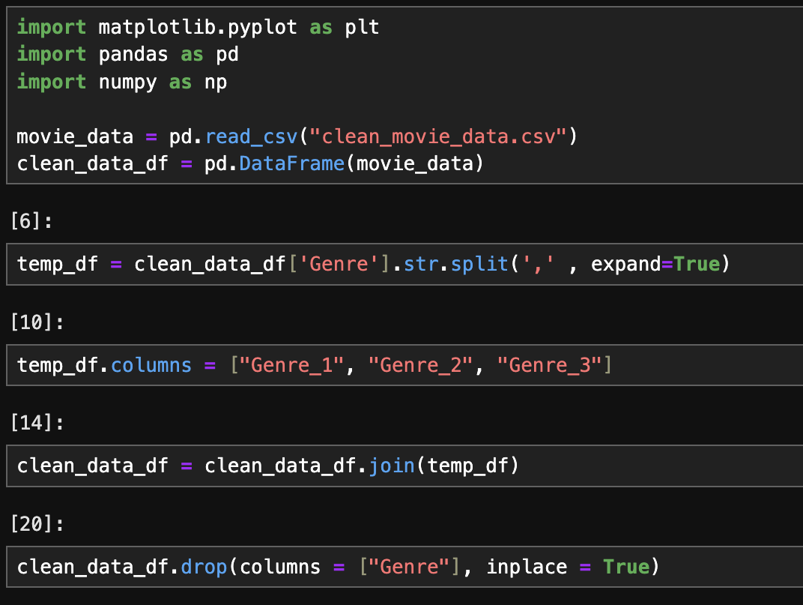
Data Cleaning
2. Separating “Genre” column to the Primary, Secondary, and Tertiary genres and then restitch into dataset

Slide 7
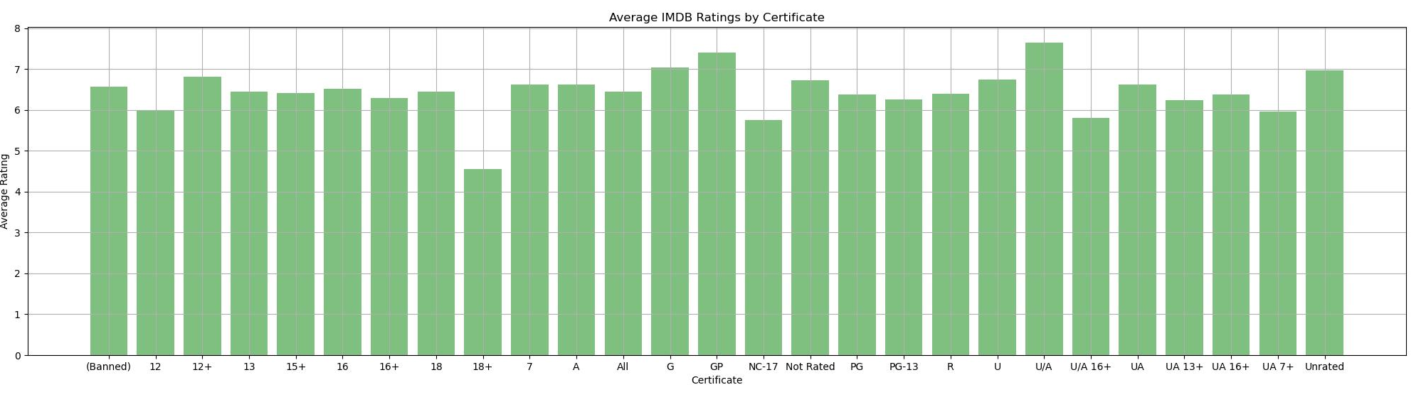
Average Ratings – Rotten Tomatoes vs Metascore
This Graph here illustrates the average ratings recorded by IMDB themselves based on the Certificate or otherwise known as rating of movies.
As we can see here there is more or less a common threshold for average rating scores on IMDB, with the exception of a couple outliers of course.

Slide 8
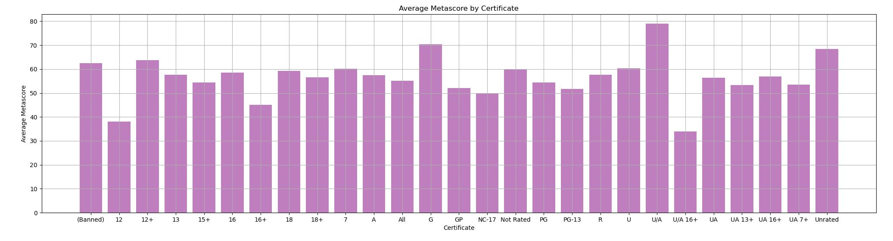
In this Graph we are illustrating the averages of Meta scores (professional ratings) which appear to have much more variability to their IMDB counterpart.
This suggests that perhaps within a more professional setting there is more inconsistency with how these types of movies are often viewed.

Slide 9
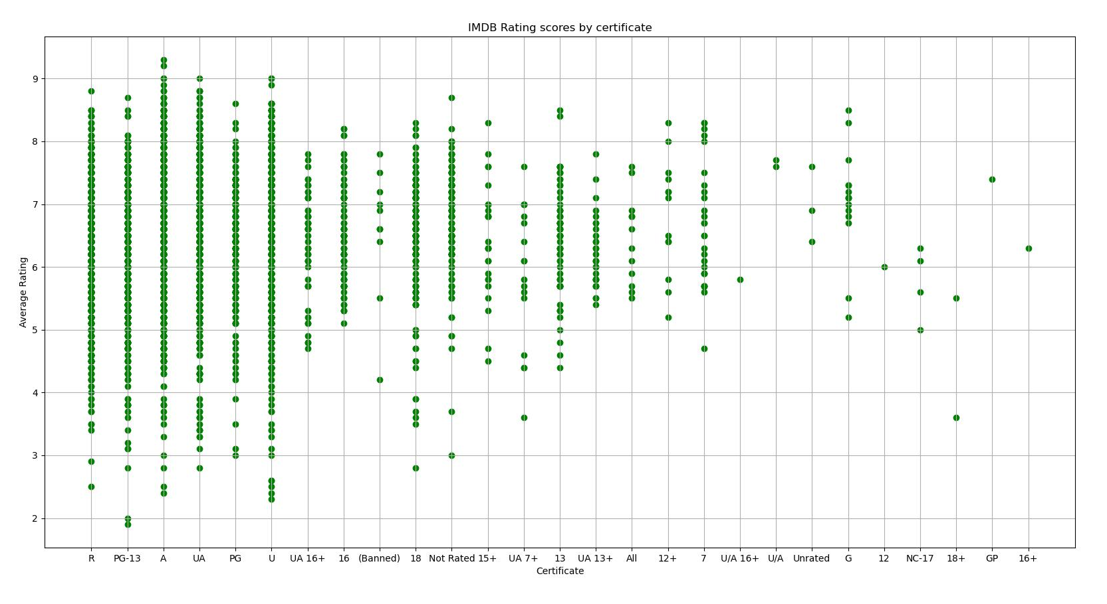
This scatter plot here can illustrate just how different the rating can be for IMDB based on the different Certificates of movies.
From here we can see the top 6 with the most variability are rated R, PG-13, A, UA, PG, and U.
Most of these ratings are also similar, yet are considered separate which could explain some of the inconsistency between rating 18 and 18+.

Slide 10
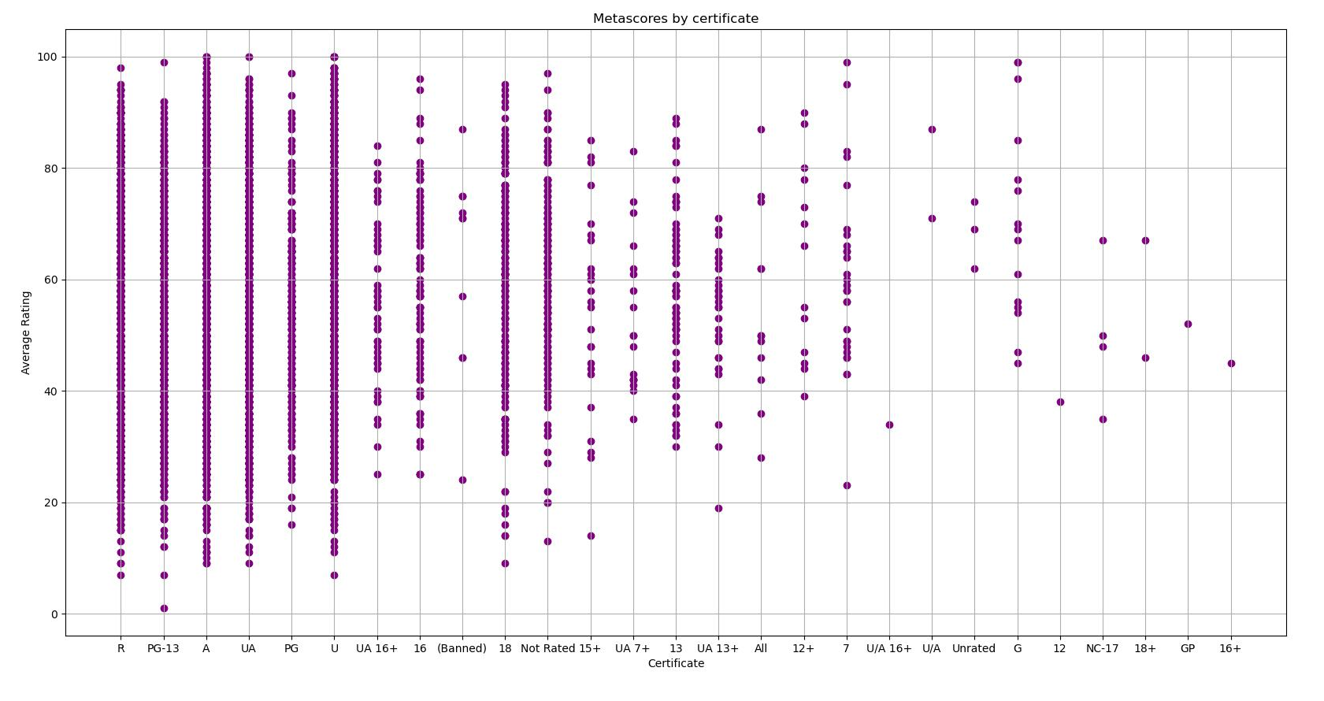
With this scatter plot we can see a near identical relation between the variability of Meta scores compared to IMDB scores.
The only notable difference is that Meta scores tend to hive higher ratings within their outlier scorings.
There can be a large multitude of reasons the top 6 certificates have so much variability.

Slide 11
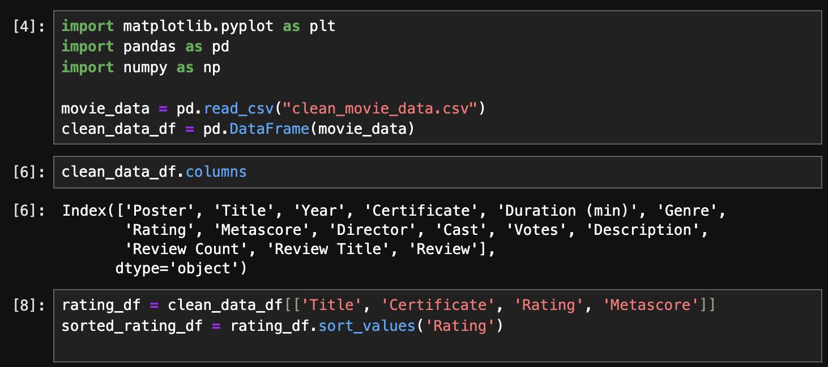
Rotten Tomatoes Rating vs. Critics Metascore – Broken Down by Movie Certificate Rating
Using pandas and numbpy to create and manipulate Data Frames
View columns and ensure correct spelling for extraction
Create new Data Frame and sort by Rotten Tomatoes Rating

Slide 12
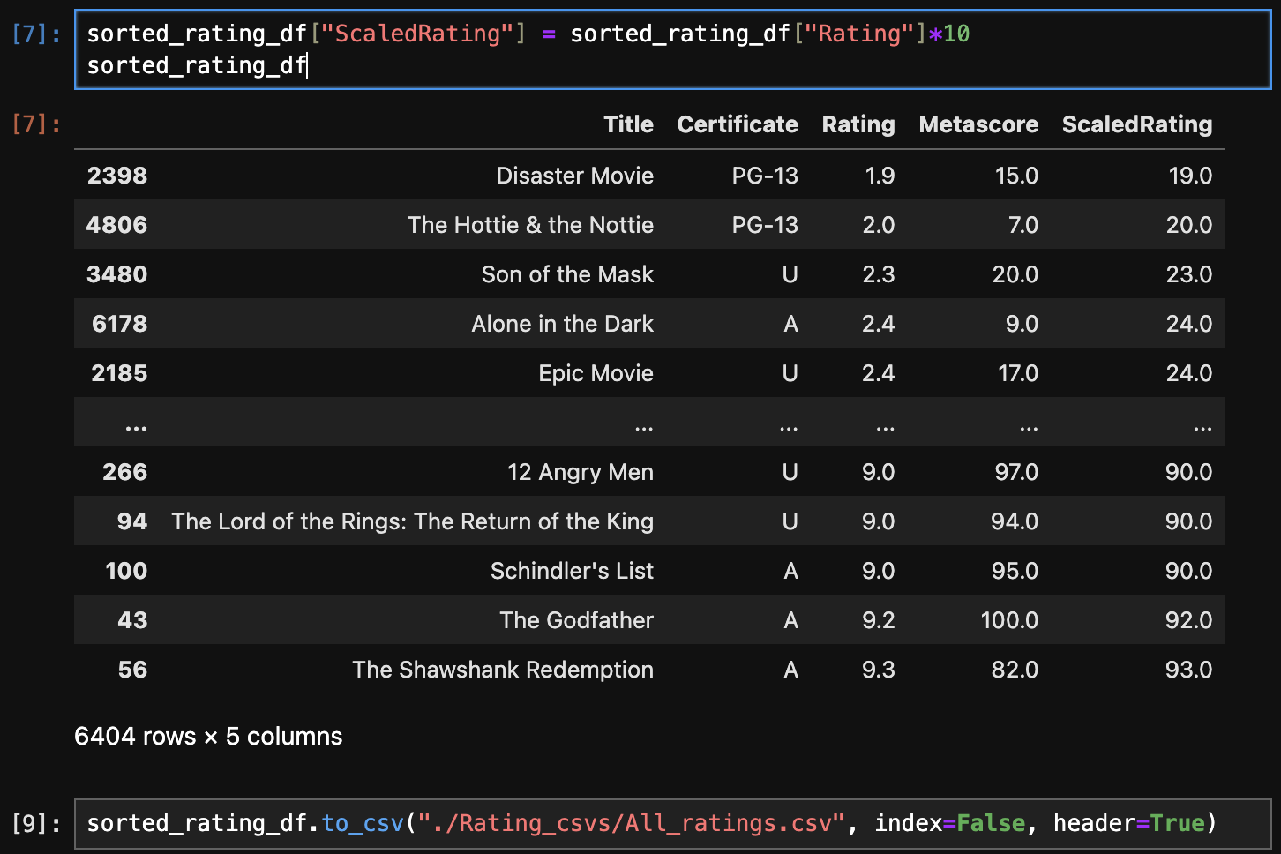
Rotten Tomatoes Rating vs. Critics Metascore – Broken Down by Movie Certificate Rating
3. Scale rating values for Rotten Tomatoes to then compare to Metascore, and export to CSV for safe keeping

Slide 13
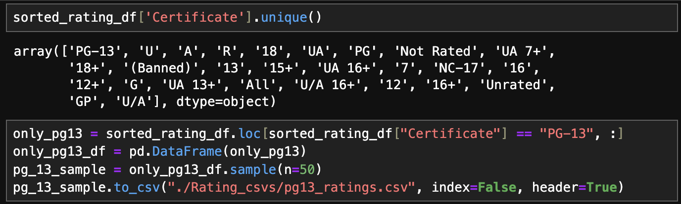
Rotten Tomatoes Rating vs. Critics Metascore – Broken Down by Movie Certificate Rating
4. Pull DataFrames by certificate and begin to extract and sample data from each certificate rating identified
5. Export to .csv file and complete data visualization in Excel

Slide 20
How does the average movie duration compare?
Movie durations vary across different genres, directors, year of filming, etc.

Slide 21
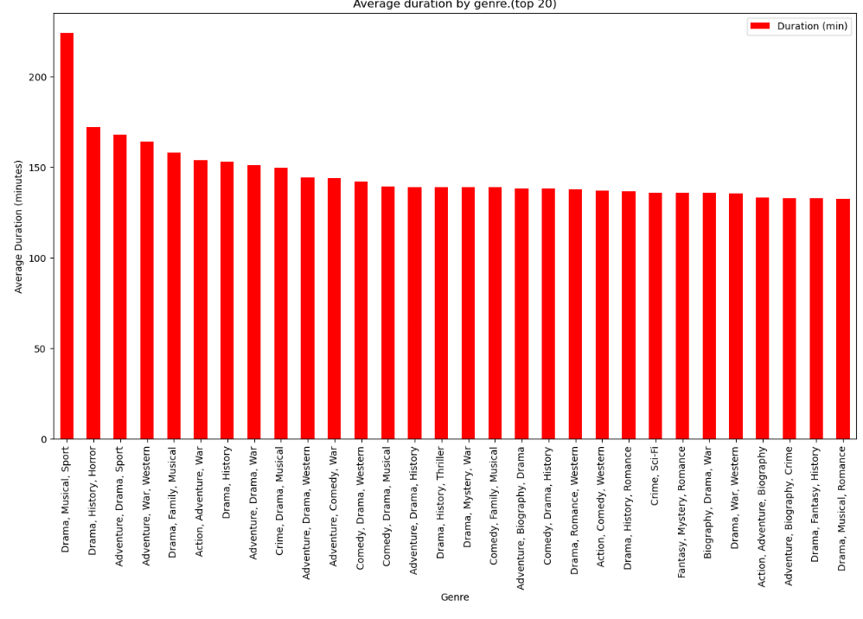
Average Movie Duration by Genre

Slide 22
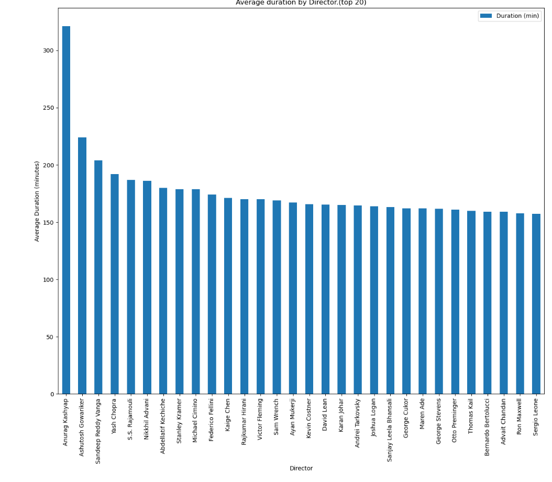
Average Movie Duration by Director

Slide 23
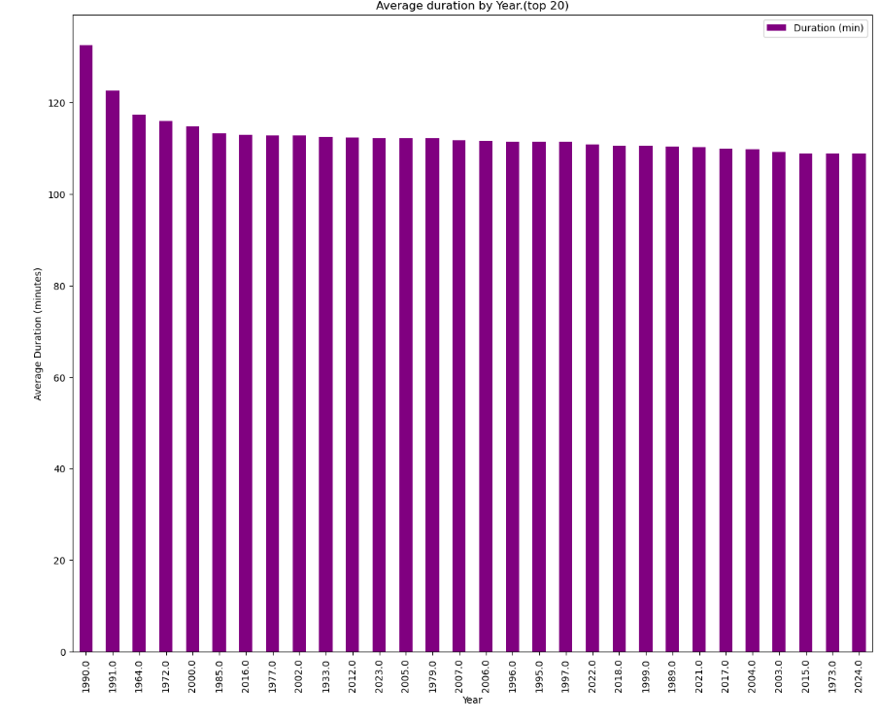
Average Movie Duration by Release Year

Slide 24
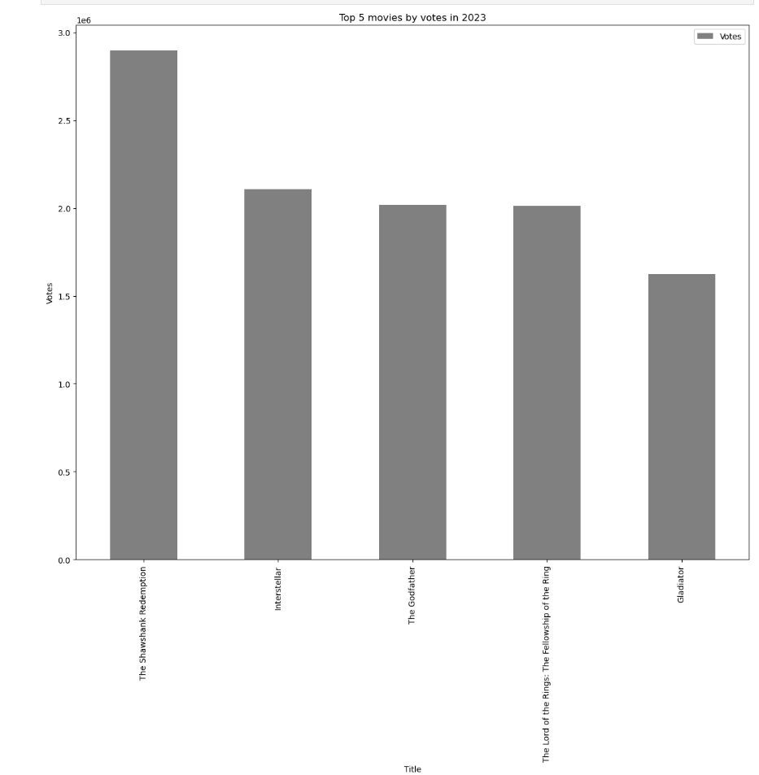
The top 5 movies for 2023

Slide 25
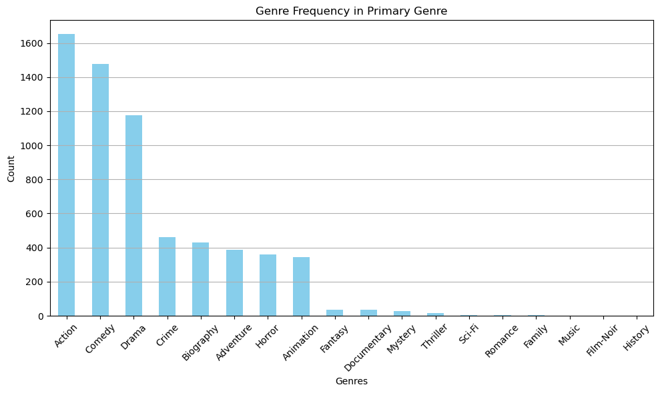
Most Common Primary Genre
The most common primary genres action, comedy, and drama.
The least common are musicals, film-noir, and history.

Slide 26
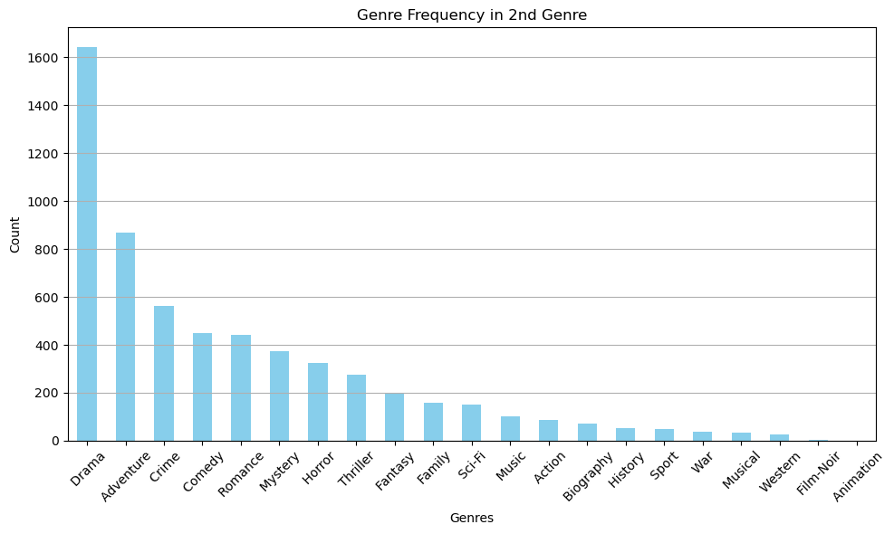
Most Common Secondary Genre
The most common secondary genres are drama, adventure, and crime.
The least common secondary genre are westerns, film-noir, and animation.

Slide 27
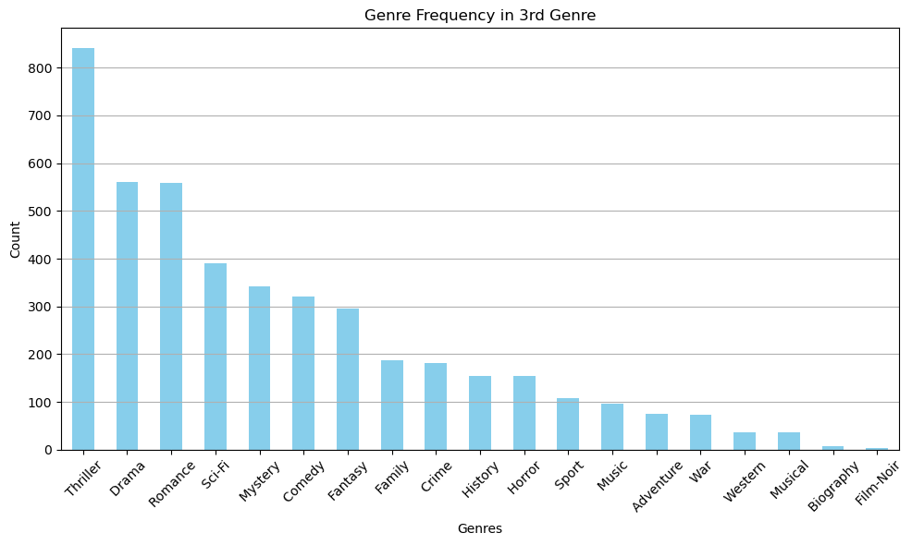
Most Common Tertiary Genre
The most common third genres are thriller, drama, and romance.
The least common third genres are musicals, biographies, and film-noir.

Slide 28
Overall Conclusion
This full analysis can help movie production companies in their evaluation of which genre, duration, and rating certificate may lead to the greatest return of investment.
In regards to average ratings, we concluded that the overall variability in ratings within a rating certificate is not different enough to draw a strong comparison
When referring to Rotten Tomatoes ratings compared to the critics Metascore Rating, we generally saw that as the films were rated higher, they would have less of a discrepancy between Rotten Tomatoes and the Metascore
Overall movies have increased in duration the newer they are, and most directors tend to film multiple of their own movies around the same length
There is a stronger relationship between common genres than there is less common genres.
For instance and Action/Comedy/Thriller will be more common than a Animated/Historical/Film Noir

Slide 29
Limitations
Inconsistent data values for certificate and rating with missing fields of data
Sample data is a limited data set and does not integrate real time pushes of data
Limited samples sizes for certain certificate ratings
Due to focus of subject, there were limitations in comparisons between different additional variables
If we were to review this towards the end of our Boot Camp we feel that our overall analysis and toolkit would be more robust resulting in deeper statistics and analysis across more variables in the dataset
The publicly available data we were able to access was limited by not having more variables that could be analyzed numerically

Slide 30
Future Considerations
Identify datasets with Gross and Net earnings for movies to determine how movies do financially when broken down by certificate rating
Identify datasets to include total nominations and awards won to determine which objective measures in a movie most closely correlates to award winners
If implementation of API, then can create this into a live program that constantly adds to the log of movies reviewed and provides visualizations of best movies by certificate and ratings
Purchasing larger numerical datasets that would allow for more statistics to be derived and presented
Notes:
- Would be financially beneficial for a production company to tailor their portfolio to movies that result in the highest net earnings

Slide 31
References
Kaggle Dataset – https://www.kaggle.com/datasets/talha002/rottentomatoes-400k-review
Happy Donut
Matplotlib Documentation - https://matplotlib.org/stable/index.html
Python Documentation - https://docs.python.org/3/
Our Fearless Leaders
Drew Hoang
Natural Chan
Henry Deane

