Slide 1
Predicting Usage of 18 Different Drugs
Kyle Spanski
DSC540
Notes:
Thinking about project, I thought of DARE classes in grade school and how they didn’t work for many kids.
Based on 2015 study

Slide 2
Questions
What types of people use drugs?
Legal
Illegal
How often do they use them?
What factors differ between drugs?

Slide 3
Data
1885 observations from an online survey
May be biased
Demographic Data
Age, Education, Country, Ethnicity
Personality Test Data
Neuroticism, Extraversion, Openness to Experience etc.
Target Data
7 Classes of Drug Use for 18 actual and 1 fake drug
Never, Used in Past Decade, Used in Past Year etc.
Dropped fake drug

Slide 4
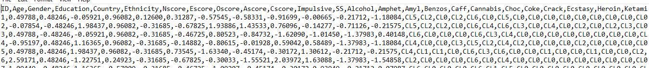
Data
All data came as transformed into real values (including non-ordinal data)
Personality data centered around 0
Spent some time converting those to dummy variables
Updated drug classes (targets) to numeric values
0-6

Slide 5
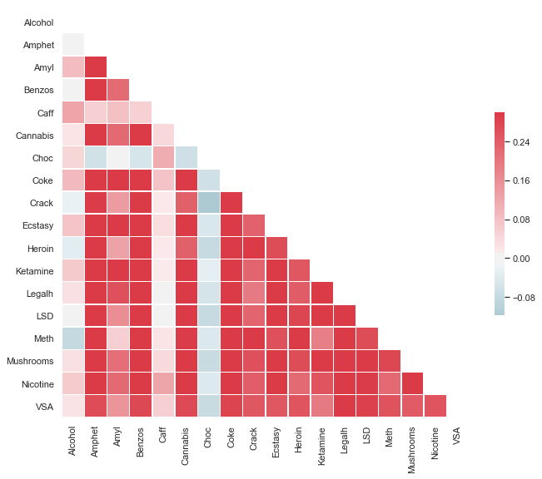
Correlations Between Drugs
Notes:
Chocolate was negatively correlated with illegal drugs.

Slide 6
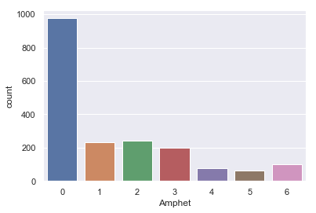
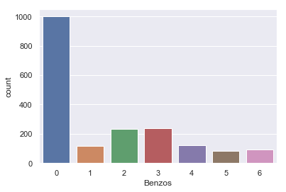
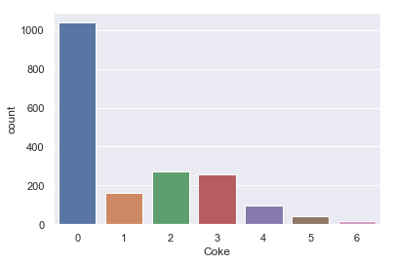
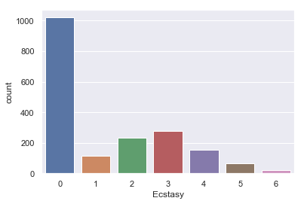
Unbalanced Target Class Problem

Slide 7
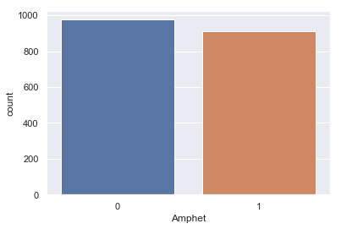
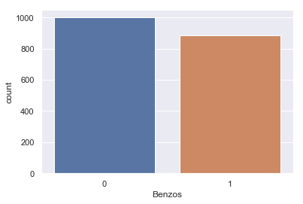
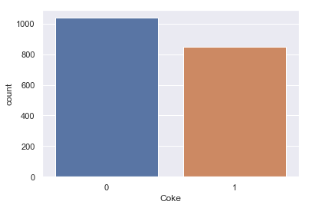
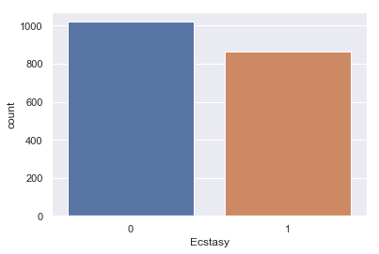
Make the Classes Binary!
Notes:
Ever used drug or not

Slide 8
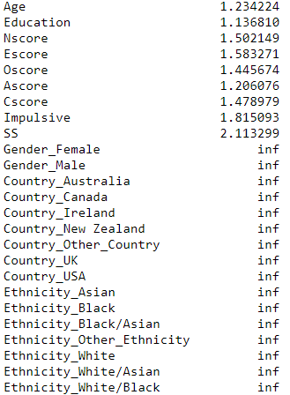
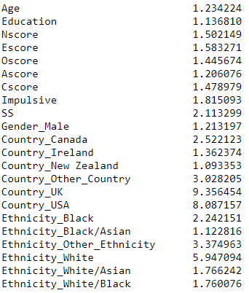
Multicollinearity
Problems with Variance Inflation Factor with new demographic dummy variables
Made sure to drop the first value to reduce VIF

Slide 9
Standard Decision Trees – No Feature Selection
Consistently not great performance for binary classification
Amphet
Decision Tree Acc: 0.59 (+/- 0.07)
Decision Tree AUC: 0.59 (+/- 0.07)
CV Runtime: 0.11183047294616699
Benzos
Decision Tree Acc: 0.58 (+/- 0.05)
Decision Tree AUC: 0.58 (+/- 0.05)
CV Runtime: 0.2356574535369873
Cocaine
Decision Tree Acc: 0.61 (+/- 0.09)
Decision Tree AUC: 0.61 (+/- 0.09)
CV Runtime: 0.4512300491333008
Ecstasy
Decision Tree Acc: 0.63 (+/- 0.09)
Decision Tree AUC: 0.62 (+/- 0.08)
CV Runtime: 0.5725538730621338
Notes:
ACC = (True Positive + True Negative) / All

Slide 10
Feature Selection – Decision Trees
Wrapper Select
Personality Traits are generally more important than Demographics.
Only large countries matter
Don’t affect Accuracy/AUC much.
Amphet
Wrapper Select: ['Age' 'Education' 'Nscore' 'Escore' 'Oscore' 'Ascore' 'Cscore' 'Impulsive' 'SS' Country_UK']
Features (total/selected): 22 10
Decision Tree Acc: 0.58 (+/- 0.07)
Decision Tree AUC: 0.58 (+/- 0.07)
CV Runtime: 0.05657553672790527
Notes:
N = Neuroticism, E = Extraversion, O = Openness to Experience, A = Agreeableness, C = Conscientiousness

Slide 11
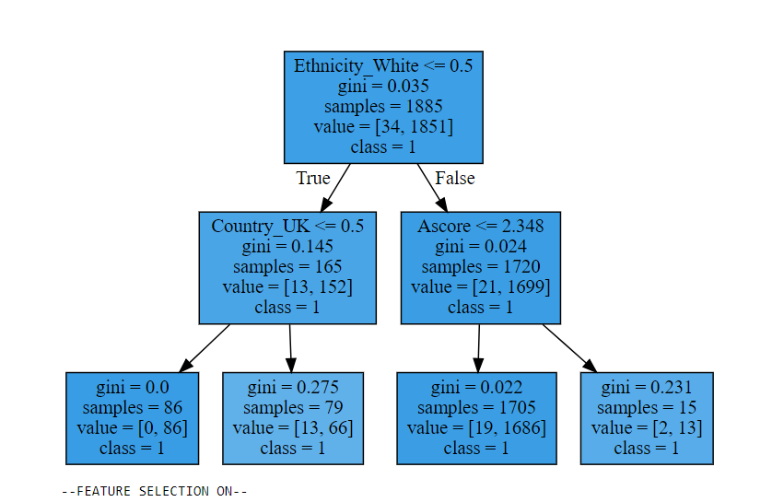
Decision Trees (2 levels) - Visual
The most important feature is different depending on the drug
Demographic information becomes more important with few features
Alcohol
Notes:
Ascore = Agreeableness
Really agreeable people (top 90% don’t drink)

Slide 12
Random Forest
Statistically better performance than decision trees
Keep max depth at ~5
Similar features were selected
Amphet
Wrapper Select: ['Nscore' 'Oscore' 'Cscore' 'Impulsive' 'SS' 'Gender_Male' 'Country_UK' 'Country_USA']
Features (total/selected): 22 8
Random Forest Acc: 0.68 (+/- 0.10)
Random Forest AUC: 0.74 (+/- 0.08)
CV Runtime: 0.5400617122650146
Notes:
About 10 points higher Acc
About 15 points higher AUC

Slide 13
Differences between Drugs –Random Forests
Best Performers
Legal Drugs (so common)
Heroin
Worst Performers
Amphet
Accuracy increased most from Decision Trees for drugs with biased targets
Heroin
Random Forest Acc: 0.85 (+/- 0.01)
Random Forest AUC: 0.78 (+/- 0.09)
CV Runtime: 0.6033084392547607
Amphet
Random Forest Acc: 0.64 (+/- 0.06)
Random Forest AUC: 0.69 (+/- 0.08)
CV Runtime: 1.1383910179138184

Slide 14
Train / Test / Eval (70 / 20 /10)
Trained Random Forest on 70% > Tested with CV on 20% > Evaluated on last 10%
Suggests data are balanced enough

Slide 15
Support Vector Classifier for Binary Targets
About the same performance as Random Forests
Kernel didn’t matter too much
RBF
Linear
Amphet : SVM Classifier
Linear Kernel
SVM Acc: 0.64 (+/- 0.14)
SVM AUC: 0.73 (+/- 0.10)
CV Runtime: 24.690531969070435
Amphet : SVM Classifier
Rbf Kernel
SVM Acc: 0.66 (+/- 0.09)
SVM AUC: 0.75 (+/- 0.06)
CV Runtime: 2.11019229888916

Slide 16
Regression-Non-Binary Data
Values of 0-6
Can be off by over 2 classes
Predicted Used in Last Month > Actual Used in Last Day
Nicotine
Random Forest RMSE:: 2.24 (+/- 0.16)
Random Forest Expl Var: 0.11 (+/- 0.12)
CV Runtime: 0.8061332702636719
Notes:
CL0 Never Used CL1 Used over a Decade Ago
CL2 Used in Last Decade
CL3 Used in Last Year CL4 Used in Last Month CL5 Used in Last Week CL6 Used in Last Day

Slide 17
Past Year Use
Similar features
Model performed better (even with more unbalanced data)
No improvement for common drugs
Alcohol, Caffeine, Chocolate
All time use
Crack
Random Forest Acc: 0.86 (+/- 0.00)
Random Forest AUC: 0.77 (+/- 0.06)
CV Runtime: 0.6025903224945068
Use in last year
Crack
Random Forest Acc: 0.96 (+/- 0.00)
Random Forest AUC: 0.79 (+/- 0.15)
CV Runtime: 0.5614199638366699
Notes:
Makes sense as Age / Personality change over time

Slide 18
Combined Drugs – Random Forests
Cocaine / Crack Combination (Yearly Use)
Cocaine was .78
Crack was .96
Combined Accuracy
CokeCrack was .77

Slide 19
Further Options
Split into different timeframes
Will daily use be generalizable?
Other drug groupings
More specific locations?

Slide 20
Conclusions
Personality measures play a large role in illegal drug use
Most important feature depends on drug
Think about timeframes of use
Random Forest for yearly use was best classifier

