Slide 1

Functional Programming with Scala
Stefan Pantea
October 2018

Slide 2
Functional Programming with Scala
Why functional programming ?
A little more than a HelloWorld
Functional Data Structures
Handling errors without exceptions
What the hell is a monad ?

Slide 3
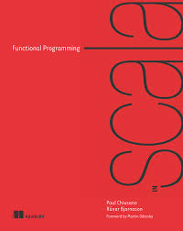
Functional Programming with Scala
Why functional programming ?
A little more than a HelloWorld
Functional Data Structures
Handling errors without exceptions
What the hell is a monad ?
Functional Programming in Scala
by Paul Chiusano and Runar Bjarnason

Slide 4

Motivation and what problem is functional programming trying to solve ?

Slide 5
What is the greatest challenge in software engineering ?

Slide 6
What is the greatest challenge in software engineering ?
fear of writing too simple code?

Slide 7
What is the greatest challenge in software engineering ?
bad requirements ?
fear of writing too simple code?

Slide 8
What is the greatest challenge in software engineering ?
bad requirements ?
fear of writing too simple code?
bad architecture ?

Slide 9
What is the greatest challenge in software engineering ?
bad requirements ?
fear of writing too simple code?
bad architecture ?
changing developers ?

Slide 10
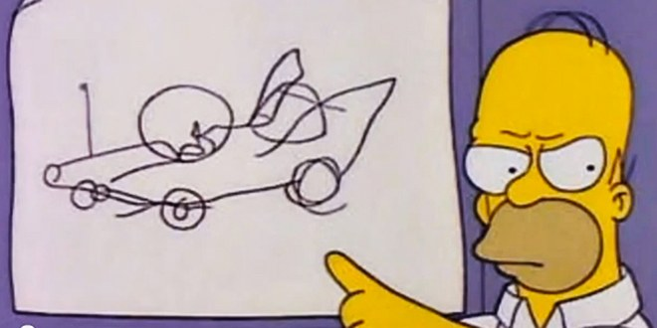
What is the greatest challenge in software engineering ?
bad requirements ?
fear of writing too simple code?
COMPLEXITY
bad architecture ?
changing developers ?

Slide 11
Functional programming removes one dimension of that complexity…
"To understand a program part (a function) you need no
longer account for the possible histories of executions
that can lead to that program part"
Martin Odersky

Slide 12
Functional programming removes one dimension of that complexity…
Functional programming is based on a simple rule:
Construct programs using only PURE FUNCTIONS (functions that have no side effects)

Slide 13
Functional programming removes one dimension of that complexity…
Functional programming is based on a simple rule:
Construct programs using only PURE FUNCTIONS (functions that have no side effects)
Side effects:
modify a variable
modify a data structure in place
setting a field on an object
throwing exceptions or halting with an error
printing to the console
reading from file

Slide 14

Getting started with functional programming with Scala
basic elements of a Scala program (HelloWorld kinda)
writing loops functionally (without modifying variables)
HOF (high order functions)
polymorphic functions

Slide 15
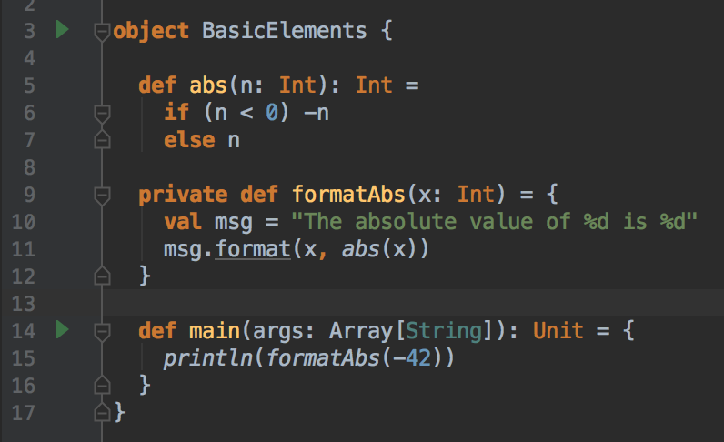
1. A very simple example

Slide 16
Declares a singleton class and its only instance

Slide 17
Declares a singleton class and its only instance
There is no static keyword in Scala.

Slide 18
Declares a singleton class and its only instance
A pure function that returns the abs value of the given param
There is no static keyword in Scala.

Slide 19
Declares a singleton class and its only instance
A pure function that returns the abs value of the given param
There is no static keyword in Scala.
Notice there is no return keyword (the method returns to what the right hand expression evaluates to)

Slide 20
Declares a singleton class and its only instance
A pure function that returns the abs value of the given param
There is no static keyword in Scala.
Notice there is no return keyword (the method returns to what the right hand expression evaluates to)
Return type is optional (good practice for public method to have it)

Slide 21
Declares a singleton class and its only instance
A pure function that returns the abs value of the given param
There is no static keyword in Scala.
Notice there is no return keyword (the method returns to what the right hand expression evaluates to)
Return type is optional (good practice for public method to have it)
In Scala everything is an object (even primitives like Int, Double etc.)

Slide 22
Declares a singleton class and its only instance
A pure function that returns the abs value of the given param
There is no static keyword in Scala.
Notice there is no return keyword (the method returns to what the right hand expression evaluates to)
Return type is optional (good practice for public method to have it)
In Scala everything is an object (even primitives like Int, Double etc.)
Unit shows there is no return (kinda like void)

Slide 23
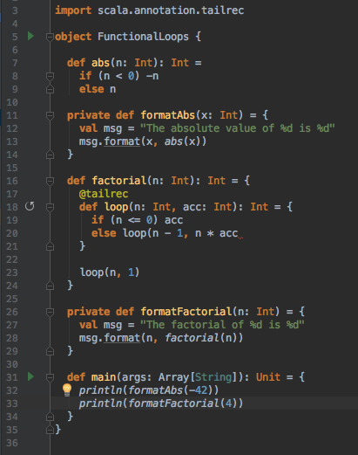
2. Writing loops functionally

Slide 24
2. Writing loops functionally
Simple recursive method to compute factorial

Slide 25
Writing loops functionally
Simple recursive method to compute factorial
You write loops by using a recursive functions that takes an acc var

Slide 26
Writing loops functionally
Simple recursive method to compute factorial
You write loops by using a recursive functions that takes an acc var
You can nest functions

Slide 27
Writing loops functionally
Simple recursive method to compute factorial
You write loops by using a recursive functions that takes an acc var
@tailrec enforces the tail recursion optimization
You can nest functions

Slide 28
Writing loops functionally
Simple recursive method to compute factorial
You write loops by using a recursive functions that takes an acc var
@tailrec enforces the tail recursion optimization
Another format method (kinda redundant) maybe we can do something about it
You can nest functions

Slide 29
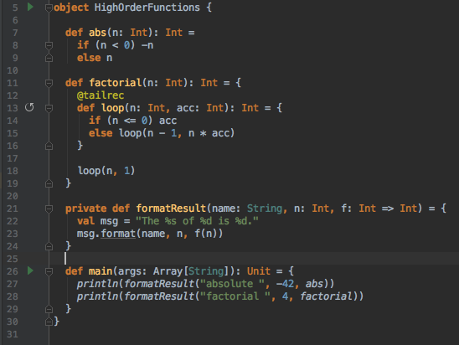
3. High order functions

Slide 30
3. High order functions
The two format methods were almost identical so we refactored them into a more general HOF

Slide 31
3. High order functions
The two format methods were almost identical so we refactored them into a more general HOF
f is just like another regular parameter

Slide 32
3. High order functions
The two format methods were almost identical so we refactored them into a more general HOF
f is just like another regular parameter
Its type is a function that takes an Int an returns also an Int

Slide 33
3. High order functions
The two format methods were almost identical so we refactored them into a more general HOF
f is just like another regular parameter
Its type is a function that takes an Int an returns also an Int
abs and factorial match this type

Slide 34
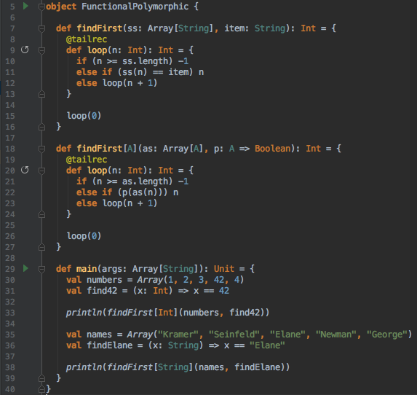
4. Polymorphic functions

Slide 35
4. Polymorphic functions
Simple method that iterates over an Array of Strings and returns the position of the first occurrence of the passed item

Slide 36
4. Polymorphic functions
Simple method that iterates over an Array of Strings and returns the position of the first occurrence of the passed item
It is limited to searching for String values only

Slide 37
4. Polymorphic functions
Simple method that iterates over an Array of Strings and returns the position of the first occurrence of the passed item
It is limited to searching for String values only
Similar generic functions that works on any type

Slide 38
4. Polymorphic functions
Simple method that iterates over an Array of Strings and returns the position of the first occurrence of the passed item
It is limited to searching for String values only
A function parameter used to check each element of the array, until the condition is met
Similar generic functions that works on any type

Slide 39
4. Polymorphic functions
Simple method that iterates over an Array of Strings and returns the position of the first occurrence of the passed item
It is limited to searching for String values only
A function parameter used to check each element of the array, until the condition is met
Similar generic functions that works on any type
Type parameters are declared using [ ]

Slide 40
4. Polymorphic functions
Simple method that iterates over an Array of Strings and returns the position of the first occurrence of the passed item
It is limited to searching for String values only
A function parameter used to check each element of the array, until the condition is met
Similar generic functions that works on any type
Type parameters are declared using [ ]
Instead of using ”==“ we just apply the method

Slide 41
4. Polymorphic functions
Simple method that iterates over an Array of Strings and returns the position of the first occurrence of the passed item
It is limited to searching for String values only
A function parameter used to check each element of the array, until the condition is met
Similar generic functions that works on any type
Type parameters are declared using [ ]
Instead of using ”==“ we just apply the method
Lambda function for finding 42

Slide 42
4. Polymorphic functions
Simple method that iterates over an Array of Strings and returns the position of the first occurrence of the passed item
It is limited to searching for String values only
A function parameter used to check each element of the array, until the condition is met
Similar generic functions that works on any type
Type parameters are declared using [ ]
Instead of using ”==“ we just apply the method
Lambda function for finding 42
Lambda function for finding “Elaine”

Slide 43
4. Polymorphic functions
Simple method that iterates over an Array of Strings and returns the position of the first occurrence of the passed item
It is limited to searching for String values only
A function parameter used to check each element of the array, until the condition is met
Similar generic functions that works on any type
Type parameters are declared using [ ]
Instead of using ”==“ we just apply the method
Lambda function for finding 42
Lambda function for finding “Elaine”
We can also write _ == “Elaine”

Slide 44
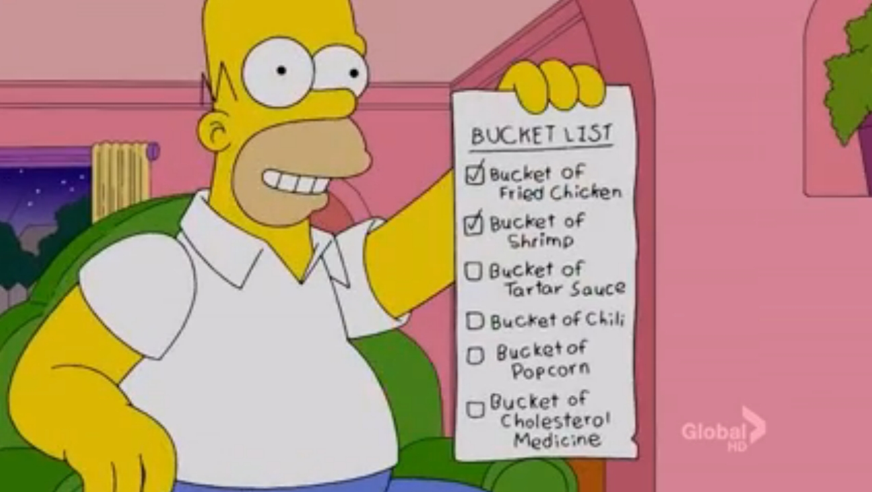
Functional Data Structures
Functional programs don’t update variables
or modify modify mutable data structures
What kind of data structures can we use ?
Use case single involving linked list
Pattern matching

Slide 45
Functional Data Structures
Functional data structures are by definition immutable
We operate on them by using only pure functions, that don’t change any data in place or perform any side effects.
Does this imply that we need to do a lot of copying of data ? It seems that we don’t have to.

Slide 46
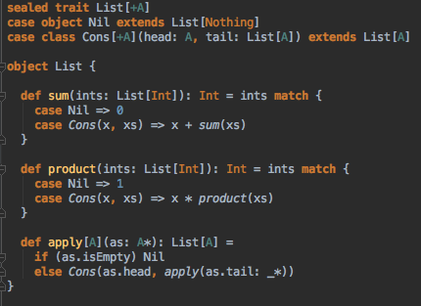
Single linked list

Slide 47
trait keyword defines the type List (similar to Interface)

Slide 48
trait keyword defines the type List (similar to Interface)
List data type parameterized on a type [A]

Slide 49
trait keyword defines the type List (similar to Interface)
List data type parameterized on a type [A]
sealed forces all implementations of List to be included in this file

Slide 50
trait keyword defines the type List (similar to Interface)
List data type parameterized on a type [A]
A singleton case object representing the empty list
sealed forces all implementations of List to be included in this file

Slide 51
trait keyword defines the type List (similar to Interface)
List data type parameterized on a type [A]
A singleton case object representing the empty list
sealed forces all implementations of List to be included in this file
Another case class representing a non-empty list composed of a head element and a pointer to the rest of the list

Slide 52
trait keyword defines the type List (similar to Interface)
List data type parameterized on a type [A]
A singleton case object representing the empty list
sealed forces all implementations of List to be included in this file
Another case class representing a non-empty list composed of a head element and a pointer to the rest of the list
List companion object. Contains functions for creating and working with lists

Slide 53
trait keyword defines the type List (similar to Interface)
List data type parameterized on a type [A]
A singleton case object representing the empty list
sealed forces all implementations of List to be included in this file
Another case class representing a non-empty list composed of a head element and a pointer to the rest of the list
List companion object. Contains functions for creating and working with lists
Using pattern matching to recursively add all the elements of the list

Slide 54
trait keyword defines the type List (similar to Interface)
List data type parameterized on a type [A]
A singleton case object representing the empty list
sealed forces all implementations of List to be included in this file
Another case class representing a non-empty list composed of a head element and a pointer to the rest of the list
List companion object. Contains functions for creating and working with lists
apply methods are used for constructing objects. They live in the companion objects and are called by using “()”
Using pattern matching to recursively add all the elements of the list

Slide 55
trait keyword defines the type List (similar to Interface)
List data type parameterized on a type [A]
A singleton case object representing the empty list
sealed forces all implementations of List to be included in this file
Another case class representing a non-empty list composed of a head element and a pointer to the rest of the list
List companion object. Contains functions for creating and working with lists
apply methods are used for constructing objects. They live in the companion objects and are called by using “()”
Using pattern matching to recursively add all the elements of the list
Variadic function

Slide 56
Scala case classes
Case classes are like normal classes but different :D
  they are immutable (good for actor messages)
  accessor methods are generated for each constructor parameter
  apply method is generated
  (you can create an instance MyCaseClass(firstParam, secondParam) without new
  unapply method is generated (extractor – for accessing param values in match cases)
  copy method is generated
  equals and hashcode are generated (for using them as keys in hash based ds)
  toString also is generated

Slide 57

4. Handling errors without exceptions
Trilogy of Error : The Simpsons ep18s12

Slide 58
4. Handling errors without exceptions
Throwing exceptions is a side effect so what do we use instead ?
Trilogy of Error : The Simpsons ep18s12

Slide 59
4. Handling errors without exceptions
Throwing exceptions is a side effect so what do we use instead ?
The idea is that we can represent failures and exceptions with values.
Trilogy of Error : The Simpsons ep18s12

Slide 60
4. Handling errors without exceptions
Throwing exceptions is a side effect so what do we use instead ?
The idea is that we can represent failures and exceptions with values.
The functional solution to handling errors retains referential transparency.
Trilogy of Error : The Simpsons ep18s12

Slide 61
4. Handling errors without exceptions
Throwing exceptions is a side effect so what do we use instead ?
The idea is that we can represent failures and exceptions with values.
The functional solution to handling errors retains referential transparency.
Either and Option to the rescue.
Trilogy of Error : The Simpsons ep18s12

Slide 62

A simple example where we might use an exception

Slide 63
A simple example where we might use an exception
Seq is a common interface of various linear like collections (Set, List)

Slide 64

A simple example where we might use an exception
Seq is a common interface of various linear like collections (Set, List)
Same method using Option value

Slide 65
A simple example where we might use an exception
Seq is a common interface of various linear like collections (Set, List)
Same method using Option value
In case of empty list we return None instead of throwing an exception

Slide 66
A simple example where we might use an exception
Seq is a common interface of various linear like collections (Set, List)
Same method using Option value
In case of empty list we return None instead of throwing an exception
We wrap the result in Some(val)

Slide 67

A simple example where we might use an exception
Seq is a common interface of various linear like collections (Set, List)
Same method using Option value
In case of empty list we return None instead of throwing an exception
We wrap the result in Some(val)

Slide 68
A simple example where we might use an exception
Seq is a common interface of various linear like collections (Set, List)
Same method using Option value
In case of empty list we return None instead of throwing an exception
We wrap the result in Some(val)
The problem with Option is that it doesn’t tell us what went wrong

Slide 69

5. So what the hell is a Monad ? In 2s
The Otto Show: The Simpsons ep22s03

Slide 70
5. So what the hell is a Monad ? In 2s
You can think of monads as wrappers
The Otto Show: The Simpsons ep22s03

Slide 71
5. So what the hell is a Monad ? In 2s
You can think of monads as wrappers
A data type that encapsulates a value and to which essentially two operations can be performed:
1. unit - creates a value of the monad type (the wrapping part)
2. flatMap - apply a function to the value in the monad
The Otto Show: The Simpsons ep22s03

Slide 72
5. So what the hell is a Monad ? In 2s
You can think of monads as wrappers
A data type that encapsulates a value and to which essentially two operations can be performed:
1. unit - creates a value of the monad type (the wrapping part)
2. flatMap - apply a function to the value in the monad
The Otto Show: The Simpsons ep22s03

Slide 73
5. So what the hell is a Monad ? In 2s
You can think of monads as wrappers
A data type that encapsulates a value and to which essentially two operations can be performed:
1. unit - creates a value of the monad type (the wrapping part)
2. flatMap - apply a function to the value in the monad
there is no such thing as monad type class in Scala. That doesn’t mean there are no monads in Scala
The Otto Show: The Simpsons ep22s03

Slide 74
5. So what the hell is a Monad ? In 2s
You can think of monads as wrappers
A data type that encapsulates a value and to which essentially two operations can be performed:
1. unit - creates a value of the monad type (the wrapping part)
2. flatMap - apply a function to the value in the monad
there is no such thing as monad type class in Scala. That doesn’t mean there are no monads in Scala
ex.: Option, List, Future just to name a few
The Otto Show: The Simpsons ep22s03

Slide 75
5. So what the hell is a Monad ? In 2s
You can think of monads as wrappers
A data type that encapsulates a value and to which essentially two operations can be performed:
1. unit - creates a value of the monad type (the wrapping part)
2. flatMap - apply a function to the value in the monad
there is no such thing as monad type class in Scala. That doesn’t mean there are no monads in Scala
ex.: Option, List, Future just to name a few
Obs. “Unit” is merely a convention for referencing monad’s identity operation in Scala.
The Otto Show: The Simpsons ep22s03

