Slide 1

The New Users
Sophia Parafina
FOSS4G-NA 2013

Slide 2
WE
MAKE
CIVIC
APPLICATIONS

Slide 3

WHERE’S MY SEPTA?

Slide 4
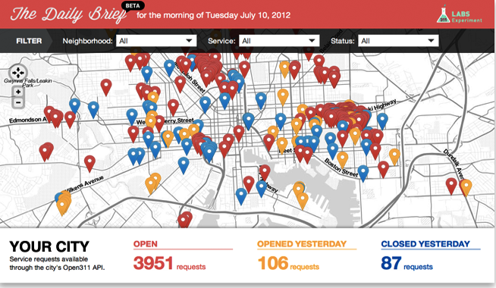
311 DAILY BRIEF
Notes:
311 Daily Brief

Slide 5
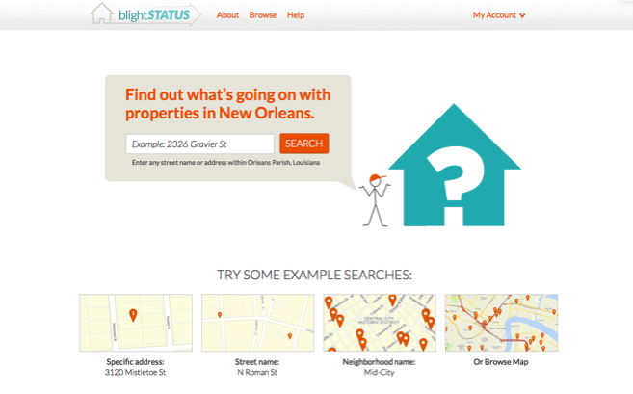
BLIGHTSTATUS

Slide 6
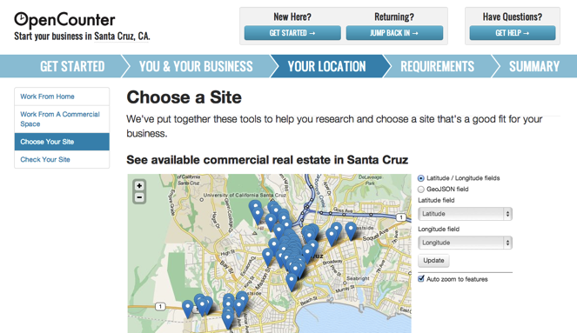
OPENCOUNTER

Slide 7
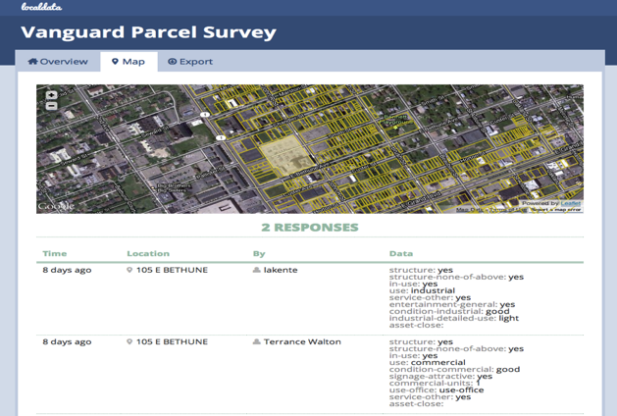
LOCAL DATA

Slide 8
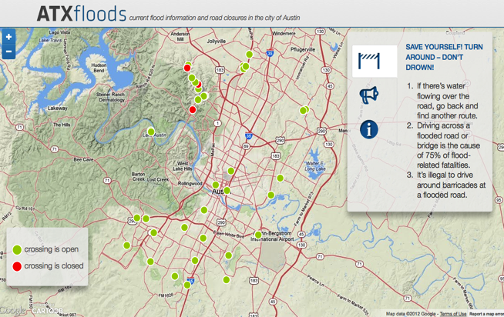
ATX FLOODS

Slide 9
Design Pattern:
Single page applications with embedded services.

Slide 10
Visualization
Service wrappers
Open data

Slide 11
keyword frequency in code
map 5881
address 3616
zipcode 150
street 910
state 6314
lat 1752
lng 346
lon 1374
long 2533
coordinate 409
geojson 836
kml 890

Slide 12
# Provide all the wireless providers within a US census block given a passed latitude and longitude.
BroadbandMap.wireless(:data_version => 'fall2010', :latitude => '38.0', :longitude => '-77.5')
# Provide all the wireline providers within a US census block given a passed latitude and longitude.
BroadbandMap.wireline(:data_version => 'fall2010', :latitude => '38.0', :longitude => '-77.5')
# Returns rankings within nation by specific geo id
BroadbandMap.almanac_ranking_geo_id_within_nation({:data_version => 'fall2010', :census_metric_type => 'population', :ranking_metric => 'wirelineproviderequals0', :geography_type => 'county', :geography_id => '01101', :sort_order => 'asc'})

Slide 13
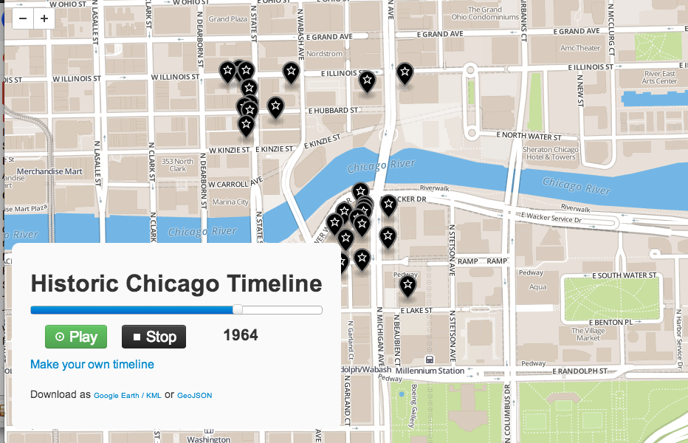

Slide 14
Technology:
Scripting languages
Web frameworks
External services

Slide 15
Javascript 102
Ruby 66
Python 34
PHP 34
Objective-C 4
Java 2
ActionScript 1
CoffeeScript 1

Slide 16
Generic web frameworks:
ruby-on-rails
sinatra
PHP
node
drupal
django

Slide 17
Services:
Google Maps
CartoDB
MapBox

Slide 18
Data Driven:
Statistical tool chain
Javascript libraries

Slide 19
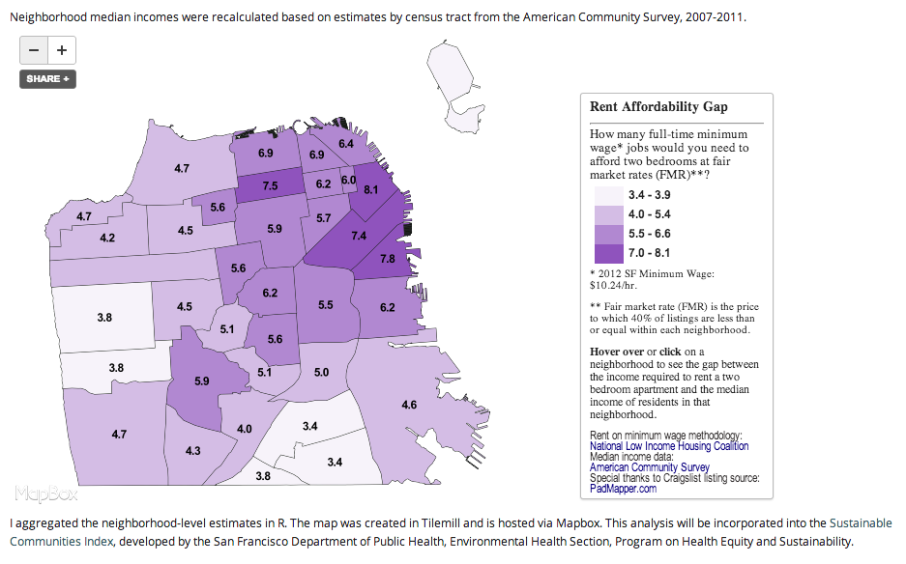

Slide 20
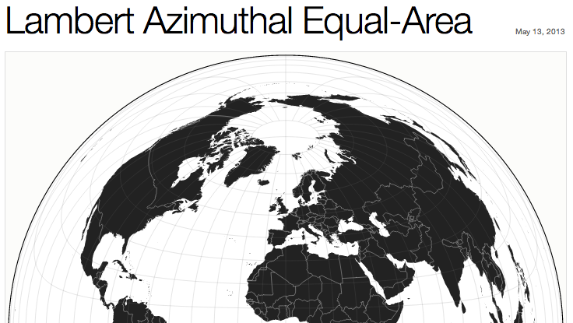

Slide 21
Impacts:
Demise of GeoSpatial Stack
Rise of geospatial services
Application focus over geo

Slide 22
Future stuff:
Moar services!
gecoding & routing
Imagery
where am I?
Weather
water & mineral rights
real-time crime

Slide 23
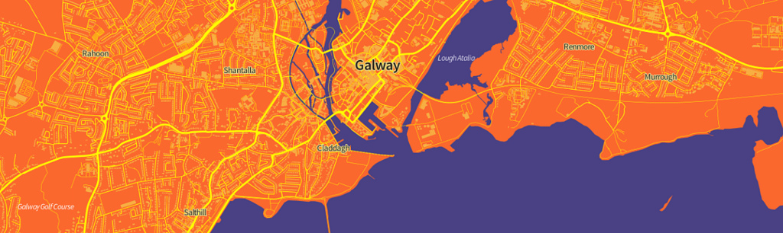
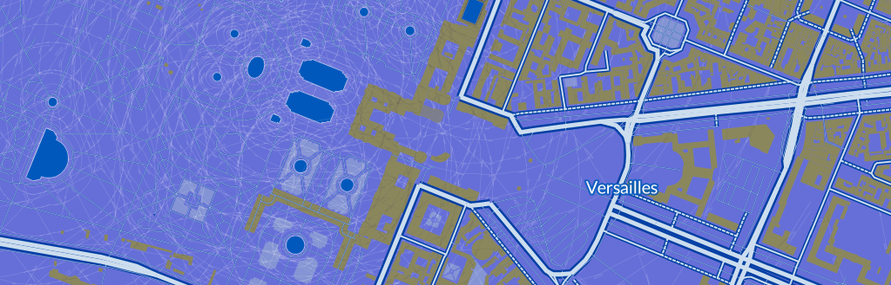

Slide 24
Sophia Parafina
sophia@codeforamerica.org
@spara

