Slide 1

HAZOP Analysis
Using This Funky Spreadsheet I Made in My Back Yard
Brenda Larcom
2010-12-11
Notes:
Why I’m qualified to speak to this topic:
I write threat models for a living.
I’m the lead developer and half of the brain trust for Trike, an open source threat modeling tool and methodology.
I’ve been doing threat modeling, and working on threat modeling methodologies, since 2001.
I’ve mentored many experienced and inexperienced threat modelers, and reviewed many threat models.
This is a detailed how to talk. You’ll walk out of here being able to do the basics of HAZOP analysis.

Slide 2
What – Overview
What is HAZOP analysis?
HAZOP = Hazardous Operations
Systematic method for identifying which variations in a process need to be mitigated for safety
Repurposed for security
Partially replaces threat and attack trees
HAZOP analysis results include threat tree leaf nodes
Notes:
Leaf nodes are all you can mitigate anyway.

Slide 3
What – Fair Warning
What do you mean, “in your back yard”?
Very complicated spreadsheet
All formulas, no macros
Incomplete compatibility testing
Mac OS X with Excel 2008: Known good
Windows with Excel: Working, but ugly
OpenOffice and others: Please report back if you try it
No help yet
Performance issues
Recent complete rewrite

Slide 4

Where
I want it now so I can play with it while you talk!
http://www.octotrike.org/

Slide 5
Why
Why is HAZOP analysis better than threat trees?
Division of labor
System analysis vs. security analysis
Effective use of minions
Quality
Experienced folks find more holes
More consistent quality
Easily reviewable
Speed
Less work to get the same results*
* If you were missing more than 50% before, you will probably have to do more work.

Slide 6
How – Process Overview
What do I do?
Preparation
Set security objectives (Actors, Data Model, Intended Actions, Threats, Security Objectives)
Document static architecture (e.g. data flow diagram; optional for HAZOP)
Document use case or other sequence of steps (Actors, Data Model, Use Case Details A-L)
HAZOP analysis
Vary each element of each step (Use Case Details M-P)
Analyze meaningful variations for security implications (Use Case Details Q-AE)
Use HAZOP analysis results
Plan mitigations
Plan implementation reviews
Notes:
There’s a whole slide about using the results, coming up later.

Slide 7
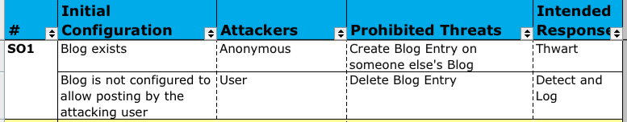
What – Example Overview
What should it look like before I start?
7

Slide 8
What – Example Overview
What should it look like before I start?
8
Notes:
Yes, this is a rather old example.

Slide 9
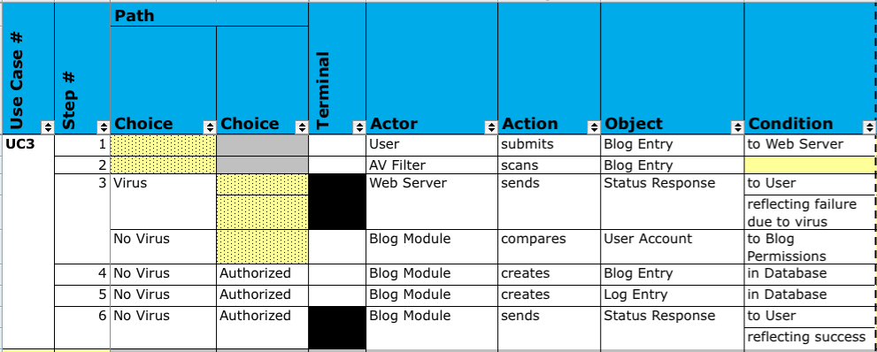
What – Example Overview
What should it look like before I start?
9

Slide 10
How – Varying a Step
I assembled all that stuff. How do I get started?
Pick a step
Pick an element
Actor, Action, Object, or Condition? (Use Case Details M)
Pick a guide word
NO, AS WELL AS, PART OF, OTHER THAN, MORE, LESS, BEFORE, AFTER (Use Case Details N)
Figure out what this variation means, if anything
Document all meanings (Use Case Details O and P)
Productivity tips
Vary elements in the same order each time
Apply guide words in the same order each time
Vary depth-first (all guide words for one element, then all for the next element)

Slide 11
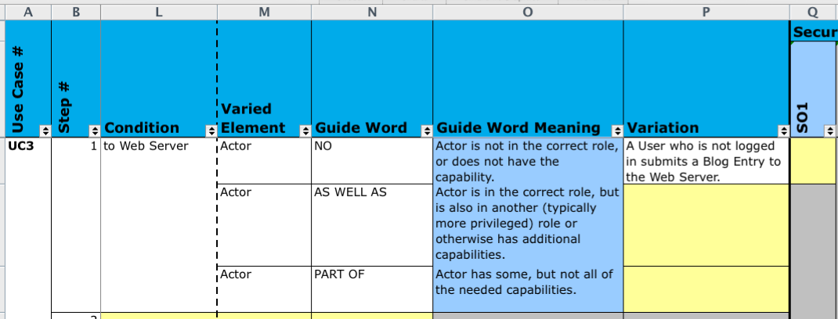
What – Example Variation
How should varying a step turn out?
11

Slide 12
How – Analyzing a Variation
I’ve got a variation. Now what?
Can this variation help an attacker?
Decide separately for each security objective (Use Case Details Q-AC)
If the variation can help an attacker, can an attacker* cause or influence it? (Use Case Details AD-AE)
* Not necessarily the same attacker. Assume collaboration!
Productivity tips
Finish all variations for a step (maybe even use case) before analyzing variations

Slide 13
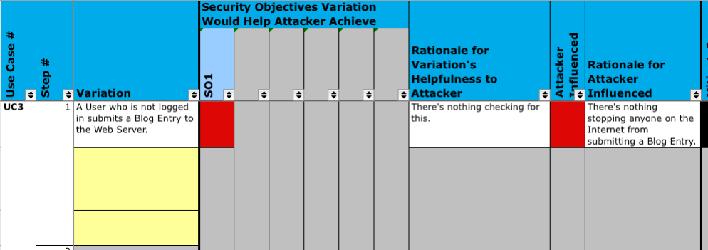
What – Example Analysis
How should analyzing a variation turn out?
13

Slide 14
How – Shortcuts
Isn’t that going to be awfully repetitive?
Factor common portions of use cases out into a separate use case
Don’t document variations that won’t get you anything
Variations that are equivalent to earlier variations
Variations you know are not helpful to an attacker, or not controllable by an attacker*
Claim that variations you know are pure implementation issues are not attacker-influenced
* This has a reviewability penalty and may cause you to miss issues; do 3-10 use cases before you try it.

Slide 15
How – Reviewing
My minion just showed up with a first draft. Now what?
Refresh your memory of the security objectives
Are variations that appear clear and meaningful?
Do all interesting variations appear?
After you have reviewed 6-12 models, save time by checking this last
Are variations that appear analyzed correctly?

Slide 16
How – Using the Results
Dude, that’s a lot of data.
Plan and prioritize mitigations (Use Case Details AF-AI)
Plan implementation reviews
Security code reviews (Use Case Details some from AE, some from AG)
Security test coverage (Use Case Details some from AG)
Penetration tests (Use Case Details AD-AE, some from AF-AI)
Notes:
Have a plan for how you will use the results before you create them, so that you don’t do more work than necessary creating results.
Mitigate design flaws while you can.

Slide 17
Who – Contacts and Credits
Where shall I send gin & tonics?
trike-devel@lists.sourceforge.net
http://www.octotrike.org/
Trike team
Brenda Larcom
Eleanor Saitta
Academics who extended HAZOP for security, notably
Thitima Srivatanakul, John A. Clark and Fiona Polack from University of York
Our open-source-friendly employer
Stach & Liu

