Slide 1

Evaluation of Cities for a Tutoring Business Applied Data Science Capstone by IBM, Course 9
SUDHA KOLATHU PARAMBIL JUNE 7, 2019

Slide 2
Table of content
Some students prefer to have extra coaching out of the classroom to achieve their ideal GPA.
There are several tutoring centers available close to schools to help such students to achieve their goals.
Analyze the accessibility of a tutoring center between two different cities to decide where to start a Tutoring center to help those students who need extra coaching.
INTRODUCTION
DATA/CLEANSING
METHODOLOGY
ANALYSIS
CONCLUSION
FUTURE PLAN
REFERENCE

Slide 3
Source of Data and cleansing data
construct an URL to send a request to the Foursquare API to search for schools in the city of Roseville in California in a radius of 15000 meters.
convert the result in JSON file into a Pandas dataframe.
filter the columns as name, categories, address, distance, lng and lat.
filter the rows which has Elementary, Middle and High school.
delete the rows which has null cells.
rename the column heading ‘name’ to ‘RosevilleSchools’ and ‘categories’ to ‘Type’.
repeat the similar procedure to explore the tutoring centers in Roseville.
follow the above procedures for Columbus city in Ohio.

Slide 4
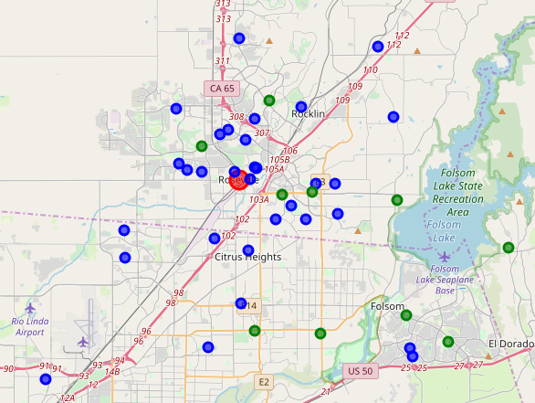
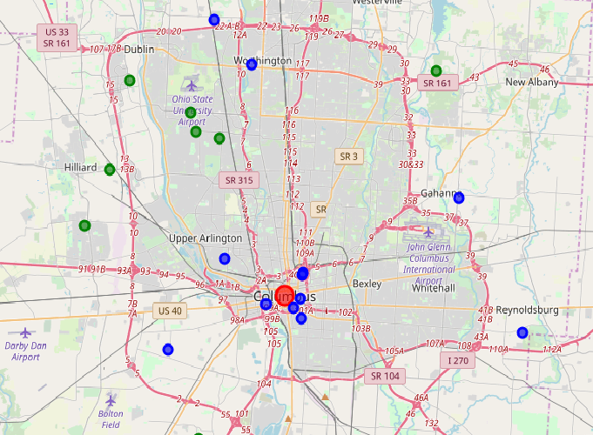
Roseville, CA Columbus, OH
.
Main City School Tutoring Center

Slide 5
Methodology and analysis

Slide 6
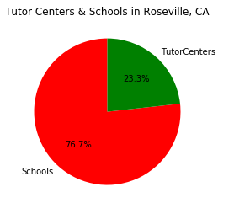
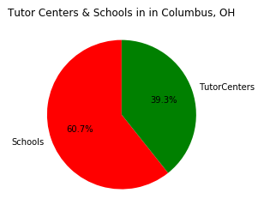
Roseville, CA Columbus, OH
.

Slide 7
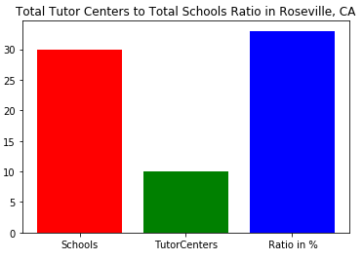
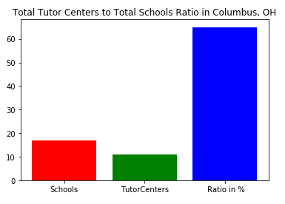
Roseville, CA Columbus, OH
.

Slide 8
RESULTS
 | Roseville CA | Columbus OH
Schools | 33 | 17
Tutoring Centers | 10 | 11
Tutoring Centers to Schools Ratio | .30 | .65

Slide 9
analysis
Tutoring center to school ratio in the Roseville is smaller than Columbus.
So, choose Roseville as the city for the new tutoring center.
Choose the appropriate location using centroid which has more schools.

Slide 10
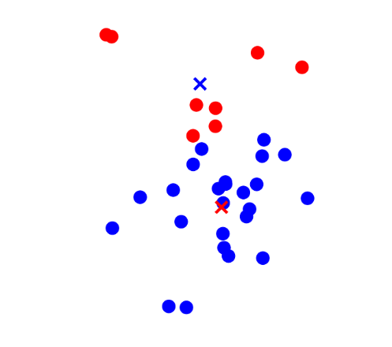
methodology
Use K-mean to find two centroids of the schools in the city to identify two possible locations in the city.
I mapped the schools and tutoring center and centroid to make a decision.

Slide 11
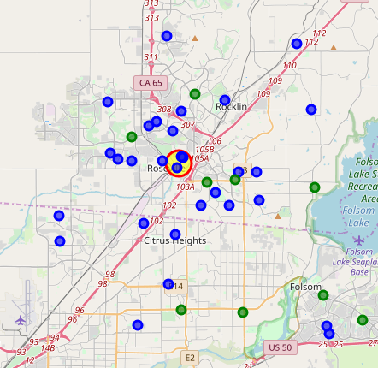
Proposed location of the tutoring center in Roseville, Ca

Slide 12
conclusion
Proposed location of the Tutoring center
Suggested location for the New tutoring center is at latitude 38.75477366246383, longitude -121.29437221487791.
Schools near by the new Tutoring center
There are three schools near with 500 miles

Slide 13
FUTURE PLAN
Find the SAT/ACT scores or any standardized exam score of the of students in three close by schools.
Find the total number of students in the three close by schools.

Slide 14
references
Foursquare API
Pandas and numpy
Folium
Jupitar notebook
GitsHub
Geopy
References and requirements

