Slide 1

Getting the Grade
Affordably Improving the Energy Efficiency and Carbon Emissions of Buildings in NYC

Slide 2
Agenda
1
Story
2
Problem
3
Solutions
4
Current Status
5
Goals
6
Needs
‹#›
Notes:
A brief intro of the project team, relevant background & qualifications, and the inspiration behind the project idea.
The problem you are working to solve.
The solution you are building.
The current status of your project.
What you’re hoping to accomplish next for your project. What additional milestones & goals you have yet to achieve.
What additional support you might need, including a) more collaborators (possible skills gaps); b) feedback; c) promotion; d) something else.

Slide 3


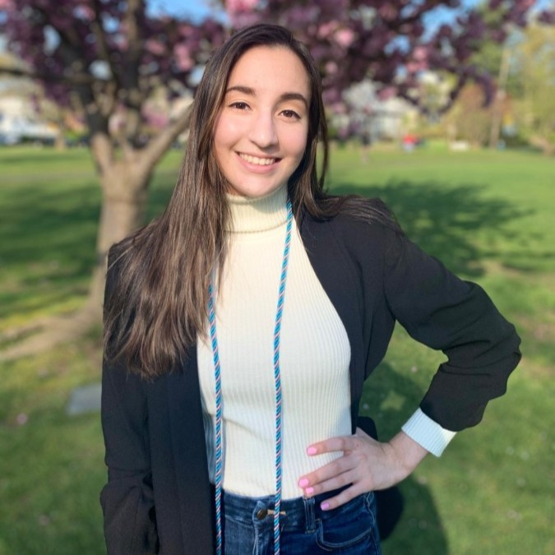





Project Team
Justin Seret
Sara Pardee
Sofia Fernandez
Rod Mobini
User experience researcher, human factors engineer, and educator with experience across the medical technology sector.
Recent graduate from Johns Hopkins with a focus on mechanical and environmental engineering.
Software engineer with experience in big tech, looking to transition into climate tech
Engineering leader dedicated to using teamwork, science, and technology.
Marina Rayman
Cecilia Cheng
Yujia Han
Theo Manton
Senior strategist with diverse financial services experience across public and private asset classes, product advocacy, business management, technology and senior stakeholder engagement.
Operations strategist with consulting experience for financial service organizations, project management and finance operations
Researcher specializing in sustainable finance, energy policy, and development economics.
Frontend-leaning software engineer with a strong sense of design.

Slide 4
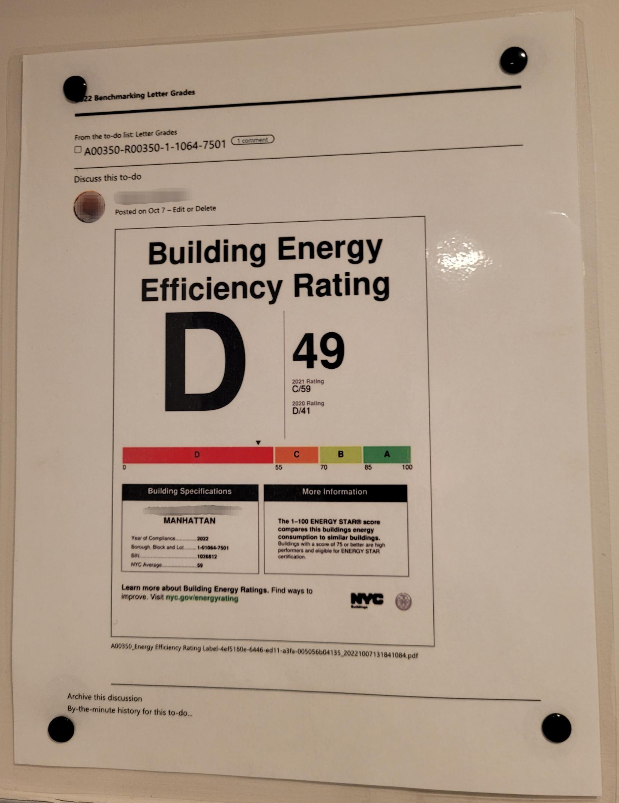
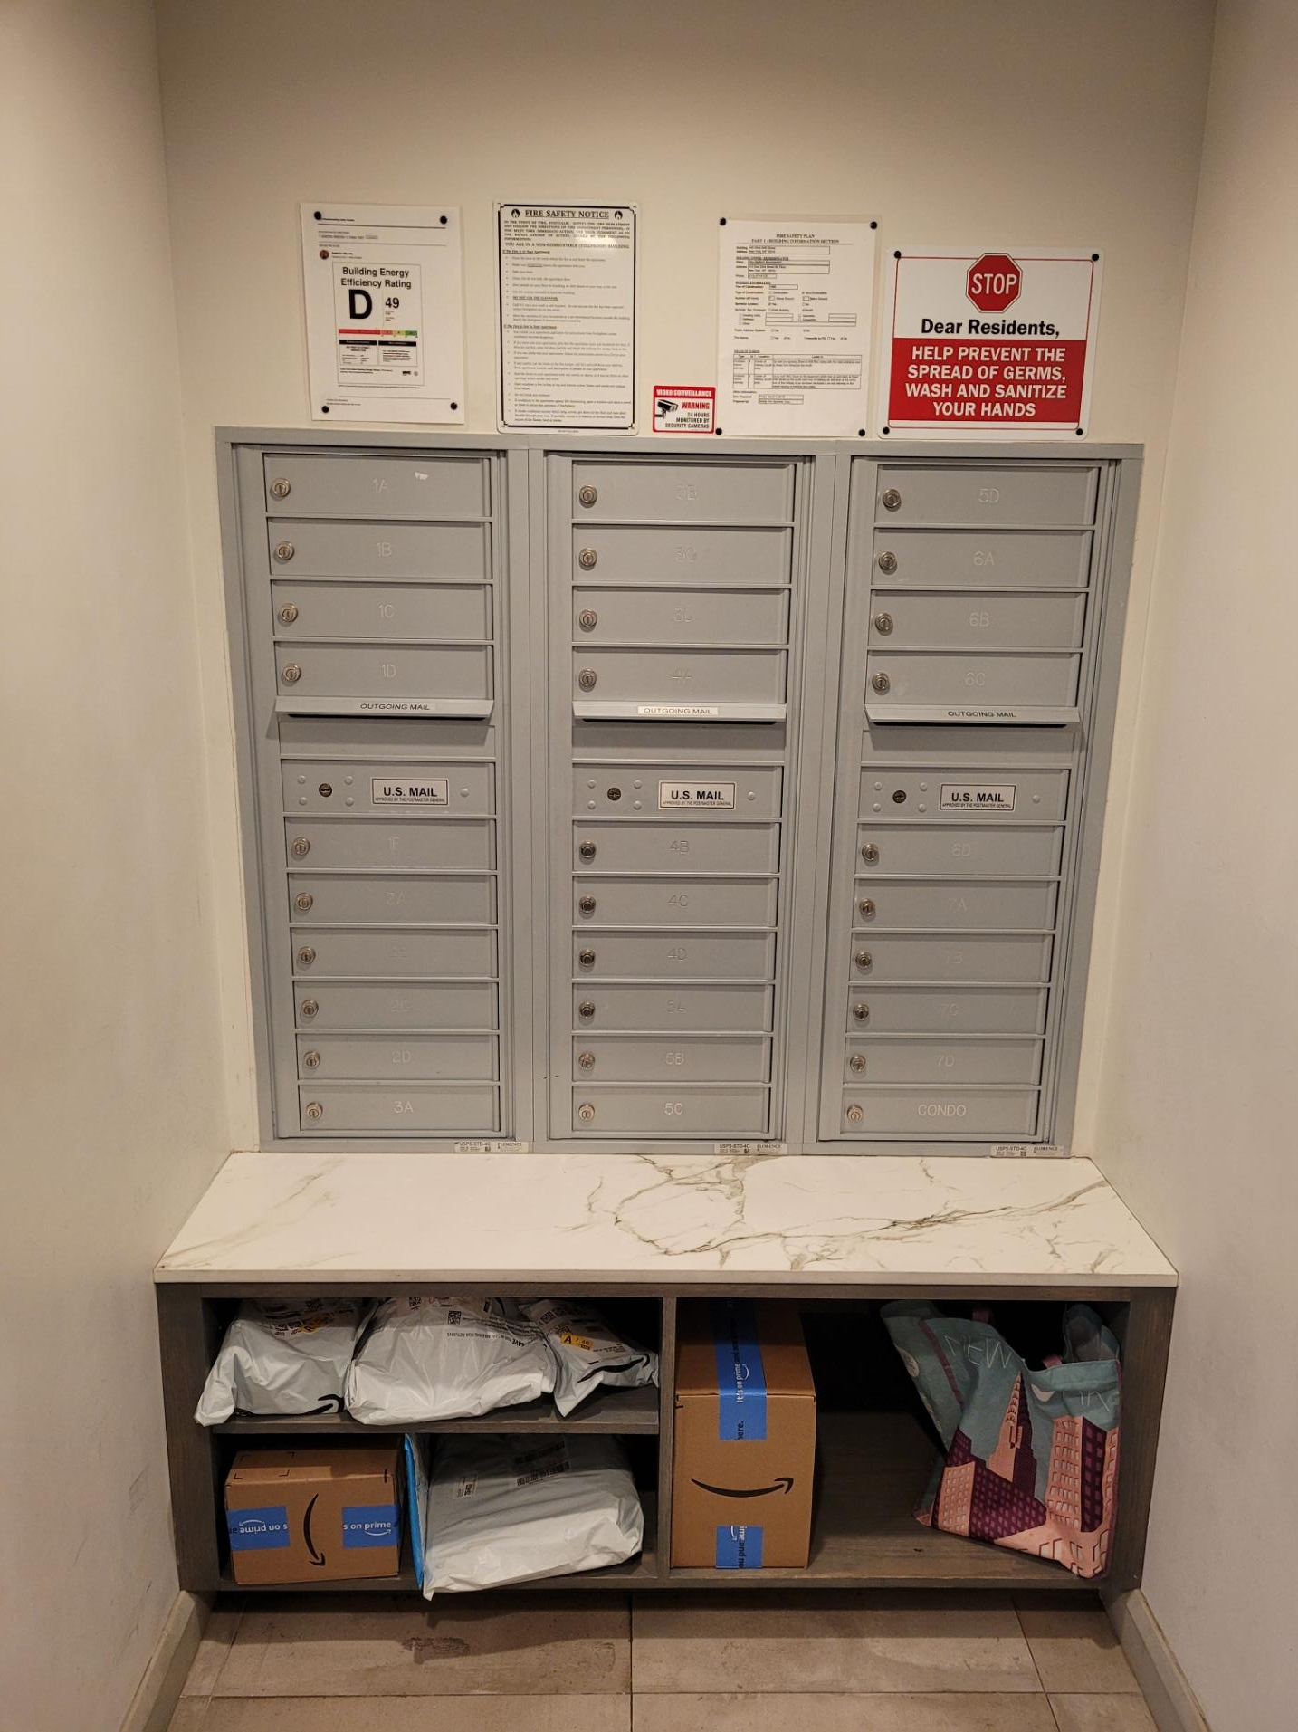
Inspiration

Slide 5
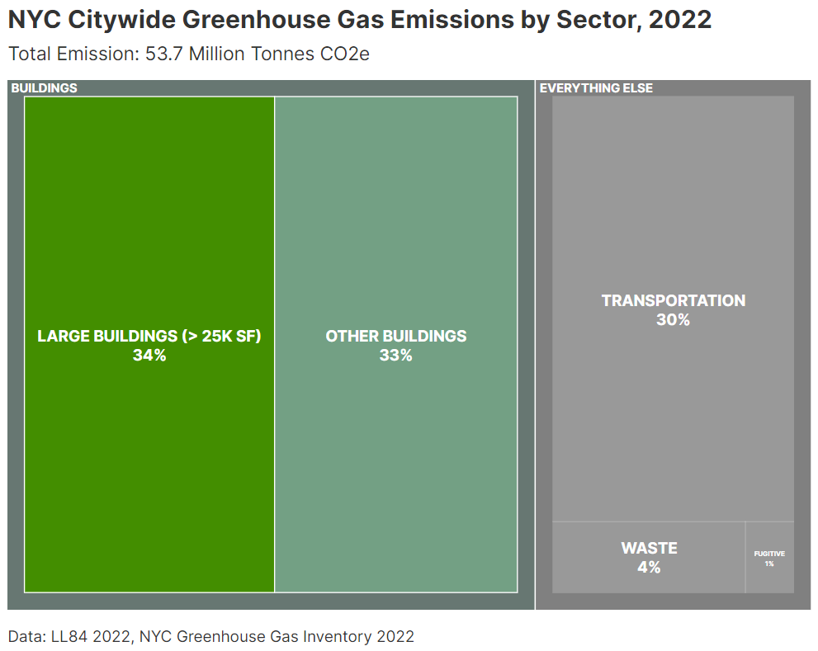
About two thirds of greenhouse gas emissions in NYC come from buildings.
Notes:
About two thirds greenhouse gas emissions in NYC come from buildings.
Other leading sources include transportation, waste, and fugitive emissions.

Slide 6
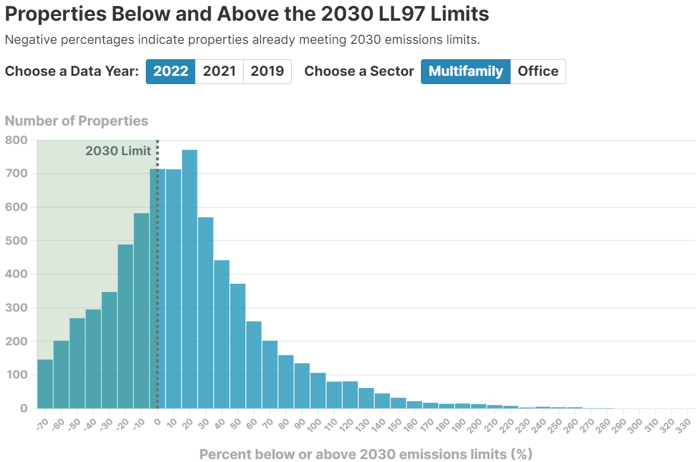
Most buildings do not meet NYC emissions limits.
65%
Of all buildings in NYC do not meet 2030 emissions limits.
Local Law 97, part of New York City’s Climate Mobilization Act of 2019, is one of the country’s boldest climate laws.
Goal: cut building carbon emissions by 40% by 2030 and reach net-zero by 2050 by setting progressively lower caps.
Nearly two thirds of all applicable buildings (> 25,000 sq. ft.) do not meet 2030 emissions limits.
Several other cities (e.g., Seattle, Boston, and Washington, DC) are enacting similar emissions laws and standards.
Notes:
Local Law 97, part of New York City’s Climate Mobilization Act of 2019, is one of the country’s boldest climate laws.
Its goal is to cut carbon emissions by 40% by 2030 and reach net-zero by 2050 by setting increasingly stringent limits on the city’s biggest polluters — buildings.
Goal: cut building carbon emissions by 40% by 2030 and reach net-zero by 2050 by setting progressively lower caps.
Several other cities (e.g., Seattle, Boston, and Washington, DC) are enacting similar emissions laws and standards.
But 65% of all buildings do not.
For example multifamily residential buildings will have the following limits:
2024: 6.75 kgCO₂/ft²
2030: 3.35 kgCO₂/ft²
2040: 2.05 kgCO₂/ft²
2050: 0 kgCO₂/ft²
Sources:
https://www.withum.com/resources/planning-for-new-york-citys-carbon-tax-local-law-97-explained/
https://www.urbangreencouncil.org/wp-content/uploads/2022/11/2019.06.18-Urban-Green-Retrofit-Market-Analysis.pdf

Slide 7
The problem:
Many buildings cannot afford the upgrades needed to meet NYC emissions standards for 2030 and beyond.
Notes:
Many residential buildings in New York City cannot easily afford the upgrades needed to meet the requirements of Local Law 97.

Slide 8
Solution: provide consultative and project management services to help buildings make affordable upgrades to reduce emissions.
Evaluate Building Finances
Assess Building Needs
To determine current spending and budget that they can afford
From data about building emission sources and input from building decision-makers
Recommend Upgrades
Navigate Implementation
Based on return on investment from improved efficiency, reductions to emissions, and other secondary benefits
From hiring contractors to applying for rebates, incentives, and financing

Slide 9
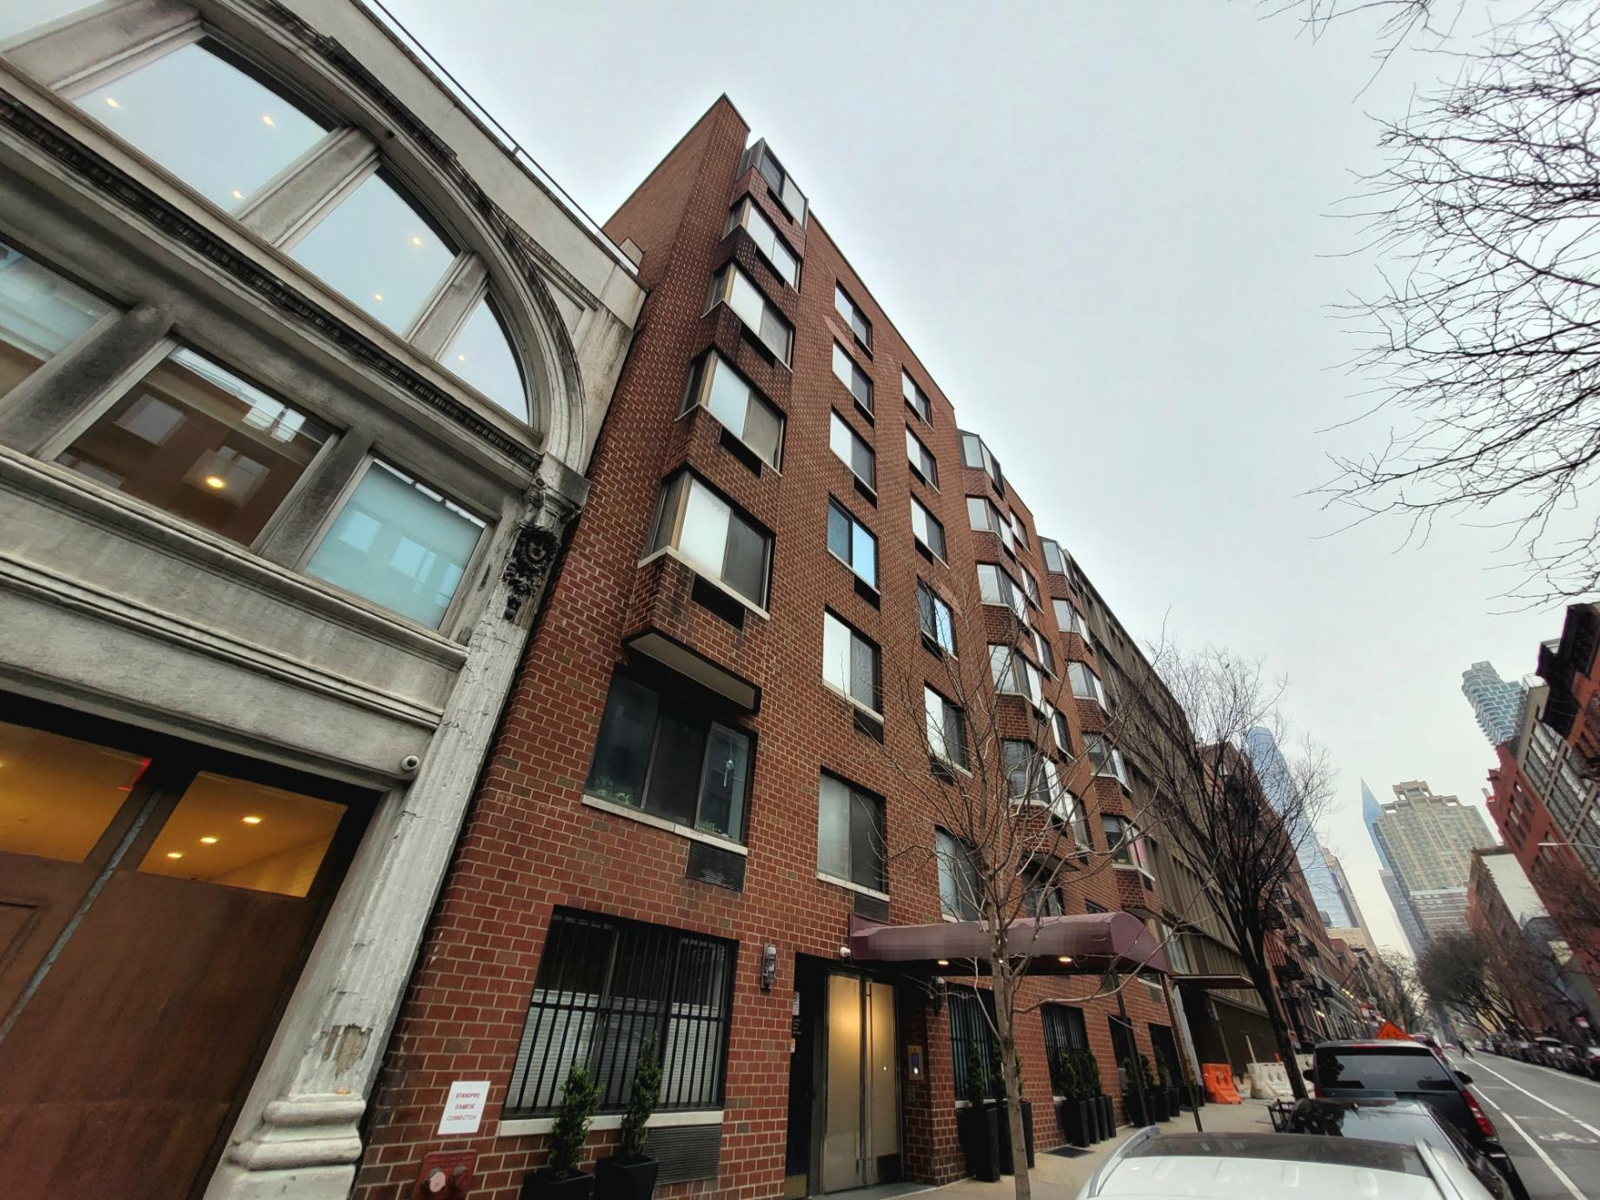
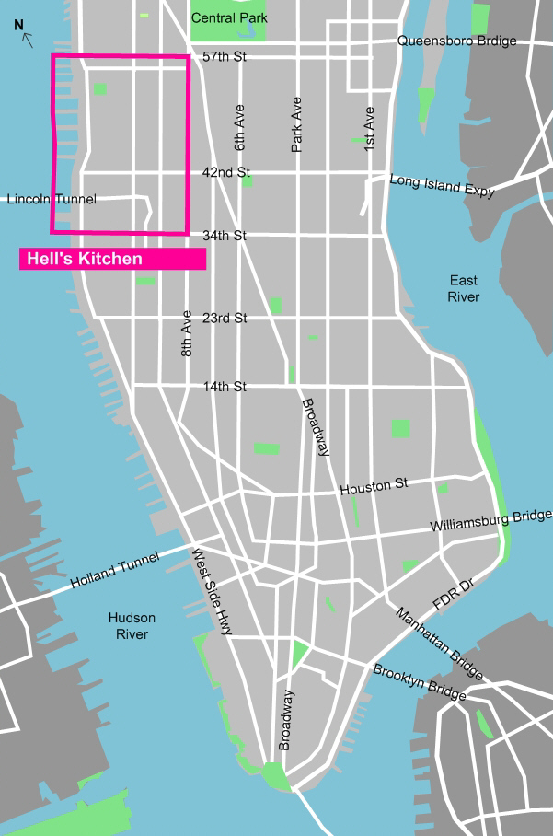
Pilot: Multifamily Building in Manhattan
Notes:
Our initial focus was on a 7-story, 29-unit, 33,000 square foot multifamily residential building built in 1986

Slide 10
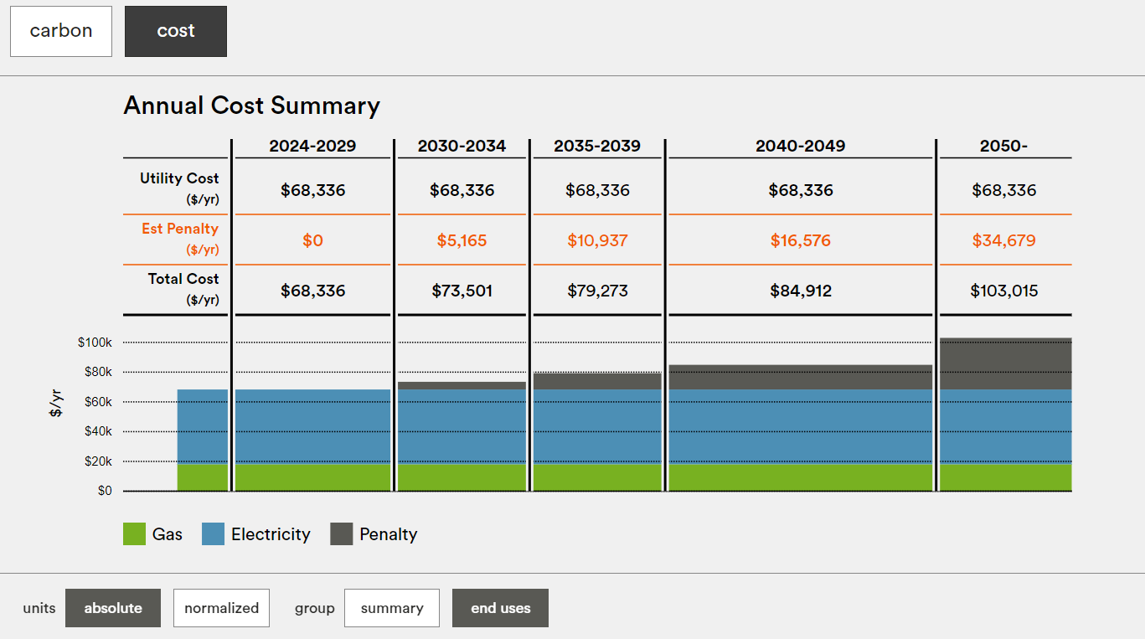
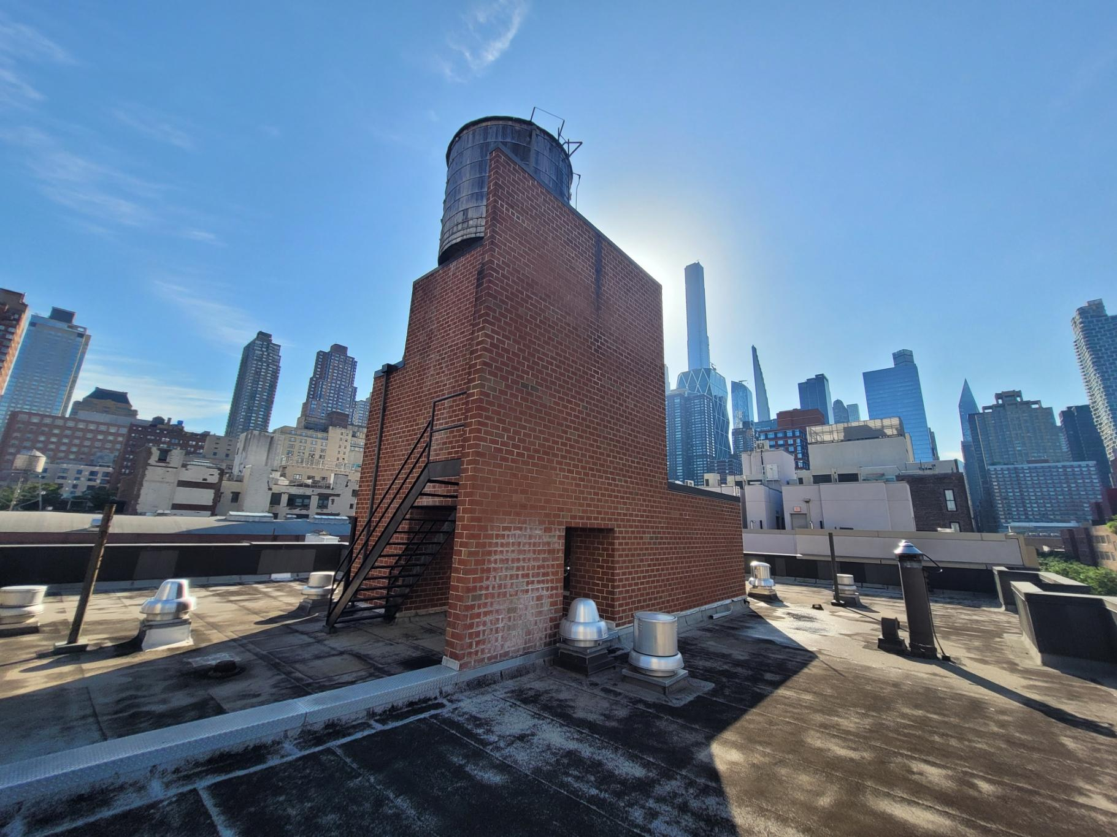
Building-specific needs were also examined and used to guide our initial research
Need: Evaluate the pilot building’s finances and budget for energy efficiency upgrades.
Research Question: What are the biggest expense categories, and where might there be opportunities to reduce costs?
Need: Improve understanding of the building’s energy consumption and opportunities to lower cost of utilities and LL97 penalties.
Research Question: How might we define a target reduction of energy consumption for the building?
Need: Complete renovation of aging building roof and façade while staying on-budget.
Research Question: How might we incorporate energy efficiency improvements into these existing projects?
BE-Ex NYC LL97 Carbon Emissions Calculator
Aging Rooftop of Pilot Building
Notes:
https://www.be-exchange.org/calculator/

Slide 11
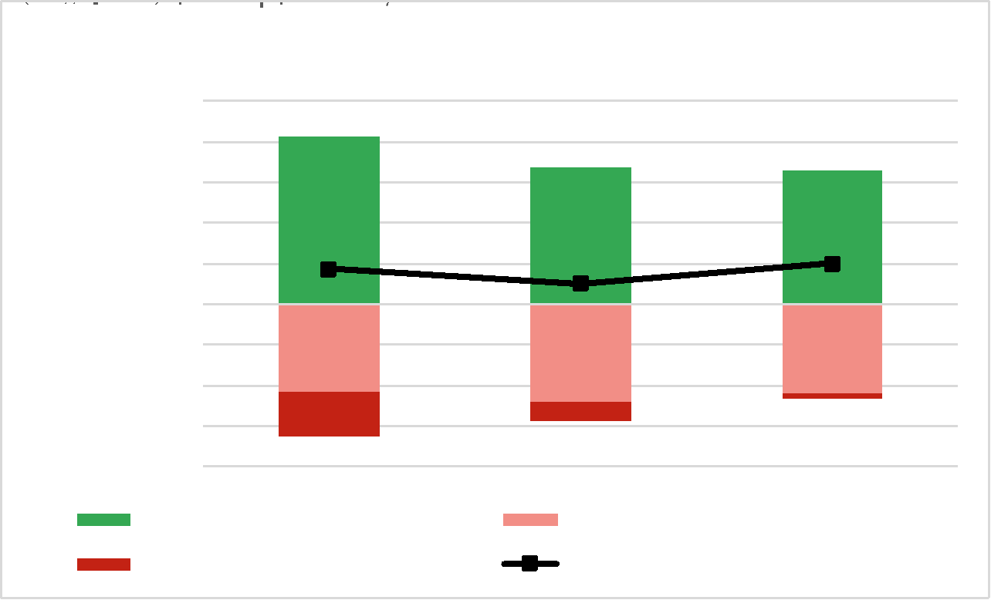
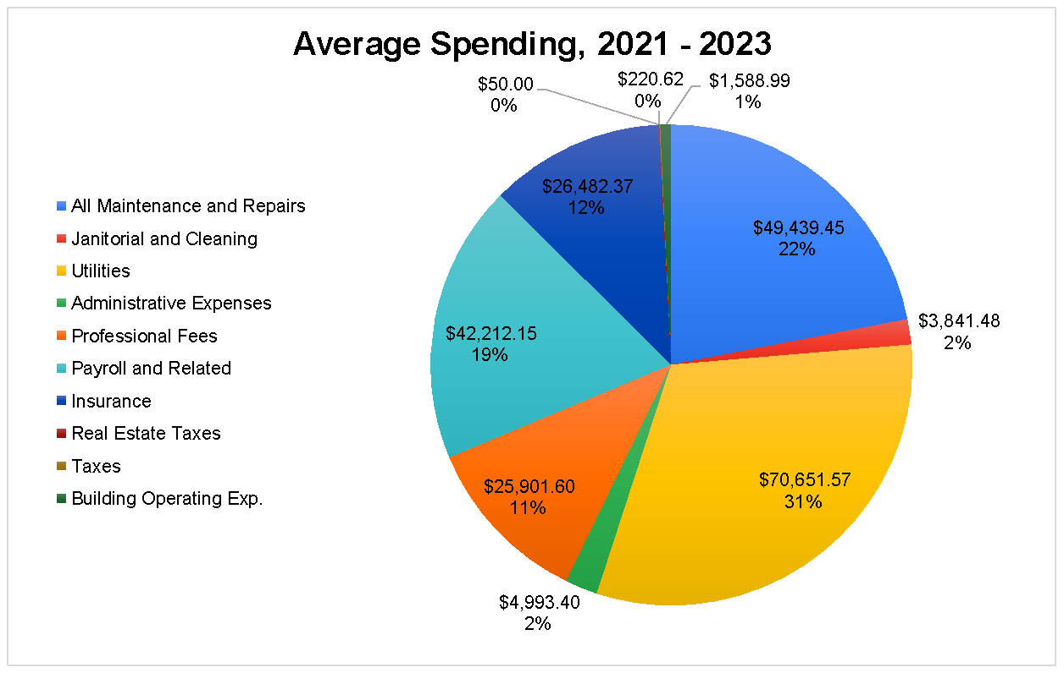
Several savings targets were identified through an evaluation of building finances
Analysis
Reviewed building’s actual expenditures from 2021 – 2023 financial statements to identify potential cost savings
Findings
Average total expenses from 2021 – 2023 were about $225k
Average grand profit was ~$78k
Utilities were the biggest expense category, at about $71k (~33% of total).
About $32k (46%) was for gas
About $20k (29%) was for electricity
About $18k (25%) was for water/sewer
Additional savings might be found in top-ranked expense subcategories
Recommendations
Request additional information from management company about sources of spending in each category/subcategory.
Seek competitive pricing for alternative service providers.
Benefits
Cost savings could be directed toward more energy efficiency upgrades
710-001 Payroll - Wages | $34,189.93
600-003 Gas | $32,280.85
800-998 Insurance | $20,985.37
600-001 Electricity | $20,404.83
705-002 Management Fees | $18,375.00
600-006 Water & Sewer | $17,965.89
500-001 Elevator Maintenance | $8,519.64
510-004 Plumbing Repairs | $8,256.73
500-005 Exterminator | $5,651.33
705-004 Accounting | $5,125.00
510-019 Heating/Cooling Sys Rep | $5,003.85

Slide 12
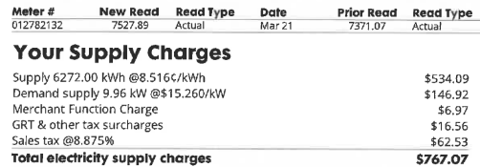
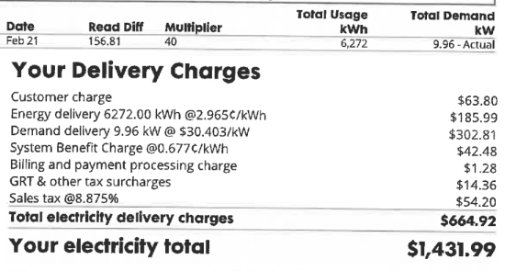
Energy bill analysis showed that “Demand” rates contributed significantly to the building’s electricity cost
Analysis
Averaged gas and electricity consumption and spending for the building’s common areas across the last 16 months
Findings
Average monthly electricity consumption from building common areas was 6,287 kWh. Average monthly cost of electricity was $1,373.
Over 45% of the electricity costs came from electricity consumption billed at "demand" rates, but less than 0.2% of the building’s energy consumption was in the “demand” category.
Per local utility Consolidated Edison (ConEd), if the building consumes less than 5,000 kWh per month, demand rates will be eliminated.
Recommendations
Reduce electricity consumption by 1,300 kWh / month (~20%)
Cancel unused gas supply in ancillary apartment (saving 12 – 24 therms and ~$550 / year)
Perform energy audit to get more details about biggest consumers of electricity within building (e.g., elevator, water pumps, lighting, fans, etc.)
Benefits
Per LL97 conversion factors, the reduction in annual electricity consumption equivalent to emissions reductions of about 643.2 tCO2e per year
Cost savings of up to $10,000 per year could be directed toward more energy efficiency upgrades.

Slide 13
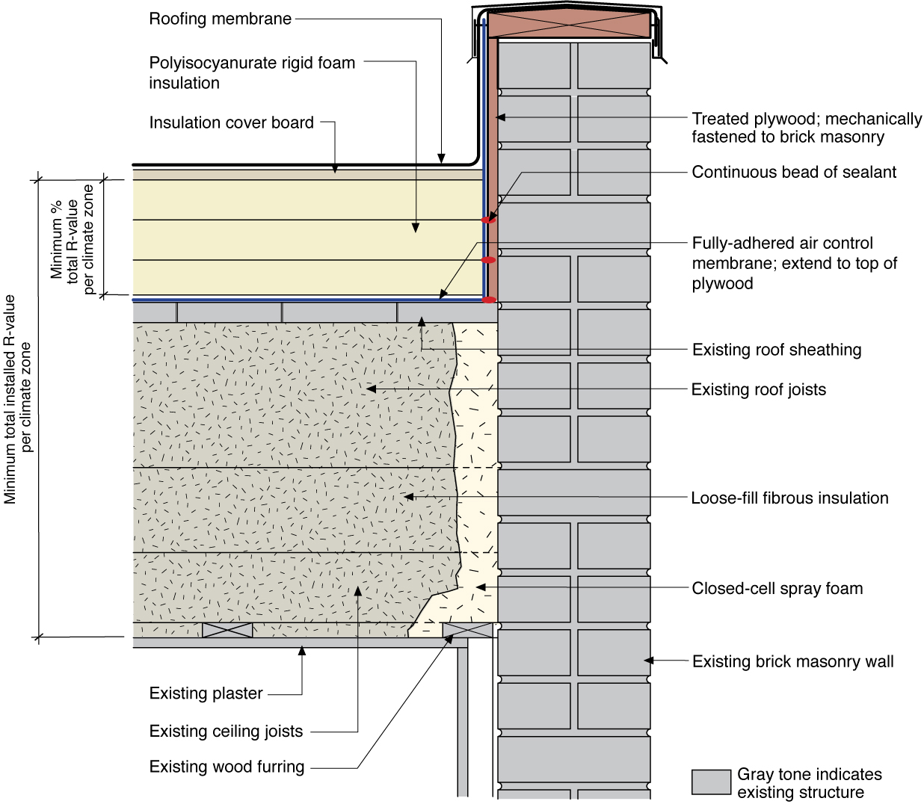
Research on low-slope roofing materials was used to recommend an energy-efficiency approach to planned roof repairs
Research
Characterized thermal and reflective performance of various roofing materials, and calculated estimated energy and cost savings from their use.
Identified roofing incentives through the Multifamily Energy Efficiency Program from ConEd; Multifamily Buildings Low-Carbon Pathways Program from New York State Energy Research and Development Authority (NYSERDA); and the NYC Cool Roofs Program.
Recommendations: use phenolic foam, polyiso, or closed-cell polyurethane insulation in combination with a cool roof coating in final roofing project.
Benefits: up to ~$35k in discounts from incentive programs, with an additional $15k discount if the incentive application package is submitted by June 30, 2024.*
*Calculations of total reductions to energy consumption are pending validation.
Notes:
The diagram at the right shows an existing low-slope (“flat”) roof and brick masonry walls with a new fully adhered air barrier membrane plus polyisocyanurate rigid foam insulation and a roofing membrane water control layer
(source: https://basc.pnnl.gov/resource-guides/low-slope-flat-roofs#edit-group-retrofit)

Slide 14
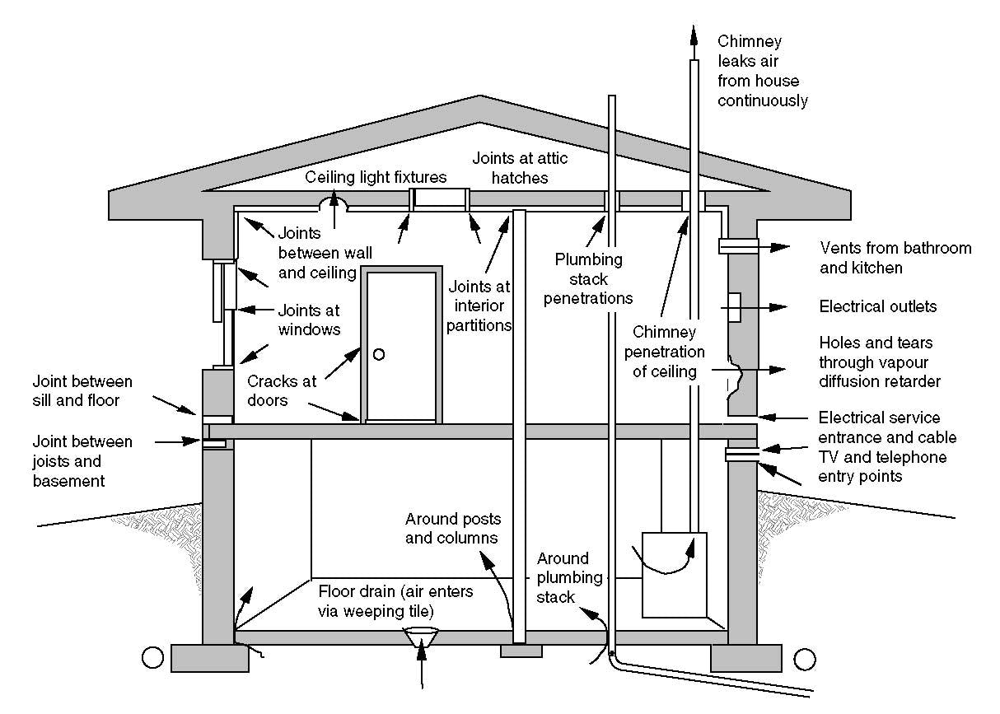
Research on additional envelope upgrades was used to recommend add-on work for planned façade repairs
Research
Profiled various façade-related upgrades (e.g., air sealing measures, wall insulation, thermal bridge mitigation, high performance windows and doors).
Identified additional envelope-related incentives in the ConEd and NYSERDA programs.
Recommendations: perform air sealing around window frames, exterior doors, and louver vents while scaffolding is up and incentives are available.
Benefits: could receive discounts of up to $1400 (plus an additional $3/therm) from air sealing incentives.*
*Calculations of total reductions to energy consumption are pending validation.
Notes:
The diagram at the right shows an existing low-slope (“flat”) roof and brick masonry walls with a new fully adhered air barrier membrane plus polyisocyanurate rigid foam insulation and a roofing membrane water control layer
(source: https://basc.pnnl.gov/resource-guides/low-slope-flat-roofs#edit-group-retrofit)

Slide 15
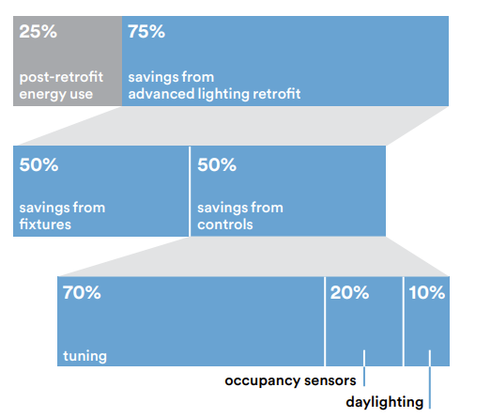
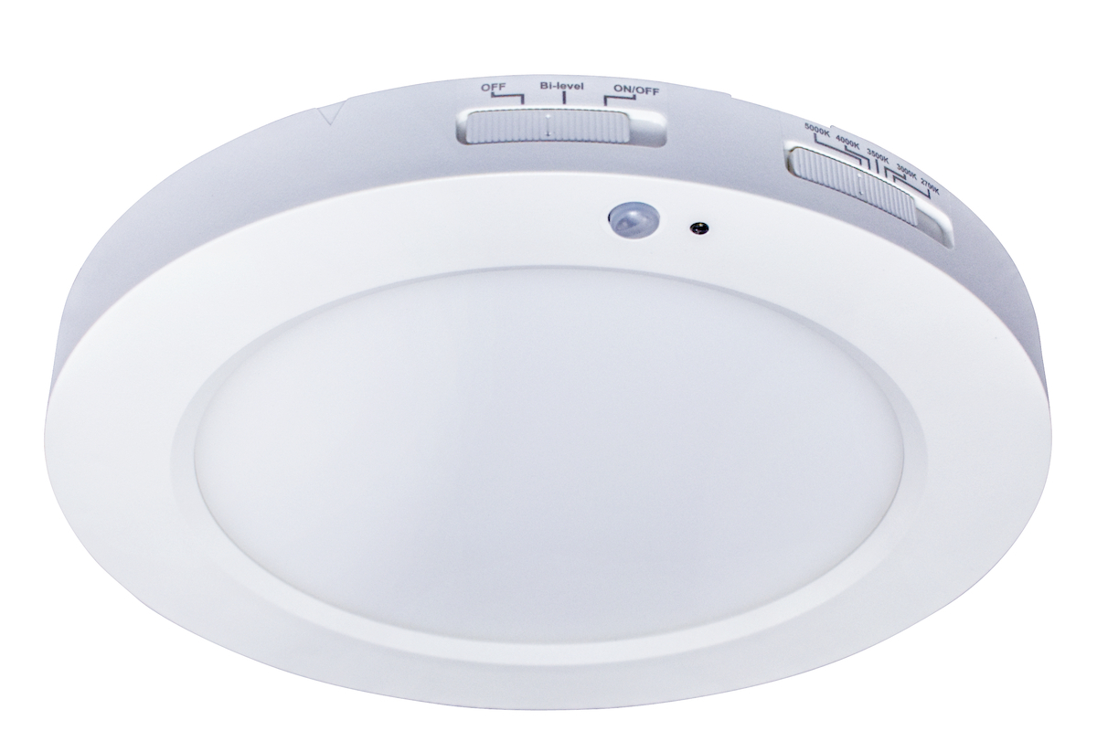
Lighting, lighting controls, and plug loads were also investigated as a solution due to low relative cost
Research
Profiled various lighting upgrades, such as lamp and ballast replacements, fixture retrofits, and advanced sensors and controls
Identified LED lighting fixture upgrade incentives through ConEd’s Multifamily Energy Efficiency and Instant Lighting Incentives programs.
Performed building walkthrough with ConEd-designated lighting contractor to quantify impact of upgrades to bi-level LED fixtures throughout building.
Recommendations
Install bilevel LED fixtures throughout building hallways, stairwells, and other common areas.
Manage plug loads in ancillary apartment, particularly for appliances (e.g., refrigerator).
Benefits
Estimated 80% reduction in lighting-related electricity consumption compared to existing system.
*Calculations of total reductions to energy consumption are pending validation.
Notes:
Image Sources:
https://be-exchange.org/wp-content/uploads/2019/07/20181203_LED-lighting_20210802.pdf
https://www.southwire.com/lamps-luminaires/surface-mount/7-led-surface-mount-round-sleek-profile-13-watt-white-cct-selectable-with-motion-sensor/p/SMD7/RND/13/CTS/MS

Slide 16
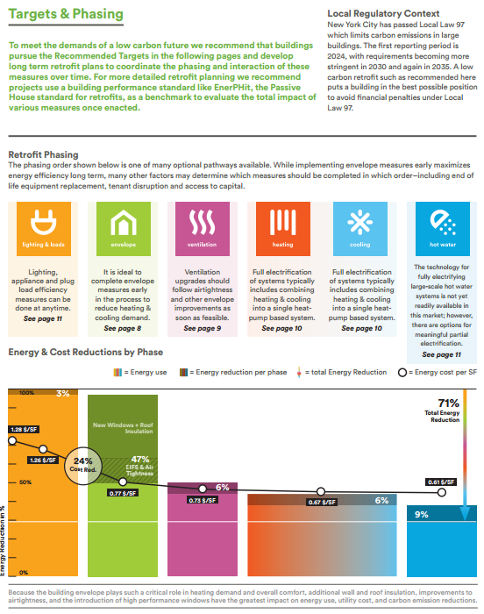
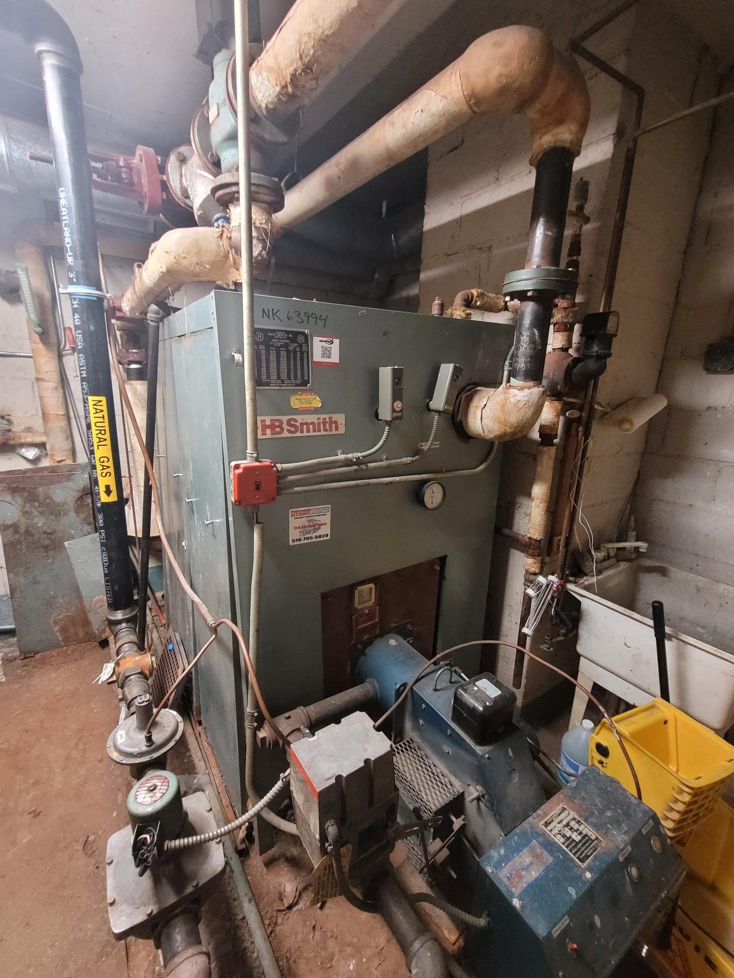
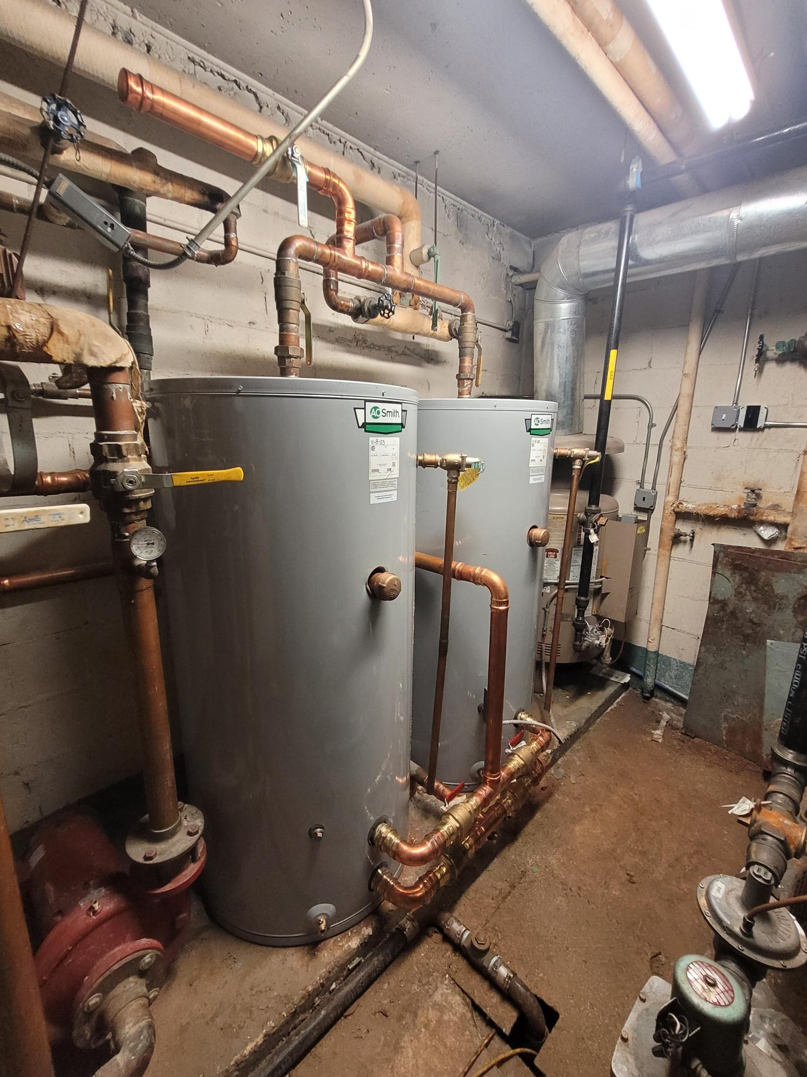
Our next steps are to complete research on HVAC and water heating systems and summarize all findings in a case study
Research Ventilation Systems
Balanced ventilation and energy recovery systems work in tandem with an airtight envelope to manage air intake and recover heat energy that would otherwise be exhausted to the outdoors, thereby reducing energy use.
Need to research available ventilation systems and see which might work best for the building.
Research Heating and Cooling Systems
Heating and cooling is currently provided through an aging natural gas boiler and in-apartment Packaged Terminal Air Conditioners (PTACs)
Need to research available heating and cooling systems and see which might work best for the building (e.g., Heat Pump PTACs, Ductless Heat Pumps, etc.)
Since the boiler is owned by the building and the PTACs are owned by the apartment, additional research will be needed to determine cost-sharing strategies
Project costs have already been estimated based on similar projects.
Research Hot Water Systems
The building also has an aging natural gas water heater
Additional research is needed on heat pump water heaters
The building owns electric water heater units, so it may be worth evaluating a hybrid solution.
Deliverables:
Updated pitch deck for long-term upgrades for pilot building.
Case study on pilot building.
BE-Ex Low Carbon Multifamily Retrofit Playbooks: Post-1980 8+ Stories
Aging Boiler in Pilot Building
Aging Water Heater in Pilot Building
Notes:
Source: https://be-exchange.org/wp-content/uploads/2021/03/Post-80-High-Full-playbook.pdf

Slide 17

Long-term Vision: Expand to Other Buildings and Cities
Background
Expand the model used for the pilot building to a business focused on consulting and project management services to help buildings afford the full range of building upgrades needed emissions standards
Activities:
Research the market (buildings in NYC that are likely to encounter challenges affording LL97 upgrades).
Research potential competitors in the space to identify unoccupied niches and key differentiators.
Build a business plan that includes a profit model and commercialization strategy.
Deliverables:
Written business plan.
Impact:
Emissions reduction the 50,000+ buildings that are held to LL97 emissions standards.

Slide 18
Team-related Needs
Financial professionals, particularly those with experience with navigating building budgets, financing (mortgages, loans, or energy service agreements), or carbon credit purchasing
Marketing or sales professionals, particularly those who have experience with retrofits or upgrades sold to residential buildings (or similar)
Architects, Civil Engineers, General Contractors, and other technical professionals who have experience with technology or materials related to improving building energy efficiency
Examples: HVAC systems, water heating systems, low flow water distribution systems, roof and wall insulation, air sealing, windows, lighting, building automation or energy management systems.
Project Managers
New York City residents, particularly those who live in buildings where energy efficiency upgrades are needed, planned, or being implemented
Any others with a strong interest in the project!
Notes:
Thanks again to everyone for joining – we’ve already got a few people with experience in the categories shown in this slide. If you think of anyone else who might be interested, please let me know.

Slide 19
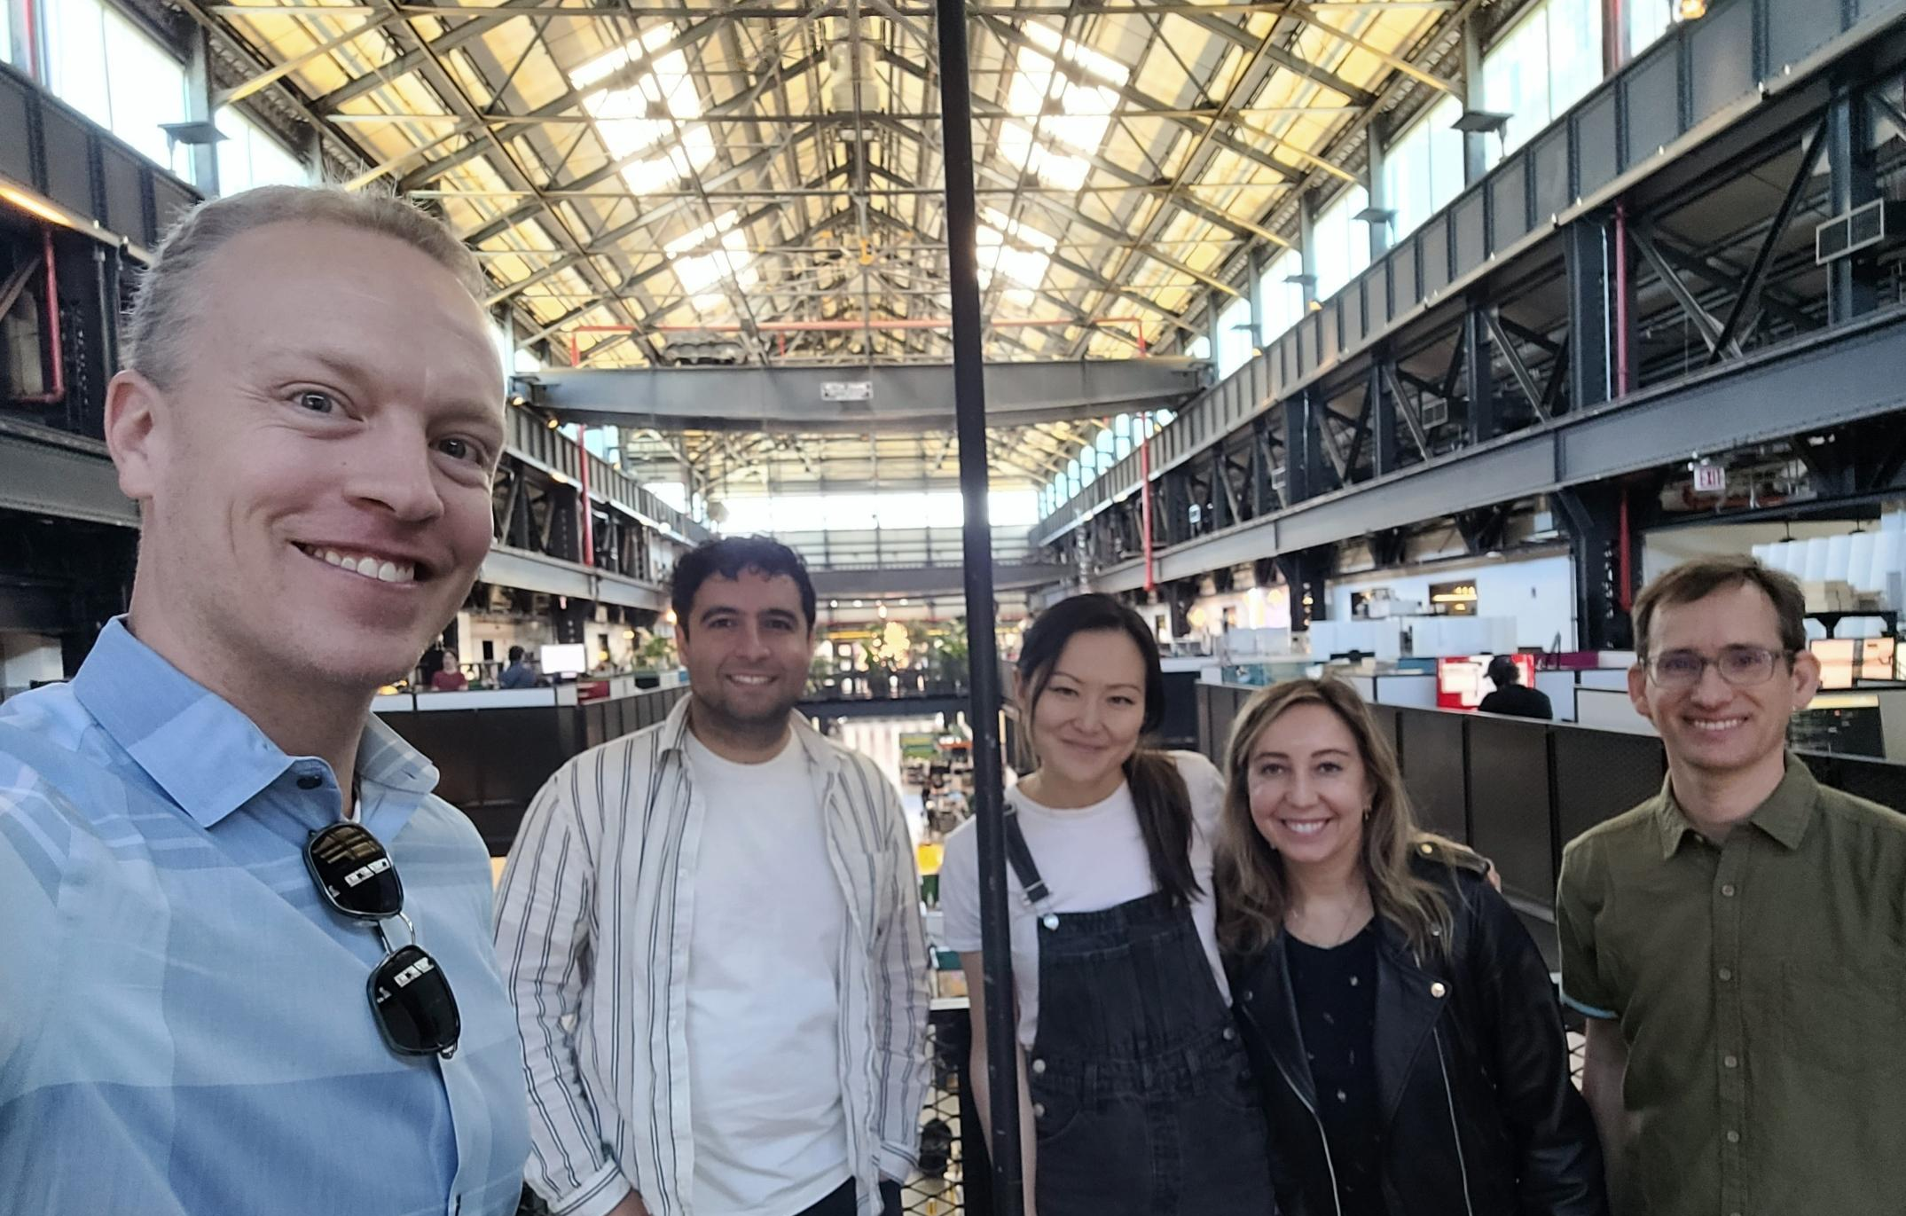



Thanks again to everyone on the team!
(Slightly Edited!) Team Photo at Newlab in Brooklyn Navy Yard

