Slide 1
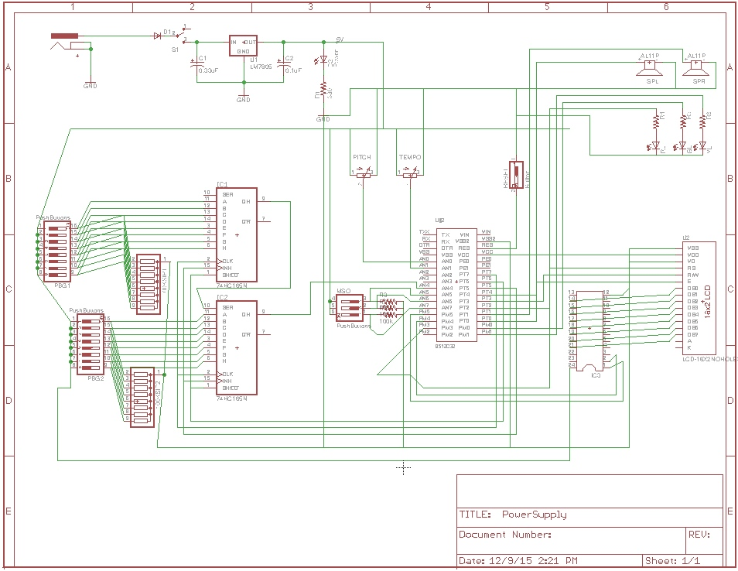
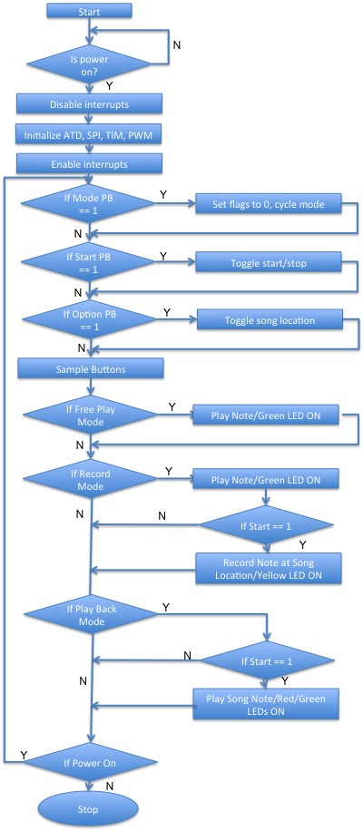
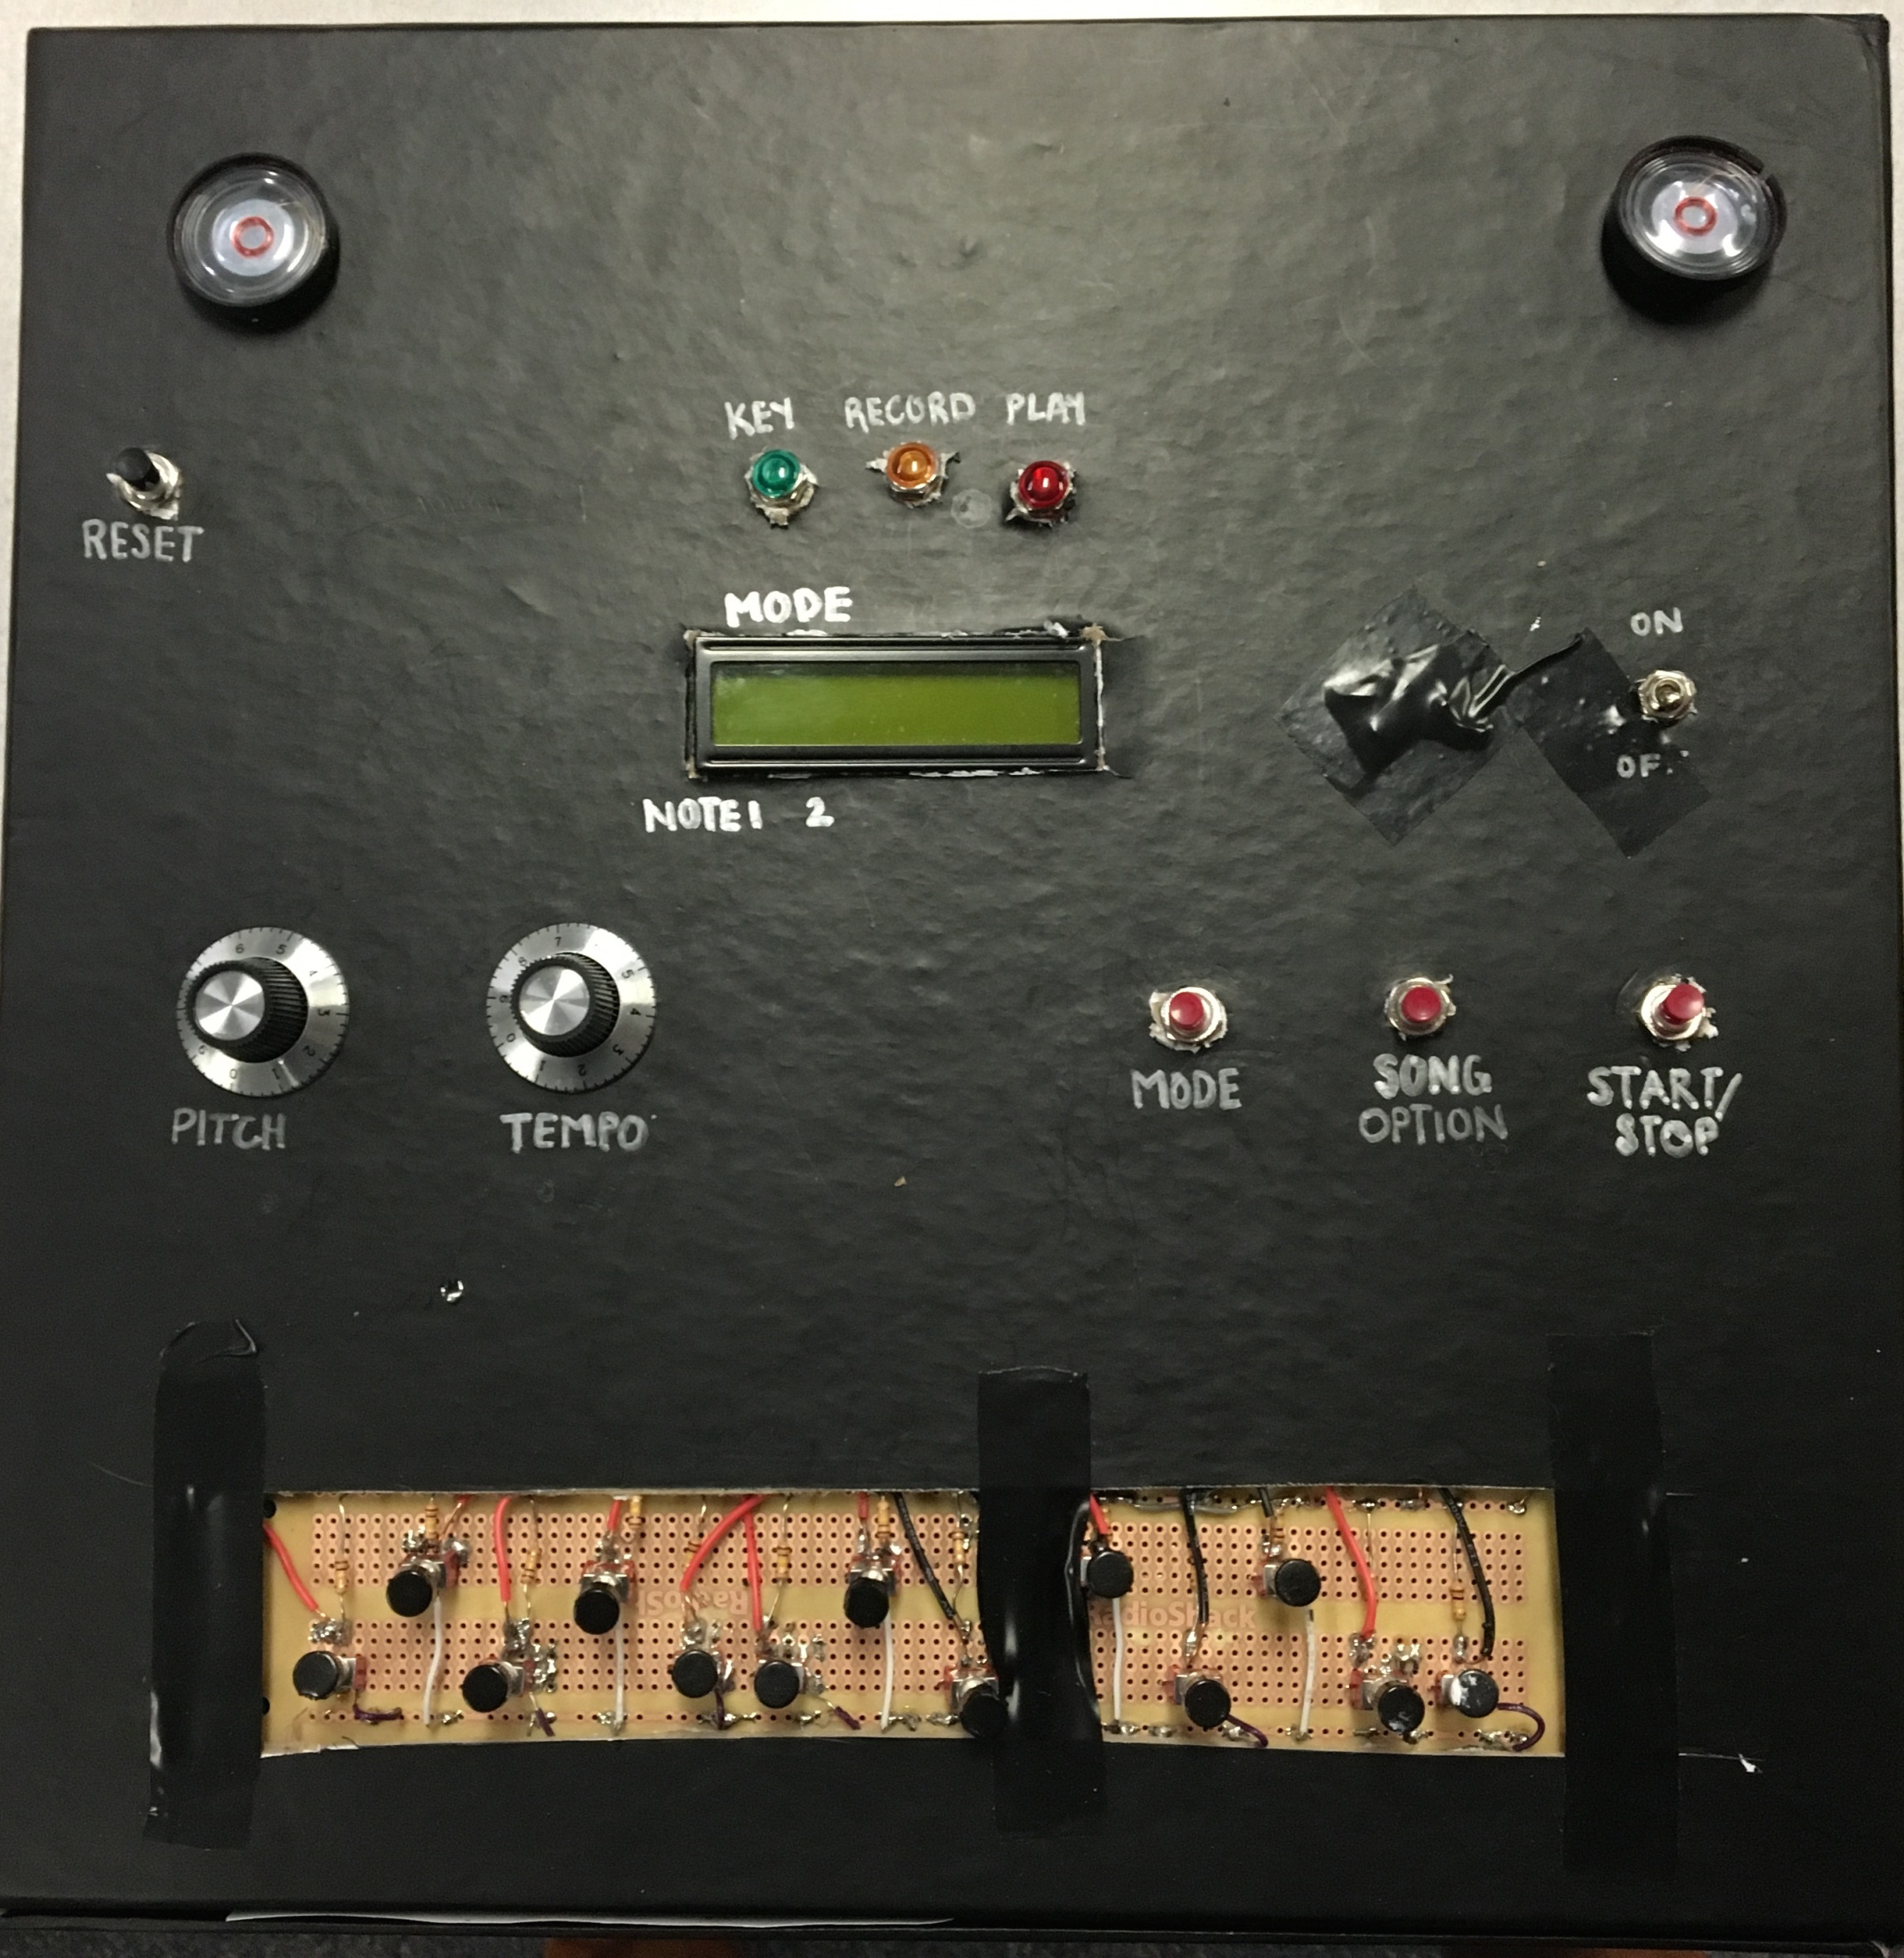
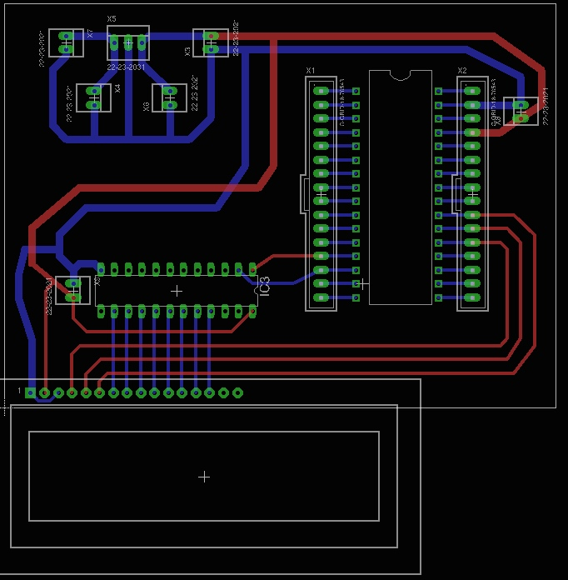

ECE 362 Embedded Microcontroller Mini-Project − Fall 2015
Team 19 – Musical Piano – Sid Parida, Kylie Broton, Mark Brooks
Schematic
Piano
This musical piano was built using a 9S12C32 microcontroller. The PWM and TIM modules were used to create the piano notes while a shift register and ATD modules were used for piano keys and the pitch and temp knobs respectfully. The piano allows free play, record, and play back.
Video Link:
PCB Design
Software Flow Chart
https://youtu.be/JayZlmSxuPU
Digijock(ette)-Strength Digital System DesignTM

